Slide 1
Components and Physical Properties of Soil
Unit: Soil Science Lesson 3

Slide 2
Objectives
Define: aggregate, the four components of soil (mineral matter, organic matter, air and water), bulk density
Describe the basic characteristics of the three soil textures – sand, silt and clay
Create models of seven soil structures – granular, platy, wedge, blocky sub-angular, blocky angular, prismatic and columnar
Explain factors that affect aggregate stability
List and explain factors that affect soil structure
Differentiate between soil structure and aggregate stability
Explain what causes soil color
Explain basic soil color indications

Slide 3
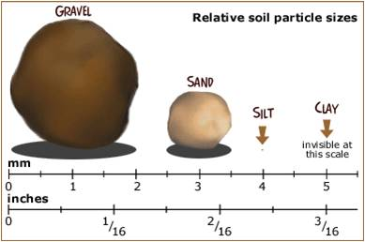
Soil Texture
Soil Particle | Size
Sand | > 2 mm
Silt | .05mm – 2mm
Clay | <.05mm
http://www.pdst.ie/sites/default/files/Particle%20Size.jpg

Slide 5
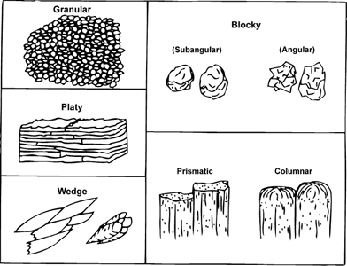
Seven Soil Structures
http://aces.nmsu.edu/pubs/_circulars/CR667/images/fig2_3.jpg

Slide 6
Soil Structure
Soil structure is the way in which the individual particles (sand, silt, and clay) are arranged into larger distinct aggregates.
Soil aggregates are groups of soil particles that bind together more strongly than to neighboring particles
Aggregate stability refers to the ability of soil aggregates to avoid disintegration when disturbed by tillage or erosion.
Bulk Density is and indicator of soil compaction and is calculated by the dry weight of soil divided by its volume. The variation in bulk density is due largely to the difference in total pore space

Slide 7
Factors that affect…
Aggregate Stability
Soil Structure
Amount of clay
Chemical elements
Organic matter
Biological activity
Organic matter
Soil organisms
Tillage
Freezing and thawing
Water movement

Slide 8
Differentiate between Soil Structure and Aggregate Stability
Soil Structure
Aggregate Stability

Slide 9
Soil Color
Causes of Soil Color
Basic Soil Color Indications
Humus content
Iron compounds in the soil
Indicator of different soil types
Indicator of certain physical and chemical characteristics
Due to humus content and chemical nature of the iron componds

