Slide 1
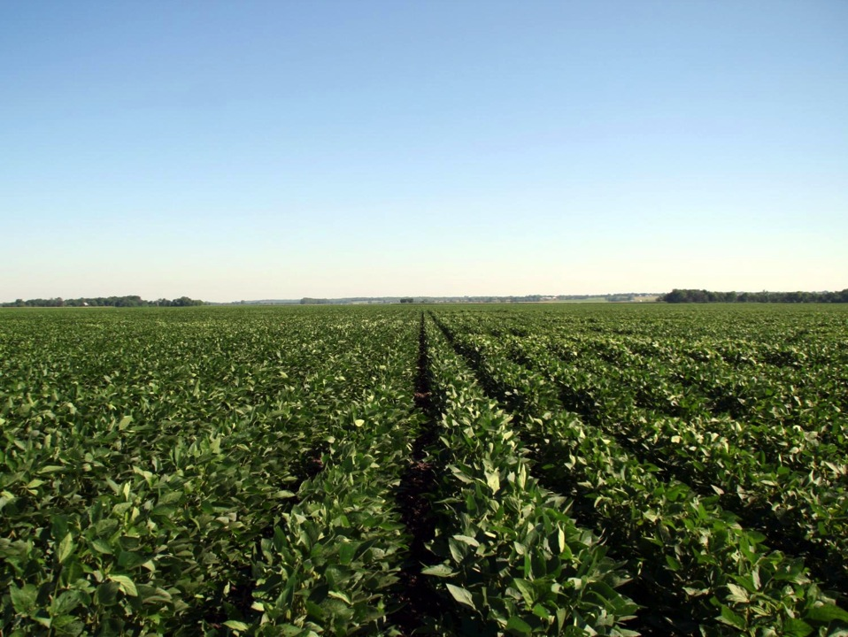
Soybean Growth and Development
Notes:
This presentation is similar to the previous Corn Growth and Development presentation. These slides explain how a soybean plant develops during the season and how stress at different growth stages relates to crop yield loss.
Insects, diseases, weeds, and other disorders are most likely to be more problematic during certain stages of a soybean plant’s development. Because of this, understanding the growth stage of a plant aids the producer, agronomist, or crop scout in efficiently and effectively scouting their fields.

Slide 2
Outline
The soybean plant
Growth staging
Vegetative stages
Reproductive stages
  Bloom
  Pod development
  Seed development
  Maturity
Conclusions
Notes:
We will begin by discussing a little bit of the history and biology of the soybean plant, as well as the names of the different plant parts of soybean.
Once we know the various parts of the plant we can then stage, or determine how developed, a soybean plant and a soybean field are.
Then we will go over the vegetative and reproductive stages of development and conclude the presentation.

Slide 3
The soybean plant
Domesticated about 4,500 years ago in China
The U.S. grows the most soybeans in the world
North central states grow majority of soybeans
Nine different maturity groups: 00 (in the north) to IX (in the south)
Group II and III grown in Nebraska
Symbiotic relationship exists between soybean and nitrogen fixing bacteria
Notes:
Domestication of the soybean plant occurred about 4,500 years ago in China. Currently, the United States grows the most soybeans in the world and the north central states grow the majority of soybeans in the U.S.
There are nine different soybean maturity groups grown in the U.S. These groups range from 00 which are grown in the northernmost states to IX which are grown in the southern half of Florida. In the top two-thirds of Nebraska, maturity group II is grown and maturity group III is best suited for the bottom third of Nebraska.
Soybeans have an interesting relationship with a nitrogen fixing bacteria. Soybeans gain nitrogen from these bacteria and in return, the bacteria obtain carbohydrates from the soybean. This kind of relationship, where both organisms benefit, is called a symbiotic relationship.

Slide 4
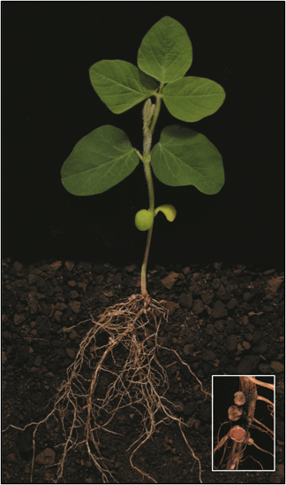
Soybean plant parts
Trifoliate leaf- a compound leaf made of three leaflets
Petiole- connects the stem and leaf
Growing point- where active growth takes place
Axillary bud- bud found where petiole and stem meet
Unifoliate leaf- single leaf, not compound
Cotyledons- first leaves of newly emerging plant
Hypocotyl- the seedling’s stem below the cotyledons
Branched tap root- main root of the plant
Lateral roots- roots growing laterally into the soil
Nodules (enlarged)- where nitrogen fixing bacteria live
Notes:
Understanding the different parts of the soybean plant are important for staging fields.
Trifoliate leaf- a compound leaf made up of three leaflets, so it appears as though it is three separate leaves, but it is attached to the plant by a single petiole. The number of trifoliate leaves is used to determine vegetative growth stage.
Petiole- connects the stem and leaf.
Growing point- where active growth takes place.
Axillary bud- bud found in the upper angle of where the petioles and stem meet.
Unifoliate leaf- a single leaf, not compound. These leaves only develop near the beginning of soybean growth, after cotyledons emerge, but before trifoliate leaves are produced.
Cotyledons- first leaves of newly emerging plant, these are also called seed leaves.
Hypocotyl- the seedling’s stem below the cotyledons.
Branched tap root- main root of the plant.
Lateral root- roots growing laterally into the soil.
Nodules (enlarged)- where the nitrogen fixing bacteria are located.

Slide 5
Stress and crop yield loss
At each growth stage of soybean, certain aspects of management must be considered.
Various problems are associated with each stage and can interfere with growth at that stage.
Problems include adverse soil conditions, weeds, insects, diseases, and other disorders.
Problems that occur early in the season may contribute to the yield loss experienced at the end of the season during harvest.
We will examine various problems for the stages of soybean throughout the growing season.
Notes:
At each growth stage of soybean, certain aspects of management must be considered. This is because various problems are associated with each stage and can interfere with growth at that stage. Problems include adverse soil conditions, weeds, insects, diseases, and other disorders. Problems that occur early in the season may contribute to the yield loss experienced at the end of the season during harvest. We will examine problems for the stages of soybean throughout the growing season.

Slide 6
Growth staging
Growth stages may overlap in a field.
A growth stage for a field begins when at least 50 percent of the plants have reached or are beyond a certain stage.
The Soybean Field Guide 2nd Edition provides disease scouting information by growth stage.
Notes:
Firstly, it is important to know how to determine the growth stage for a field of soybeans. Growth stages may overlap within a field and because of this, a growth stage for a field begins when at least 50 percent or more of the plants within that field have reached or are beyond a particular stage.
The Soybean Field Guide 2nd Edition provides scouting information by growth stage for many diseases and insects (beginning page 20). This makes it useful to know the growth stage of a field so you know what will most likely be problematic during those periods of development.

Slide 7
Vegetative stages
Vegetative Stages
- VE: Emergence
- VC: Unrolled unifoliate leaves
- V1: First unrolled trifoliate leaf
- V2: Second unrolled trifoliate leaf
- V(n): Each successive unrolled trifoliate leaf
Notes:
There are several vegetative stages of the soybean plant. We will discuss some of the features of those stages and examine some of the problems to look out for.

Slide 8
Vegetative stages VE-V1
VE: emergence (7-14 days after planting)
VC: unifoliate leaves unroll
V1: 1st trifoliate leaf unrolls (7-10 days after VE)
VE
VC
V1
Notes:
The first stage after planting is VE, or emergence. This occurs 7-14 days after planting, depending on environmental conditions and the depth the seeds were planted. The cotyledons open during this time and the plant uses energy that is stored in them. The cotyledons are also capable of photosynthesis. Soybean plants have growing points above ground, making them very vulnerable to damage during this stage.
At VC, the unifoliate leaves are entirely unrolled. Food reserves in the cotyledons are still being used during this time.
V1 occurs when the first trifoliate leaf is unrolled (7-10 days after VE). This first trifoliate leaf is now providing enough photosynthesis to supply the young plants needs.

Slide 9
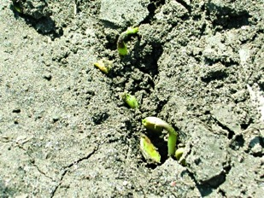
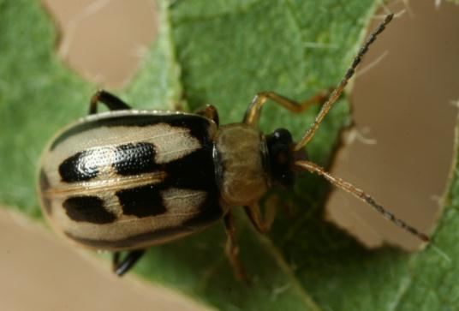
Vegetative stages VE-V1
Problems to watch for:
  Soil temperature, crusting
  Flooding, frost, hail
  Bean leaf beetle feeding
  Pythium root rot, Phytophthora root and stem rot
  Common early season pathogens like Fusarium, Rhizoctonia, Phomopsis, and a few other early season root “rots”
  Weed competition
Notes:
Problems to watch for during VE-V1:
Soil temperature and crusting (page 52, Soybean Field Guide 2nd Edition)
Flooding, frost, and hail (pages 53, 52, and 54, Soybean Field Guide 2nd Edition)
Bean leaf beetle feeding (page 46, Soybean Field Guide 2nd Edition)
Pythium root rot and Phytophthora root and stem rot (page 27, Soybean Field Guide 2nd Edition)
Common early season pathogens like Fusarium, Rhizoctonia, Phomopsis, and a few other early season root “rots” (see page 26, Soybean Field Guide 2nd Edition)
Weed competition (see Weed Identification Field Guide)
[soil crusting causes emergence problems and bean leaf beetle]

Slide 10
Vegetative stage V2
V2: 2nd trifoliate leaf unrolls
  6 to 8 inches tall
  Nitrogen fixation can begin
Problems to watch for:
  Bacterial blight
  Septoria brown spot
  Rhizoctonia root rot
  Flooding
  Some problems may appear anytime during the season
V2
Notes:
A V2 soybean plant has two completely unrolled trifoliate leaves and is 6 to 8 inches in height.
As mentioned before, there is a symbiotic relationship between the soybean and nitrogen fixing bacteria. This bacteria lives in the soil and uses root hairs to gain access to the soybean roots where it forms nodules. Nitrogen fixation begins at V2 to V3, with the bacteria supplying much of the nitrogen needed by the plant. Soil nitrate can actually decrease development of nodules.
Problems to watch for during V2:
Bacterial blight (page 20, Soybean Field Guide 2nd Edition)
Septoria brown spot (page 21, Soybean Field Guide 2nd Edition)
Rhizoctonia root rot (page 26, Soybean Field Guide 2nd Edition)
Flooding may still have a large impact on yield at this stage (page 53, Soybean Field Guide 2nd Edition)
Keep in mind that some problems, like a few viruses (pages 24 and 25, Soybean Field Guide 2nd Edition) or lightening damage (page 56, Soybean Field Guide 2nd Edition), can appear at anytime during the growing season.

Slide 11
Vegetative stage V(n)
V(n): successive vegetative stages
  As the plant continues to develop trifoliate leaves, V stage increases accordingly
  Vegetative growth continues for a time after reproductive stages start, but plants are then known by reproductive characteristics
Problems to watch for during V(n) stages:
  Begin scouting for soybean cyst nematodes in later V stages, early R stages
  Soybean aphid scouting in mid-June
  Grasshoppers, potential for spider mites
  Many problems mentioned on previous slides
  Herbicide injury
Notes:
V(n) stages are successive vegetative stages. As the plant continues to develop trifoliate leaves, V stage increases accordingly. For example, a V3 plant has 3 unrolled trifoliate leaves and a V6 plant has 6 unrolled trifoliate leaves.
Plants continue to develop trifoliate leaves even after entering into the reproductive stages. However, the plant is staged according to reproductive characteristics after they begin to appear.
Problems to watch for during V(n) stages:
Begin scouting for soybean cyst nematodes in later V stages and early R stages (page 32, Soybean Field Guide 2nd Edition).
Scouting for soybean aphid should begin in mid-June (pages 38 and 39, Soybean Field Guide 2nd Edition).
Grasshoppers, potential for spider mites (pages 47 and 45, Soybean Field Guide 2nd Edition)
Many of those previously mentioned problems in earlier V stages can still be problematic during later V stages.
Many post herbicides are applied to both corn and soybean fields during late May through early July. Scout for drift from neighboring fields, overlap injury, and direct application injuries, tank contamination, or adjuvant issues (pages 62-66, Soybean Field Guide 2nd Edition).

Slide 12
Reproductive stages
Reproductive Stages
- R1: Beginning bloom
- R2: Full bloom
- R3: Beginning pod development
- R4: Full pod
- R5: Beginning seed
- R6: Full seed
- R7: Beginning maturity
- R8: Full Maturity
Notes:
Reproductive stages of the soybean plant begin when 1 flower opens at any node (beginning bloom). Full maturity occurs when at least 95 percent of the pods have reached mature color.

Slide 13
Reproductive stages: R1 & R2
Beginning and full bloom
R1: Beginning bloom occurs when at least 1 flower is open at any node
R2: Full bloom occurs when either of the two top nodes have an open flower
Notes:
Beginning bloom occurs when at least 1 flower is open at any node and is referred to as R1. Flowers develop from axillary buds. The first flowering will happen somewhere between the 3rd and 6th node (the place where a stem and leaf meet), and will continue both up and down along the stem. Weather conditions that cause an extended flowering period can be beneficial for yield.
R2 is called full bloom and occurs when either of the two top nodes of the plant have an open flower (nodes must have a trifoliate leaf fully formed). Plant dry weight and nutrients quickly accumulate during this period and roots have grown across the 30 inch spacing between rows.

Slide 14
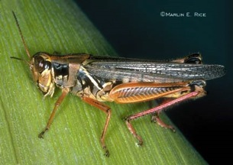
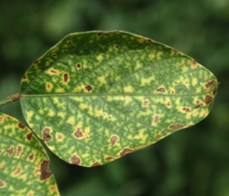
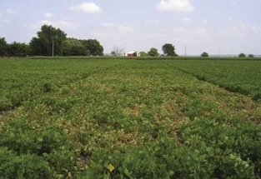
Reproductive stages: R1 & R2
Beginning and full bloom
Problems to watch for:
  Bacterial pustule, Fusarium wilt, powdery mildew, Septoria brown spot
  Sudden death syndrome
  Grasshoppers, spider mites, soybean aphid
  Flooding, Drought
Notes:
Problems to watch for:
Bacterial pustule, Fusarium wilt, powdery mildew, Septoria brown spot (pages 20, 26, 23, and 21, Soybean Field Guide 2nd Edition)
Sudden death syndrome (page 28, Soybean Field Guide 2nd Edition)
Grasshoppers, spider mites, soybean aphid (pages 47, 45, and 38-40, Soybean Field Guide 2nd Edition)
Flooding may have the greatest impact on yield during R1-R3 as well as V1-V2, drought can cause flower abortion (page 53, Soybean Field Guide 2nd Edition)
[grasshopper, sudden death syndrome, and symptoms of Fusarium wilt]

Slide 15
Reproductive stage: R3 & R4
Beginning and full pod
R3: Beginning pod is when pods are 3/16 inch long at 1 of the top 4 nodes on the main stem with a fully developed leaf
R4: Full pod is when pods are ¾ inch long in the same location as above
R4
Notes:
Beginning pod, called R3, is when pods are 3/16 inch long at one of the top four nodes on the main stem with a fully developed leaf.
Full pod, or R4, is when pods are ¾ inch long in the same location as those in the R3 stage. It is crucial to reduce stress during this stage as the most yield damage from a stress can occur between R4 and right after R6.

Slide 16
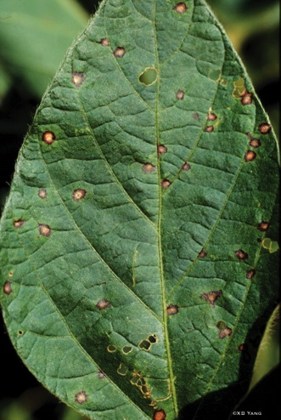
Reproductive stage: R3 & R4
Beginning and full pod
Problems to watch for:
  Cercospora leaf blight, brown stem rot, stem canker
  White mold, downy mildew, frogeye leaf spot
  Green cloverworm, soybean looper, soybean aphid
  Japanese beetle, spider mite
  Nutrient deficiencies
Notes:
Problems to watch for:
Cercospora leaf blight, brown stem rot, stem canker (pages 22 and 29, Soybean Field Guide 2nd Edition)
White mold, downy mildew, frogeye leaf spot (pages 30, 23, and 22, Soybean Field Guide 2nd Edition)
Green cloverworm, soybean looper, soybean aphid (pages 42, 44, and 38-40, Soybean Field Guide 2nd Edition)
Japanese beetle, spider mite (pages 43 and 45, Soybean Field Guide 2nd Edition)
Nutrient deficiencies (pages 57-61, Soybean Field Guide 2nd Edition)
[frogeye leaf spot]

Slide 17
Reproductive stage: R5 & R6
Beginning and full seed
R5: Beginning seed is when seeds are 1/8 inch long in the pod at 1 of the 4 top nodes on the main stem
R6: Full seed is when green seeds fill pod capacity at the same location as above
Pod of an R5 plant
Pod of an R6 plant
Notes:
At R5, or beginning seed, seeds are 1/8 inch long in the pod at 1 of the 4 top nodes on the main stem. Seed nutrient and dry weight increases rapidly and the plant reaches the pinnacle of its growth: height, leaf area, and nodes. Resources from vegetative plant parts are redistributed to the seeds. Plants require a lot of water and nutrients during this time period.
When soybeans reach R6, or full seed, green seeds fill pod capacity at 1 of the 4 top nodes on the main stem, though the plant may have beans in various stages of development on it. The rapid acquiring of dry weight and nutrients in the plant and seed slows. Leaves start to yellow.

Slide 18
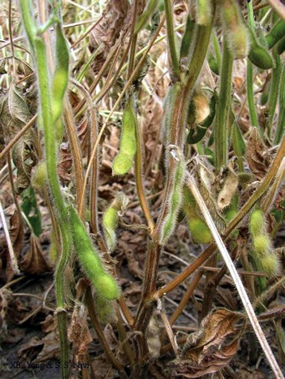

Reproductive stage: R5 & R6
Beginning and full seed
Problems to watch for:
  Anthracnose, charcoal rot, pod and stem blight
  Sudden death syndrome, brown stem rot, white mold
  Grasshoppers, Japanese beetles, bean leaf beetles, stink bugs
  Hail
  Drought
Notes:
Problems to watch for:
Anthracnose, charcoal rot, pod and stem blight (pages 31 and 30, Soybean Field Guide 2nd Edition)
Sudden death syndrome, brown stem rot, white mold (pages 28, 29, and 30, Soybean Field Guide 2nd Edition)
Grasshoppers, Japanese beetles, bean leaf beetles, stink bugs (pages 47, 43, and 46, Soybean Field Guide 2nd Edition)
Hail (page 54, Soybean Field Guide 2nd Edition)
Drought (page 53, Soybean Field Guide 2nd Edition)
[charcoal rot symptoms and the interior of a soybean stem infected by charcoal rot]

Slide 19
Reproductive stage: R7 & R8
Beginning and full maturity
R7: Beginning maturity occurs when 1 pod on the main stem reaches mature color
R8: Full maturity occurs when 95 percent of pods reach mature color
R7
R8
Notes:
When the plant reaches R7, or beginning maturity, 1 pod on the main stem will have attained its mature color: tan or brown. Seed maturity happens when dry weight is no longer accumulated in seeds. Yields are not really effected by stress at or after R7.
At R8, or full maturity, 95 percent of pods have reached mature coloration. When plants reach R8, a number of drying days are required before seed is at an appropriate moisture content for harvest.

Slide 20
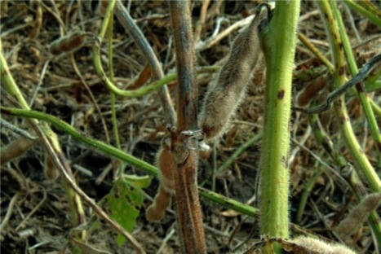
Reproductive stage: R7 & R8
Beginning and full maturity
Problems to watch for:
  Green stem
  Stem diseases (pod and stem blight, charcoal rot, Anthracnose)
  Seed diseases (Phomopsis, white mold, purple seed stain, etc.)
  Grasshoppers, bean leaf beetles, stink bugs
  Lodging
Glen Hartman
Notes:
Problems to watch for:
Green stem (page 54, Soybean Field Guide 2nd Edition)
Stem diseases: pod and stem blight, charcoal rot, Anthracnose (pages 31 and 30, Soybean Field Guide 2nd Edition)
Seed diseases: Phomopsis, white mold, purple seed stain, etc. (pages 33 and 34, Soybean Field Guide 2nd Edition)
Grasshoppers, bean leaf beetles, stink bugs (pages 47 and 46, Soybean Field Guide 2nd Edition)
Lodging
[soybean plants with green stem]

Slide 21



Conclusions
Certain management considerations must be taken into account during the various stages of soybean growth.
Each stage has its own set of problems.
Many insects, diseases, and disorders are problems during multiple soybean stages.
This knowledge can help growers to be aware of the potential problems soybeans are facing during the growing season.
Notes:
We have learned how to identify the different stages of soybean growth throughout the season. This information can help us become better soybean growers because at each of the particular growth stages of soybean, certain management considerations must be taken into account. Each stage has its own particular problems which may interfere with growth at that stage including soil temperature and crusting, weeds, insects, diseases, and other disorders. Also, many insects, diseases, and disorders are problems during multiple soybean stages. This knowledge can help growers to be aware of the potential problems soybeans are up against throughout the growing season.
Much of the information in this presentation is from: Soybean Growth and Development. PM 1945. Palle Pederson. Iowa State University Extension. Reviewed December 2009.
All images © ISU, except where noted.
Thanks to ISU Extension and Outreach and North Central IPM Center for financial support.

