Slide 1
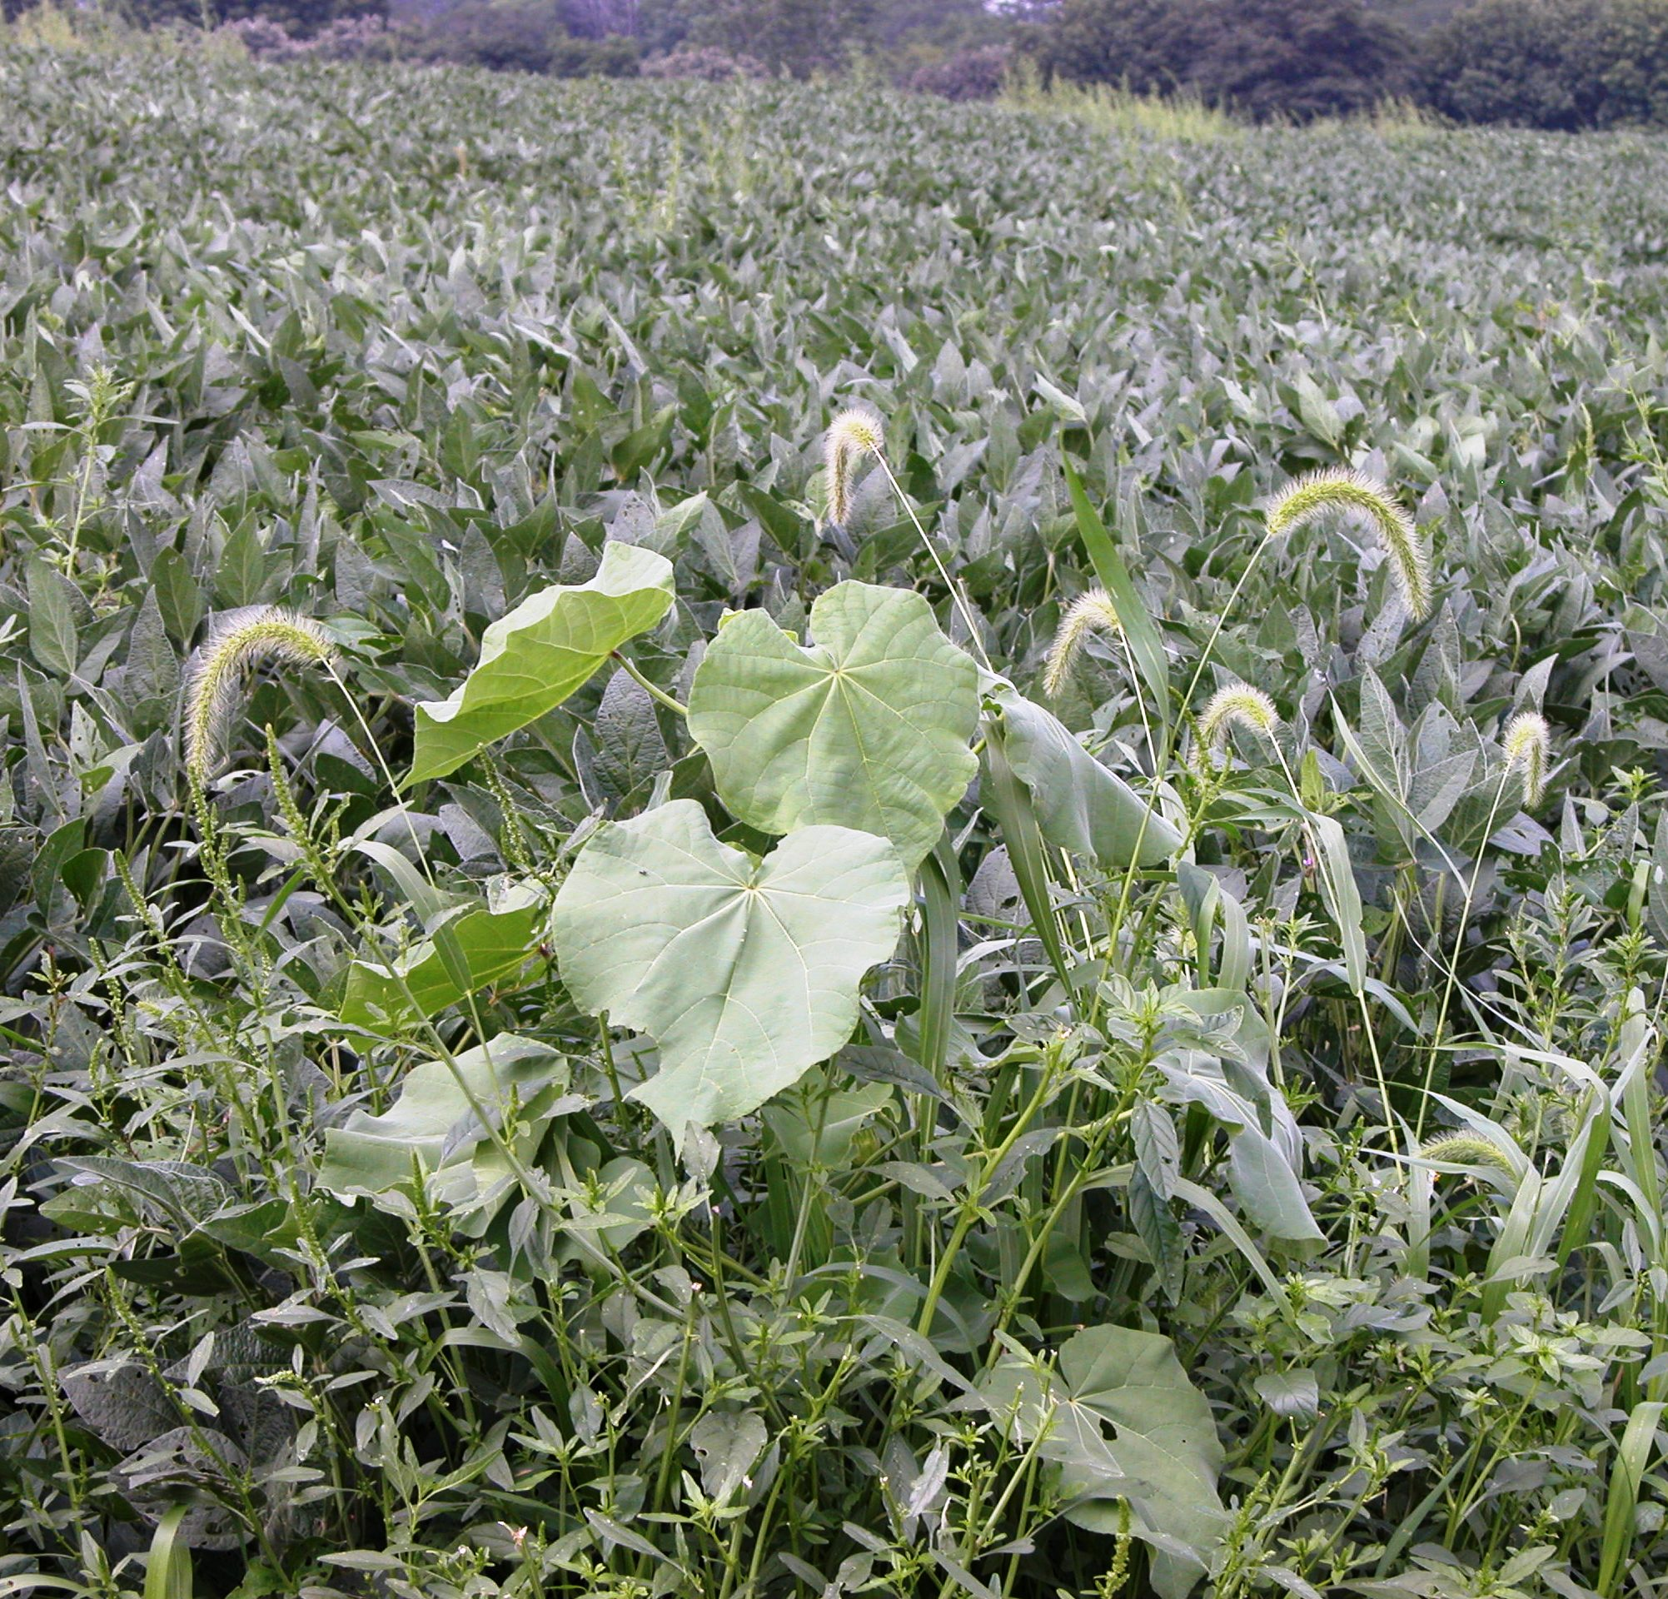
Managing Weeds
Notes:
This presentation is about the management of weeds.

Slide 2
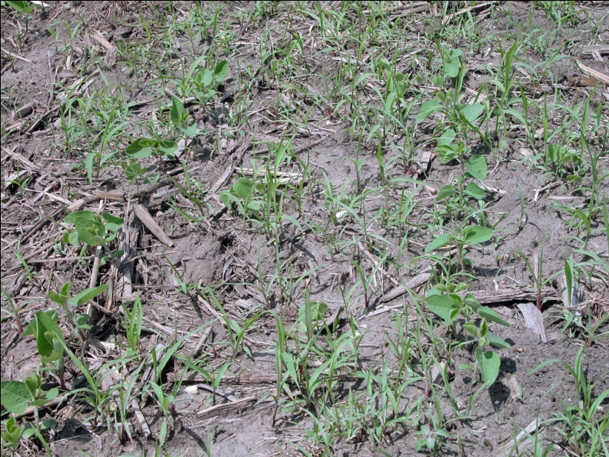
Timeliness of weed control
Weeds are best controlled within the first several weeks after a crop is planted
Herbicides are more effective against smaller weeds
Smaller weeds are less competitive than larger weeds
Notes:
Weed control within the first several weeks after crops are planted is critical in order to avoid a yield reduction from weeds. The effectiveness of any weed control program depends largely on timeliness of the control. Preventative, cultural, mechanical, and chemical weed management methods all are most effective if applied at the correct time. Fields that are kept free of weeds for the first several weeks after planting give the crop a competitive edge that allows the crop to shade out or out compete weeds that emerge later in the season.

Slide 3
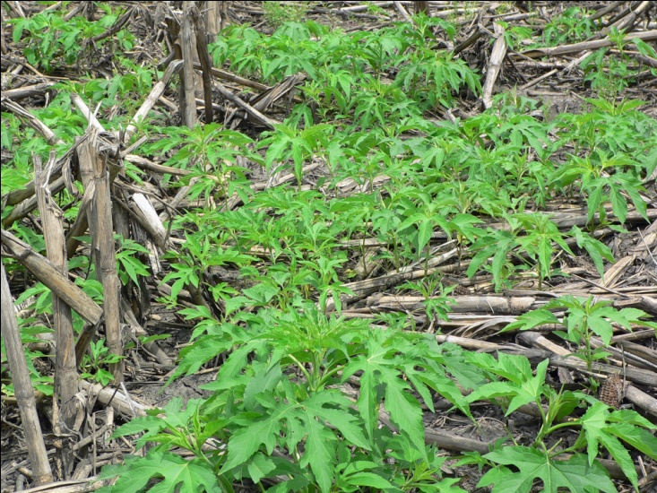
Maximize profit
Weed management programs should maximize profit, not just weed control
Some weeds may need 100% control if they are particularly competitive, persistent, or difficult to control
Notes:
Is 100% control of all weeds necessary? Most successful producers design control programs to maximize profit, not just weed control. While it is true that crops can tolerate certain numbers of weeds without suffering a yield reduction, it is important to consider individual weed problems. There are some weeds where 100% control may be desirable because they are particularly competitive, persistent, or difficult to control. These include some annual weeds such as giant ragweed – as shown in this picture (page 49, Weed ID Guide), common cocklebur (page 58), burcucumber (page 74), or shattercane (page 36), and several perennial weeds such as Canada thistle (page 52), bindweeds (page 71), quackgrass (page 26), and hemp dogbane (page 45).

Slide 4
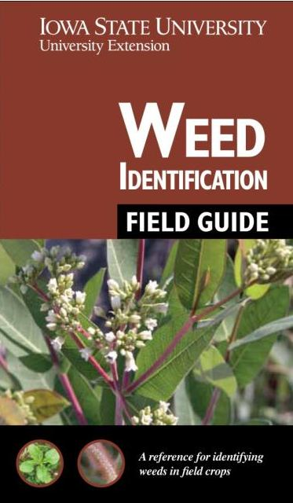
Proper identification
  Identifying weeds is important for developing effective management plans
Notes:
Accurate weed identification is the first step to successfully managing weeds. Since weeds vary in their ability to compete with crops and reduce yields and also vary in their response to different management strategies, proper identification is essential to develop effective management plans.

Slide 5
Weed Control
Preventative
Cultural
Mechanical
Chemical
Notes:
There are four main systems of controlling weeds: Preventative (not letting weeds become established), cultural (practices like adjusting planting date that aid or deter weed development), mechanical (cultivation or hand pulling as examples), and chemical (herbicide application).

Slide 6
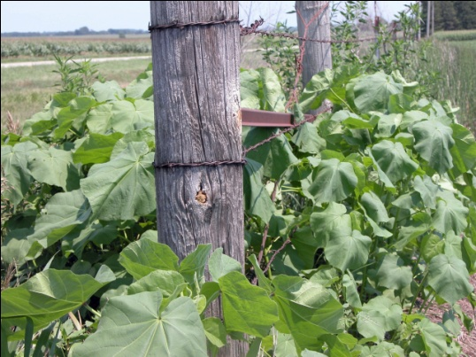
Weed Control – Prevention
Not allowing weeds to become established
  Control in non-cropland areas
  Plant weed-free crop seed
  Not spreading manure, hay, or crop residue on fields that is contaminated with weed seeds
  Clean machinery between fields
  Eliminate “new” weeds that appear
Notes:
Following are several preventative cultural practices that do not allow weeds to become established and spread:
Control weeds in non-cropland areas, including fencerows, drainage ditch banks, and rights-of-way
Plant only high quality weed-free crop seed
Do not spread manure, hay, crop residues, etc. contaminated with weed seed on cropland
Clean farm machinery between fields to avoid transport of weed seed, rhizomes, tubers, and rootstocks
If “new” or unfamiliar weeds appear, have them identified quickly and take appropriate control measures if necessary

Slide 7
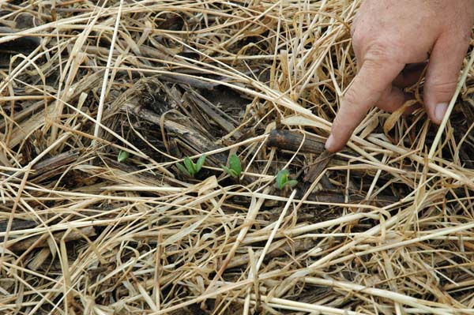
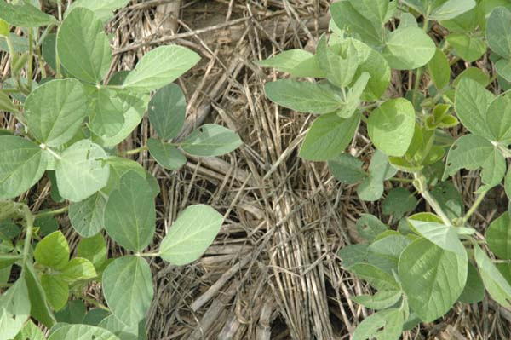
Weed Control – Cultural
  Altering the environment
  Crop rotation
  Cover crops and canopies
Photos courtesy Laura Greiner
Notes:
Some different techniques used in cultural control include altering the environment by planting different crops with different life cycles and using cover crops or canopies to shade out weed species.
[Images show soybeans which were planted in soil covered by a rye cover crop.]

Slide 8
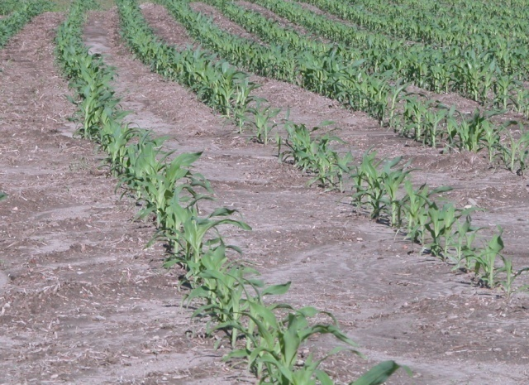
Weed Control – Cultural
  Giving crops competitive edge
  Narrow row spacing (soybeans)
  Proper planting date and seeding rate
  Using resistant varieties
  Insect control
  Adequate soil fertility
  Adequate drainage
  Seed treatments (soybeans)
Notes:
Any practice that provides optimum conditions for early and vigorous growth of crops helps give them a competitive edge over weeds. Following are some of these practices:
Narrow row spacing (15 inches or less) for soybeans
Proper planting date and seeding rate
Use of disease- and nematode-resistant varieties
Insect control
Adequate soil fertility
Adequate drainage
Seed treatments – most corn is treated with seed treatments; soybeans may need seed treatments to help with early season growth, especially if planting early in the season.

Slide 9
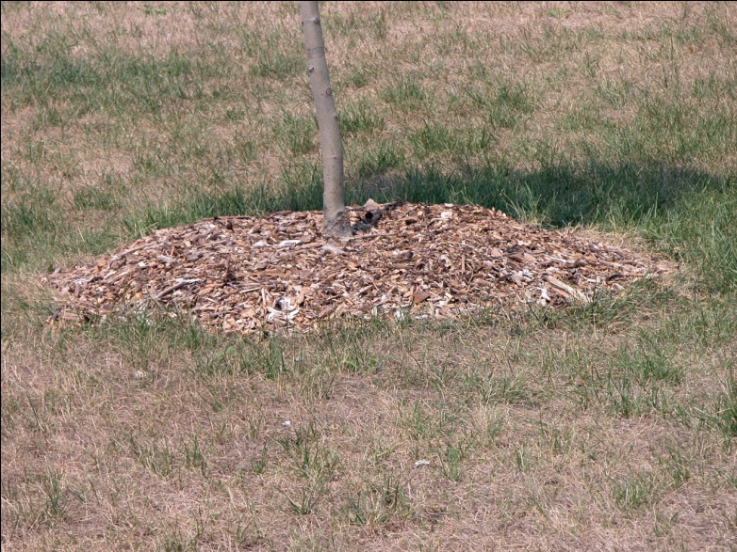
Weed Control – Mechanical
Physical disruption of the environment
  Tillage (both vegetative and seed)
  Cultivation and rotary hoeing
  Mowing
  Mulching
Notes:
Mechanical weed control involves physically disrupting the environment around the weeds. This can be accomplished by using tillage to disrupt vegetative and seed reproduction, using cultivation or rotary hoeing to kill emerged weeds, mowing weeds to cut off reproductive structures and/or decrease food storage and energy reserves, and mulching to inhibit germination of weed seeds.

Slide 10
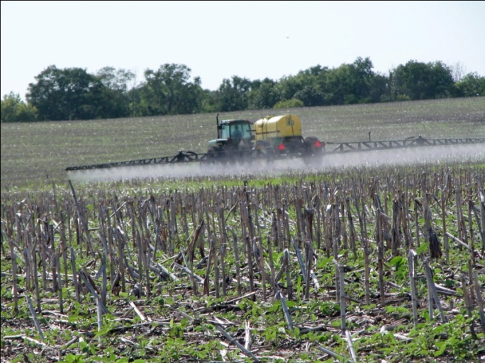
Weed Control - Chemical
  Herbicide use
  Selective
  Nonselective
      Burn-down treatment
  Rate and timing are critical
Notes:
It is important to select herbicides based on the weeds present in a field.
Chemical weed control involves the use of herbicides to suppress or kill weeds. There are many different herbicides available and some knowledge about how particular herbicides work is necessary before applying herbicides. Herbicide rate and application timing are always important factors to consider when using herbicides.
Selective herbicides will control certain plant species and leave others (the crop) relatively unharmed.
Nonselective herbicides will typically control all vegetation contacted by the herbicide application. A burn-down treatment that is used to control all vegetation prior to crop emergence is an example of nonselective herbicide use.

Slide 11
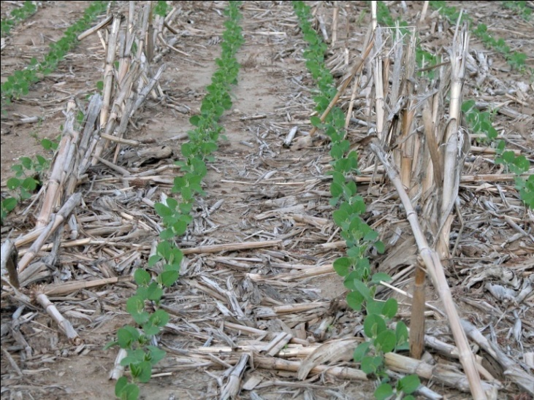
Herbicide Decisions
Soil-applied herbicides (preemergence)
  Control weeds as seeds germinate
  Reduce early-season weed competition
  Protect yield potential
  Provide residual activity
  Provide greater flexibility in timing of postemergence herbicides
Notes:
Herbicide applications are made at different times depending on the herbicide, crop, and weeds present and crop and weed growth stages. Herbicide programs typically include soil-applied (e.g., preemergence) and postemergence products. Soil-applied herbicides control weeds as seeds germinate, reducing early-season weed competition and protecting yield potential. They also provide residual activity and greater flexibility in timing of postemergence herbicides.
Soil-applied herbicide application factors
Factors particularly important to consider for soil-applied products include soil type, environmental impacts such as leaching or runoff potential, and possible interactions with insecticides or other herbicides. Rates should be based on soil type, target weeds, and objectives of the application
(full-season weed control versus set up for planned postemergence herbicide).

Slide 12
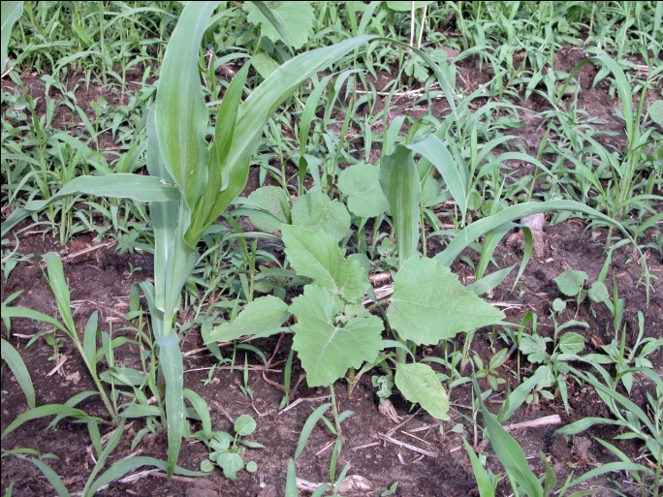
Herbicide Decisions
Postemergence herbicides
  Target weed species not controlled by soil applications
  Some control weeds emerged at the time of application
  Others control emerged weeds and provide residual activity against later emerging weeds
Notes:
Postemergence herbicide applications target weed species not controlled by soil applications. Some postemergence herbicides only control weeds emerged at the time of application. Others control emerged weeds and provide residual activity against later emerging weeds.
Postemergence herbicide application timing factors
Field scouting is particularly important when selecting postemergence herbicides. Fields should be scouted frequently following crop emergence to determine the need and appropriate timing of postemergence weed control. Weed species, density, and growth rates are critical factors influencing how long weeds can compete with the crop before yields are reduced. Treat fields with heavy infestations as soon as possible after weeds emerge.
The initial growth of weeds is relatively slow, but their growth rate increases rapidly as time progresses. Weeds as small as two inches tall can reduce crop yields if present at high densities. Crop yield loss per day increases due to increasing competition of larger weeds.

Slide 13
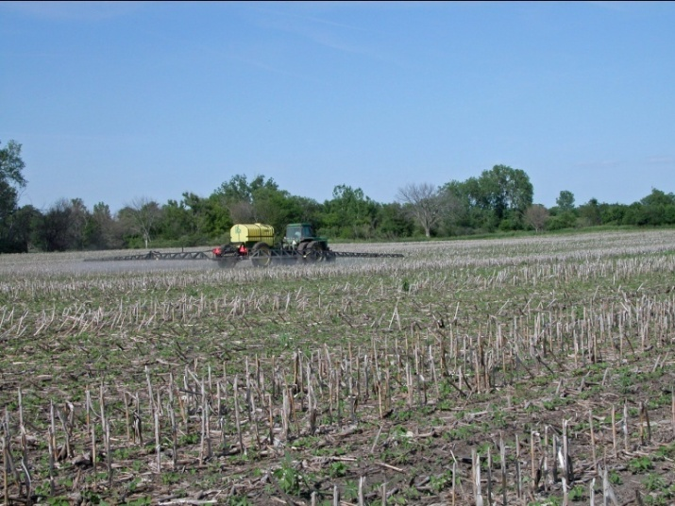
Selecting Herbicides
Considerations from the previous year
  Weed escapes the previous year
  Environmental conditions that may be favorable for carryover
  Herbicide-tolerant crops used
Notes:
A well designed weed management plan involves field scouting and protects crops from weed competition, prevents weed populations
from increasing over time, minimizes herbicide injury, and delays or prevents herbicide resistant weed development.
Considerations from the previous year
Weed escapes or problems the previous year
Environmental conditions the previous year, including conditions favorable for herbicide carryover
Herbicide tolerant crops used the previous year

Slide 14
Selecting Herbicides
Considerations for the current year
  Weeds present
  Herbicide-tolerant crop plans
  Tillage plans
  Herbicide resistance development
  Timing
  Crop rotations for future years (carryover)
  Label restrictions
Notes:
A well designed weed management plan involves field scouting and protects crops from weed competition, prevents weed populations from increasing over time, minimizes herbicide injury, and delays or prevents herbicide resistant weed development.
Considerations for the current year
Weeds present
Herbicide tolerant crops planned for the current year
Tillage plans for the current season
Using herbicides with different sites of action to delay or prevent herbicide resistant weed development
Using timely herbicide applications that prevent early-season weed competition and provide residual control for late-emerging weed species
Crop rotation plans for the next year (carryover)
Postemergence herbicide label restrictions based on crop and weed growth stage and/or height

Slide 15
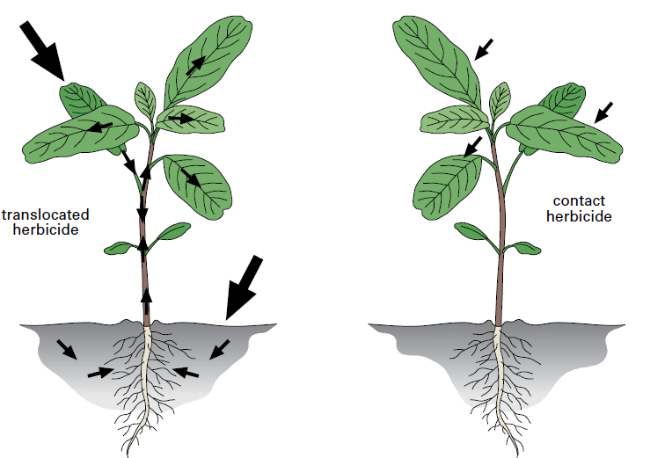
Herbicide Classes
Different classes of herbicides
Mode of action - mechanism by which a herbicide kills a plant
Site of action - Specific protein to which a herbicide binds, disrupting a physiological process in plants
Herbicides with the same mode of action may or may not have the same site of action
Notes:
There are different classes of herbicides with different modes of action (how they disrupt plant processes) and sites of action (where in the plant they affect plant processes). Some herbicides have the ability to move throughout the plant (translocated) and others damage only the parts of the plant they are sprayed on (contact).
The Weed ID Guide (pages 8-10) briefly explains herbicide resistance, but also shows the different sites of action of different herbicides. For more information on herbicide resistance, see presentation #12 in this series.

Slide 16



Summary
Weed management is vital for maximizing crop production.
Because weed species vary in their response to different management strategies, proper identification is essential to develop effective management plans.
Weed management plans include preventative, cultural, mechanical, or chemical control methods that are specific to the particular cropping system and weeds present.
Control methods must be employed at the appropriate time for optimum results.
Notes:
Weed management is vital for maximizing crop production.
Accurate weed identification is the first step to successfully managing weeds. Because weed species vary in their response to different management strategies, proper identification is essential to develop effective management plans.
These plans include preventative, cultural, mechanical, or chemical control methods that are specific to the particular cropping system and weeds present.
Control methods must be employed at the appropriate time for optimum results.
All images © ISU, except where noted.
Thanks to ISU Extension and Outreach and North Central IPM Center for financial support.

