Slide 1
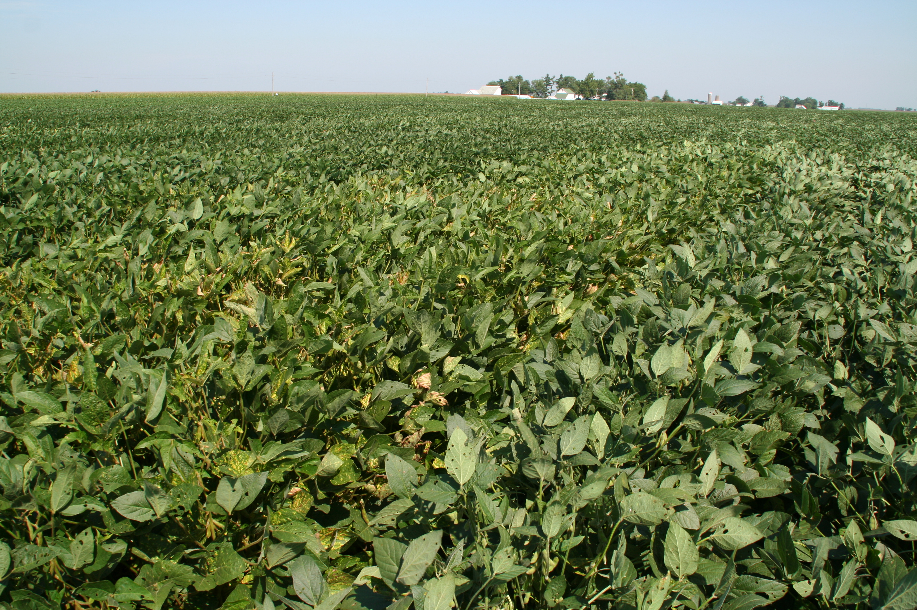
Management of Plant Diseases
Notes:
No matter the weather conditions, there will be problematic diseases every year. Which disease may change from year to year. This presentation focuses on integrated pest management of corn and soybean diseases.

Slide 2
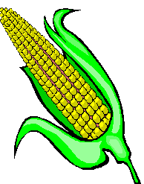
Outline
Review the disease triangle
The disease cycle
Management strategies
Interrupting the disease cycle
Notes:
This presentation includes the disease triangle and disease cycle, management strategies used to control plant disease, and how these management strategies interrupt the disease cycle and thus control disease.

Slide 3

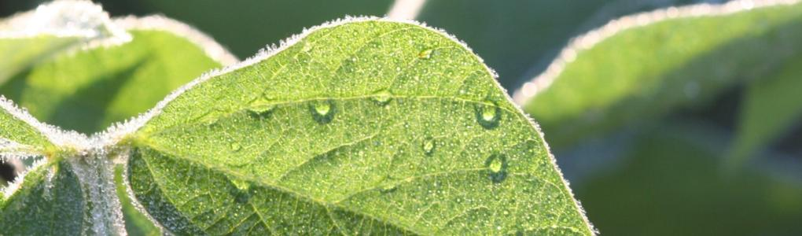
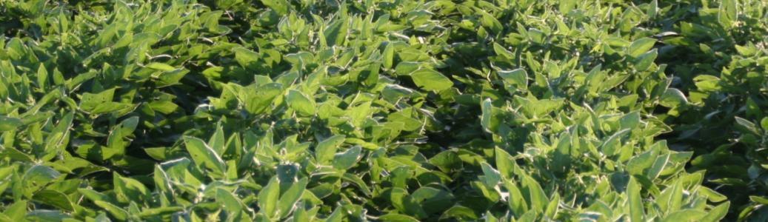
The Disease Triangle
Environment
Pathogen
Host
Notes:
The disease triangle is an important concept in plant pathology. Disease will ONLY occur if these three factors interact simultaneously. For disease to occur, a susceptible host plant and the pathogen must be present in environmental conditions that are favorable for infection and disease development. All three of these factors must occur at the same time. IF one of these three factors is missing, disease will not occur. In this example of soybean rust – soybean plants must be growing, spores of the soybean rust fungus must be present, and soybean leaves have to be wet for a minimum of eight hours to enable the spores to germinate and infect the leaves.

Slide 4
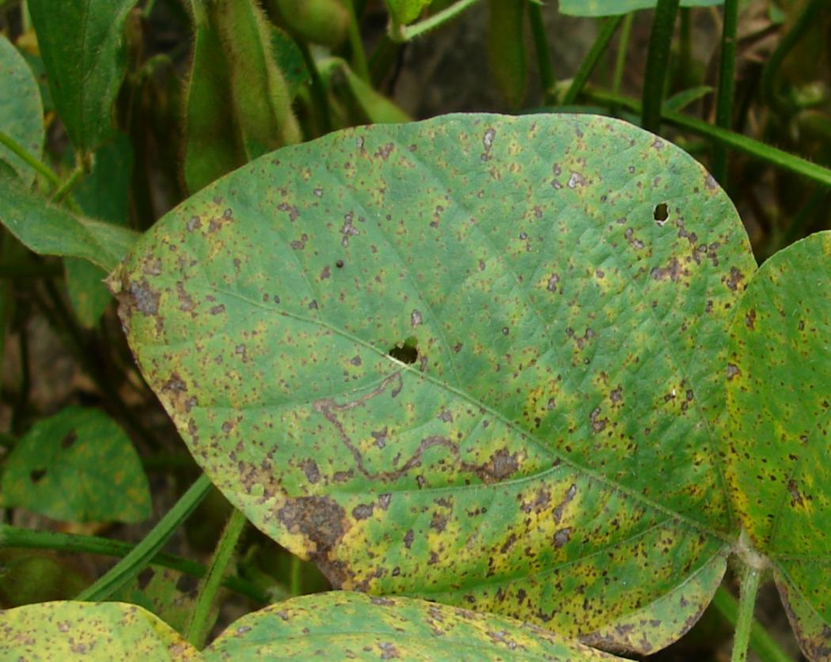
The Disease Triangle
Soybean rust
Notes:
When the three factors come together, they may result in disease, and in this case, soybean rust (page 24, Soybean Field Guide 2nd Edition).

Slide 5
Disease Cycle
Survival
Inoculum produced
Production of survival structures
Dispersal
Symptoms
Colonization
Infection
Management = interrupt the disease cycle
Adapted from P. Vincelli, 2005
Notes:
The disease cycle is another important concept in plant pathology. The disease cycle describes the interaction of the pathogen with the host. The cycle starts with production of inoculum by the pathogen. The inoculum (spores, bacterial cells, nematode eggs) is dispersed (by wind, water, insects, etc.) and if it comes into contact with a susceptible host under the right environmental conditions, infection occurs. The pathogen colonizes the host tissue and disease symptoms develop. The pathogen forms survival structures in the diseased host tissue that enable it to survive in the absence of the host.
The goal of plant disease management is to interrupt the disease cycle and stop it from completing a full cycle. It is important to understand the disease cycle of each disease to make the most effective management decisions.

Slide 6
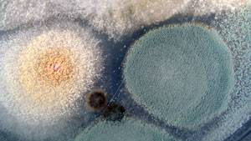
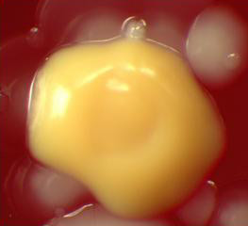
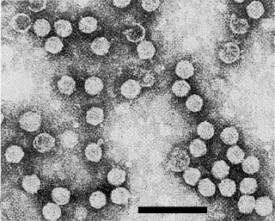
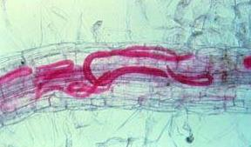
What causes plant diseases?
Fungi
Bacteria
Viruses
Nematodes
Notes:
Plant disease can be caused by numerous types of micro-organisms; fungi, bacteria, viruses, or nematodes. Fungal pathogens are the most common.
[Clockwise from the upper left: fungal colonies, bacterial colony, scanning electron microscope image of viruses (which are very small), and nematodes (in purple) inside a cell.]

Slide 7
Comparison of Disease Cycles
 | Fungi | Bacteria | Viruses | Nematodes
Survival | Crop residue Soil Alt. hosts - | Crop residue Soil Alt. hosts Insect vectors | - - Alt. hosts Insect vectors | Crop residue Soil - -
Dispersal | Wind Rain Insects | Wind Rain Insects | - - Insects | Tillage Equipment Water run-off
Infection | Directly Wounds Insect feeding | - Wounds Insect feeding | - - Insect feeding | Directly - -
Notes:
These four types of pathogens share certain characteristics regarding the disease cycle. Fungi, bacteria, and nematodes often survive in crop residue or in the soil. Viruses and bacteria often survive in insect vectors. Fungi, bacteria, and viruses can be dispersed by insects. Only fungi and bacteria are dispersed by rain or wind. Fungi and nematodes are able to directly infect the host, while bacteria and viruses infect the host indirectly, via insect feeding for example.

Slide 8
Management Practices
GOAL: interrupt the disease cycle
Variety selection
Manage insects, weeds, and nematodes
Cultural practices (rotation, tillage, planting date, etc.)
Reduce plant stress (population, weed management, fertility)
Fungicides (seed treatments, foliar fungicides)
Notes:
Several management practices are used to reduce plant disease. Often they are used in combination. The goal of any practice should be to break the disease cycle. Management practices that are used include: variety selection, insect and weed management, cultural practices, good agronomics, and fungicides.
We will discuss each of these in more detail over the next several slides.

Slide 9
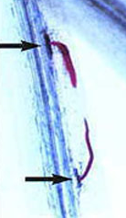
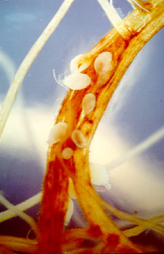
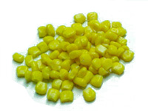
Management Practices
Variety selection
Resistance
- prevents colonization and disease development
SCN Management Guide, 1999
B. Matthews, ARS
Notes:
Variety selection should be the cornerstone of disease management. Planting disease resistant varieties can go a long way to reducing disease.
Resistance can work in a number of ways. One way is by preventing colonization and subsequent disease development. For example, if a plant is resistant to soybean cyst nematode (page 32, Soybean Field Guide 2nd Edition), the nematodes are unable to establish feeding sites in the soybean cyst nematode-resistant soybeans and therefore the nematodes die.
[Left: Nematodes feeding on soybean root, Right: Soybean cyst nematode “cysts” on soybean root]

Slide 10
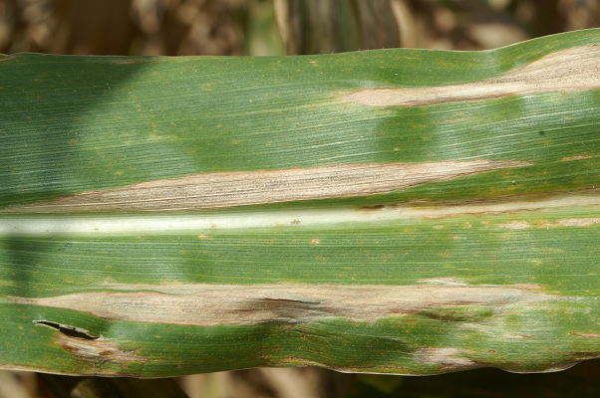
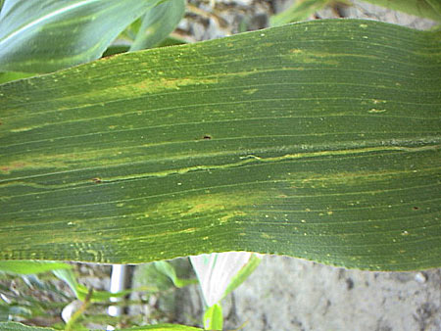
Management Practices
Variety selection
Resistance
- reduces build up of inoculum
Susceptible variety has large lesions
Resistant variety has
smaller and yellowish-green color lesions
Notes:
Some forms of resistance can slow or reduce the build up of inoculum.
For example, corn plants resistant to the pathogen that causes Northern leaf blight (page 30, Corn Field Guide) will get infected and colonized, but the lesions are smaller, less distinct than on susceptible hybrids, and produce fewer spores.

Slide 11
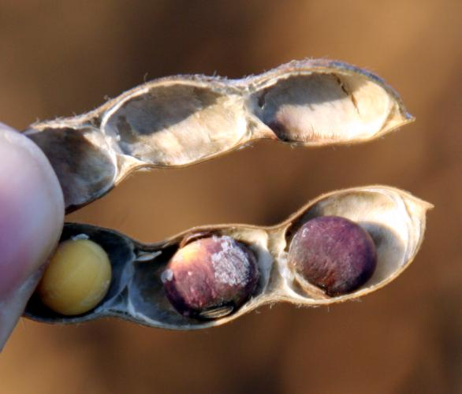
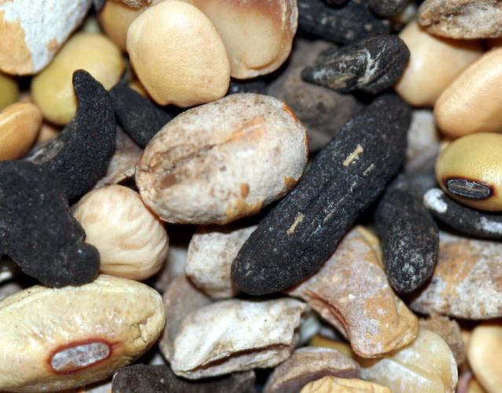
Management Practices
Variety selection
Seed quality
- plant seed that is high quality
Planting infected seed can inhibit germination, slow seedling growth, or introduce new pathogens into a field.
Notes:
Some pathogens infect seed (pages 33-34, Soybean Field Guide 2nd Edition; pages 39-42, Corn Field Guide) and reduce germination or slow seedling growth. Planting high quality seed reduces disease. In addition, using high quality seed may prevent introduction of new pathogens into a field.
[Left: Purple seed stain on soybean. Right: Survival structures for white mold (page 30, Soybean Field Guide 2nd Edition). These survival structures (sclerotia) can move with seed and survive in soil for several years.]

Slide 12
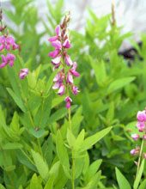
Management Practices
Manage weeds, insects, and nematodes
Weeds
- increase inoculum
- “improve” microclimate for spore production
Desmodium species (tick trefoils) are an alternate source of some viruses
Notes:
Weed management is important. Many of the weeds that commonly occur are also hosts of some pathogens, e.g. Desmodium species are hosts of bean pod mottle virus (page 25, Soybean Field Guide 2nd Edition) that affects soybean. Therefore, these hosts enable the pathogen to produce more inoculum. Furthermore, weeds may improve the microclimate for spore production by increasing relative humidity and/or decreasing light intensity.
[Image shows: Desmodium species (tick trefoils). Some viruses can live in the absence of one host by colonizing another host. Then, when a crop host is present, the virus can move from weed host to crop host in various ways.]

Slide 13
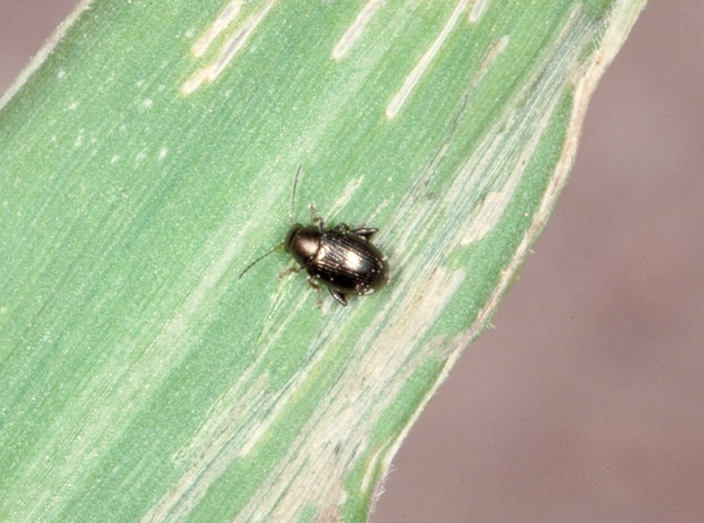
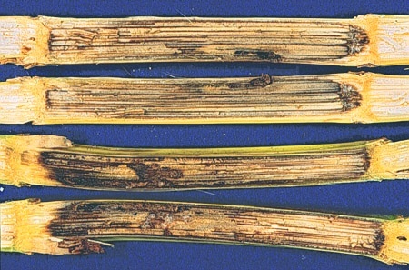
Management Practices
Manage weeds, insects, and nematodes
Insects
- source of inoculum
- provide entry wounds for pathogens
© Marlin E. Rice
Notes:
Insects can be a source of inoculum. Insects can carry fungal pathogen spores on their bodies, or may carry bacterial or virus pathogens inside them. For example the corn flea beetle (page 47, Corn Field Guide) carries the Stewart’s disease bacterium that infects corn (page 33, Corn Field Guide). Furthermore, some insects can cause wounds in plants that allow pathogens to enter the host plant. For example, corn stalk borers (page 52, Corn Field Guide) can wound corn, leading to stalk rot (pages 36-38, Corn Field Guide).
[Left: Corn flea beetle. Feeding by the corn flea beetle wounds corn leaf tissues, allowing the bacterium, which is carried by the beetle, to enter the plant. Right: Corn pith tissue damaged by stalk rots is discolored and can lead to lodging.]

Slide 14
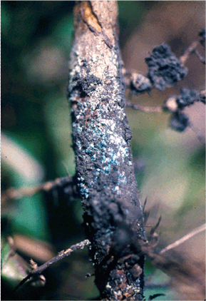
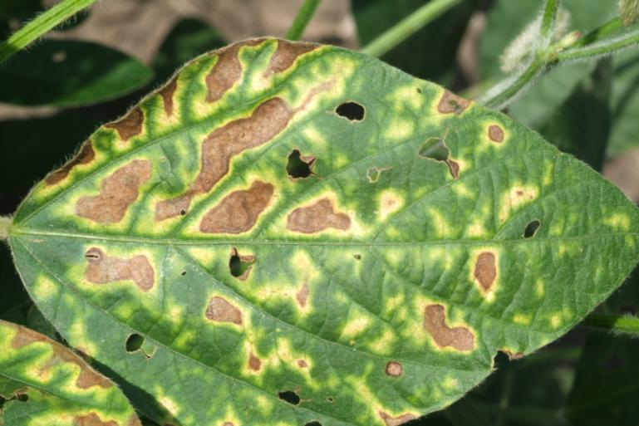
Management Practices
Manage weeds, insects, and nematodes
Nematodes
- interact with other pathogens
The presence of soybean cyst nematode can increase other soybean diseases like brown stem rot and sudden death syndrome.
Notes:
Some soybean diseases like sudden death syndrome (page 28, Soybean Field Guide 2nd Edition) and brown stem rot (page 29, Soybean Field Guide 2nd Edition) are more severe when high numbers of soybean cyst nematode are present. Thus interactions can occur between two different types of pathogen that can result in greater disease severity.
[Left: Brown stem rot of soybean. Right: These yellow spots surrounding necrotic (dead) tissue on a soybean leaf are indications of sudden death syndrome.]

Slide 15
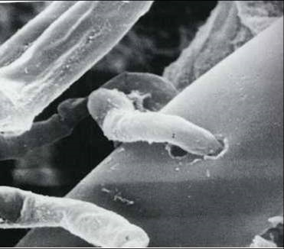
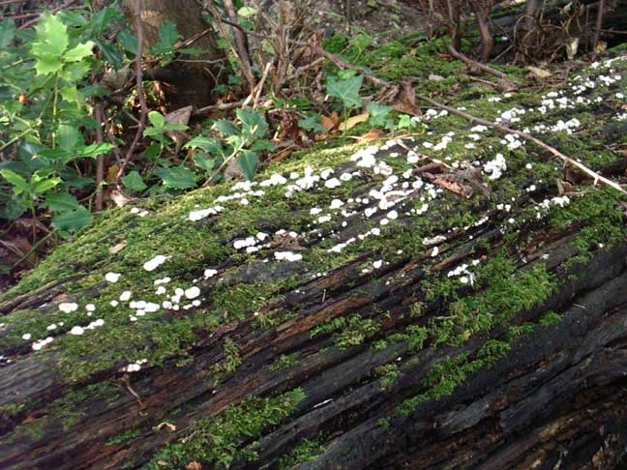
Management Practices
Cultural practices
Crop rotation
- prevents build up of inoculum
Photo courtesy Dr. Randy Martin, Bioworks, inc.
Photo by Brenda Collins, Http://glaucus.org.uk/Fungi-LC.html
Destroyed/suppressed
Competition for food
Notes:
One of the most important cultural practices that can be used for disease management is crop rotation. Many pathogens can only survive on infested crop residue for a limited period of time. The reason for this is that saprophytic (organisms which survive by feeding on dead organic matter) micro-organisms are better at competing for food and some may even destroy or suppress a pathogen. For example, the fungus Trichoderma harzianum is pathogenic to the pathogen causing Rhizoctonia root rot (page 26, Soybean Field Guide 2nd Edition).
[Left: Trichoderma harzianum (small worm-like objects) attacking Rhizoctonia (fungus that causes Rhizoctonia root rot). Right: There are other micro-organisms present in the environment which compete for food resources better than pathogens, leaving the pathogen with no resources to survive on.]

Slide 16
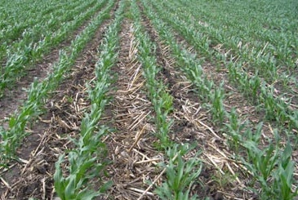
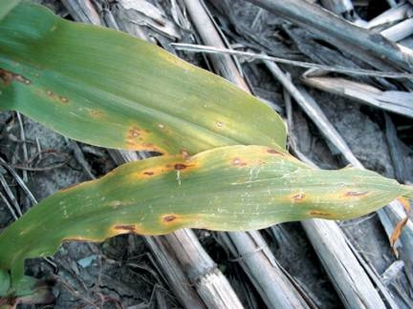
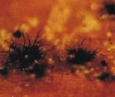
Management Practices
Cultural practices
Tillage
- decreases surface residue (foliar disease inoculum)
- conservation tillage increases soil moisture
Notes:
Tillage is another excellent disease management tool. Tillage reduces surface residue by burying it, and thus removes the source of inoculum from contact with the host. Buried crop residue also decomposes quicker than residue left on the soil surface and thereby reduces survival of the pathogen. For example, many corn foliar diseases (pages 28, 30-32, Corn Field Guide) may be more severe if previously infected residue remains on the surface.
Conservation tillage may promote some seedling diseases. Also, seedling diseases (page 42, Corn Field Guide) may be more problematic in fields that have minimal tillage because soils remain cooler and wetter and thus more conducive for seedling disease development.
[Left: Conservation tillage leaves crop residue on soil surface. Right: Anthracnose survival on unincorporated crop residue can facilitate re-infection of plants the next season.]

Slide 17
Management Practices
Cultural practices
Planting date
- escape infection
- escape severe disease
Harvest date
- remove plants from field before disease becomes
problematic
Notes:
Other cultural practices that can be used to manage disease include planting and harvest dates.
Delaying planting date may allow the crop to escape infection and therefore avoid severe disease, e.g., corn seedling blights (page 42, Corn Field Guide). Similarly, planting earlier can also be a disease management tool, e.g. Phytophthora damping off in soybeans (page 27, Soybean Field Guide 2nd Edition).
Harvesting plants in a timely manner is another good management practice since it reduces colonization of the host and subsequent disease development.

Slide 18
Management Practices
Reduce plant stress
High populations
- compete for light, water, and nutrients
Heavy weed pressure
- competition
Fertility
- adequate nitrogen and potassium
Notes:
Good agronomic practices that include planting at the recommended plant population and managing fertility and weeds help reduce disease by limiting stress on the host plant. If crops are planted at higher than the recommended plant populations, competition for light, water, and nutrients can increase susceptibility to disease, e.g., corn stalk rots (page 36-38, Corn Field Guide). Weeds stress crops by competing for light and nutrients.

Slide 19
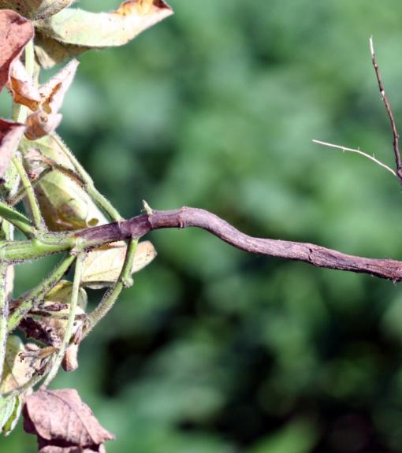
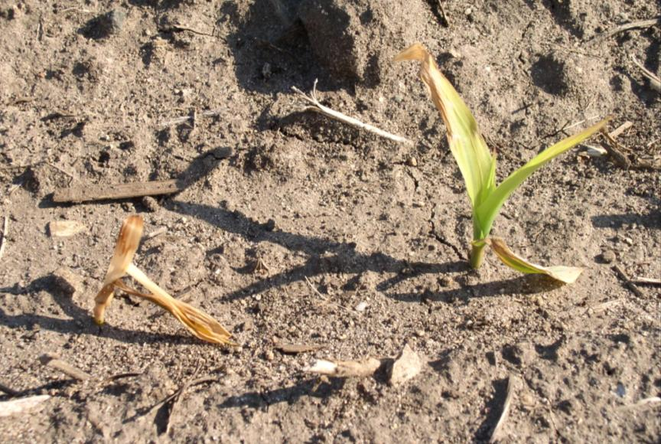
Management Practices
Fungicides
Seed treatments
- protect roots from soilborne pathogens
Notes:
Fungicides can be used to manage disease but they should be used in combination with other management practices.
Fungicides are available as seed treatments and protect the germinating seed from infection by soil-borne pathogens. Almost all hybrid corn is treated with seed treatments. Recently, an increasing percentage of soybean seed is treated each year.
[Left: Phytophthora root rot (page 27, Soybean Field Guide 2nd Edition). This disease can be managed with seed treatments. Right: Damping off of seedlings (page 42, Corn Field Guide).]

Slide 20
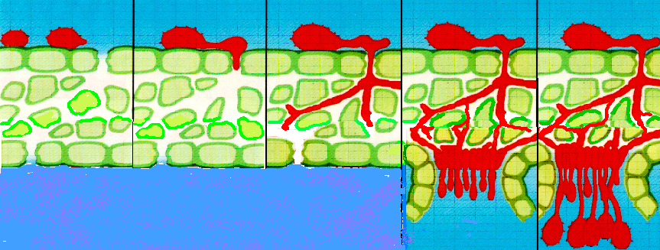
Management Practices
Fungicides
Foliar fungicides
- stop infection and colonization of host
Spore
germination
Pustule
formation
Penetration
Growth
Sporulation
Syngenta
Notes:
Fungicides can also be applied to the leaves of crop plants. Depending on which chemical group the fungicide belongs to they can stop germination of the spore and thus infection of the host; or they prevent growth of the fungus and consequently colonization of the host tissue. The diagram above shows the steps in infection and lesion (pustule) formation for rust diseases (page 24, Soybean Field Guide 2nd Edition; page 29, Corn Field Guide). In general, fungicides are most effective when applied before disease is too established in a field.

Slide 21
Management Practices
Fungicides
Foliar fungicides
CONSIDERATIONS
Cropping history and percent surface crop residue affect the risk of disease. Many pathogens survive in crop residue, which can be a source of inoculum.
Varieties vary in their susceptibility to diseases.
Disease presence early in the season may result in greater yield loss than diseases that occur later in the season.
Fungicides do not affect diseases caused by bacteria, viruses, or nematodes.
Profitability of a fungicide application depends on the price of grain and the cost of application.
Notes:
Before using a foliar fungicide, there are several factors that need to be taken into consideration.
First of all – what is the risk of disease? Has the disease been a problem in that area before and thus could the pathogen have survived on previous crop residue?
Is the host plant susceptible to disease or does it have resistance to the disease of concern? If the host is resistant to the prominent diseases, a fungicide may not be needed.
At what stage of the growing season is disease becoming an issue? Disease early in the growing season is more likely to reduce yield than disease that arrives at the end of the growing season. So treatments with a fungicide are more critical when disease appears earlier in the season.
Fungicides have no effect on bacterial, viral, or nematode diseases.
The profitability of a fungicide application depends on costs associated with the application and the price of grain.

Slide 22
Interrupting the disease cycle
How does management interrupt the disease cycle?
Survival
Inoculum produced
Production of survival structures
Dispersal
Symptoms
Colonization
Infection
Notes:
So now we have discussed various management practices, let’s go back to the disease cycle and illustrate how the practices interrupt the disease cycle.

Slide 23
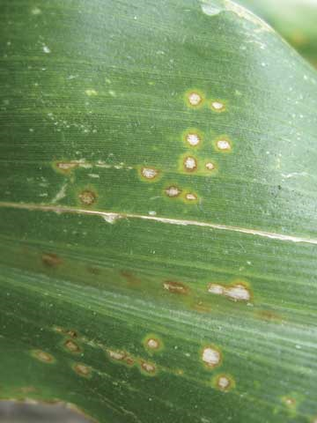
Interrupting the disease cycle
Rotation; tillage; planting high quality seed
Survival
Inoculum produced
Production of survival structures
Dispersal
Symptoms
Colonization
Infection
Notes:
Rotation, tillage, and planting high quality seed interrupt the disease cycle by reducing the amount of inoculum available for infection. This often delays the onset and/or severity of disease.
[Image shows a corn leaf with symptoms of eyespot (page 31, Corn Field Guide). Eyespot is a disease which may be minimized by crop rotation and tillage.]

Slide 24
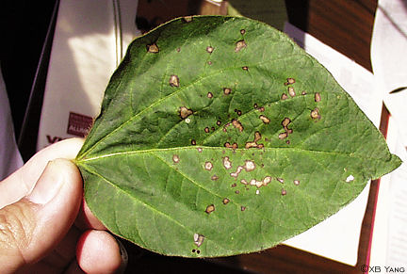
Interrupting the disease cycle
Variety resistance; fungicides
Survival
Inoculum produced
Production of survival structures
Dispersal
Symptoms
Colonization
Infection
Notes:
Disease resistance and fungicides stop the disease cycle by preventing infection, or stopping colonization of the host tissue.
[Image shows a soybean leaf with symptoms of frogeye leaf spot (page 22, Soybean Field Guide 2nd Edition). Frogeye leaf spot is a disease which may be minimized by planting resistant varieties and fungicide application.]

Slide 25



Summary
The disease cycle for all pathogens is essentially the same.
Effective management strategies break the disease cycle.
An understanding of the disease cycle will help implement management strategies.
Notes:
In summary, knowing the disease cycle is the foundation for plant disease management. Although we have four types of pathogens that can cause disease on plants, the disease cycle is essentially the same for all of them.
The most effective disease management strategies break the disease cycle.
Understanding the disease cycle and how management strategies break the disease cycle will enable the most effective strategies to be used for plant disease management.
All images © ISU, except where noted.
Thanks to ISU Extension and Outreach and North Central IPM Center for financial support.

