Slide 1
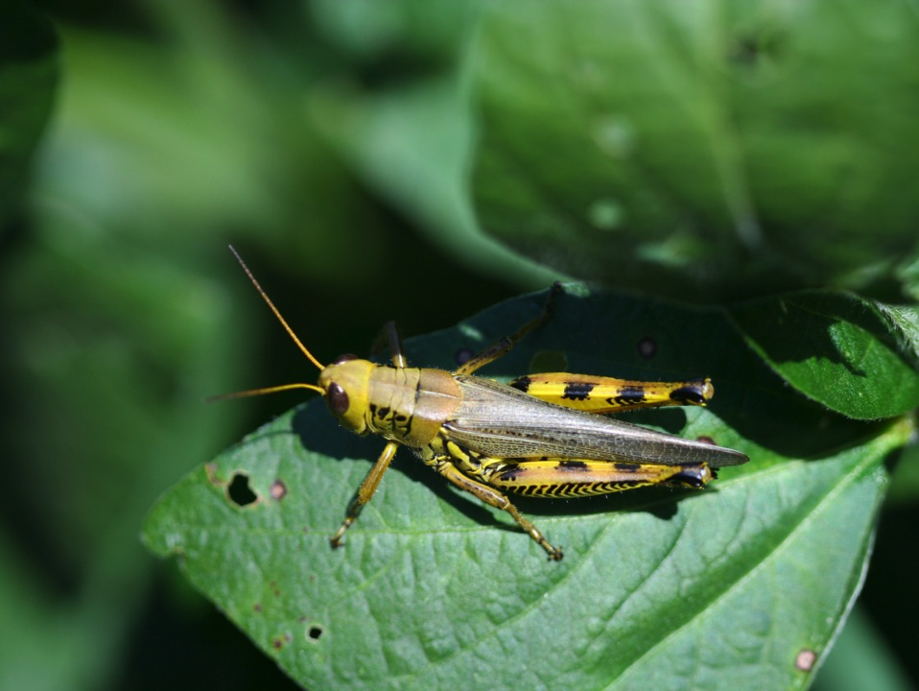
Insect Management
Notes:
This presentation focuses on the use of integrated pest management (IPM) with field-crop insect pests.

Slide 2
Know your system…
What is the plant, what is normal?
Most plant health problems are not caused by biotic (living) factors such as insects and disease.
Most plant health problems are a result of non-biological factors (environment, cultural methods, irrigation, plant nutrients, etc.).
Proper identification of insects is critical.
Notes:
Whenever you think about maximizing yields and profit, it is really important to know the system.
First, you must know what the plant normally looks like so that you know when it starts to look abnormal.
Surprisingly, most plant health problems are not caused by biotic (living) factors like insects or disease. Typically, plants are stressed or sick because of abiotic factors, such as uncontrollable, adverse weather or environmental conditions or as a result of growers over-managing. Some cultural practices, such as overwatering or fertilizing can make crop plants in fields very attractive to insects or promote disease.
To confirm biotic factors are damaging plants, proper identification of the insect (or disease) is critical to successful management.

Slide 3
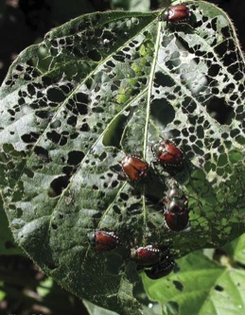
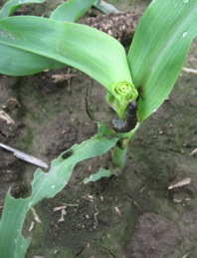
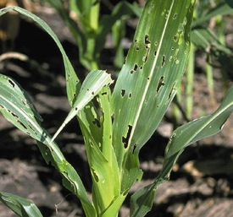
IPM for insects
Integrated pest management (IPM)
  Use multiple tactics to reduce pests
  Protect yield and minimize loss
  Only spray when needed
  Understanding the field history
Tristan Mueller
© Marlin E. Rice
© Marlin E. Rice
Notes:
For most field crops, there are many tactics that we can use to protect yield and minimize unnecessary risk to the environment. That concept is often recognized as Integrated Pest Management or IPM. (Refer to the IPM sections in the field guides: start on page 18, Corn Field Guide; start on page 7, Soybean Field Guide 2nd Edition)
IPM for insects usually involves combining multiple tactics to reduce pest pressure. A strong IPM program involves planning ahead and being proactive instead of reactive.
Once crop foliage or other tissue is destroyed, it may be impossible to recover the losses.
Instead of calendar-based insecticide sprays, IPM programs recommend only treating when needed to preserve natural enemies and reduce overall production costs.
Taking good notes and developing a field history can be a useful reference for making future management decisions.
Review the Introduction to IPM presentation for terms such as Economic Threshold and Economic Injury Level.

Slide 4
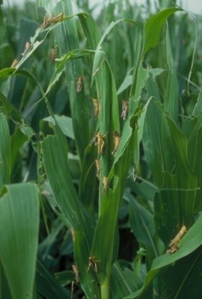
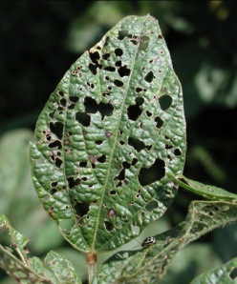
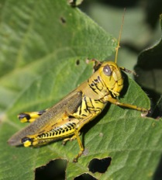
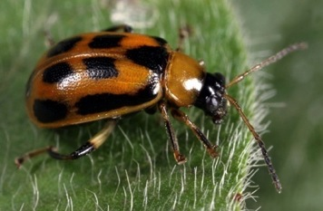
How to scout for insects
Understand their biology
  Recognize feeding damage
  Where they feed on the plant
© Marlin E. Rice
© Marlin E. Rice
Notes:
Scouting for insects is a big part of a successful IPM program. You need to be a crop detective to describe normal insect activity. Understanding the biology and life cycle of insect pests is the first step. Questions to answer include: How many generations does the insect have per year and when do different life stages occur? What is the damaging life stage and what does that damage look like?
One of the more common damages to plants is feeding on plant tissue. For example, bean leaf beetle (page 46, Soybean Field Guide 2nd Edition) feeding on soybean and grasshopper feeding on corn (page 54, Corn Field Guide).

Slide 5
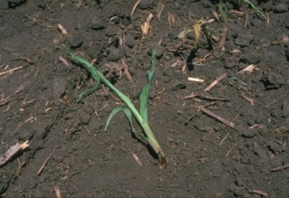
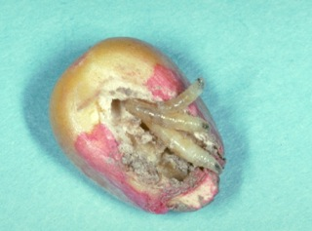
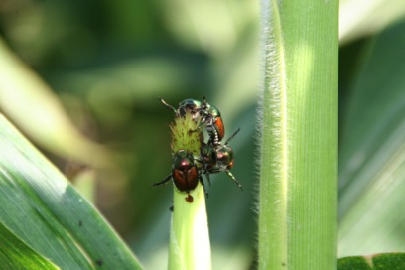
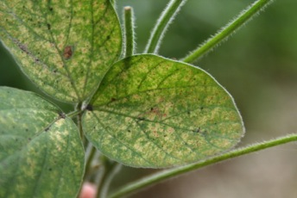
How to scout for insects
Understand their biology
  Recognize feeding damage
  Where they feed on the plant
© Marlin E. Rice
© Marlin E. Rice
Notes:
Other injuries include damage to seeds (seedcorn maggot-middle image-page 46, Corn Field Guide and page 36, Soybean Field Guide 2nd Edition) or seedlings (black cutworm damage-top right image-page 48, Corn Field Guide). Also, some insects feed on plant sap with piercing-sucking mouth parts causing stippling on the leaves (spider mites [a close relative of insects]-lower right image-page 45, Soybean Field Guide 2nd Edition and page 55, Corn Field Guide). Insects can also interfere with pollination (Japanese beetles on silks-lower left-page 57, Corn Field Guide) or destroy different parts of a plant depending on the generation of the insect.

Slide 6
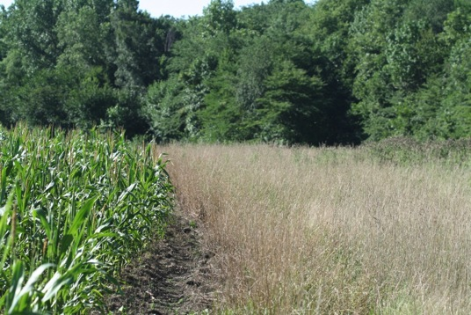
How to scout for insects
Know how to find them
  Where they are in a field
  When they are feeding
Notes:
Knowing how to find the target insects will help you accurately describe what’s going on in the field. Insects usually have a preferred feeding site, whether it’s the leaves, stems, or flowers. For example, some insects cause more damage along edges of fields, especially near grassy edges.
Some feed only at night while others are constantly eating.

Slide 7
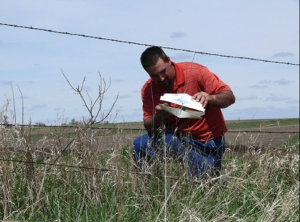
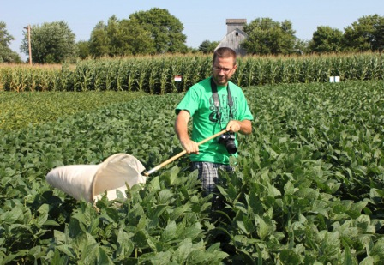
How to scout for insects
Common tools to estimate density
  Sweep net, in-field counts, sticky traps, etc.
Notes:
Once you understand the insect pest’s behavior, an appropriate sampling technique that will most effectively collect your target insect can be chosen. A sweep net (figure on right) is a common sampling tool for some insects because it dislodges insects from the foliage. But nets won’t accurately estimate insects like aphids, which are difficult to collect with nets. Counting insects per plant is also used to sample insects. Some insect pests can be monitored using visual or chemical lures (figure on left). More information on visual or chemical lures can be found here - http://edis.ifas.ufl.edu/pdffiles/IN/IN08000.pdf.

Slide 8
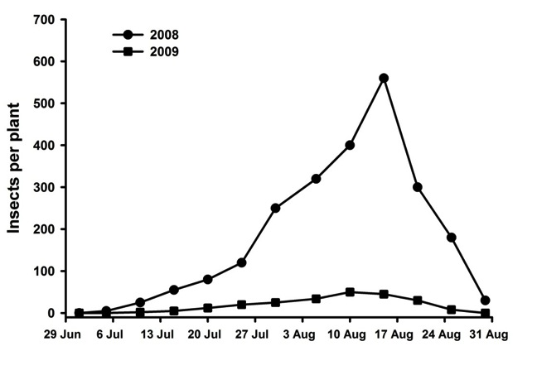
Typical scenarios
High and low insect
populations are
common.
Only scouting will
tell you what the
insects are doing.
Notes:
All insect populations go through high and low cycles. Some might peak several times a year while others may peak only every few years. Scouting will help you describe density over time. This is a figure of a typical insect population scenario. Each dot represents a sampling date. Note that the numbers were very high in 2008, with a peak of over 500 insects per plant in mid-August. Compare that with 2009, where the numbers remained low throughout the season.

Slide 9
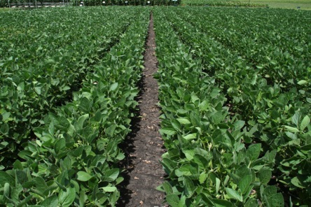
IPM tactics for insects
Regulatory
Genetic
Mechanical/physical
Cultural
Biological
Chemical
Notes:
Common IPM tactics to manage insects are described on this slide. Most of these tactics attempt to disrupt activity, so that insects don’t do as well as they normally could – hopefully preventing population flares that result in economically significant damage.
Regulatory control is largely conducted by direction of state and federal agencies, especially the United States Department of Agriculture and the Nebraska Department of Agriculture and Land Stewardship. Regulations may prevent harmful and invasive insects from entering the state because they are shown to cause severe damage. The following slides will elaborate on the other tactics, as they are usually more in our control.

Slide 10
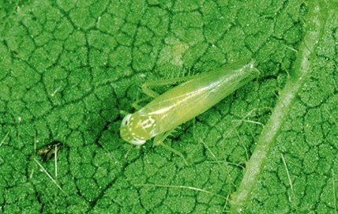
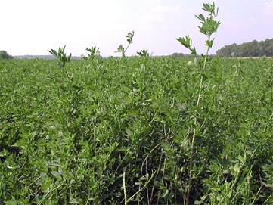
Genetic control
Select varieties that will help minimize yield loss
Conventional and molecular breeding
Host plant resistance or tolerance
  Insects don’t survive or do as well
© Plant Management Network
© Marlin E. Rice
Notes:
Genetic control is largely based on improvements in seed quality. Starting with high yielding varieties is often worth the extra cost to improve plant health before the insects arrive. Some varieties are bred for genetic resistance or tolerance to an insect or group of insects or other pests.
Desirable genetic traits have been selected for many years by breeders, and now certain traits can be modified by molecular techniques to alter the plant to protect yield. Insects that feed on resistant plants don’t survive or do as well as they normally would. For example, the potato leafhopper (left image) is a common pest in alfalfa. Glandular-haired alfalfa varieties are a genetic improvement that discourages the leafhoppers from doing as well because they have difficulty feeding on hairy leaves.

Slide 11
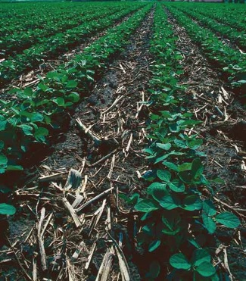
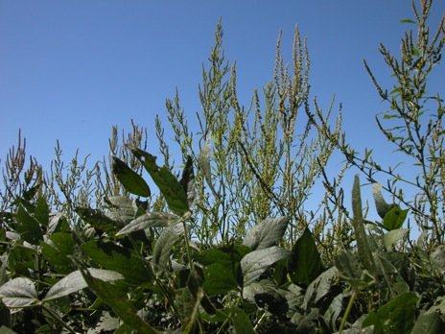
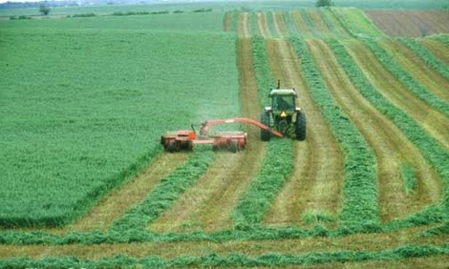
Mechanical/Physical control
Sanitation
Tillage
Harvesting
© Marlin E. Rice
Soybean tillage photo: Lynn Betts, USDA, Natural Resources Conservation Service
Notes:
Sometimes mechanical or physical control is helpful to discourage insect success.
Controlling weeds or volunteer plants (sanitation) will reduce refuge sites for mobile insects and can make overwintering more difficult.
Tillage can destroy insects that overwinter or feed in the soil.
Harvesting crops like alfalfa and small grains will leave insects with nothing to feed on, often resulting in starvation.

Slide 12
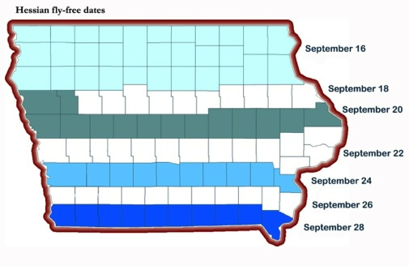
Cultural control
Date of planting
Rotate crops
Keep plants healthy
Avoid susceptible varieties
Notes:
Cultural control can include a selective date of planting to avoid peak emergence of a pest. For example, planting winter wheat after the peak of Hessian fly adult activity (the “Fly-Free date”) is recommended so that females don’t have a place to deposit eggs. A map of predicted fly-free planting dates is shown here. Crop rotation, when practical, can also make it more difficult for insects to find their favorite host plants. Keeping plants healthy by using recommended soil fertility amendments will help minimize stress, making plants better able to tolerate insect feeding. Whenever possible, avoid using known susceptible varieties.

Slide 13
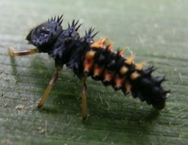
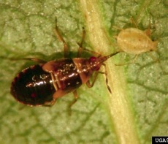
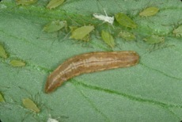
Biological control
Natural enemies controlling “pests”
Predators and parasitoids
  Most pests have enemies
  Will respond to low/moderate density
Encourage natural enemies
  Reduce broad spectrum insecticides
© Bradley Higbee, www.ipmimages.org
© Marlin E. Rice
Notes:
Biological control involves using beneficial insects to naturally control pests. Fortunately, most of the insects we consider pests have multiple natural enemies. Predators and parasitoid wasps can regulate low to moderate pest levels, but can only be effective in the absence of broad spectrum insecticides.
The “good guys” are shown above. Many of these feed on aphids and other soft-bodied insects. [Top: Ladybeetle larva (page 48, Soybean Field Guide 2nd Edition; page 59, Corn Field Guide), Middle: Insidious flower bug (page 50, Soybean Field Guide 2nd Edition; page 60 Corn Field Guide), and Bottom: Syrphid fly larva (hover flies as adults).]

Slide 14
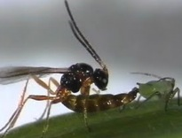
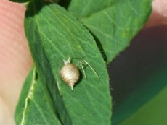
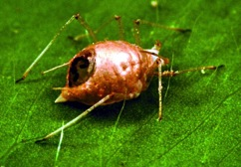
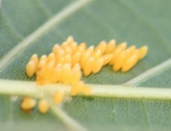
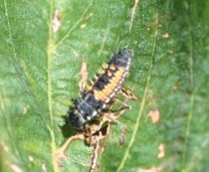
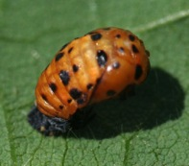
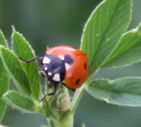
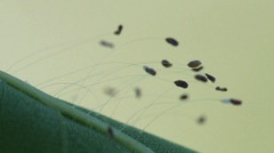
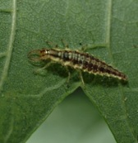
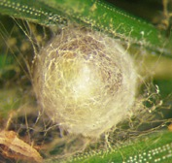
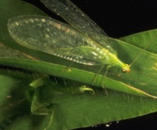
Parasitoid wasp
Muratori et al., BMC Evolutionary Biology 2008
© Marlin E. Rice
Ladybug
Lacewing
© Joseph Berger,
www.ipmimages.org
Whitney Cranshaw, Colorado State University, Bugwood.org
© Frank Peairs, www.ipmimages.org
Notes:
Here are just a few examples of common natural enemies in field crops.
[Top: The parasitoid wasp is a small, stingless wasp that injects eggs into aphids. The wasp larvae then hatch and begin feeding on the aphid, eventually killing it. The aphid becomes bloated, dies, and is commonly referred to as a mummy. The larvae pupate and later emerge as adult wasps ready to find more aphids.]
[Middle: Ladybugs are the most common natural enemy – they feed on aphids and other soft-bodied insects. The eggs are football-shaped and laid in small groups. Predatory larvae hatch and actively look for soft-bodied insects as prey. The larvae will pupate on the plant and emerge as adults, which we are probably more familiar with seeing in the field. Adult ladybugs are predatory, too.]
[Bottom: Lacewings (page 60, Corn Field Guide and page 50, Soybean Field Guide 2nd Edition) are common predators of soft-bodied insects. The female lays eggs on protective stalks (protects the first emerging larva from eating its siblings!). Lacewing larvae hatch and are voracious predators. Pupae look like small cotton balls. Adults emerge and feed on nectar and pollen or are predaceous.]

Slide 15
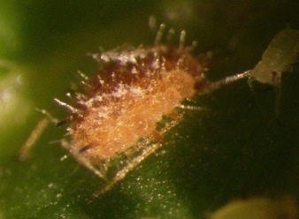
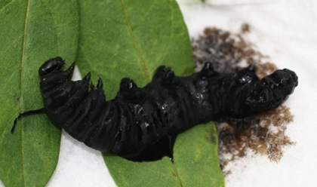
Pathogens
Targeted host selection
Kill, reduce reproduction, or shorten the life
Environment controls effectiveness
Relatively slow acting; may take several days
Fungal-infected aphid
Bacteria-infected caterpillar
© tdogmom/MonarchFriend
© Karrie Koch, University of Minnesota
Notes:
In addition to predators and parasitoids, there are many naturally-occurring pathogens that help reduce pest numbers. Pathogens may include fungi, bacteria, nematodes, and viruses. Pathogens usually have a very limited host range, where they target one species or group of related insects. The pathogens have a range of effectiveness, some outright kill their hosts and others just shortening the life of insects. The environment plays a huge role in the effectiveness of pathogens on controlling pests. For example, fungi need certain temperature and moisture conditions to be viable.

Slide 16
Bt as an example…
Bacillus thuringiensis “Bt”
Insect consumes foliage
Toxin binds to gut
Gut breaks down, allows normal bacteria to enter body cavity
Insect dies in 1-2 days
Notes:
One particularly effective pathogen is a bacteria called Bacillus thuringiensis, or “Bt” [bass-ill’-iss / thur-in-gee-en’-sis]. There are several subspecies of Bt, with each strain being very selective to a small group of insects. There are Bt strains for mosquitoes, caterpillars, and beetles. Bt can be incorporated into the genetics of a plant or used as a foliar application.
Using a caterpillar as an example, we can see how Bt works: As the caterpillar eats foliage with Bt, the crystalline toxins enter the gut and bind to the gut wall, eventually breaking it open. Normal bacteria in the gut enter the body cavity and the caterpillar dies of a runaway infection within 1 to 2 days.

Slide 17
Chemical control
Traditional insecticides
  Broad spectrum, long residual, toxic
  Pyrethroids, organophosphates, carbamates
Reduced risk insecticides
Limit pesticide applications
  Follow label rates/harvest intervals
  Think about good timing – when is the best time
  Alternate chemical classes
Notes:
Chemicals can be a very effective management tactic against insects. Traditional insecticides are broad spectrum with a residual of 7-14 days. Major classes of these insecticides include pyrethroids, organophosphates, and carbamates. Many different products and formulations are available for most pests in field crops.
Recently, industry has formulated some new insecticide chemistries that are considered reduced-risk. These are not as destructive as broad spectrum insecticides. Typically, these products are more selective so they preserve natural enemies and pollinating insects.
It is always important to follow the label rates, reentry periods, and harvest intervals of insecticides. The label on the product is the law and should be followed carefully. Whenever planning an insecticide spray, think about getting the maximum control possible. Most insects have a weak link in their life cycle where they are susceptible to insecticides. Plan to spray when you get the biggest bang for your buck – that may be when the majority of nymphs have emerged, or when most of the adults have emerged. Whenever possible, try to alternate chemical classes or modes of action so that the insects are not exposed to the same products all the time. This is important because insects can develop resistance to chemicals and this process can be sped by the repeated application of the same product.

Slide 18
Economic thresholds are key!
Be ‘ok’ with some insects
  Avoid calendar-based sprays
Use a cut-off point, or threshold, to suppress insects
  5 beetles/sweep or 25% defoliation
Extend insecticide effectiveness
  Saves money!
  Prevents genetic resistance
  Preserves natural enemies
  Reduces environmental risks
Notes:
As just mentioned, insecticides are a part of IPM programs, but should only be used when warranted. Understand that completely eliminating insects is not possible and fields are never going to be insect-free. Most of the insects we find in field crops are not at levels high enough to warrant sprays or are even considered harmful. The number of true pest species we would find is actually very low. But sometimes pests flare up and do cause economic damage. IPM tries to avoid economic loss whenever possible. A keystone concept in IPM is the use of thresholds instead of calendar-based sprays. An economic threshold is a cut-off point that tells you to spray before economic damage occurs. Examples of economic thresholds may be five beetles per sweep or 25% defoliation.
There are several advantages of using a threshold. Of course you will save money if you only spray when needed versus spraying regardless of insect pressure. Reducing applications can help delay genetic resistance in insect populations to major classes of insecticides, making the products we have available now last longer.
A good example of using economic thresholds is for the control of soybean aphid (pages 38-40, Soybean Field Guide 2nd Edition). Treatments are not considered appropriate until the aphid population reaches 250 per plant and is increasing. Most of the foliar insecticide applications we have commercially available are considered broad spectrum, so they will kill the target insect but also kill beneficial insects as well. Any time an insecticide is used, there are always risks to the applicator and accidental non-target effects to other animals. By waiting to spray until pest pressure reaches or exceeds the economic threshold you can minimize all these potential negative impacts.

Slide 19
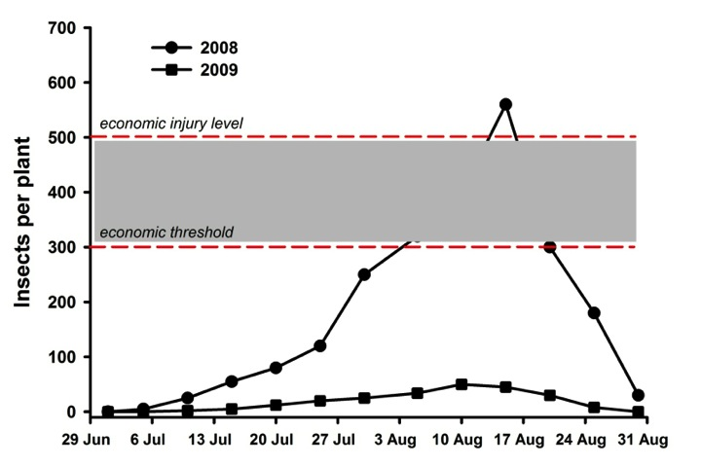
When should a grower spray?
Spray after reaching
ET but before
surpassing EIL.
Notes:
Here is same figure that was shown before, but it might help explain an economic threshold a bit better. Thresholds are a predetermined cut-off point when you should schedule a spray. It’s not actually the point at which economic loss occurs. That is called the economic injury level. Careful scouting will help you determine when the pest has exceeded the threshold, shown here at 300 insects per plant. A well-timed spray before surpassing the economic injury level, shown here as 500 insects per plant, will prevent economic yield loss. In 2008, insects surpassed the threshold and justified an insecticide spray. But in 2009, the pest populations never entered the grey area and an insecticide treatment would not pay for itself.

Slide 20
Items to consider
Market value of crop
Overall production costs
Insecticide costs (product plus delivery)
Sufficient coverage
Maximum suppression
Leave a check strip!
Notes:
There are many changing factors that go into using insecticides. Growers need to think about several environmental and economic issues to decide if the treatment is financially worth it. Although difficult to do, growers must be able to predict the market value of the crop and anticipate the overall production costs, including insecticide applications. Sometimes treating for insects with predicted low market values is not cost-effective.
Another item to consider is coverage of the application. Whenever spraying, growers should strive for maximum coverage, or a high killing rate. Adjusting volume and pressure of the application will ensure full coverage.
If feasible, leave a check strip so that you can compare treated and untreated portions of the field. This is one great way to know if the insecticide was worth it and well-timed.

Slide 21


Summary
Know the system – plants and insects
Consider history of insect activity
Use IPM tactics to minimize insects
Only spray when needed
Notes:
In summary, managing insects in field crops takes a lot of proactive work. Knowledge of how plants and insects interact in a system is an important first step. Developing a field history can help make management decisions easier. Implement multiple, proactive IPM tactics to minimize insect pressure. Selecting high-yielding seed and regular scouting will improve the odds of a successful crop. Use economic thresholds and only spray when needed.
All images © ISU, except where noted.
Thanks to ISU Extension and Outreach and North Central IPM Center for financial support.

