Slide 1
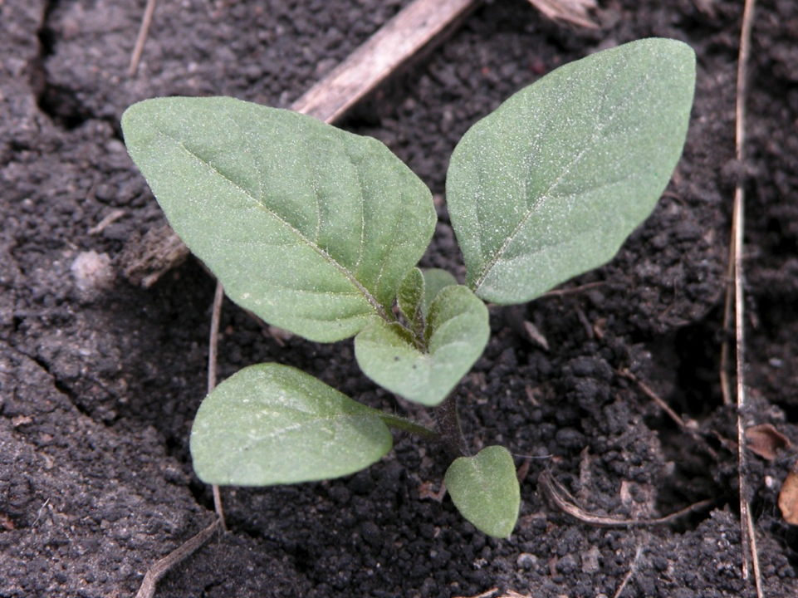
Introduction to Weed Science and Weed Identification
Notes:
This presentation provides an introduction to weed science and weed identification.

Slide 2
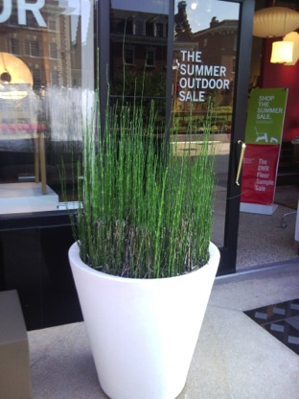
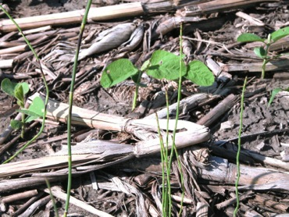
Definition of a Weed
A plant growing where it is not wanted (Oxford Dictionary)
Any plant or vegetation, excluding fungi, interfering with the objectives or requirements of people
(European Weed Science Society)
A plant that is especially successful
at colonizing and proliferating in
disturbed sites
Notes:
There are many different definitions of a weed. The same plant can be considered a weed in one setting and beneficial in another. Weed is a subjective term.
A simple definition is “a plant out of place.” A few others are listed here…..
[Images from left: scouringrush (page 20, Weed ID Guide) in a soybean field as a weed and also as an ornamental in a planter outside of a shop]

Slide 3
First Steps in Weed Management
To effectively manage weeds you should know:
  What weed you are dealing with – correct identification
  Consider impact of the weed
  Life cycle of the weed
Weed biology influences methods and optimum time for management strategies
Notes:
In order to manage weeds you will need to correctly identify the weed, consider the impact of the weed, and also know the life cycle. Many weed management techniques exploit the life cycles of weeds and use weed biology characteristics in the development of control strategies.

Slide 4
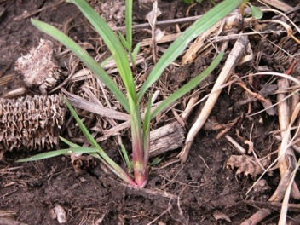
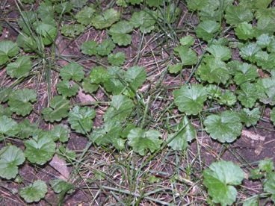
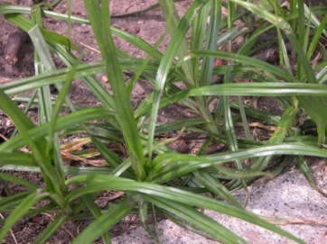
Weed Classification
Morphology
  Structure and form
Life cycle
  How it develops
Yellow foxtail
Ground ivy
Yellow nutsedge
Notes:
Weeds may be classified by their structure and form such as grass species, sedges, or broadleaf weeds. Weeds are further characterized by their life cycles and how they develop and reproduce.
Yellow foxtail (page 34, Weed ID Guide), yellow nutsedge (page 18), and ground ivy (page 96)

Slide 5
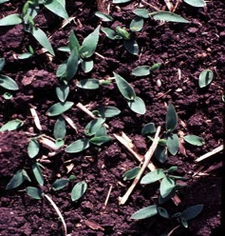
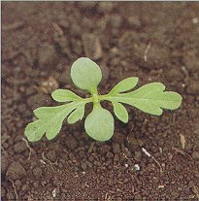
Weed Classification – Morphology
Monocotyledon – one cotyledon or one embryonic leaf
  Grasses, sedges, rushes
Dicotyledon - two cotyledons
  “Broadleaf” plants
Notes:
Monocotyledon weeds, or “monocots,” have one cotyledon or first, embryonic leaf. Grasses, sedges, and rushes are examples of monocots. Dicotyledons, or “dicots,” refers to two cotyledons (the first leaves that emerge from the soil). Broadleaf plants are often referred to as dicots.

Slide 6
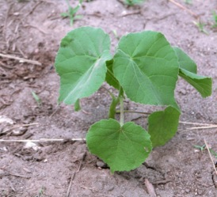
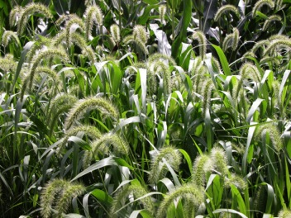
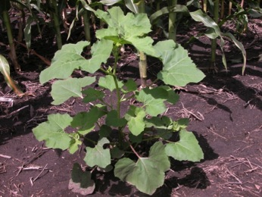
Weed Classification – Life Cycle
Annuals
  Complete their life cycle from seed to seed in less than 12 months
Velvetleaf
Giant foxtail
Cocklebur
Notes:
Weeds typically fall into one of three life cycle classifications: annuals, biennials, or perennials. Some weeds may be classified into more than one life cycle. Weeds are usually best adapted to survive in a crop with a similar life cycle, germination time, or growth habit. The most effective control methods often are based on the life cycle of a weed.
Annuals are plants that grow and complete their life cycle in one year.
Velvetleaf (page 78, Weed ID Guide), cocklebur (page 58), and giant foxtail (page 33)

Slide 7
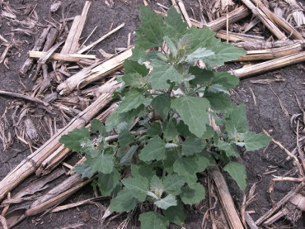
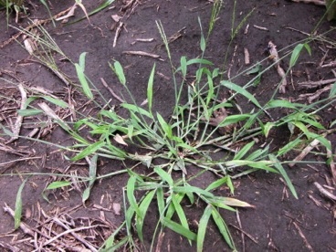
Summer Annuals
Seeds germinate in spring
Flower in mid to late summer
Produce seed in late summer or fall, then die
Similar growing season to corn and soybean
E.g., lambsquarters, foxtails, crabgrass, purslane, waterhemp
Lambsquarters
Large crabgrass
Notes:
Within the annual classification there are summer annuals that germinate in the spring, flower in summer, produce seed in late summer or fall, and then die. Summer annuals have a similar growing season to corn and soybean. They are the most common type of weed in annually tilled fields. Examples of a few common summer annual weeds include: common lambsquarters (page 67, Weed ID Guide), foxtail (pages 33-35), crabgrass (page 23), purslane, and common waterhemp (page 41).

Slide 8
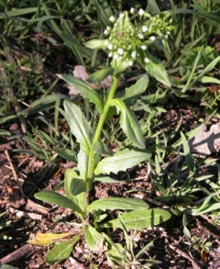
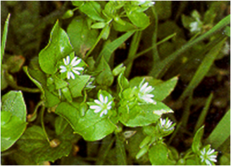
Winter Annuals
Pennycress
Germinate in late summer or fall
Dormant over winter
Flower and produce seed in mid to late spring
Die in summer
E.g., shepherd’s purse, chickweed, pennycress, speedwells
Chickweed
Notes:
Another type of annual weeds are the winter annuals. Winter annuals germinate in late summer or fall. They are dormant over the winter, then resume growth in the spring, flower and produce seed in mid to late spring, and die in the summer. Winter annual weeds can pose problems in fall-seeded crops, early spring grains, pastures, and no-till fields. A few examples of winter annuals include: shepherd’s purse (page 60, Weed ID Guide), chickweed (page 66), pennycress (page 63), and corn speedwell (page 89).

Slide 9
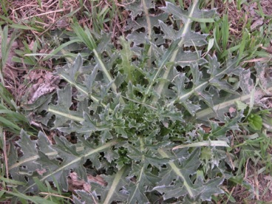
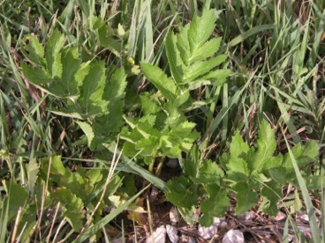
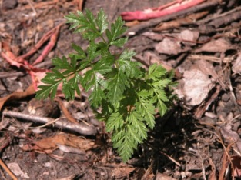
Biennials
Complete life cycle in two years
Germinate and form basal rosette first year, remain vegetative and store food for winter
Musk thistle
Wild carrot
Wild parsnip
Notes:
Biennial weeds require two years to complete their life cycle and, like annual weeds, only reproduce by seeds. Seeds germinate in the spring or summer and produce root systems and rosettes of leaves the first year. Some biennial weeds can also behave as annuals, completing their life cycle in a single growing season.
Musk thistle (page 51, Weed ID Guide), wild parsnip (page 44), and wild carrot (page 43)

Slide 10
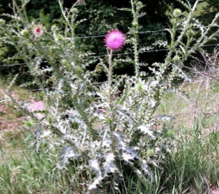
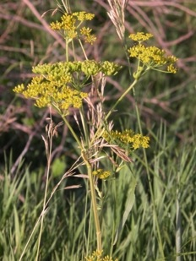
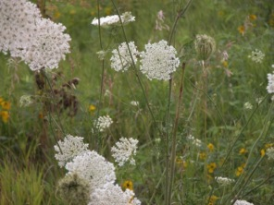
Biennials
Flower, produce seed, and die during second growing season
Need undisturbed soil for at least two years
E.g., musk thistle, wild carrot, wild parsnip, garlic mustard
Musk thistle
Wild carrot
Wild parsnip
Notes:
The following spring, biennial stems bolt (elongate) and plants flower, produce seeds, and die. Biennial weeds are typically a problem in no-till fields, pastures, and other areas undisturbed for at least two years. Some examples of biennial weeds include: musk thistle (page 51, Weed ID Guide), wild carrot (page 43), wild parsnip (page 44), and garlic mustard.

Slide 11
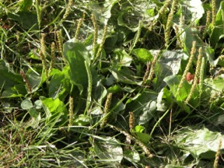
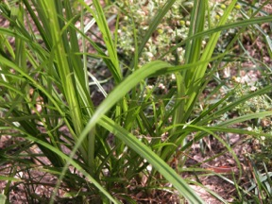
Perennials (herbaceous)
Live for more than two years
  Simple: produce a taproot, spread only by seed
    E.g., Dandelion, broadleaf plantain
  Creeping: can reproduce by buds, rhizomes, tubers, bulbs, and seed
    E.g., Quackgrass, nutsedge, leafy spurge
Broadleaf plantain
Yellow nutsedge
Notes:
Perennial weeds live multiple years. Perennial plants may be classified as “herbaceous” or “woody.” Woody perennials typically have aboveground plant parts that can overwinter, whereas herbaceous perennials re-grow each season from underground overwintering structures. They reproduce vegetatively and/or by seeds. Perennials typically inhabit no-till fields, pastures, roadsides, and, occasionally, tilled fields. Most perennial weeds found in row crops regrow annually from underground overwintering structures.
Herbaceous perennials can be grouped into two classes, simple and creeping. Simple perennials usually have taproots and reproduce by seed. Creeping perennials can reproduce by seed and vegetatively by rhizomes, tubers, stolons, budding roots, and bulbs.
As tillage increases, incidence of perennials increases: Why?
Tillage breaks vegetative structures into pieces that can regenerate into new plants, potentially spreading the infestation within or between fields. Perennials may require either repeated efforts or a combination of management tactics to achieve adequate control.
Examples of simple perennials include dandelion (page 57, Weed ID Guide) and broadleaf plantain. Some creeping perennials include quackgrass (page 26, Weed ID Guide), yellow nutsedge (page 18), and Canada thistle (page 52).

Slide 12
Weed ID - Sources of Information
ISU Weed Identification Field Guide
Reference books
Extension bulletins
Many websites
  http://www.wssa.net/Weeds/ID/PhotoGallery.htm
  http://plants.usda.gov/
Someone “in the know”
  Local experts
  Extension offices
Notes:
For more information on weed identification consult one or more of the many resources available. Some sources include reference books and extension bulletins, and also there are several good sites on the internet. There are many websites that provide descriptions and photos of weed species that can help with identification.

Slide 13
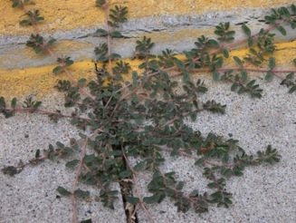
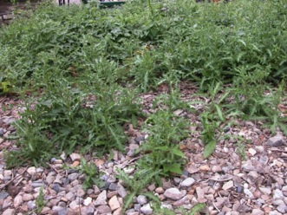
What Makes a Weed Successful?
Seed characteristics
Ability to germinate and grow in many environments
Rapid seedling growth
Self-compatibility or easy cross-pollination
Vigorous vegetative reproduction
Ability to tolerate environmental stresses
Prostrate spurge
Canada thistle
Notes:
Weeds seem to occur in an endless supply. Why are weeds so successful? A key reason is their different seed characteristics. We will discuss some of these seed characteristics in the following slides. Additional weed characteristics that allow them to grow and be competitive with desirable plant species include the ability to germinate and grow in many different environments, rapid seedling growth that allows them to be competitive quickly, ease of pollination, the ability to reproduce vegetatively, and the ability to tolerate adverse environmental conditions.
Prostrate spurge and Canada thistle (page 52, Weed ID Guide)

Slide 14
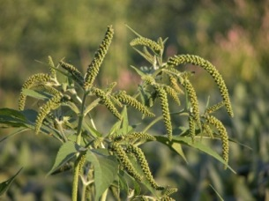
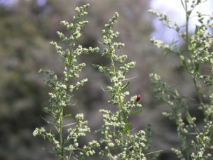
Seed Characteristics
Longevity of seed
Long period of seed production
High seed output
Ability to produce seed in adverse conditions
Long and short seed dispersal
Giant ragweed
Lambsquarters
Notes:
Often weed seeds can remain dormant in the soil for many years (the seeds of velvetleaf [page 78, Weed ID Guide] have been reported to remain viable for over 100 years). Then, when the right conditions occur, they germinate and grow. Some weedy species produce seed for an extended period of time, and many weed species can produce thousands of seeds on a single plant. Weeds can also find success by producing seeds even under adverse environmental conditions. And finally, weeds have developed various effective ways of spreading their seeds, with different species using different techniques to spread seeds either short or long distances.
Giant ragweed (page 49, Weed ID Guide) and lambsquarters (page 67)

Slide 15
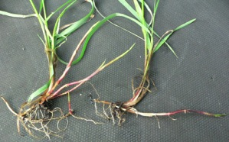
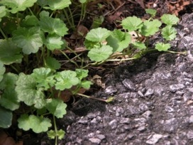
Vegetative Reproduction
Rhizomes
  Underground structures that produce new plants
    E.g., canada thistle, quackgrass
Stolons
  Above-ground creeping stems that root at nodes and produce new plants
    E.g., ground ivy (creeping charlie)
Quackgrass
Ground ivy
Notes:
Weeds that can reproduce vegetatively have an advantage in areas that are not tilled regularly and often pose serious long-term problems. Rhizomes are underground stems that root at nodes and allow the plant to reproduce and spread vegetatively. Canada thistle (page 52, Weed ID Guide) and quackgrass (page 26) are two weed species that reproduce by growth of sturdy rhizomes. Stolons are aboveground creeping stems that can root at the nodes and produce new plants. Ground ivy (page 96, Weed ID Guide), also known as creeping charlie, is an example of a weed that reproduces effectively by stolons.

Slide 16
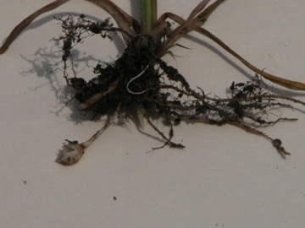
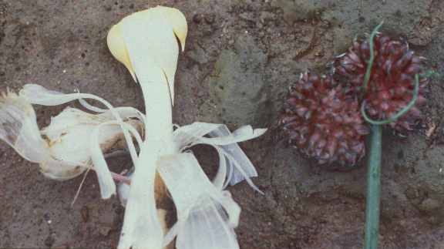
Vegetative Reproduction
Bulbs, bulblets, tubers
  Underground leaf tissue modified for food storage. Produces new plants
    E.g., wild garlic, yellow nutsedge
  Aerial bulblets (above ground)
    E.g., wild onion, wild garlic
Yellow nutsedge
Wild onion
Notes:
Some weed species reproduce vegetatively by bulbs, bulblets, or tubers. These are underground structures that are actually leaf or modified stem tissue where food (carbohydrates) is stored for later growth, overwintering, and production of new plants. Wild garlic and yellow nutsedge (page 18, Weed ID Guide) are examples of plants that have underground reproductive leaf tissue structures. Some plants also have aboveground bulblets that can produce new plants. Wild onion and wild garlic are two examples of weedy plants that produce aboveground bulblets.

Slide 17
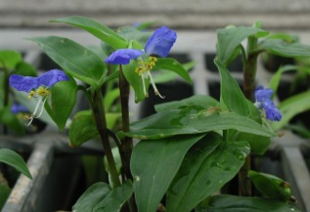
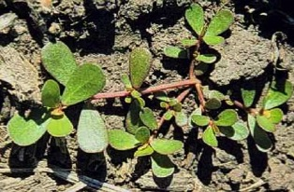
Vegetative Reproduction
Plant reproduction
  Each plant part can regenerate another plant
  When cultivating, the implement can redistribute them in the field
    E.g., Asiatic dayflower, purslane
Asiatic dayflower
Purslane
Notes:
Some weeds can produce new plants from parts broken off the original plant. Purslane and Asiatic dayflower are examples of plants that can regenerate another plant just from a section of the original plant. These species can often survive on the soil surface for several days without water, and will produce roots at the nodes to reestablish and reproduce.

Slide 18
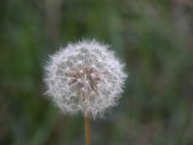
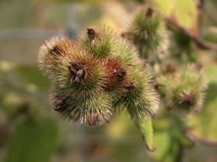
Dispersal
Wind
Attachment – burs, thorns, stickers
Birds – digestion/excretion
Artificial dispersal – “human dispersal”
  Soil and compost
  Equipment
  Plants
  Contaminated seed
Dandelion
Burdock
Notes:
A few methods of weed seed dispersal include: wind-blown seeds (dandelions [page 57, Weed ID Guide]), animals or humans moving burs (cockleburs [page 58] and burdock [page 50]), thorns or stickers transporting parts of plants to new locations (Canada thistle [page 52] and leafy spurge), and birds that ingest weed seeds and then excrete them in different places (Mulberries!!). Humans also do a lot to aid in weed dispersal by moving soil or compost, moving weed seeds or plant parts with tillage equipment, planting nonnative plants that become invasive weeds, and planting desirable plant seeds that are contaminated with weed seeds.

Slide 19
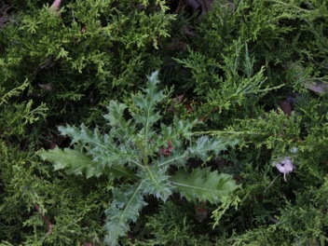
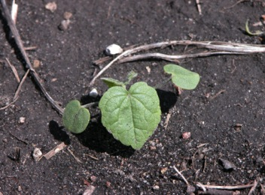
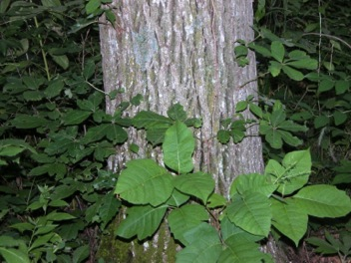
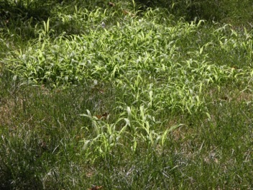
Weed Management Strategies
Canada thistle
Velvetleaf
Poison ivy
Yellow nutsedge
Notes:
Different management strategies are necessary for different weed problems. Controlling Canada thistle (page 52, Weed ID Guide) in an evergreen shrub border will require a different approach than the other situations shown here - velvetleaf (page 78) control in field, poison ivy in a forest, or yellow nutsedge (page 18) in a lawn.
These different strategies are covered in the PowerPoint titled “Managing Weeds”.

Slide 20



Summary
  Identify the weed
  Know the life cycle
  Use control strategies based on weed species, life cycle, crop, field or landscape situation, and the environment
Notes:
In summary, it is important to correctly identify the weed species you target for control, understand their life cycles, and base your control strategies on all factors involved.
All images © ISU, except where noted.
Thanks to ISU Extension and Outreach and North Central IPM Center for financial support.

