Slide 1
Introduction to Plant Pathology
Notes:
No matter the weather conditions, there will be problematic diseases every year. Which disease may change from year to year. This presentation provides background on plant diseases.

Slide 2
What is a plant disease?
A plant disease is any abnormal condition that alters the appearance or function of a plant. It is a physiological process that affects some or all plant functions. Disease may also reduce yield and quality of harvested product.
Disease is a process or a change that occurs over time. It does not occur instantly like injury.
Notes:
A plant disease is any abnormal condition that alters the appearance or function of a plant. It is a physiological process that affects some or all plant functions. Disease may also reduce yield and quality of harvested product.
Disease is a process or a change that occurs over time. It does not occur instantly like injury, for example, herbicide injury. Injury will be covered in another presentation.

Slide 3
What is a plant disease?
Visible effects of disease on plants are called symptoms. Any detectable changes in color, shape, and/or functions of the plant in response to a pathogen or disease-causing agent is a symptom.
Signs of plant disease are physical evidence of the pathogen, for example, fungal fruiting bodies, bacterial ooze, or nematode cysts. Signs also can help with plant disease identification.
Notes:
Visible effects of disease on plants are called symptoms. Any detectable changes in color, shape, and/or functions of the plant in response to a pathogen or disease-causing agent is a symptom. Leaf spots or blights, discoloration of plant tissue, stunting, and wilting are symptoms that may be evidence of disease.
Symptoms can occur throughout the plant or they can be confined to localized areas. Although certain symptoms are characteristic of a particular disease, a number of pathogens may produce the same or similar symptoms. Furthermore, symptoms often change over time and their expression is influenced by environmental conditions and corn and soybean varieties.
Signs of plant disease are physical evidence of the pathogen, for example, fungal fruiting bodies, bacterial ooze, or cyst nematode females. Signs can help with plant disease identification.

Slide 4
What causes plant disease?
Infectious plant diseases are caused by living organisms that attack and obtain their nutrition from the plant they infect. The parasitic organism that causes a disease is a pathogen. Numerous fungi, bacteria, viruses, and nematodes are pathogens of corn and soybean in Nebraska.
The plant invaded by the pathogen and serving as its food source is referred to as a host.
Notes:
Infectious plant diseases are caused by living organisms that attack and obtain their nutrition from the plant they infect. The parasitic organism that causes a disease is a pathogen. Numerous fungi, bacteria, viruses, and nematodes are pathogens of corn and soybean in Nebraska.
The plant invaded by the pathogen and serving as its food source is referred to as a host – in this case the host is the corn or soybean plant.

Slide 5
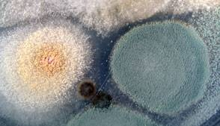
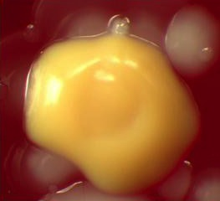
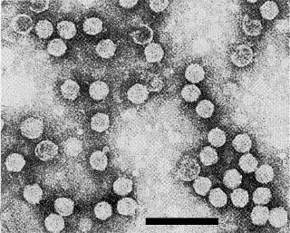
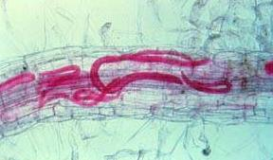
Types of pathogens
Fungi
Bacteria
Viruses
Nematodes
Notes:
Pathogens are capable of producing infection and causing a disease. Fungal spores, bacterial cells, virus particles, and nematode juveniles or adults are examples of plant pathogens. Fungi are the most common plant pathogens.

Slide 6
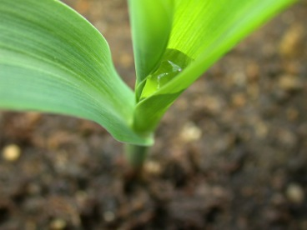
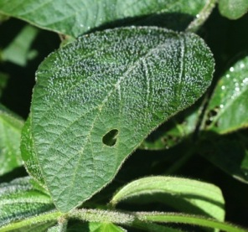
Role of the environment
A favorable environment is critically important for disease development – even the most susceptible plants exposed to huge amounts of a pathogen will not develop disease unless environmental conditions are favorable.
Notes:
A favorable environment is needed for plant disease to develop. For example, soybean and the white mold fungus (page 30, Soybean Field Guide 2nd Edition) must interact in cool, moist conditions during flowering in order for disease (white mold) to occur. A favorable environment is critically important for disease development – even the most susceptible plants exposed to huge amounts of a pathogen will not develop disease unless environmental conditions are favorable.
Temperature and moisture are the most important environmental factors that affect development of nearly all diseases. Both air or soil temperature and moisture can affect soybeans and/or the pathogen. If temperature is unsuitable, a soybean plant may grow poorly, and therefore become more susceptible to a particular disease. Temperature also may stimulate or reduce the growth of a pathogen, resulting in a different level of disease. Excess or deficient moisture also may stress soybean plants, making them more prone to attack by some pathogens. Additionally, moisture is important for many fungal and bacterial pathogens.
Relative humidity, soil pH, soil texture, light, and nutrient status may affect disease development as well. Moreover, such factors as compaction, tillage practices, planting depth, seed bed preparation, and residue management can have significant effects on disease development.

Slide 7
The Disease Triangle
Environment
Pathogen
Host
Notes:
The disease triangle is an important concept in plant pathology. Disease will ONLY occur if these three factors interact simultaneously.
A susceptible host plant, a pathogen, and a favorable environment are the three factors composing the plant disease triangle. All three factors are necessary for development of a plant disease, thus, disease can be affected by altering any of these three factors. For example, the host plant can be changed by growing disease-resistant varieties. The pathogen can be removed by tilling residue, rotating crops so that pathogens do not survive year to year on the same crop, controlling insects that carry pathogens to plants, or using fungicides to kill the pathogen. Finally, the environment can be managed so that it is less favorable for disease, such as by changing row spacing or draining low areas.
In this example of soybean rust – soybean (host) must be planted, spores (pathogen) of the soybean rust fungus must be present, and the soybean leaves have to be wet for a minimum of eight hours (environment) to enable the spores to germinate and infect the leaf.

Slide 8
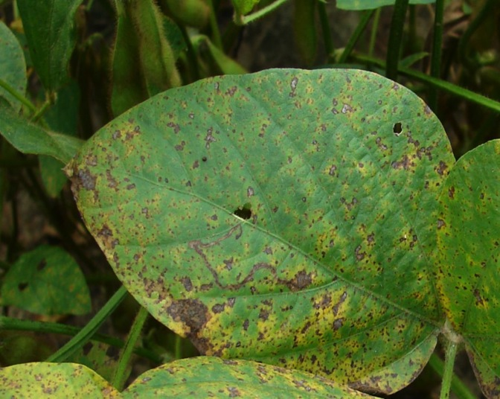
The Disease Triangle
Soybean rust
Notes:
When the three factors come together, they may result in disease, and in this case, soybean rust (see page 24, Soybean Field Guide 2nd Edition).

Slide 9
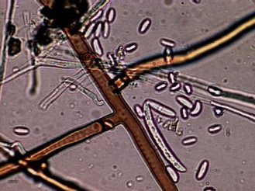
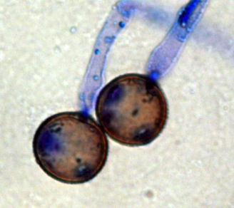
Groups of plant pathogens - fungi
Vast majority are beneficial
Can cause plant, human, and livestock diseases
Most cannot be seen without a microscope
Lack chlorophyll
Composed of growing structure of delicate, threadlike filaments called hyphae
Reproduce by forming spores
Notes:
Fungi are the largest and perhaps most well-known group of plant pathogens. The vast majority of fungi, however, are beneficial. Many help decompose organic matter, releasing nutrients for other plants and organisms to use. Fungi and fungal products are used in food preparation; for instance, yeast is used in making bread and beer, manufacturing processes, and in medicine (e.g., penicillin). However, several thousand types of fungi can cause plant disease, and a relatively small number of them cause disease in humans and livestock. Most plant pathogenic fungi are extremely small and, except for possible extensive growth on the surface of a plant, normally cannot be seen without a microscope.
Fungi lack chlorophyll, the green-colored compound that most plants use to complete photosynthesis to make food, so they must obtain their food from either dead or decaying organic matter, or from living tissue.
Most fungi are composed of a growing structure of delicate, threadlike filaments called hyphae (top image). Hyphae absorb both the water and nutrients needed for growth and reproduction of the fungi. They may also secrete enzymes, toxins, and other chemical substances that may be important factors in disease development and symptom expression. A mass of hyphae is referred to as mycelium. The “fuzzy” fungal growth that is sometimes visible on plant surfaces is this mycelium. However, mycelium frequently develops completely or primarily within the host and is not visible on the plant’s surface.
Most fungi reproduce by forming spores (bottom image, common rust spores). Spores are carried to plants primarily by wind and water. Some types of spores are produced inside structures called fruiting bodies that may be seen on or in plant tissues. Spores and fruiting bodies are often used to identify a fungus. Some spores and fruiting bodies are resistant to adverse environmental conditions and can survive in soil or decaying plant material for a long time.
Fungi can cause a variety of symptoms including leaf spots and blights, root rots, seedling blights, seed discoloration, wilts, and stem rots.

Slide 10
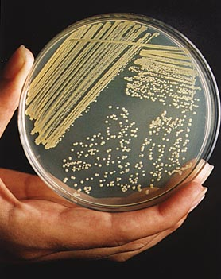
Groups of plant pathogens - bacteria
Extremely small organism requiring microscope to be seen
Bacteria population can increase in number in short time period
Cells clump together in masses called colonies
Obtain food from dead or decaying organic matter or living tissue
www.foodmate.net
Spread plant to plant by wind-driven rain
Gain entrance through natural plant openings or injuries
Notes:
Bacteria are perhaps more familiar to us as the cause of important human and animal diseases, such as tuberculosis and pneumonia. However, most bacteria are harmless and many are even beneficial, such as the nitrogen-fixing bacteria present in soybean roots. Nonetheless, bacteria can also be destructive plant pathogens.
Bacteria are extremely small microorganisms. Individual bacterial cells require a microscope to be seen. They reproduce by individual cells splitting into nearly equal halves, each becoming a fully developed bacterium. A bacterial population may increase to very high numbers within a short period of time. For example, if a bacterium divided every 30 minutes, a single cell would produce more than 250 trillion descendants in 24 hours.
As bacteria divide, the cells tend to clump together in masses called colonies. Bacterial cells and colonies vary in size, shape, color, and growth habit. These characteristics are used to identify specific bacteria.
Like fungi, bacteria cannot make their own food; they must obtain it either from dead or decaying organic matter, or living tissue. Nearly all bacteria have the ability to grow and develop on dead tissue. Most plant pathogenic bacteria populations are not adept at competing with other organisms in the soil, so their populations may decline rapidly in the absence of a host.
Bacteria are primarily spread from plant to plant by wind-driven rain and gain entrance into plant tissues through natural plant openings. Wounds in plant tissues from insects, hail, wind, or other causes also provide entry points for bacteria.
Typical symptoms of bacterial diseases include leaf spots, water soaking, and soft rots of plant tissues.

Slide 11
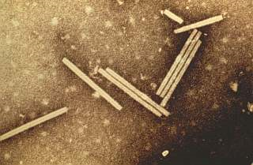
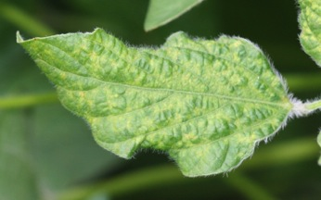
Groups of plant pathogens - viruses
Most familiar because they cause human and animal diseases such as influenza, polio, rabies, smallpox, and warts
Cause some destructive plant diseases
Measure only about one-millionth of an inch in size
Are not complete living systems
Survive only in living cells
University of Florida
Transmitted by insects which are called vectors
Notes:
Like bacteria, viruses are probably most familiar to us as the cause of human and animal diseases, such as influenza, polio, rabies, smallpox, and warts. Viruses, however, are also responsible for several plant diseases.
Viruses are infectious, disease-producing particles that can only be seen with an electron microscope. They are very small, measuring only about one-millionth of an inch. Viruses are complex chemical molecules consisting in most cases of a piece of genetic material surrounded by a protein coat. Viruses multiply by inducing the host cells to form more viruses instead of performing normal cell processes.
Almost all viruses can survive only in living cells. Therefore, their spread from diseased to healthy plants depends on some means of direct movement from host to host. Many viruses are transmitted by insects, called vectors, particularly aphids and leafhoppers. Some viruses are transmitted when equipment or people spread sap or juice from diseased plants to healthy plants. This type of mechanical transmission may happen occasionally by simple leaf contact between healthy and diseased plants.
Typical viral symptoms include mosaic patterns on leaves, deformation of plant tissues, stunting, seed discoloration, and reduced yield.

Slide 12
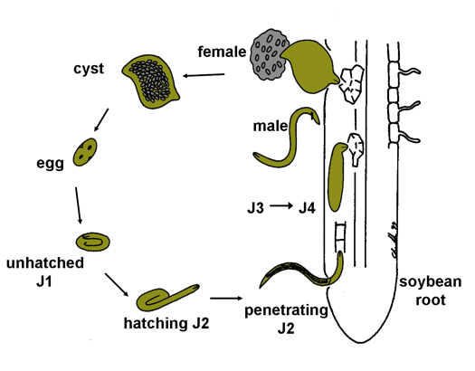
Groups of plant pathogens - nematodes
Round, slender, threadlike worms
Some are parasites on animals, insects, fungi, other nematodes, and plants
Plant-parasitic nematodes have a stylet
Most live in the soil and feed in or on plant roots
Notes:
Nematodes are microscopic, non-segmented, round, slender worms. Several thousand species of nematodes are found in soil, in fresh and salt water, in animals, and within or on plants throughout the world. Most feed on dead or decaying organic material. Some are parasites on animals, plants, insects, fungi, or other nematodes.
A single acre of cultivated soil may contain hundreds of millions of nematodes, but due to their small size, they are seldom, if ever, seen. Most adult parasitic nematodes of plants cannot be seen unless magnified. They seldom exceed 1/8 inch and may be smaller than 1/64 inch.
Plant-parasitic nematodes have a hollow, needle-like feeding structure called a stylet that is used to puncture plant cells. Nematodes inject substances into host plant cells through their stylets and then withdraw nutrition from the plant cells through their stylets as well.
The life cycle of a nematode includes an egg, four juvenile stages, and an adult. Females lay eggs that hatch into juveniles, and after four molting periods, juveniles become adults and the egg-laying process is repeated. The average life cycle of a nematode is 20 to 60 days. Nematodes overwinter mainly in the egg stage.
Most plant-parasitic nematodes live in the soil, and feed in or on plant roots. Some nematodes live a part or all of their lives inside plant roots.
Most important plant-parasitic nematodes feed on plant roots and directly interfere with water and nutrient uptake by the plant. Root injury causes aboveground symptoms similar to those produced by other conditions that damage root systems. Plants frequently appear to be suffering from lack of moisture or nutrient deficiency, even when water and minerals are adequate. When nematodes occur in high population densities, stunting, yellowing, loss of vigor, general decline, and eventual death of plants are typical above-ground symptoms.

Slide 13
Disease cycle
Survival
Inoculum produced
Production of survival structures
Dispersal
Symptoms
Colonization
Infection
Adapted from P. Vincelli, 2005
Notes:
Disease development occurs over a period of time as a series of events. This series of events is called the disease cycle. The basic steps in most disease cycles are as follows: production of inoculum, spread of inoculum to susceptible host, penetration of inoculum into host, infection, secondary cycles, and pathogen survival between host plants.
The rest of this presentation will further explain this process. Knowing the disease cycle is important in managing any disease. Depending on the disease, management will target certain stages of that disease’s development. Management options that break the disease cycle prevent or reduce development of the disease.
The goal of plant disease management, therefore, is to interrupt the disease cycle and stop it from completing a full cycle. It is important to understand the disease cycle of each disease to make the most effective management decisions.
Inoculum: Potential infective units of a pathogen, including fungal spores and bacterial cells.
Dispersal: Movement of inoculum.
Infection: Pathogen penetrating into the host plant.
Colonization: Pathogen establishing itself in the host plant.

Slide 14
Comparison of disease cycles
 | Fungi | Bacteria | Viruses | Nematodes
Survival | Crop residue Soil Alt. hosts - | Crop residue Soil Alt. hosts Insect vectors | - - Alt. hosts Insect vectors | Crop residue Soil - -
Dispersal | Wind Rain Insects | Wind Rain Insects | - - Insects | Tillage Equipment Water run-off
Infection | Directly Wounds Insect feeding | - Wounds Insect feeding | - - Insect feeding | Directly - -
Notes:
These four types of pathogens share certain characteristics regarding the disease cycle. Fungi, bacteria, and nematodes often survive in crop residue or in the soil. Viruses and bacteria often survive in insect vectors. Fungi, bacteria, and viruses can be dispersed by insects. Only fungi and bacteria are dispersed by rain or wind. Fungi and nematodes are able to directly infect the host, while bacteria and viruses infect the host indirectly, via insect feeding for example.

Slide 15
Inoculum
Source of inoculum varies for each disease
May be produced on residues left in the field
Present in the soil
Present in weeds or other crops in the area
Present in or on the seed
Present in soil sticking to equipment or tools
Carried by wind or water
Carried by insect vectors
Carried in by animals, birds, and people
Notes:
Inoculum- Form of a pathogen that is capable of causing infection, including spores and bacterial cells.
Spread of inoculum may occur by wind, water, infected plant material, insects, animals, birds, and people.
Plant diseases may have more than one source of inoculum. For example, soybean cyst nematode (page 32, Soybean Field Guide 2nd Edition) may survive as eggs in the soil of infested fields, be carried into fields by contaminated soil clinging to tires, or could be carried by birds.

Slide 16
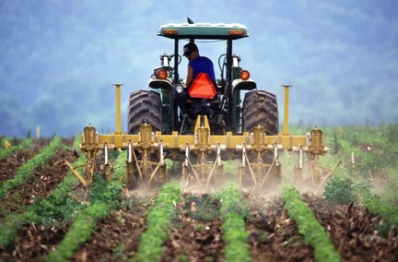
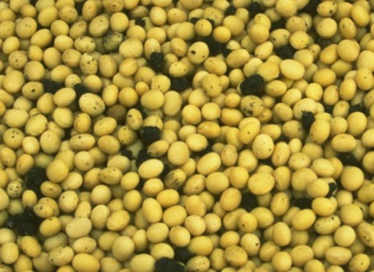
Spread of inoculum
Two ways
Plant placed in soil that contains a pathogen
Inoculum moves from its source to host plant
Keith Weller, U.S. Department of Agriculture
Notes:
Knowing how a pathogen is spread can be valuable information when planning a disease management program. For example, it may be difficult to control the spread of pathogens by wind or water, but it is possible to control movement of diseased seed or infected plant material, to restrict movement of pathogens on equipment or tools, and to reduce levels of insect vectors or shift planting dates to avoid high populations of insect vectors.
[Images from left: Tilling can move soilborne pathogens from one field to another and soil in soybean seed can spread pathogens such as soybean cyst nematode (page 32, Soybean Field Guide 2nd Edition).]

Slide 17
Penetration of inoculum and infection
Infection occurs when a pathogen successfully enters a plant and grows, reproduces, and spreads within the plant
Pathogens enter a host through natural openings, wounds on plant surfaces, or by penetrating directly into the plant
Spore
germination
Mycelial
growth
Pustule
formation
Penetration
Sporulation
Syngenta
Notes:
Infection occurs when a pathogen successfully enters a plant and grows, reproduces, and spreads within the plant. Pathogens enter a host through natural openings, wounds on plant surfaces, or by penetrating directly into the plant
Insect vectors may acquire pathogens from diseased plant tissue as they feed and then introduce the pathogen into healthy plant tissue as they feed on the healthy plant.
Some pathogens attack and multiply only in leaf tissue. Others attack and multiply in stems, roots, fruits, or the conducting tissue of the plant. Another type may attack virtually the entire plant while some attack only seedlings or mature plants and some have no preference.
The period between infection and first symptoms is the incubation period. The length of the incubation period may range from days to weeks or even months depending on the pathogen and host plant involved. For example, leaf symptoms on corn caused by Carbonum leaf spot (page 30, Corn Field Guide) may appear in three to five days of infection; while symptoms of gray leaf spot (page 28, Corn Field Guide) on corn may not develop for fourteen to twenty one days after infection.
[This figure shows the steps of infection for a soybean rust pathogen (page 24, Soybean Field Guide 2nd Edition).]

Slide 18
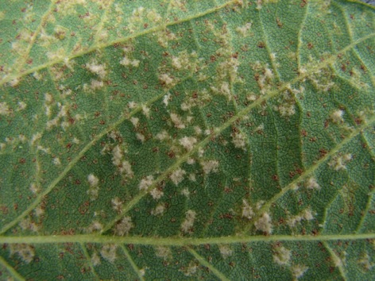
Secondary cycles
Some diseases have only one cycle during the growing season (often root rots)
Some diseases develop secondary or repeating cycles during the growing season (often foliar diseases)
Number of cycles depends on the pathogen, susceptibility of the host, and environmental conditions
Notes:
Diseases with repeating cycles produce additional inoculum in or on the diseased plant. The secondary inoculum is spread to other parts of the same plant or to adjacent plants, leading to another cycle of penetration, infection, symptom development, inoculum production, and so on. Two or more cycles of disease development may occur in a single season.
[Image shows secondary spores produced on the underside of a soybean leaf – downy mildew and soybean rust (pages 23 and 24, Soybean Field Guide 2nd Edition). These spores can cause disease on new leaves during the same growing season.]

Slide 19
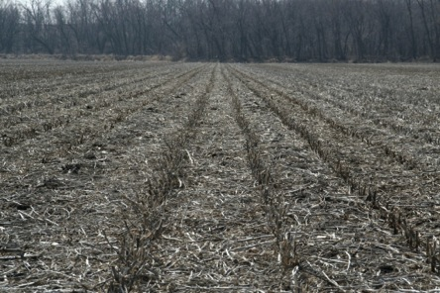
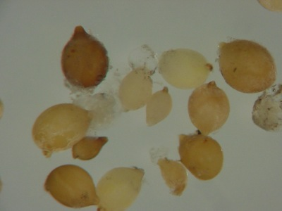
Pathogen survival
Pathogens survive season to season in:
Soil
Crop residue
Weed or noncrop hosts
Seed or vegetative plant parts
Insects
Mild climates
Notes:
For plant diseases to occur season after season, pathogens must have some means of surviving from one growing season to the next, or until a favorable host crop is grown again.
Many fungi and nematodes enter stages that enable them to survive extreme temperature and moisture conditions in the soil. Others persist in crop residues year to year; burying crop residue can decrease survivability of the pathogen. Some survive in or on seed and may cause disease when infected seed is planted. Some pathogens overwinter in the bodies of insect vectors and are spread when insects feed on susceptible hosts the next spring. Many rust spores survive in the south and are carried north by winds each growing season.
[Photos from top: soybean field with residue and soybean cyst nematode cysts (page 32, Soybean Field Guide 2nd Edition), which is how this pathogen survives from season to season.]

Slide 20
Summary
Understanding the difference between a sign and a symptom is key in identifying a plant disease
A plant disease cannot develop if a susceptible host, pathogen, and favorable environment do not occur simultaneously
The major plant pathogens responsible for disease development in plants are fungi, bacteria, viruses, and nematodes
The disease cycle describes the interaction of the pathogen with the host
Notes:
In summary, knowing the disease cycle is the foundation for plant disease management. Although we have four types of pathogens that can cause disease on plants, the disease cycle is essentially the same for all of them.
The most effective disease management strategies break the disease cycle.
Understanding the disease cycle and how management strategies break the disease cycle will enable the most effective plant disease management strategies to be used.
All images © ISU, except where noted.
Thanks to ISU Extension and Outreach and North Central IPM Center for financial support.

