Slide 1
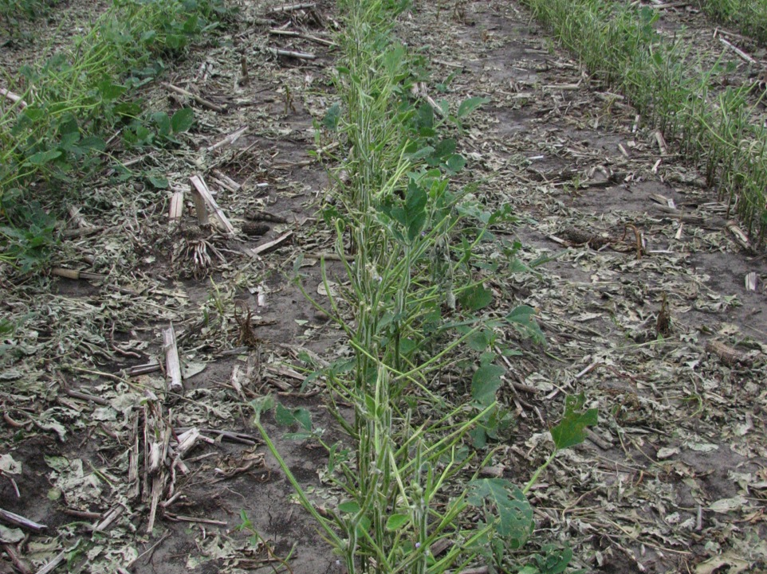
Introduction to Crop Injury
Notes:
In this presentation we will discuss injuries to crops caused by something other than insects, diseases, and weeds. These types of injuries are called noninfectious disorders.
Shown above are soybean plants damaged by hail (page 54, Soybean Field Guide 2nd Edition).

Slide 2
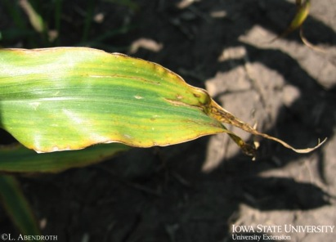
Outline
What is a noninfectious disorder?
Differences between noninfectious disorders and disease
Symptoms and what to look for in the field
Types of disorders:
  Environmental
  Nutrient deficiency
  Chemical injury
  Mechanical injury
Other problems
Notes:
During the course of this presentation we will learn what noninfectious disorders are. We will then move to the differences between noninfectious disorders and disease, and the symptoms you should look for when examining crops for this type of injury.
There are several types of injury that we will discuss including those related to the environment, nutrients, herbicides, and mechanical damage.
We will then look briefly at other problems associated with noninfectious disorders.
[potassium deficiency on corn (page 68, Corn Field Guide)]

Slide 3
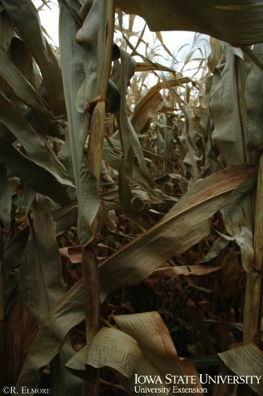
Noninfectious disorders
Nonliving agents or factors
Caused by any physical or chemical component of the environment that is harmful to the plant’s growth and development
  Environmental conditions
  Improper soil nutrient levels
  Toxic chemicals
  Mechanical damage
Notes:
Noninfectious disorders are injuries to plants caused by nonliving agents or factors. A noninfectious disorder might be caused by any physical or chemical component of the environment that is harmful to the plant’s growth and development. Examples of noninfectious disorders are temperature and moisture extremes, hail, wind, lightning, unfavorable light, improper soil nutrient levels, toxic chemicals, and mechanical damage.
[This corn has been damaged by frost before it was mature. Notice grey-green color of leaves.]

Slide 4
Differences between noninfectious disorders and plant diseases
Noninfectious disorders do not reproduce or spread from plant to plant.
Symptoms may appear suddenly and often occur in patterns.
Although symptoms on individual plants may change by becoming progressively better or worse, the area of a field that is affected will not increase over time.
Notes:
Noninfectious disorders do not reproduce or spread from plant to plant. However, a group of plants in the same area may exhibit symptoms, as they may be subject to similar conditions.
Symptoms of noninfectious disorders may appear suddenly and often occur in patterns. Although symptoms on individual plants may change by becoming progressively better or worse, the area of a field that is affected will not increase over time. See the “Basics of Scouting” presentation for more information on patterns.

Slide 5
Symptoms
Wilting, stunting, yellowing, plant tissue deformation or death of plant tissue
Symptoms of noninfectious disorders often resemble those caused by infectious diseases.
  For instance, nutrient deficiency symptoms may resemble symptoms of root rot diseases.
  Herbicide injury on soybean leaves may resemble virus-like symptoms.
Notes:
Noninfectious disorders may produce symptoms such as wilting, stunting, yellowing, plant tissue deformation, or death of plant tissue. Symptoms of noninfectious disorders often resemble those caused by infectious diseases. For instance, nutrient deficiency symptoms may resemble symptoms of root rot diseases. Another example is herbicide injury to soybean leaves which may resemble virus-like symptoms.

Slide 6
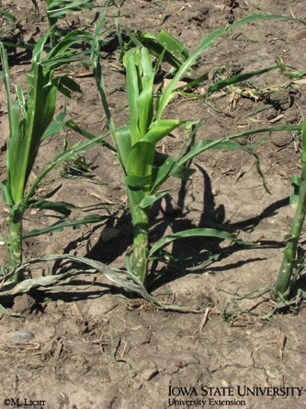
Symptoms and what to look for
Patterns in the field
  Does it occur in a straight line or other shape?
  Only in low spots?
Timing
  Did symptoms show up after herbicide application?
  After certain weather events?
Other plants
  How do surrounding plants appear?
Notes:
When looking for symptoms of noninfectious disorders, there are some clues to look for in the field which may help to determine what kind of problem is present. These are:
Patterns in the field
Does it occur in a straight line or other shape? A sprayer may have overlapped herbicide application, causing plant damage.
Does is occur only in low spots? These spots may have been flooded for long periods of time and plant roots may lack oxygen or a nutrient.
Timing
Did symptoms show up after herbicide application? Herbicide drift from another field may have damaged crops on the adjacent farm.
After certain weather events? Wind may have caused corn stalks to lodge or leaves may be tattered due to hail.
Other plants
How do surrounding plants appear? If surrounding plants appear similarly injured, and not in progressive states of injury, it may indicate a noninfectious disorder.
[corn damaged by hail (page 76, Corn Field Guide)]

Slide 7
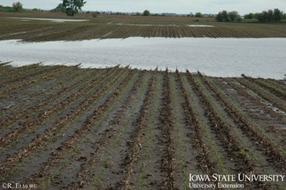
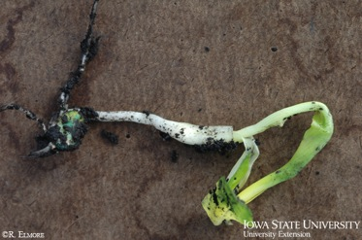
Environmental conditions
Water damage
  Drought
  Flooding
  Soil crusting
Temperature extremes
  Frost
  Heat stress
Notes:
Many environmental factors contribute to noninfectious disorders. These include:
Water damage
Drought causes leaf rolling in corn and wilt in soybean (page 75, Corn Field Guide and page 53, Soybean Field Guide 2nd Edition).
Flooding causes yellowing, wilting, stunting, or death of plants (page 74, Corn Field Guide and page 53, Soybean Field Guide 2nd Edition).
Soil crusting makes it difficult for young plants to break the soil surface (page 73, Corn Field Guide and page 52, Soybean Field Guide 2nd Edition).
Temperature extremes
Frost can kill plant tissues (page 72, Corn Field Guide and page 52, Soybean Field Guide 2nd Edition).
Heat stress can cause yield loss.
[Photos from top: Flooding in a field and corn seedling that leafed-out underground as it was not able to emerge thru the surface of the soil]

Slide 8
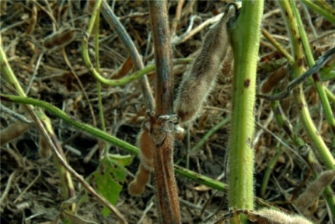
Environmental conditions
Other weather issues
  Hail
  Wind
  Lightening
Additional concerns
  Green stem
  Sunburn or sunscald
Glen Hartman
Notes:
Other weather issues
Hail causes damage to leaves and other plant tissues such as developing corn ears. (page 76, Corn Field Guide and page 54, Soybean Field Guide 2nd Edition).
Wind may lodge plants.
Lightening can create a dead spot in a field very quickly (page 56, Soybean Field Guide 2nd Edition).
Additional concerns
Green stem (plants with moist, green stems at maturity) in soybean can be associated with viruses, but artificial lighting, genetic mutations, and other things may also contribute to this type of injury (page 54, Soybean Field Guide 2nd Edition).
Sunburn or sunscald, appearing between leaf veins as red spots which later turn brown in the center, usually occurs on the lower leaf surface (page 56, Soybean Field Guide 2nd Edition).
[green stem of soybean]

Slide 9
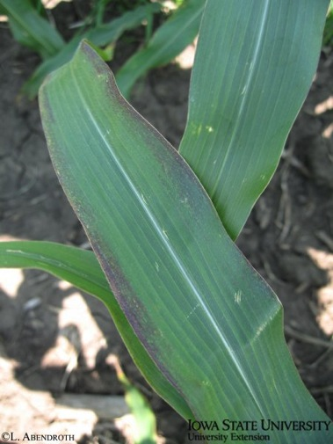
Nutrient problems
Macronutrients – most significant for plants
  Nitrogen
  Phosphorus
  Potassium
Micronutrients – secondary, plants need less
  Iron
  Magnesium
  Sulfur
  Zinc
Notes:
Plants, like people and other organisms, require nutrients for proper development. There are the “macro” nutrients and the “micro” nutrients. Macronutrients are nitrogen, phosphorus, and potassium; plants need these in large amounts and they are the most significant. Micronutrients include iron, magnesium, sulfur, zinc, and others; these are needed by the plant as well, but in smaller amounts.
When these nutrients are lacking, or are unavailable to crops, development may be inhibited. Sometimes nutrients may be in the soil, but certain conditions exist so that plants are unable to take them out of the soil and use them. For example, in alkaline, high-pH soils, availability of iron is limited. In this situation, plants have difficulty obtaining iron from the soil, even though it may be present.
Macronutrients
Nitrogen deficiency can cause leaf yellowing in corn and soybean. It can leach out of the soil after large amounts of rain (page 67, Corn Field Guide and page 60, Soybean Field Guide 2nd Edition).
Phosphorus deficient corn plants have purplish coloring on leaves (page 67, Corn Field Guide and page 60, Soybean Field Guide 2nd Edition).
Corn and soybean plants that lack potassium may have yellow and dying margins on older leaves (page 68, Corn Field Guide and page 61, Soybean Field Guide 2nd Edition).
Micronutrients
Iron chlorosis in soybean can occur in high-pH soils. Soybean leaf veins stay green, but tissue between veins becomes yellow or lighter (page 59, Soybean Field Guide 2nd Edition).
Magnesium deficient corn initially shows stripes between veins on lower leaves, followed by other symptoms (page 68, Corn Field Guide).
Sulfur deficient corn appears as yellowing of young plants and top leaves may have yellowing between veins (page 69, Corn Field Guide).
A lack of zinc can cause corn leaves to have light stripes between veins or a band starting near the leaf base that appears bleached (page 69, Corn Field Guide).
[phosphorus deficiency on corn leaf]

Slide 10
Chemical injury
Fertilizers may harm plants by
  Vapors
  Broadcast applications
  Banding applications
Herbicide injury happens several ways
  Drift
  Carryover
  Misapplication
  Tank contamination
Notes:
Fertilizers applied to fields may harm plants. They can do this in several ways:
Vapors from anhydrous ammonia sidedressing applications can scorch and kill plant tissue (page 70, Corn Field Guide).
Broadcast applications of certain urea-ammonium nitrate solutions or granular urea that falls into whorls can also burn corn tissue (pages 70 and 71, Corn Field Guide)
Banding applications of urea that occur with or next to corn seed can damage plants in several ways (page 71, Corn Field Guide).
Herbicide injury can happen several ways:
Drift occurs when herbicide is blown from its intended target.
Carryover happens when the herbicide persists in the soil from a previous years application.
Misapplication is when a herbicide is purposely applied to a crop that it was not intended to be applied on, such as glyphosate applications to non-tolerant varieties of soybean.
Tank contamination occurs when herbicide is left over in a spray tank from a previous application and is then applied along with a desired chemical in a subsequent spray.

Slide 11
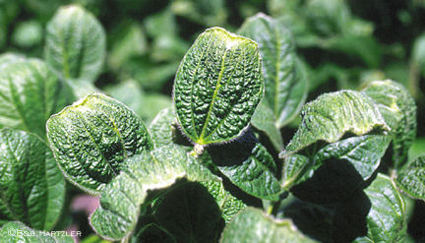
Chemical injury
Plant tissue damage from herbicide may show:
  Scorched or burned leaves
  Yellowing
  Delayed
  emergence
  Leaf cupping
  Malformed or
  damaged roots
  Stunting
  Defoliation
  Death
Notes:
Plant tissue damage due to herbicides is widely variable and includes:
Scorched or burned leaves
Yellowing
Delayed emergence
Leaf cupping
Malformed or damaged roots
Stunting
Defoliation
Death
See pages 62 thru 66, Corn Field Guide and pages 62 thru 66, Soybean Field Guide 2nd Edition for more information.
[growth regulator herbicides may cause leaf cupping in soybean]

Slide 12
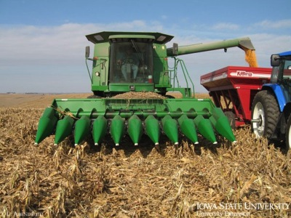
Mechanical injury
Plant damage caused by equipment driving in the field
Heavy equipment can compact soil, creating less than ideal growing conditions
Improper combine settings during harvest may damage grain and increase harvest loss
Notes:
Mechanical injury to plants is caused by equipment driving through a field such as a sprayer or tractor.
Heavy equipment can cause soil compaction, creating less than ideal growing conditions for crops.
Adjust combine settings appropriately during harvest to minimize damage to grain and reduce loss.

Slide 13
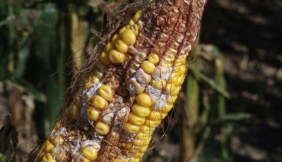
Other problems
Plants stressed by noninfectious disorders may be more prone to attack by infectious diseases.
  For example, soybean plants stressed by herbicide injury may be more prone to root rot diseases.
Problems may occur in combination, so when diagnosing a problem all possible causes or combinations of causes must be carefully considered.
Notes:
Plants stressed by noninfectious disorders may be more prone to attack by infectious diseases. For example, soybean plants stressed by herbicide injury may be more prone to root rot diseases. Problems on field crops frequently occur in combination, so when diagnosing a problem all possible causes or combinations of causes must be carefully considered.
[corn ear damaged by hail may be at increased risk for disease (page 76, Corn Field Guide)]

Slide 14



Conclusions
There are many different types of noninfectious disorders; the symptoms of some may be confused with those of infectious crop diseases.
Proper identification is important in making informed management decisions – herbicides, fungicides, and insecticides will not help when dealing with noninfectious disorders.
Some types of injury can be remedied, and some cannot.
Notes:
There are many different noninfectious disorders in corn and soybean. These injuries range from chemical caused to weather related. The symptoms of some may be confused with symptoms of infectious crop diseases.
Proper identification of noninfectious disorders is important in making informed management decisions – herbicides, fungicides, and insecticides will not help when dealing with these disorders. Some types of crop injury cannot be prevented such as hail damage, but some, such as nitrogen deficiency, can be figured into management decisions for coming years.
All images © ISU, except where noted.
Thanks to ISU Extension and Outreach and North Central IPM Center for financial support.

