Slide 1
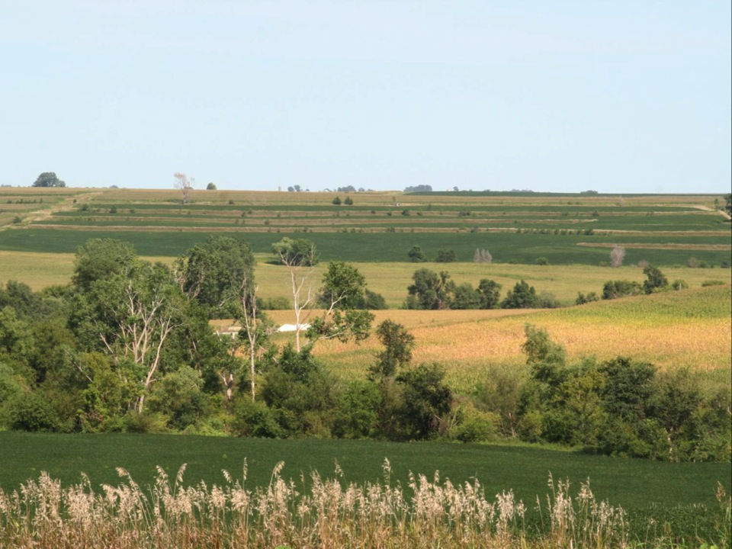
Introduction to Integrated Pest Management (IPM)
Notes:
This is the introduction to Integrated Pest Management, and is the first presentation in a curriculum series produced for Agriculture classrooms and natural resource education venues by the Iowa State University Integrated Pest Management program, with support from the North Central Integrated Pest Management (NC-IPM) Center.

Slide 2
Key points of IPM
Integration
Harmonious use of multiple methods to control single pests or pest complexes
Pest
An organism detrimental to humans, including: invertebrates, vertebrates, weeds, and pathogens
Management
Decisions based on ecological principles and economic and social considerations
Kogan, M. 1998. INTEGRATED PEST MANAGEMENT: Historical Perspectives and Contemporary Developments, Annual Review of Entomology. Vol. 43: 243-270.
Notes:
Key points of IPM (what constitutes IPM or Integrated Pest Management). Let’s talk about those three words:
Integration is the harmonious use of multiple methods to control single pests or pest complexes. To do this, one must learn everything they can about a pest and the crop that is affected by the pest, and then put that information together as a management plan.
Pest is any organism that is detrimental to humans and it includes invertebrates (insects, mites, spiders, etc.), vertebrates (ground squirrels, mice, rabbits, birds, etc.), weeds, and pathogens (microorganisms that cause plant diseases).
And, management, which is simply a set of decisions making up a strategy or plan to control a pest based on ecological principles and economic and social considerations.
So assembled together, we are going to gather as much information as possible, develop an understanding of what is going on in the field, and then develop a strategy to manage a particular pest under specific crop situations.

Slide 3
Key points of IPM
IPM is a multidisciplinary endeavor
Agronomy (crop and soil science)
Entomology (insects: pests and beneficial)
Plant pathology (plant diseases)
Economics (decision-making)
Agricultural Engineering (machinery, grain handling, etc.)
Climatology (weather trends and effects)
Kogan, M. 1998. INTEGRATED PEST MANAGEMENT: Historical Perspectives and Contemporary Developments, Annual Review of Entomology. Vol. 43: 243-270.
Notes:
IPM is a multidisciplinary endeavor. It takes from branches of crop science and then assembles information from the following disciplines:
Agronomy—understanding about the crop and the soils and landscape that the crop will grow on.
Entomology—understanding insects and mites, including both pests and beneficial insects that affect a specific crop.
Plant pathology—understanding the disease-causing microorganisms that affect crops. There are also beneficial microorganisms, including “entomopathic” organisms that attack insects and other invertebrates (plant pathologists and entomologists work together on these) and nitrogen-fixing bacteria that infect soybean and other legume roots.
Economics is basically making decisions that generate profit to the operator when compared with other decisions.
Agricultural Engineering usually addresses how we deliver management tactics to the field. Ag engineers work with machinery, grain handling equipment, soil sampling equipment, and operator safety issues that allow for more effective management practices.
Climatology is important to understand weather trends including rainfall, wind, and temperature that affect both crop and pest development. “Cold blooded” organisms (both crops and most pests) develop based on heat, water, solar radiation, etc. and understanding weather is a key component of understanding how a pest can cause damage to a crop.

Slide 4
History
~2500 BC: The element sulfur was found to help control mite and insect populations
~1500 AD to present: some plants found to generate insecticidal—and more recently—herbicidal compounds
Pyrethrum (pyrethrin - insecticidal)
The Neem tree (NEEM - insecticidal)
Bottlebrush plant, Callistemon sp. (herbicide Callisto)
Notes:
The history of pest management gives us a perspective of how IPM came into being and how we have learned (and continued to learn) about effective ways to control pests.
Around 2500 B.C. (4500 years ago), it was observed that the element sulfur controlled some insects and mites and several fungal diseases that damaged crops. While not every pest was affected, sulfur had pesticidal (pest-killing) properties on several targeted pests. So by simply mining a material out of the ground and applying it as a dust provided some protection from pests to crops. Elemental sulfur is still used today, especially in some organic production systems for control of plant diseases.
Then about 500 years or so ago, around 1500 AD, and continuing until present day, plants were discovered that effectively produced their own pest suppressants, and upon research, some natural, plant-developed pesticides were developed. Classic examples include the plant Pyrethrum (several species), which are showy chrysanthemum species. Fields planted next to the Pyrethrum seemed to have fewer insects present. The Chinese sold the dried flowers to traders along the Silk Route to repel insects, which resulted in Pyrethrum being introduced into Europe. Napoleon reportedly used the pyrethrum plant to de-louse troops. The chemical pyrethrum is produced in the plants and especially in the flower heads. Extracts are still being used some to control farm insects and also mosquitoes. Often today formulations are chemically supplemented and enhanced to give the active ingredient pyrethrum a longer effective control life. There is a class of “modern” insecticides that are derived from the pyrethrin [PIE-WREATH’-RIN] that are called pyrethroids (including “Warrior,” “Mustang,” “Pounce,” and “Asana”). Another example is the neem tree native to southern Asia. Neem also was observed to suppress insects and extracts have been used as insecticides. Knowledge of the insecticidal benefits of neem have been known in some localities for nearly a thousand years. Early traders used it to control several field insect pests. In the last decade or so another natural, plant-derived pesticide was discovered and developed into a modern formulated pesticide. Local people observed that the bottlebrush plant, Callistemon sp. that is native to Australia, seemed to suppress growth of some neighboring plants. Research led to isolation of a chemical with herbicidal effects, and that is the basis for the compound mesotrione. Mesotrione [MEES-OH-TRI’-OWN) is the active ingredient in the commonly used herbicide Callisto.

Slide 5
History
Late 1800s: inorganic compounds used for insect and fungal organism control, including:
Paris green (copper acetoarsenate)
Bordeaux mix (copper sulfate and hydrated lime)
Lead arsenate
Creosote (coal tar derivative)
Sodium hypochlorite solutions (bleach)
Notes:
In the late 1800s, quite toxic inorganic compounds were used for particularly problematic pests, especially insects and fungicides. These included:
Paris green
Bordeaux mix
Lead arsenate
Creosote (coal tar derivative)
Sodium hypochlorite solutions (bleach)
Paris green (copper acetoarsenate) is a very toxic compound to most living creatures (a side note: Paris green has also been used as a bright green pigment by several artists, including Cezanne and Vincent Van Gogh—and likely contributed to health problems for both of them). Paris green will control many insects, but also persists in the areas where it has been applied. It is not currently registered as a pesticide in the United States.
Bordeaux mix is a blend of copper sulfate and hydrated lime that found most prominent early use in the grape vineyards of France in the 1880s. It can control a multitude of fungal diseases with its copper ions interfering with the germination of fungal spores. Bordeaux mix is still in use in some places, but it does leave soluble copper that can remain in the soil or move to nearby water resources after repeated heavy use.
Lead arsenate was first used in about 1892 against gypsy moths in New England as an alternative to the equally toxic Paris green, which caused considerable damage to the targeted crop. Lead arsenate performed well, but the discovery in 1919 that it was nearly impossible to wash it from produce severely limited its use. Other, less problematic arsenates (notably Calcium arsenate) were used, but it was in 1947 when DDT really took over as a replacement insecticide. There now exist a few areas where heavy repeated use of lead arsenate has left environmental “clean-up” sites that are difficult to correct. The lesson here is that new technologies may initially be relatively trouble free, but sometimes later issues develop that can be considerable problems.
Creosote (coal tar derivative) was used to control some insect species, notably by coating trenches dug at the field edge with creosote to intercept chinch bugs (a major pest of grasses a century ago) moving en masse from field to field.
Sodium hypochlorite has been used for more than a century, and is the chemical in household bleaches. A 10-percent solution of sodium hypochlorite is used as a surface sterilant in homes and laboratories to this day.

Slide 6
History
1939 (dawn of the modern insecticide era): DDT recognized as an effective insect control
Late 1940s (post WWII): the advent of “chemical” pesticides including 2,4-D
1948 Warfarin™ registered as a rodenticide (and later -in the early 1950s- as an anticoagulant in human medicine)
Notes:
In about 1939, the synthetic chemical DDT (dichloro diphenyl trichloroethane) was discovered to be an effective contact poison with strong insecticidal properties. Immediately DDT found use to control mosquitoes that spread malaria and lice that spread typhus to both troops and civilians. The savings of lives was amazing. After the war, DDT found immediate wide use to control field crop pests. Some view the introduction of DDT as an insecticide as the dawn of the modern insecticide era.
During World War II, the herbicide 2, 4-D was used to clear forest canopies to expose troop placements. After the war, 2, 4-D became very popular broadleaf herbicide in U. S. corn and sorghum production, and lead a revolution in developing herbicides used for selective weed control.
In 1948, Warfarin™[WAR’-FER-IN] was registered as a rodenticide. The basic active ingredient of Warfarin™ is dicoumerol [DI-KOO’-MER-ALL], which was isolated from moldy sweet clover hay. Numerous stories abound of cattle fed moldy sweet clover and then suffering injuries (cuts through fences or de-horning or castration are notable) and dying because their blood could not clot. Warfarin™-poisoned rats and mice die from uncontrollable internal bleeding. Warfarin™ has another interesting use in human medicine, and is a great example of a toxin actually serving a therapeutic purpose if the dosage is managed. Because it inhibits blood clotting, controlled doses can greatly help people who have blood clotting issues (heart attacks, strokes, etc). Marketed medicinally as Coumadin [koo’-mah-din], President Eisenhower was one of the first patients to be treated with it when he suffered a heart attack in 1955.

Slide 7
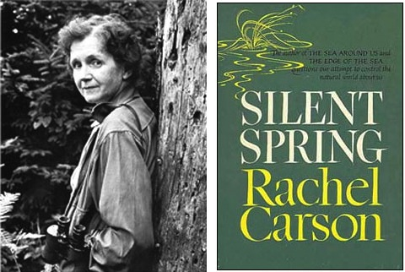
History
1962: Silent Spring published
1967: the term “IPM” first used
Notes:
In 1962, a marine biologist named Rachel Carson published the book Silent Spring, which raised concerns among the American public about environmental issues arising from the use of synthetic pesticides. A result of Silent Spring was a nationwide ban on DDT use on December 31, 1972, and an indirect result was the establishment of the U.S. Environmental Protection Agency. Rachel Carson was a true environmentalist, but never called for the complete banning of pesticides, only that they be tested to ensure they could be used safely and with full consideration of lower-risk alternatives.
In 1967, the term “Integrated Pest Management (IPM)” was first used. Rapidly, the concept became popular to describe making informed management decisions based on a thorough understanding of the factors that affect the pest or pests involved.

Slide 8
History
1970: the United States Environmental Protection Agency (EPA) was founded
1993: call for 75% of U.S. crop acreage grown under IPM principles (by 2000)
Notes:
In 1970, the U.S. Environmental Protection Agency was founded. This agency oversees the registration of pesticide formulations, and has an enforcement arm to implement the Fungicide, Insecticide, and Rodenticide Act (as amended) and other protections involving environmental contamination of air, water, and land.
In 1979, the Iowa State University Integrated Pest Management program was founded. Land Grant Universities were granted funds to provide education to citizens to promote environmental and economic information involved in farm and home pest management situations.
In 1993, Vice President Al Gore formally announced a call that by the year 2000, 75% of U.S. crop acreage be grown under IPM principles. The first thought about that is how we define what an acre grown under IPM principles would be. IPM is a broadly defined concept, and to quantify to that level is exceedingly difficult. But the biggest part of Vice President Gore’s call to action was a public acknowledgement of the need for wise stewardship in agriculture, and to encourage people toward better management methods.

Slide 9
History
1996: Roundup-ready® soybeans introduced in the U.S. By 2005, 87% of commercial U.S. soybean acres were Roundup-ready® varieties
In 1998 Roundup-ready® corn introduced in the U.S.
2000s: U.S. farmers now apply over 1.2 billion pounds of pesticides annually
Today: with increasing knowledge of pests, crops, and improving technologies, field-specific management is possible
Notes:
In 1996, Roundup-ready® soybeans were introduced in the U.S. Roundup-ready® crops are developed transgenically, which means that genes carrying the trait that makes a plant able to tolerate glyphosate (the active ingredient of Roundup herbicide) is plucked from one species and then manually placed in the genetic material of the soybean (or other crop). Such transgenic or Genetically Manipulated Organisms (GMOs) are quite controversial because a plant is produced that is partially manufactured—not naturally occurring. By 2005, 87% of commercial U.S. soybean acres were planted to Roundup-ready® varieties.
In 1998, a similar transgenic process brought commercially available Roundup-ready® corn to the U.S.
By the 2000s, U.S. farmers apply over 1.2 billion pounds of pesticides annually. So, with increasing knowledge of pests, crops, and improving technologies, field-specific management is possible. Though each farmer and each agronomist are covering more acres, we have increasing ways of focusing on fields and parts of fields to better hone application of management practices.

Slide 10
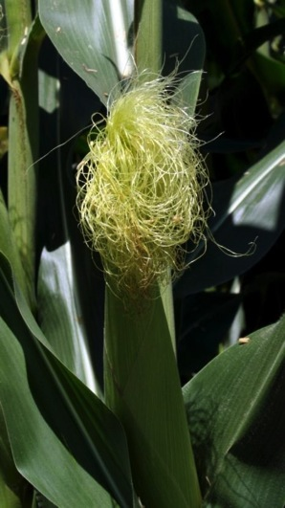
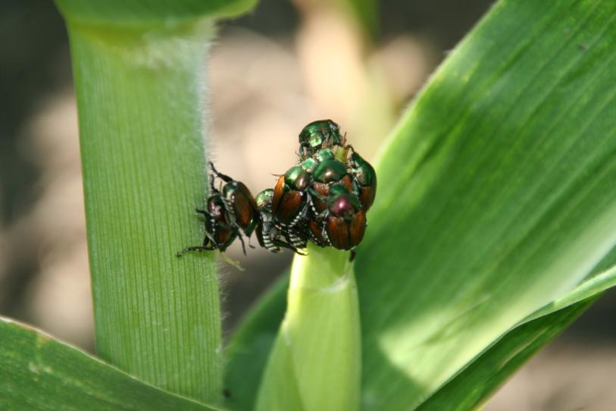
IPM
What is “normal?”
- Is it really a problem?
Notes:
Now let’s turn to how IPM is applied to a crop. The first question that needs to be answered is, “Is it normal?” Sometimes what appears to be a symptom is really just non-pest related expressions of plant genetics or responses to environmental conditions. So the first thing to ask is if what you see is normal.
[Left: Japanese beetles on a corn silk. Right: A healthy corn silk.]

Slide 11
IPM
2. What is the problem?
Proper identification is critical; that is why it is the first step.
3. How and what does the pest attack?
Only the plant of interest affected?
Parts of plant affected?
Patterns in field?
Kogan 1998
Notes:
Once you determine that something is abnormal, the first step is to figure out what the problem is. If you identify the problem correctly, you can learn how it develops and when the best type of controls can be applied. Three resources are provided for your use from ISU Extension and Outreach. These are the Corn Field Guide, the Soybean Field Guide 2nd Edition, and the Weed Identification Field Guide, all in hard copy. Copies of ISU Extension and Outreach Field Guides are available at the ISU extension online store at http://www.extension.iastate.edu/store/.
Part of that identification process is to know how and what the pest attacks. That lets us focus on the parts of the plant that are affected and to look for distinctive patterns in the field that help us assess the issue.

Slide 12
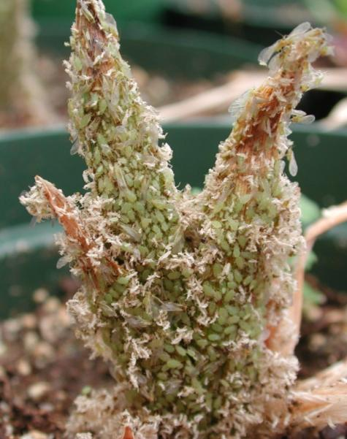
IPM
4. How many pests are there?
Is it too early or too late to control?
Management must be at the correct time to maximize effectiveness.
Daylily plants with aphids
5. Determine an action threshold
How many pests are too many?
Economic, health, and aesthetic threshold
Kogan 1998
Notes:
The next question is how many pests are there? Often, researchers have discovered what pest levels are critical to cause damage, and when that damage occurs, so that management practices can be applied at the best time to have the most effect.
These critical levels for treatment decisions are referred to as action thresholds. The most common type of action threshold is based on economic return and is called an economic threshold. Other action triggers like health, aesthetic, or legal thresholds may be considerations.

Slide 13
IPM
6. Choose appropriate management tactics
For many pests, there are several management options to consider.
7. Review your work:
Was the management effective?
Did actions do what you wanted?
Was the method itself satisfactory?
Were there any unintended side effects?
What will be done in the future for this pest situation?
Kogan 1998
Notes:
So now you have decided something needs to be done (reached an economic or other threshold). For many pests, there are several control options that can be used. These management options will be covered in the other modules.
One key point is that whatever management technique you use, go back and check that it did what you hoped it would, and if there was anything that happened that you could learn from for the future. Was the method satisfactory, were there any unintended side effects, and what would you do in the future for the pest on that crop?

Slide 14
Three important components
Economic injury level
Lowest population density that will cause economic damage
Economic threshold
Population size large enough to trigger an action to prevent an increasing pest population from reaching the economic injury level
General equilibrium position
Average density of a population over time
Stern et al. 1959
Notes:
Three important components to making informed pest management decisions involve the number of pests present:
Economic injury levels – this is a research-based population level of a pest that represents the smallest pest population that will cause economic damage (that is where the costs to treat are covered by the resultant yield and quality saving from making the treatment).
Economic threshold – this is the population of a pest that is large enough to trigger a treatment response to avoid the population reaching the economic injury level. This allows time for a decision to be made and the product to be applied at or before economic injury levels are reached.
General equilibrium position – this is the average density of a population over time. It is useful to help in tracking peaks and crashes of a given pest population.

Slide 15
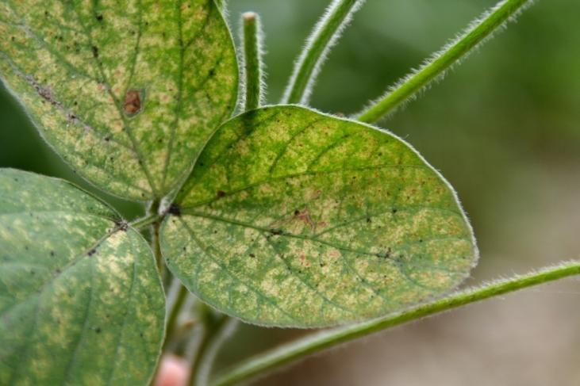
Costs vs. Benefits of a Practice
Costs
Product cost
Fuel
Labor
Marketing options
May increase crop damage from secondary pests
Spider mite damage to soybean
Notes:
Any management practice has costs and benefits. Management decisions should constantly balance between the costs and benefits of implementing a practice. Think about these before using the practice, and reexamine the costs and benefits as a follow-up. Examples of costs that are associated with a pest management tactic include:
Product cost (for example, a pesticide)
Fuel (to operate spray, tillage, etc. equipment)
Labor (to operate the equipment)
Marketing options (restrictions on foreign markets [transgenic varieties, etc.], pre-harvest intervals, grazing restrictions, etc.)
Increased damage from secondary pests: sometimes misapplied pesticides can knock out beneficial organisms before the targeted pest is at a treatable level. The result can be an increase in target pest populations relative to non-treatment. Another example of this is in adverse conditions, use of some pyrethroid insecticides to control one insect pest can “release” spider mite populations to cause significant problems.

Slide 16
Costs vs. Benefits of a Practice
Costs
Product cost
Fuel
Labor
Marketing options
Predisposition to secondary pests
Benefits
Yield (economic)
Quality (economic)
Appearance (aesthetics)
Human/livestock health
Legal issues
Acceptance of resultant commodity by end users
Ease of mind
Notes:
The benefits of a management practice include:
Increased or protected yield, which directly produces economic benefit.
Quality of commodity, which can either include a more valuable commodity per unit or have other benefits such as improved storage characteristics, more ease in handling, or other related attributes.
Appearance (closely related to quality): either the commodity itself or the fields in which it is grown look better.
Human and livestock health: prevention of toxins in a grain for use in human food or animal feeds. Health concerns might also relate to control of weeds, insects, or diseases that can directly harm people or livestock. For example, some weeds (wild parsnip or poison ivy) at field edges or that might otherwise be hazardous.
Legal issues: including restrictions on crop choices or land uses to meet state or Federal crop program restrictions, or could be the presence of regulated pests (noxious weeds, quarantined organisms, etc.)
Acceptance of the resultant commodity by end users: In other words, economic value of a crop may depend partially on what the end user of the crop desires. This also may apply to market restrictions from growing non-transgenic, certified organic, or other “specialty” products.
Ease of mind: A huge factor in many pest management decisions—rightly or wrongly—is getting a decision made and being done with it. This also includes situations where decisions are based on “what we have always done” and “the neighbors are spraying, so we better!” Once the decision to treat is made—especially if there is no follow up on its effect—there is a peace of mind developed.

Slide 17
What has changed in agriculture?
Fewer farm operators, yet the same acreage
Fewer ag retailers, yet the same acreage
Increased decision-making by someone other than the grower or pesticide applicator
Rapidly emerging crop alternatives and demands (biofuels, special-purpose crops)
Increased community and regulatory pressure
Increased options (products/formulations)
Greater concern about product availability and future costs
Notes:
What has changed in agriculture during the last 30 to 50 years?
We are still farming roughly the same acreage, but with many fewer farm operators (see the graph on the next slide).
Likewise, there are fewer agricultural retailers serving the same acreage.
As acreages increase and technology has gotten more complex, actual decisions are increasingly being made by someone other than the grower or pesticide applicator.
New crop alternatives are emerging rapidly, each adding to the complexity of decision making (Examples: biofuels and how to grow, manage, and market them and other special-purpose crops like food-grade soybeans, vineyards, etc.).
The non-farm public has greatly increased their interest with environmental concerns. This is especially an issue with insecticide and fungicide treatments applied by airplane or helicopter, which are visible for miles around. Another major concern is when synthetic pesticide residues are discovered in surface and groundwater resources, and also when elevated nutrient levels, presumably from field applications, are discovered.
Compared with 30 years ago, there are many more products that are formulated in different ways for different uses available. Managing the information for this plethora of materials is daunting.
Sometimes there are fears of future access to known effective products for pest control. This supply fear can complicate purchase and storage decisions.

Slide 18
Average Age of NE Farmers
Source: UNL Ag Economics, 2014

Slide 19
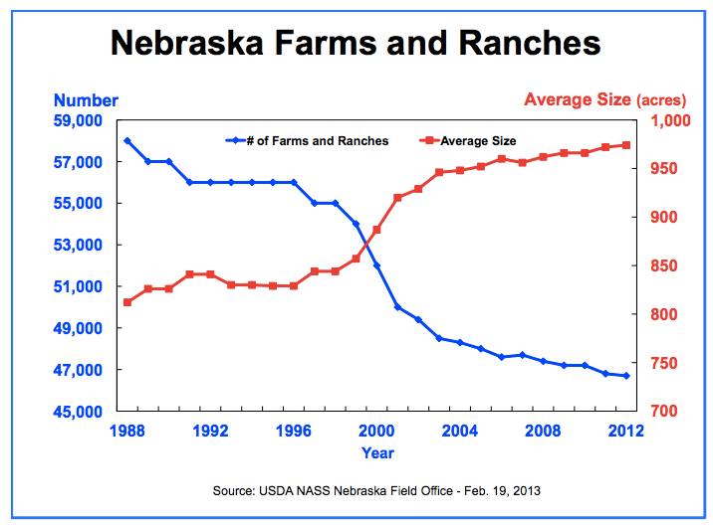
Number & Size of Farms

Slide 20
What hasn’t changed?
Ultimate goal of IPM: Increase responsible pesticide use.
Don’t apply when it isn’t needed
Apply effectively when it is needed
Weigh and apply alternative treatments wisely
Know what happened afterward
Notes:
With all that has changed, let’s now consider what HASN’T changed appreciably. Remember that one ultimate goal of IPM is to increase responsible pesticide use (by either better targeted use or by limiting use to only when needed). Steps to better use of pesticides include:
Not applying when pesticide isn’t needed.
When a pesticide is needed, apply it effectively.
Consider (weigh the decision) carefully and choose alternative treatments wisely.
Follow up and know what happened after the application is made.

Slide 21
What hasn’t changed?
Economics is important, and always will be
Farming success is based on making a profit, and if you don’t, your operation isn’t sustainable.
Habits of growers and applicators
Change is difficult and scary.
Even inefficient practices can be comfortable – we know how they work!
Notes:
What hasn’t changed in the last 30 to 50 years?
Economics will ALWAYS remain important. Farming success is driven by economic returns, and if an operation fails in making profits, the operator will be lost from the land.
Change is difficult for us all. Doing something (either a new practice or deciding NOT to treat) can be frightening. Remember that even inefficient decisions can be comfortable because we are used to the results (or maybe don’t see the results).

Slide 22
What hasn’t changed?
Knowledge gaps: may have changed but they still exist—and always will
Example: Does spraying a fungicide on corn that has no disease symptoms produce an economic benefit?
Notes:
There have always been gaps in knowledge; that is the nature of farming. We will never know everything. So take steps to learn every chance you can, especially learning from others that had to make similar decisions.

Slide 23
What hasn’t changed?
Knowledge gaps: may have changed but they still exist—and always will
Yield saved by management isn’t known—you don’t know what you prevented happening!
Leaving check strips to test management effectiveness answers questions.
Observing effects if you don’t have test strips also can answer questions.
Notes:
More of what hasn’t changed and knowledge gaps: growers can conduct their own research.
Check strips (untreated areas if a product is used) can help assess if the treatment worked as you had planned, or more importantly if it didn’t work as planned. From that you can make better decisions in the coming years.
Without test strips, you can still observe closely what happened and that itself can answer questions. Did pest populations subside? Did the crop respond well? Were there phytotoxic effects (damage to the crop plants from the treatment)?

Slide 24
What hasn’t changed?
Knowledge gaps: may have changed but they still exist—and always will
Trust and relevance of “information sources”
What makes a good advisor good?
Can you believe everything you hear equally?
Are there ethical concerns?
Just because it is in print doesn’t make it correct.
Notes:
More of what hasn’t changed and knowledge gaps: information sources. In the past few decades, we can access many different sources of information, but that can present a problem or two.
What makes good information good?
Can you believe everything you read/see/hear equally? (the answer is no…)
What ethical issues might be contained in a source of information?
This is all summed up as “If it is in print (or radio or TV or word-of-mouth), it is not guaranteed to be correct.

Slide 25
Summary
Several factors drive decision-making on farms
⇨ Habits ⇨ Aesthetics (looks)
⇨ Experience ⇨ Peer pressure
⇨ Fears ⇨ Time
⇨ Environment ⇨ Economics
⇨ Access to information
By identifying and learning about a pest, more focus can be applied to the environmental and economic considerations
Notes:
So, what is your role in the future of Integrated Pest Management?
The next slide sets will highlight scouting, crop development, pests and pest management, and pesticide related concepts.
All images © ISU, except where noted.
Thanks to ISU Extension and Outreach and North Central IPM Center for financial support.

