Slide 1
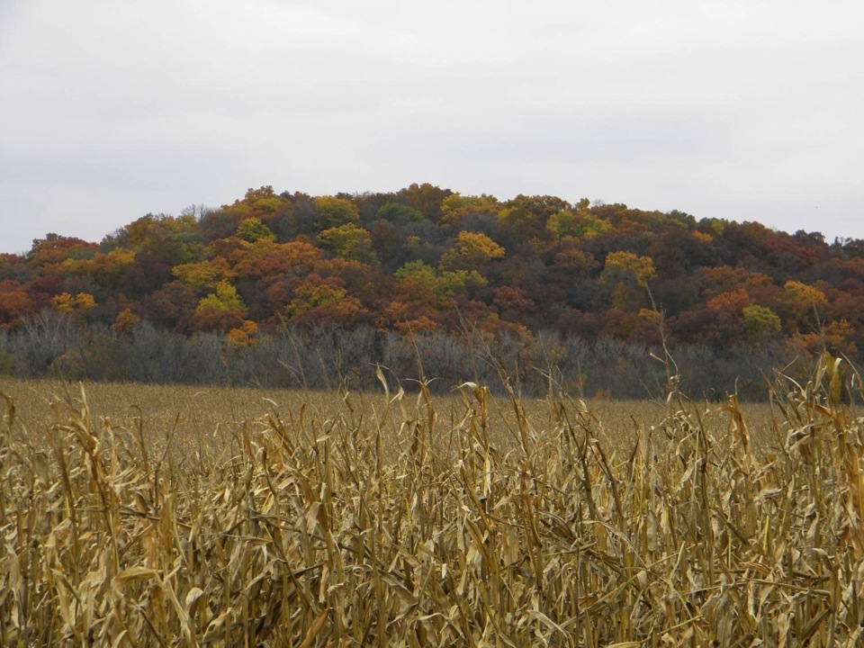
Environmental Degradation and Pesticides
Notes:
In the previous presentation on Human Health and Pesticides, we discussed some of the negative consequences associated with pesticide use. In this presentation we will focus on environmental degradation associated with pesticide use.
In reality, it may be hard to separate the negative impacts on human beings and the degradation of our environment due to pesticide use. This is because we must live, work, and play within the surrounding environment. Negative impacts that occur to the water and air may also have troublesome consequences for people and animals that utilize those resources for their livelihood.

Slide 2
Outline
Importance of our environment
What is environmental degradation?
Water
Air
Harm or loss of beneficial insects
Conclusions
Notes:
Today we will talk about the importance of our environment: what it is and how do we use it.
This will help us understand why a degraded environment can be harmful as we discuss environmental degradation to water and air and harm or loss of non-target species of animals.

Slide 3
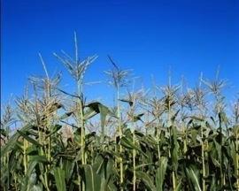
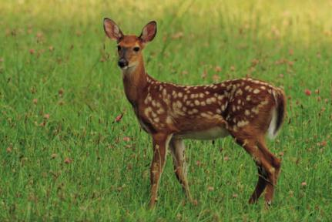
Importance of our environment
This is were we live, work, and play
Provides resources for
Food and fuel production
Water supplies
Recreational activities
Other creatures live here
Nebraska has laws in place to protect the environment from careless and damaging activities
We should seek to protect the place we live regardless of whether or not it is the law
Notes:
Our environment is very important. Is sustains our lives! We build our houses or rent apartments here, we travel to and attend jobs and school here, we fish, hunt, hike, and enjoy in many other ways the areas in which we live. Our environment is full of valuable resources.
We depend on the soil and other natural resources to produce food and fuel, not only for ourselves, but for many other people as well.
We drink the water and rely on rain for watering field crops.
We take pleasure in and benefit from recreational activities and the beauty provided by our surroundings.
And also, other creatures live here besides us. Eagles, hawks, bluegill, deer, cats, dogs, bees, and many other animals use the same resources we do in order to survive.
In fact, the government of Nebraska has laws in place to help protect the environment from careless and damaging activities. However, we should seek to protect the place we live regardless of whether or not it is the law.

Slide 4
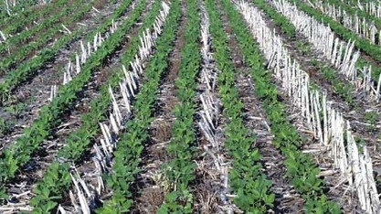
Environmental benefits of pesticides
Preserve habitat by increasing crop production on farm land
Manage erosion by enabling no-till
Manage invasive pest organisms
Data from: Whitford, F., Pike, D., Hanger, G., Burroughs, F., Johnson, B., and Blessing, A. The Benefits of Pesticides A Story Worth Telling. Purdue Extension. PPP-70. Purdue University.
Notes:
The benefits to using pesticides go beyond merely killing insects, fungi, weeds, and other organisms in corn and soybean fields.
The use of pesticides allows preservation of existing wildlife habitat by increasing crop production on farm land. Less land can be utilized for growing crops because use of the land already in production can be maximized. Crops are protected from pests that would otherwise lower per acre yield.
The practice of no-till is beneficial for soil. Crop residue left on the soil surface protects the soil from erosion caused by water run-off. However, some disease causing organisms survive the winter in crop residue. A crop grown the next season may be exposed to disease that has survived the winter in the previous season’s plant tissue. Tillage buries the infested residue in the soil, increasing decomposition of the plant tissue and making it less likely that disease causing organisms will survive. The use of pesticides enables growers to leave crop residue on the soil surface to protect it from erosion and also manage diseases that may be more problematic when crop residue is left on the surface.
Some pests can move into areas where they did not exist previously. These organisms are called invasive, since they “invade,” or move into a region that they would not normally exist in. It can be beneficial to slow the movement of invasive organisms from one area to another in order to protect the area where the pest does not currently reside. Pesticides help to manage the spread of invasive organisms from one area to another by slowing movement of the pest, thus protecting the new area.

Slide 5
What is environmental degradation?
Degradation occurs when a part of the environment in which we live is damaged or polluted in some way.
Pesticides can contaminate water sources, the air we breathe, and harm animals such as bees that are beneficial to human beings.
Contamination can make resources less usable or even dangerous to use.
Notes:
Degradation occurs when a component of the environment in which we live is damaged or polluted in some way. Pesticides can cause chemical pollution and may contaminate water sources, the air we breathe, and harm animals such as bees that are beneficial to human beings.
Contamination can make resources less usable or even dangerous to use.

Slide 6
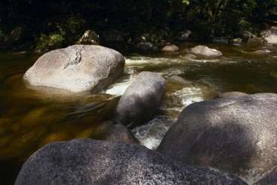
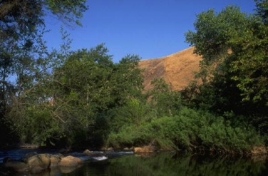
Water
People depend on water for drinking, growing food, transportation, recreation, etc.
Ground water and surface water can both be contaminated by pesticides
Data from: Iowa Water Pollution. Iowa Environmental Issues Series. Iowa Association of Naturalists. IAN-103. 1998.
Notes:
In many places of the world, water is a scarce resource. People must carry it long distances in order to meet their daily needs. It may need to be brought in using irrigation in order to grow food in some places in the world. People depend on it not only for drinking and producing food but also for bathing, transportation, fishing, industrial processes, and other uses. Without water, we would die within a few days. Water is essential to life and that is why it is important to protect it as a natural resource in our environment.
In the previous slide-set, we learned that chlorine is beneficial when used to manage bacteria in our water supply. However, other pesticides can contaminate our water supply and these chemicals are not intended for human consumption.
Both ground water and surface water have been found to contain pesticides or parts of pesticides. Ground water is water that is located beneath the soil surface; wells are drilled into this underground water supply and rural Iowan’s use it for drinking and other activities. Surface water consists of lakes, rivers, and ponds. The ways in which pesticides pollute these types of water differ.

Slide 7
Ground Water
Pollution occurs from
Pesticides leaching through soil
Old wells
Agricultural drainage wells
Explore other options of pest management before using pesticides
Data from: Iowa Water Pollution. Iowa Environmental Issues Series. Iowa Association of Naturalists. IAN-103. 1998.
Notes:
There are large sources of underground water referred to as ground water, or aquifers.
Ground water can be polluted in several ways. Pesticides can reach ground water by leaching, or travelling downwards in soil. Pesticides may run off into old wells which extend down into the ground water supply. Agricultural drainage wells are a specific kind of well used to make wet land suitable for farming and these can provide a way for pesticides to reach ground water supplies.
This type of pollution can be prevented by exploring other options of pest management before using pesticides.

Slide 8
Surface Water
Polluted by
Drift and nearby pesticide sprays
Rain washing pesticides into waterways
Contamination prevented by limiting pesticide use and following label directions
Data from: Iowa Water Pollution. Iowa Environmental Issues Series. Iowa Association of Naturalists. IAN-103. 1998.
Notes:
Surface water can be polluted by pesticide drift and nearby sprays which end up in the water. Rain may also cause pesticides to travel from a location into surface water. Crop fields may be a source of this contamination.
Limiting pesticide use is a great way to prevent surface water contamination. There can be alternative methods of achieving pest management which should be fully explored before using chemical control.
Also, be sure to follow application instructions found on the label of the pesticide.

Slide 9
Air
Pesticide drift occurs when pesticides are windblown from the target area.
Particle and vapor are two kinds of pesticide drift.
Volatile organic compounds result from some pesticides that can react with other compounds and form ozone.
Data from: Wixted, D., Boerboom, C., Alexander, M., and Pringnitz, B. Managing Pesticide Drift in Iowa: Field Sprayers. PAT 37. November 1999.
Notes:
Pesticides can be moved through the air in a process called drift. Drift occurs when pesticides are windblown from the target area of application. We will discuss two kinds of pesticide drift known as particle and vapor drift on the next slide.
Pesticides can also break down into “daughter” chemicals called volatile organic compounds. These compounds can react with other chemicals to form a pollutant called ozone. Pesticide use leads to an estimated 6% of the total ozone production.

Slide 10
Particle and vapor drift
Particle drift occurs when a pesticide moves through the air as droplets during application.
Vapor drift occurs when applied pesticides volatize, or turn into fumes and move through the air.
Can harm other plants, injure people or animals, and pollute surface water
Follow label, apply during suitable weather, and use appropriate sprayer settings
Data from: Wixted, D., Boerboom, C., Alexander, M., and Pringnitz, B. Managing Pesticide Drift in Iowa: Field Sprayers. PAT 37. November 1999.
Notes:
Particle drift occurs when a pesticide moves through the air as droplets during the actual application of the pesticide. Larger spray droplets are less likely to drift from the target site.
Vapor drift occurs when applied pesticides volatize, or turn into fumes and move through the air. High temperatures cause volatility to be more of a problem. Certain pesticides are more likely to volatize than others. These include pesticides with 2,4-D esters, clomazone, or dicamba.
Particle and vapor drift can cause harm to other plants, injure people or animals, and, as we discussed earlier, pollute surface water. To minimize drift, follow the included pesticide label, apply pesticides only during suitable weather conditions and only when needed, use the appropriate sprayer settings, and only spray after other options have been explored.

Slide 11
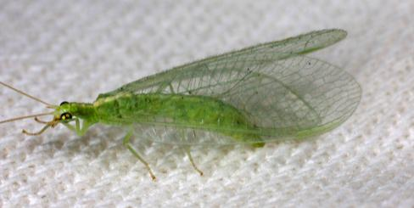
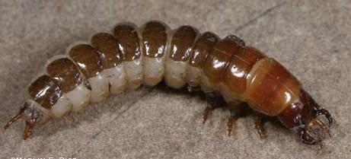
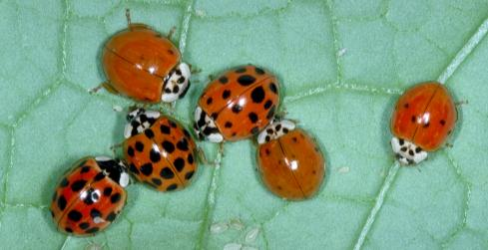
Beneficial insects
Beneficial insects are helpful insects!
They eat pest insects and can pollinate fruits and other plants (honey bees).
Beneficial insects can be harmed by insecticides and be killed along with the pests.
© Marlin E. Rice
© Marlin E. Rice
© Marlin E. Rice
Notes:
There are good insects, known as beneficial insects, that are working to keep pest insect populations under control. These insects eat pests and can pollinate fruits and other plants.
For more about beneficial insects see pages 48-50 in the Soybean Field Guide 2nd Edition and pages 59 and 60 in the Corn Field Guide.
Insecticides can harm these beneficial insects. Sometimes beneficial insects are controlled better than the pests and pest populations may become worse because of the insecticide application.
The beneficial species on this slide are [From top: a green lacewing adult (insect predator as a larva; page 50, Soybean Field Guide 2nd Edition and page 60, Corn Field Guide), a ground beetle larva (predator), and multicolored Asian ladybeetles (insect predator that can become a problem when it aggregates in and around homes for overwintering; page 49, Soybean Field Guide 2nd Edition and page 59, Corn Field Guide).]

Slide 12
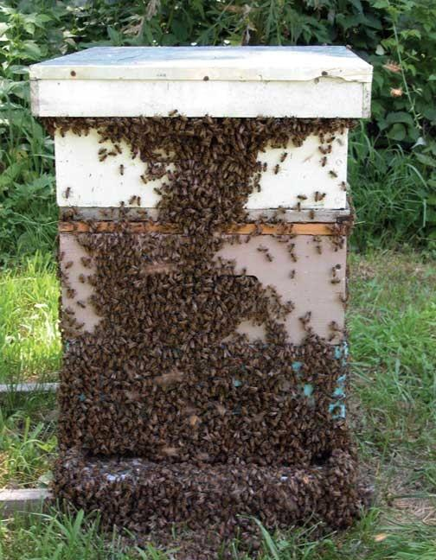
Honey bees
Honey bees pollinate many kinds of plants and produce honey.
Pesticides can harm bee colonies.
Approximately 1 million colonies per year in the U.S. are damaged or killed.
Laws are being passed that protects bees from harmful pesticides.
© Marlin E. Rice
Data from: Bohmont, Bert, L. The Standard Pesticide User’s Guide. Sixth Edition. Prentice Hall. 2003.
Notes:
Bees are a beneficial insect because they pollinate many kinds of plants and produce honey.
Pesticides can harm bee colonies. Approximately 1 million colonies per year in the United States sustain damaged or are killed.
Iowa has a law that protects bees from certain harmful pesticides. Pesticides labeled as being poisonous to bees cannot be sprayed from 8am to 6pm within a mile from a registered apiary (where bees live). Registered apiaries can be found on the Iowa Department of Agriculture and Land Stewardship Pesticide Bureau webpage at http://www.agriculture.state.ia.us/pesticides.asp.
[Honey bee hive (bees are pollinators and honey producers)]

Slide 13



Conclusions
Pesticides are an important tool in modern agriculture.
Consider how pesticides could harm the environment before you apply them.
Follow the label for correct application methods.
Consider alternative management options.
Be safe and watch out for the safety of people, animals, and the place where you live.
Notes:
In conclusion, we have learned that pesticides are an important tool in modern agriculture, but the risks and benefits of using pesticides must be considered before an application takes place. While economics may drive many pesticide use decisions, the environment must also be considered.
Since we know that there are dangers associated with pesticide use, caution must be taken when using. This includes during mixing, application, clean-up, etc.
Safe practices are outlined on the label that comes with each and every pesticide. Follow the label for correct and safe application.
Consider alternative management options for pests if available.
Be safe and watch out for the wellbeing of the environment, animals, and other people when using pesticides!
Thanks to ISU Extension and Outreach and North Central IPM Center for financial support.

