Slide 1
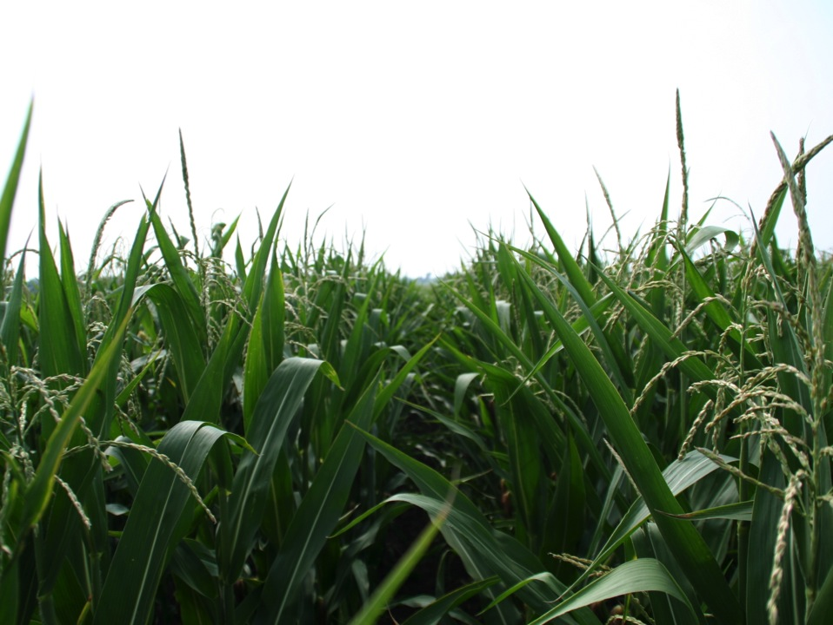
Corn Growth and Development
Notes:
These slides explain how a corn plant develops during the season and potential stresses at different growth stages that can contribute to crop yield loss.
Insects, diseases, weeds, and other disorders are most likely to be more problematic during certain stages of a corn plant’s development. Because of this, understanding the growth stage of a plant aids the producer, agronomist, or crop scout in efficiently and effectively scouting their fields.

Slide 2
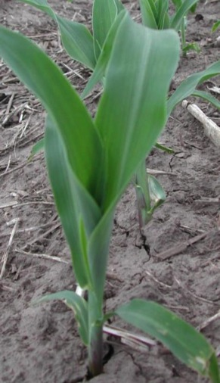
Outline
Stress and yield loss
Growth staging
Vegetative stages
Reproductive stages
Conclusions
Notes:
We will begin by discussing a little bit about stress and crop yield loss, followed by growth staging, or determining how developed, a corn plant and a corn field are.
Then we will go over the vegetative and reproductive stages of development and conclude the presentation.

Slide 3
Stress and crop yield loss
At each growth stage of corn, certain aspects of management must be considered.
Each stage has its own problems which may interfere with growth at that stage.
Problems include adverse soil conditions, weeds, insects, diseases, and other disorders.
Problems that occur early in the season may contribute to the yield loss experienced at the end of the season during harvest.
We will examine problems for the stages of corn throughout the growing season.
Notes:
At each growth stage of corn, certain aspects of management must be considered as each stage has its own problems which may interfere with growth at that stage. These problems include adverse soil conditions, weeds, insects, diseases, and other disorders. Problems that occur early in the season may contribute to the yield loss experienced at the end of the season during harvest.
As we explore the different growth stages, we will examine various problems of corn throughout the growing season.

Slide 4
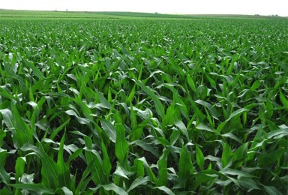
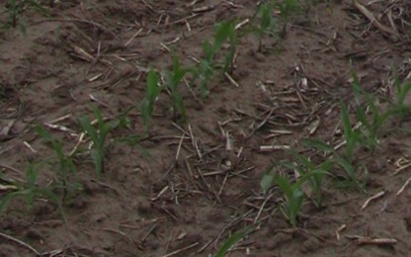
Growth staging
Growth stages may overlap in a field
A growth stage for a field begins when at least 50 percent of the plants have reached or are beyond a certain stage.
The Corn Field Guide provides scouting information by growth stage for many diseases and insects of corn.
Notes:
Firstly, it is important to know how to determine the growth stage for a corn field (page 4-5, Corn Field Guide). Growth stages may overlap within a field and because of this, a growth stage for a field begins when at least 50 percent or more of the plants within that field have reached or are beyond a particular stage.
The Corn Field Guide provides scouting information by growth stage for many diseases and insects (beginning page 28). This makes it useful to know the growth stage of a field so you know what will most likely be problematic during those periods of development.

Slide 5
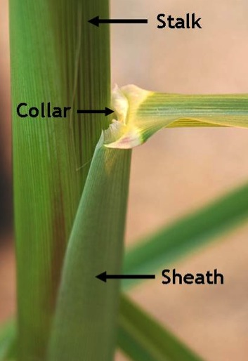
Determining growth staging
Leaf collar method
  The collar is where the leaf blade visually breaks away from the sheath and the stalk
  The number of visible collars = vegetative growth stage (V stages)
Notes:
In order to determine the growth stage of corn, many people use the leaf collar method (page 6, Corn Field Guide). The collar is where the leaf blade visually breaks away from the sheath and the stalk of the corn plant, visible here. Vegetative growth stages are based upon the number of visible leaf collars. So the number of visible leaf collars is equal to vegetative growth stage (V stages).

Slide 6
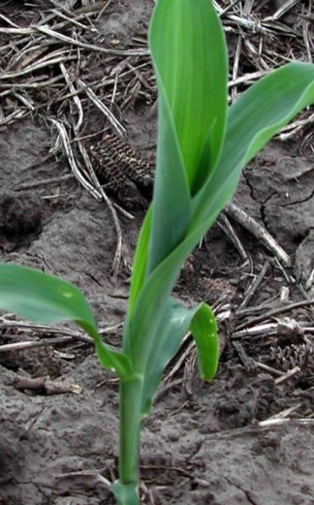
Determining growth staging
Leaf collar method
  Leaves still in the whorl – DO NOT count these leaves
  Leaves with a visible collar – COUNT these leaves
Notes:
Be sure to count only the leaves with visible colors as shown. Leaves with collars still in the whorl are not counted when determining vegetative growth stage. This corn plant is at the V2 growth stage.

Slide 7
Vegetative stages
Vegetative Stages
- VE: Shoot emerges from soil
- V1: Collar is visible on lowest leaf
- V2: Collar is visible on two lowest leaves
- V(n): Each successive collar visible
- VT: Lowest branch of tassel visible, before silks
Notes:
There are several vegetative stages of corn. We will discuss some of the features of those stages and examine some of the problems to look out for during the different stages on the next slides.

Slide 8
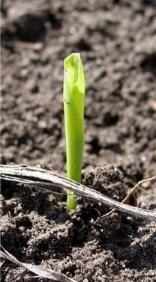
VE - Emergence
VE: When the young shoot pushes through the soil surface
Problems to watch for:
  Early and late planting
  Flooding, soil crusting
  Root rots
  Seed decay and seedling blight
  Seed corn maggot, white grubs, wireworms
  Stewart’s disease, Goss’s wilt
  Cutworms, slugs, billbugs, etc.
VE
Notes:
VE, or emergence, is when the young shoot pushes through the soil surface. Emergence occurs within 4-5 days after planting in optimum conditions and up to 14 days in cool or dry conditions.
Problems to watch for:
Early and late planting (page 10, Corn Field Guide)
Flooding, soil crusting (pages 74 and 73, Corn Field Guide)
Root rots (page 42, Corn Field Guide)
Seed decay and seedling blight (page 42, Corn Field Guide)
Seed corn maggot, white grubs, wireworms (pages 46 and 47, Corn Field Guide)
Stewart’s disease, Goss’s wilt (page 33, Corn Field Guide)
Cutworms, slugs, billbugs, etc. (pages 48-51, Corn Field Guide)

Slide 9
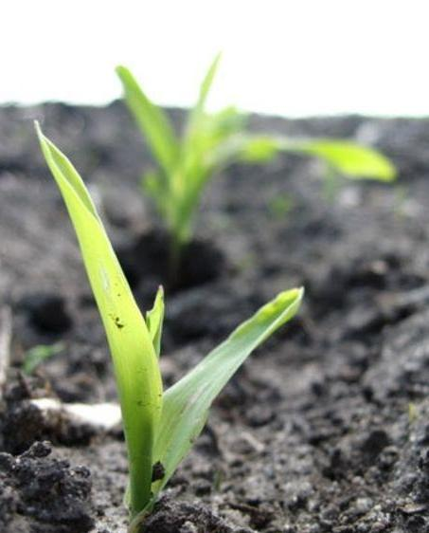
V1 to V5
First leaf has a rounded tip
All other leaves have pointed tips
The growing point is below ground
Between V1 and VT, a new leaf (growth stage) occurs every 4-5 days in May, 3-4 days in June, and 2-3 days in July
V1
Notes:
The first leaf of the corn plant has a rounded tip which is useful for identification. Subsequent leaves have pointed tips. Remember, a new growth stage is reached for each new leaf that has a collar.
Location of the growing point is important early in the season. Until V6, it is still underground, and so is fairly well protected and is able to recover and continue growth after frost and hail damage.
Between V1 and VT, 1 new leaf (growth stage) occurs every 4-5 days in May, every 3-4 days in June, and every 2-3 days in July.

Slide 10
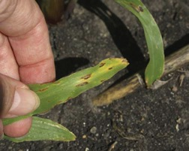
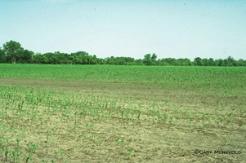
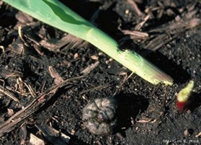
V1 to V5
Problems to watch for:
  Flooding
  Stewart’s disease, Goss’s wilt, Anthracnose leaf spot
  Root rots, seedling blight
  Cutworms, slugs, billbugs, etc.
  Herbicide injury
  Weed escapes and excess weed competition
© Marlin E. Rice
Notes:
Problems to watch for:
Flooding (page 74, Corn Field Guide)
Stewart’s disease, Goss’s wilt, Anthracnose leaf spot (pages 33 and 28, Corn Field Guide)
Root rots, seedling blight (page 42, Corn Field Guide)
Cutworms, slugs, billbugs, etc. (pages 48-51, Corn Field Guide)
Herbicide injury (pages 62-66, Corn Field Guide)
Weed escapes and competition (See Weed Identification Field Guide)
[From left: Anthracnose leaf spot, damage from seedling disease, and black cutworm damage]

Slide 11
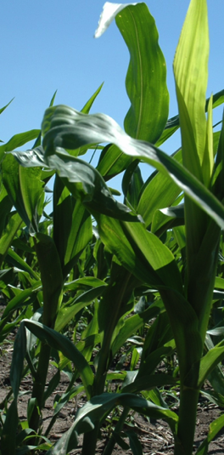
V6
V6 is one of the key stages for development
  Growing point is above the soil surface
  All leaves, ear shoots (approx. 8), and tassel are fully formed
  Ear girth - number of rows around the ear is also determined
Problems to watch for during V6:
  Eyespot, common smut, Stewart’s wilt
  Stalk borer
  Nutrient deficiencies
Notes:
V6 is one of the key stages for development. At this point, there are six leaves with visible collars.
At V6, the growing point is above ground. Ear shoots (approximately 8) and tassel are initiated, but you need to dissect the plant and use a microscope to see them. The potential row number (ear girth) is determined shortly after and is influenced by genetics, but can be reduced by severe stress.
Problems to watch for during V6:
Eyespot, common smut, Stewart’s wilt (pages 31, 34, and 33, Corn Field Guide)
Stalk borer (page 52, Corn Field Guide)
Nutrient deficiencies (pages 67-69, Corn Field Guide)

Slide 12
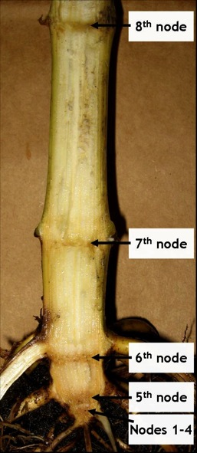
V10+
Stalks need to be split to stage
  Need a larger knife & spade
  Each leaf is attached to a specific node
  Need to line up which leaf goes to which node on the stalk
  Split lower stalk lengthwise to determine uppermost leaf node
  Approximately < ¼ inch above the condensed area is the 5th node
  First four nodes cannot be distinguished from one another
  This method required until VT
Notes:
At V10+, staging becomes difficult because the lower leaves start to fall off the plant. In order to determine the stage, stalks need to be split.
For staging at this point:
You need a large knife and a spade
Each leaf is attached to a specific node
You will need to line up which leaf goes to which node on the stalk
Split lower stalk lengthwise to determine uppermost leaf node
Approximately < ¼ inch above the condensed area at the bottom of stalk is the 5th node
First four nodes cannot be distinguished from one another - they are located at the base of the crown
This method will be required until VT

Slide 13
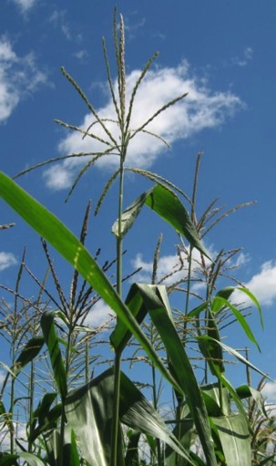
V10-VT
V10-VT
  In late June and early July new leaves appear every 2-3 days
  Hybrids & environment will cause variability in the total number of leaves
V12-VT
  Ear length - number of kernels per row - is determined over a wide range of time, from approx. V7 to V15/V16, and can be reduced by stress
  750 to 1000 ovules form per ear. Average kernel number at harvest is 475 to 550
Notes:
During V10-VT, in late June and early July, new leaves appear every 2-3 days. Hybrids & environment will cause variability in the total number of leaves.
The number of kernels per row is determined over a wide range of time, from approximately V7 to V15/V16. Ear length can be reduced by stress. There are 750 to 1000 ovules (kernels) that form per ear and the average kernel number per ear at harvest is 475 to 550.

Slide 14
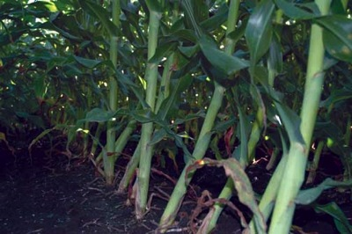
V10-VT
Problems to watch for:
  Eyespot, Physoderma brown spot, common rust
  Scout for nematodes
  Corn rootworm adults begin emerging
  Corn leaf aphid
  Root lodging
  Greensnap
  Nutrient deficiencies
  Grasshopper, armyworm
  Goss’s wilt
Notes:
Problems to watch for:
Eyespot, Physoderma brown spot, common rust (pages 31, 32, and 29, Corn Field Guide)
Scout for nematodes (page 43, Corn Field Guide)
Corn rootworm adults begin emerging (page 53, Corn Field Guide)
Corn leaf aphid (page 55, Corn Field Guide)
Root lodging (page 77, Corn Field Guide)
Greensnap (page 78, Corn Field Guide)
Nutrient deficiencies (pages 67-69, Corn Field Guide)
Grasshopper, armyworm (pages 54 and 52, Corn Field Guide)
Goss’s wilt (page 33, Corn Field Guide)
[root lodging of corn plants]

Slide 15
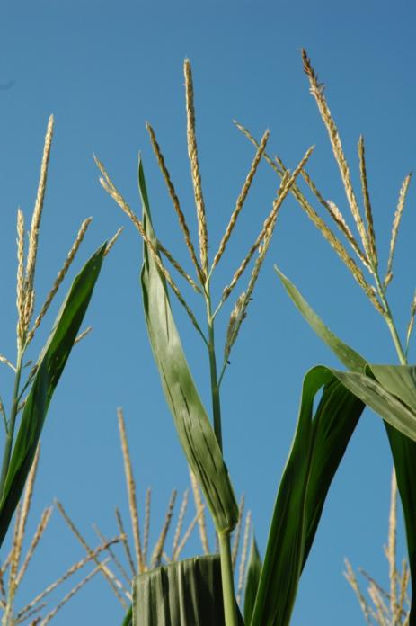
VT-Tasseling
Tasseling occurs when entire tassel is visible
Final vegetative stage
Occurs just prior to, or at the same time, as silking
The tassel produces pollen grains, shedding a half million per day per plant at the peak
Pollen shed for a field typically lasts for about a week
Notes:
At VT, or Tasseling, the entire tassel is visible. This is the final vegetative stage and occurs just prior to, or at the same time, as silking does.
The tassel produces pollen grains with more than half a million shed per plant per day at the peak. Pollen shed for a field typically lasts for about a week.

Slide 16
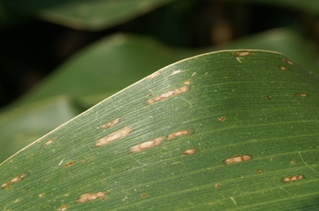
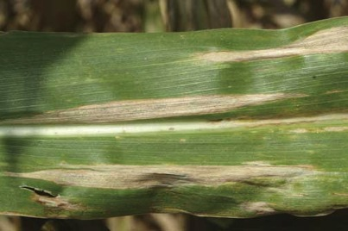
VT
Problems to watch for during VT include:
  Gray leaf spot, southern rust, northern leaf blight, and others
  Corn earworm egg mass scouting and other insects
  Corn rootworm damage to roots may really show now as lodging or nutrient deficiencies
  Silking/pollen shed synchronization problems from drought/heat
  Corn leaf aphids on tassel can throw off pollen shed
Notes:
Problems to watch for during VT include:
Gray leaf spot, southern rust, northern leaf blight (pages 28, 29, and 30, Corn Field Guide)
Corn earworm egg mass scouting (page 57, Corn Field Guide)
Corn rootworm damage to roots may really show now as lodging or nutrient deficiencies (pages 53, 77, and 67-69, Corn Field Guide)
Silking/pollen shed synchronization problems from drought/heat (page 75, Corn Field Guide)
Corn leaf aphids on tassel can throw off pollen shed (page 55, Corn Field Guide)
[gray leaf spot, northern leaf blight]

Slide 17
Reproductive stages
Staging is no longer based on the vegetative appearance of the plant
Focus only on the ear to stage the plant & field
Look at kernels in the middle of the ear
Six reproductive stages total (soybean has eight)
  Use number and names (Example: R1 = Silking)
Notes:
After VT, staging is no longer based on the vegetative appearance of the plant and instead focuses only on the ear to stage the plant and field. Look at kernels in the middle of the ear when determining reproductive developmental stages.
There are six reproductive stages total compared to eight in soybean.
Both number and names are used when referring to corn R stages. For example: R1 = Silking.

Slide 18
Reproductive stages
Reproductive Stages
  R1 (silk): Any silk becomes visible outside the husk leaves
  R2 (blister): Small, white kernels, and kernel fluid is clear
  R3 (milk): Yellow kernels, milky white fluid in kernel
  R4 (dough): Paste-like, or dough, kernel contents
  R5 (dent): Kernels dent on the top due to starch accumulation
  R6 (Physiological maturity): Physiological maturity with maximum dry matter accumulation. Black layer occurs after physiological maturity.
Notes:
These are the six reproductive (R) stages of corn:
R1 (silk): Any silk becomes visible outside the husk leaves
R2 (blister): Small, white kernels, and kernel fluid is clear
R3 (milk): Yellow kernels, milky white fluid in kernel
R4 (dough): Paste-like, or dough, kernel contents
R5 (dent): Kernels dent on the top due to starch accumulation
R6 (physiological maturity): Physiological maturity with maximum dry matter accumulation. Black layer occurs after physiological maturity.

Slide 19
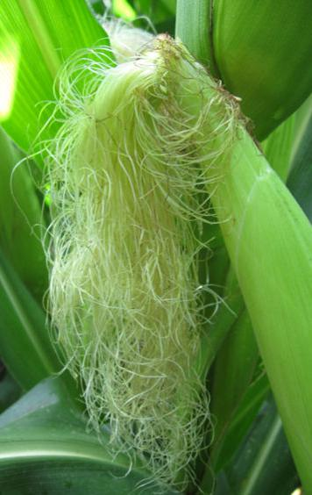
R1 - Silking
At least 50% of plants have 1 or more silks emerged (use only uppermost ear)
Pollen grains will land on silks and if receptive, fertilization will occur.
Silks are viable and receptive to pollen for at least 5 days
The plant uses the most water per day (0.35 inches) during R1
  Very sensitive to stresses
Silks have highest water content among all parts of the corn plant
Drought causes silk elongation to slow down and pollen shed to speed up
Notes:
At R1 (silking), at least 50% of plants in the field will have 1 or more silks emerged. Look at only the uppermost ear on the corn plant. Pollen grains will land on silks and if receptive, fertilization will occur. Silks are viable and receptive to pollen for at least 5 days. The plant uses the most water per day (0.35 inches) during R1, making it very sensitive to stresses. Silks have highest water content among all parts of the corn plant and drought causes silk elongation to slow down and pollen shed to speed up.

Slide 20
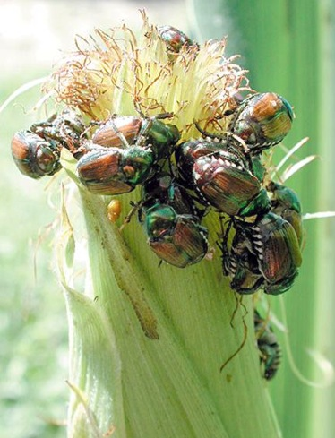
R1 - Silking
Problems to watch for during R1:
  Drought
  Corn rootworm adults
  Japanese beetle
  Corn earworm
  Foliar diseases
© Marlin E. Rice
Notes:
Problems to watch for during R1:
Drought (page 75, Corn Field Guide)
Corn rootworm adults (page 53, Corn Field Guide)
Japanese beetle (page 57, Corn Field Guide)
Corn earworm (page 57, Corn Field Guide)
Foliar diseases (beginning page 28, Corn Field Guide)
[silks being consumed by Japanese beetles]

Slide 21
R2 – Blister stage
Occurs about 10-12 days after silking
Kernel is:
  Visible and resembles a blister
  Filled with clear fluid and embryo is barely visible
  Approx. 85% moisture content
If severe stress occurs now or during R3, kernels can be aborted from the tip downward.
Kernel abortion will occur until the plant has a sufficient supply of carbohydrates for the remaining kernels.
Notes:
The R2 (blister) stage occurs about 10-12 days after silking. At this point the kernel is visible and resembles a blister, is filled with clear fluid, the embryo is barely visible, and it is at about 85% moisture content.
If severe stress occurs now or during R3, kernels can be aborted from the tip downward. Kernel abortion will occur until the plant has a sufficient supply of carbohydrates for the remaining kernels.

Slide 22
R3 – Milk stage
Occurs approx. 18-20 days after silking
Kernel is colored yellow with the inside containing ‘milky’ white fluid. Kernel moisture content is approx. 80%
Starch is beginning to accumulate in the kernel
Notes:
The third reproductive stage, R3 (milk), occurs approximately 18-20 days after silking. The kernel is colored yellow with the inside containing ‘milky’ white fluid. Kernel moisture content is approximately 80% and starch is beginning to accumulate in the kernel.

Slide 23
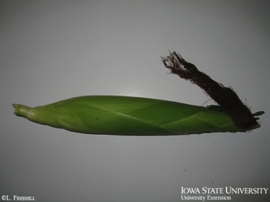
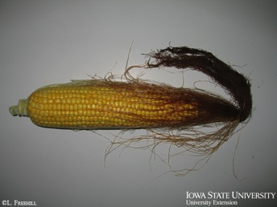
R4 – Dough stage
Occurs approx. 24-26 days after silking
Interior of kernel has thickened to a dough or paste-like substance
Kernel moisture content is approx. 70% and kernels may begin to dent at the base of the ear
Stresses will reduce kernel weight now
Notes:
R4 (dough) stage occurs approximately 24-26 days after silking. At this point, the interior of the kernel has thickened to a dough or paste-like substance. Kernel moisture content is approximately 70% and kernels may begin to dent at the base of the ear. Stresses will reduce kernel weight now.
[R4 (dough) stage corn ears, with husk and without]

Slide 24
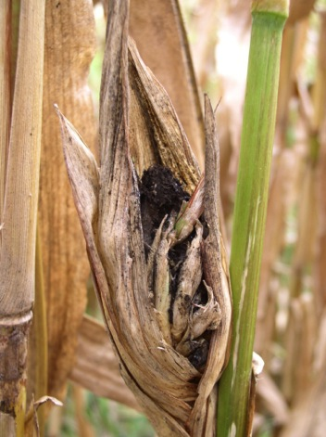
R2-Blister to R4-Dough
Problems to watch for:
  Foliar disease
  Head smut
  European corn borer
  Grasshopper
  Barren stalks, poor pollination
  Nutrient deficiencies
Notes:
Problems to watch for during R2 (blister), R3 (milk), and R4 (dough):
Foliar disease (beginning page 28, Corn Field Guide)
Head smut (page 34, Corn Field Guide)
European corn borer (page 54, Corn Field Guide)
Grasshopper (page 54, Corn Field Guide)
Barren stalks, poor pollination (page 82, Corn Field Guide)
Nutrient deficiencies (pages 67-69, Corn Field Guide)
[Head smut]

Slide 25
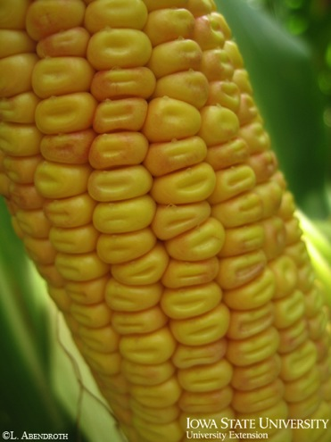
R5 – Dent stage
Occurs approx. 31-33 days after silking
Kernels dented in at top with the “milk line” separating the liquid and solid (starch) portions
Within R5, kernels are often staged according to the progression of the milk line; i.e. ¼, ½, and ¾
Beginning of R5 - kernels have 60% moisture content
Stresses will reduce kernel weight now
Notes:
The second to last stage of corn development, R5 (dent), occurs approximately 31-33 days after silking. Kernels are dented in at the top with the “milk line” separating the liquid and solid (starch) portions. Within R5, kernels are often staged according to the progression of the milk line; i.e. ¼, ½, and ¾. At the beginning of R5, kernels have 60% moisture content. Stresses will reduce kernel weight at this time.

Slide 26
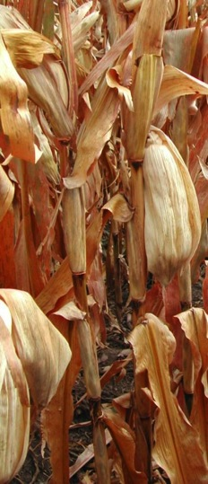
R6 – Physiological maturity
Occurs approx. 66-70 days after silking
R6 is reached after the milk line disappears and the starch has reached the base of the kernel
Kernels have reached maximum dry matter accumulation
Kernel moisture is about 35% at physiological maturity
Black layer occurs after physiological maturity, serving as a visual verification that the plant is mature; it typically occurs at 30% moisture but varies by hybrid and environment
Only external stress can reduce yield now, such as plant lodging or insect feeding
Notes:
R6 (physiological maturity) occurs approximately 66-70 days after silking. R6 is reached after the milk line disappears and the starch has reached the base of the kernel. At this point, the kernels have reached maximum dry matter accumulation. Kernel moisture is about 35% at physiological maturity. Black layer occurs after physiological maturity and serves as a visual verification that the plant is mature. Black layer typically occurs at 30% moisture but varies by hybrid and environment. Only external stress can reduce yield now, such as plant lodging or insect feeding.

Slide 27
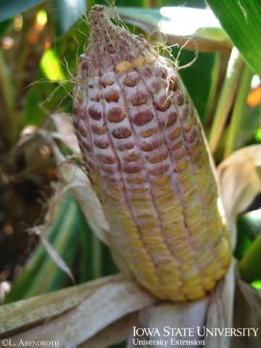
R5-Dent to R6-Physiological maturity
Problems to watch for:
  Ear rots
  Stalk rots
  Anthracnose top dieback
  Stalk lodging
  Abnormal ear fill which identifies periods of stress
Notes:
Problems to watch for during R5 (dent) and R6 (physiological maturity) stage corn:
Ear rots (pages 39-41, Corn Field Guide)
Stalk rots (pages 36-38, Corn Field Guide)
Anthracnose top dieback (page 35, Corn Field Guide)
Stalk lodging (page 79, Corn Field Guide)
Abnormal ear fill which identifies periods of stress (pages 80-82, Corn Field Guide)
[Gibberella ear rot]

Slide 28



Conclusions
Certain management considerations must be taken into account during the various stages of corn growth.
Each stage has its own set of problems.
Many insects, diseases, and disorders are problems during multiple corn growth stages.
This knowledge can help growers to be aware of the potential problems of corn throughout the season.
Notes:
We have learned the different stages of corn growth throughout the season. This information can help us become better corn growers because at each of the particular growth stages of corn, certain management considerations must be taken into account. Each stage has its own particular problems which may interfere with growth at that stage including weeds, insects, diseases, and other disorders. Also, many pests and disorders are problems during multiple corn stages. This knowledge can help growers to be aware of the potential problems of corn throughout the growing season.
All images © ISU, except where noted.
Much of the information in this presentation was taken directly from a presentation titled “Corn Growth and Development” by Lori J. Abendroth and Roger W. Elmore.
Thanks to ISU Extension and Outreach and North Central IPM Center for financial support.

