Slide 1
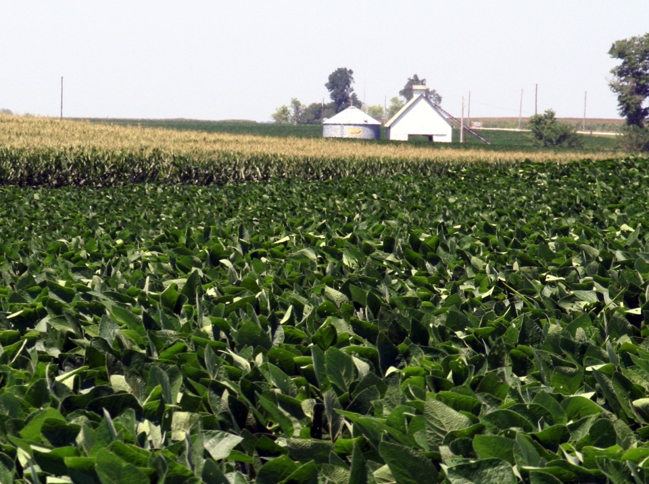
Scouting Fields
Notes:
One of the foundations for an IPM system is scouting your fields. This presentation will outline some of the basics of scouting.

Slide 2
Overview
Do your homework
Basics of scouting
Help! I still don’t know
Notes:
This presentation covers three things:
Do your homework to prepare for scouting fields; what preparation can be done at a computer or on the phone before getting to the field?
To understand the basics of scouting; to get an idea of what is going on in a field or part of a field. What to do to get help once you are done.
And finally, where to get further information if you still don’t know something.

Slide 3
Know what “healthy” looks like
What does a normal plant look like?
Above ground
Below ground
On the inside
A sick plant is less productive and often gives indicators (e.g., color or growth) called “symptoms.”
If you know what a healthy plant looks like, you can recognize when there is a problem.
Notes:
Doing your homework: first, know what a healthy plant looks like.
What does a normal plant look like? Sometimes we lose focus on symptoms of a disease or insect issue, and we need to know what the plant looks like—not just on the aboveground parts, but also on roots and interior structures of the plant.
A sick plant that is stressed will give indicators of the problem, called symptoms. Symptoms may include stunting, leaves and other plant parts changing color, crinkling of leaves or loss of tissue.
If you know what a healthy plant looks like, you can identify the symptoms better and begin to know what might be wrong as a foundation to correct the issue.
Note, for more information on what a “normal” plant looks like, see presentations on Corn and Soybean Growth and Development.

Slide 4
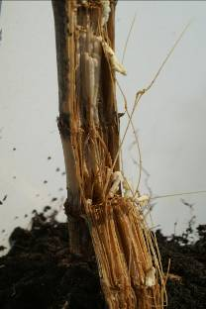
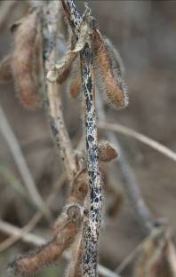
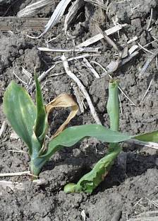
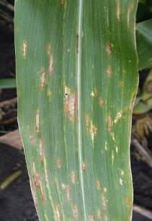
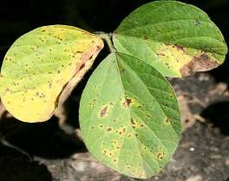
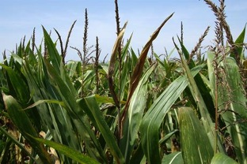
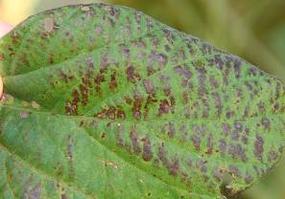
Know common problems
Notes:
Pictured on this slide are seven plant diseases, all showing up on different parts of the plant, during different times of the year and/or appearing very different. Other issues include insects, environmental stresses, weed problems or nutrient problems (see next slide).
This slide shows examples of different diseases. [Clockwise from upper left: corn stalk rot (pages 36-38, Corn Field Guide), Anthracnose of soybean (page 31, Soybean Field Guide 2nd Edition), seedling damping-off of corn (page 42, Corn Field Guide), gray leaf spot of corn (page 28, Corn Field Guide), Cercospora leaf blight of soybean (page 22, Soybean Field Guide 2nd Edition), Anthracnose top dieback of corn (page 35, Corn Field Guide) and Septoria brown spot of soybean (page 21, Soybean Field Guide 2nd Edition)]
Most diseases we deal with are caused by fungi, and affect plants throughout the season. Stalk rots are common at the end of the season, but you can have foliar diseases throughout the growing season. In general there are many diseases that can cause problems in Nebraska crops.

Slide 5
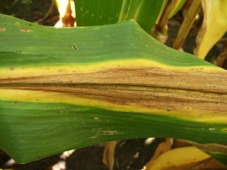
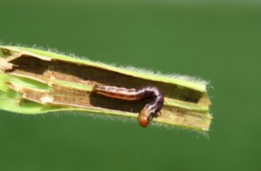
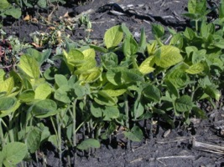
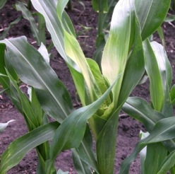
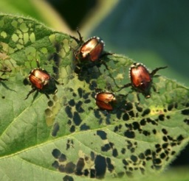
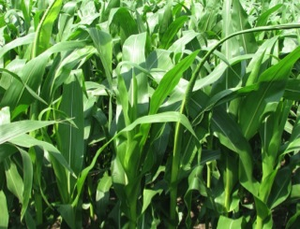
Know common problems
Notes:
There are other problems that are not diseases, but can be confused with diseases.
Here are examples of common non-infectious problems found in corn and soybean. [Clockwise from the upper left: nitrogen deficiency of corn (page 67, Corn Field Guide), stalk borer on corn (page 52, Corn Field Guide), iron-deficiency chlorosis on soybean (page 59, Soybean Field Guide 2nd Edition), buggy-whipping of corn (likely from growth-regulator herbicide) (page 78, Corn Field Guide), Japanese beetles and their damage on soybean (page 43, Soybean Field Guide 2nd Edition) and herbicide injury to corn (pages 62-66, Corn Field Guide)]

Slide 6

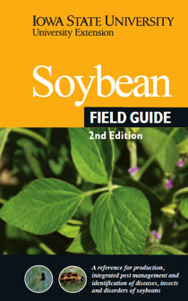
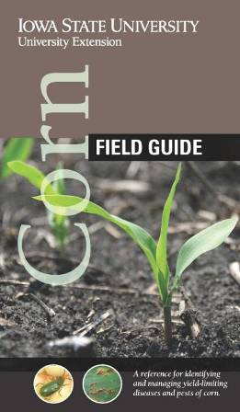
Know common problems
Assemble references
Books
Publications
Etc.
Notes:
Several references are available for help with field identification of problems, and three companion books published recently by Iowa State University are the Soybean Field Guide 2nd Edition, the Corn Field Guide, and the Weed Identification Field Guide. Copies are available at the Iowa State University Extension Distribution Center at https://www.extension.iastate.edu/store/. These are a starting point to assist in the identification and understanding of field problems. Of course, there are other available references and websites from both Land Grant Universities and the private sector.

Slide 7
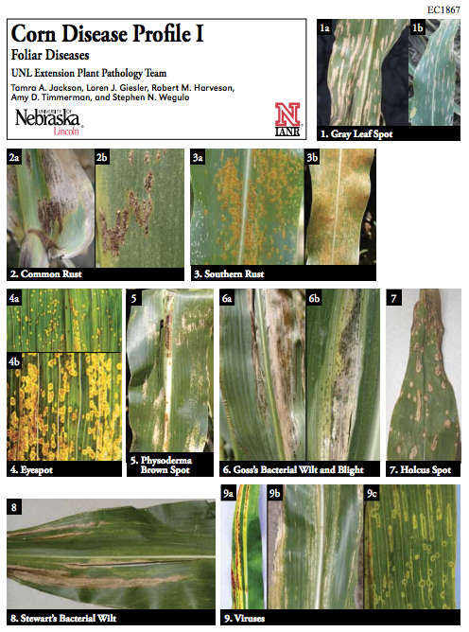
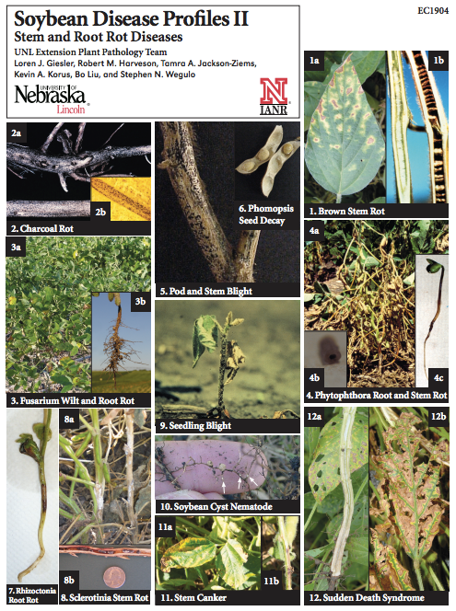
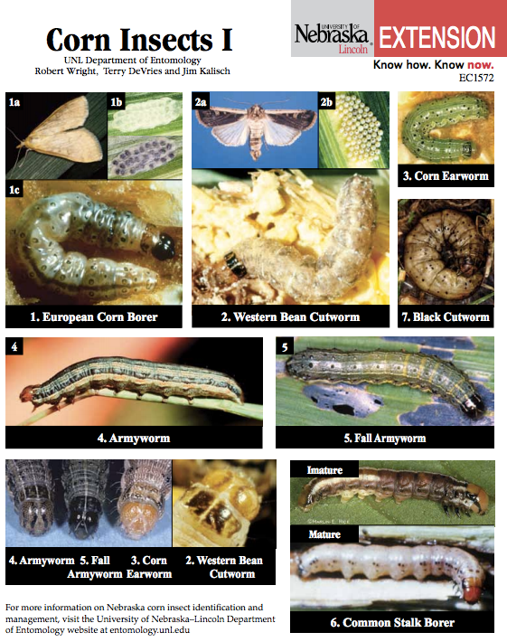
Know common problems
Assemble references: UNL’s CropWatch website
cropwatch.unl.edu

Slide 8


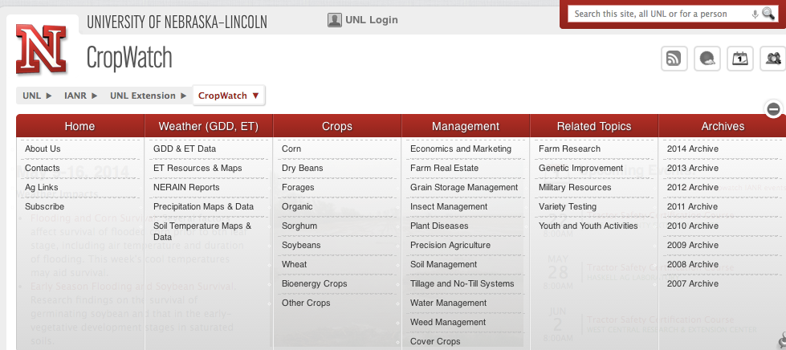
Know common problems THIS year
Keep up on the news
Local agribusiness
Internet
Print media
Word of mouth
Notes:
Knowing what is going on both nationally and locally can give clues to what problems may be expected. Much of the information is available on university extension websites, from agriculture media, or in local coffee shops. Information on emerging pests, weather conditions, etc. can help by giving you a starting point as what to expect once you start scouting.

Slide 9
Know common problems for
each time of year
Timeline for common corn diseases
Corn growth stage:
V6
V12
VT
Seedling blights
Anthracnose leaf blight
Eyespot
Common rust
Gray leaf spot (GLS)
VT
R2
R4
R6
GLS; Common rust;
Northern corn leaf blight
Anthracnose top dieback
Stalk rots;
Ear rots
Notes:
When you are gathering information, consider the time of the year. Different pests often occur at different, yet predictable times during the season. The graphic shows when several common corn diseases typically appear during the developmental stages of corn. This just illustrates how understanding when different problems may occur in a crop can help you target scouting efforts. We can eliminate many of the seedling and late-season diseases as we identify diseases in August.

Slide 10
Basics of scouting
Accurately estimate crop plant health, stand, growth stage and populations of any pests present
Pest identification and/or diagnosis of the cause of crop injury
Notes:
The basics of scouting involve:
Walking through a field and assessing how healthy that crop is and what growth stage it is in, noting any odd things you see, and
Find any pests that are present, diagnose them and then assess any damage they have currently caused and may be causing in the future.

Slide 11
First steps of scouting
Gather equipment
Contact grower
Let them know when you are coming
Ask if there are any special instructions
Spend time with them
Collect information about the field/season – learn the field history
Notes:
After doing your homework, it is now time to visit the field.

Slide 12
Equipment needs
Field maps
Field guides
Paper and pen to take notes
Safety glasses
Hand lens
Pocket knife/scissors
Sampling bags/ envelopes
Old newspapers/ paper towels
Sharpies
Ice chest
First aid kit
Water
Digital camera
Notes:
Also recommended are close-toed shoes, a rain jacket (or a change of cloths), boots (or an extra pair of shoes), sunscreen and a hat. If in corn, a long-sleeved shirt is a bonus.

Slide 13
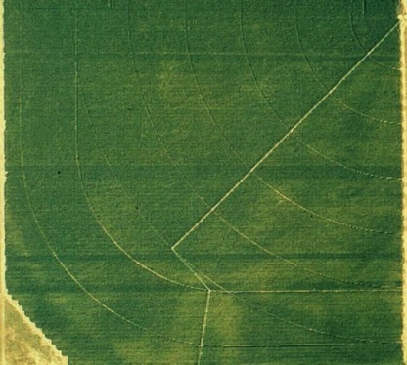
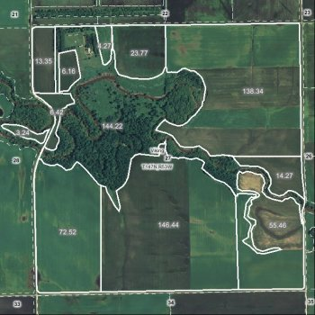
Collect information
Map fields
Aerial photographs
Map from plat book or Google™ Maps
Notes:
Another type of data record is to use aerial photographs or Google™ Maps or other map imagery to directly highlight conditions in the field. These maps can help you understand patterns that occur in the field that should be targeted for scouting.

Slide 14
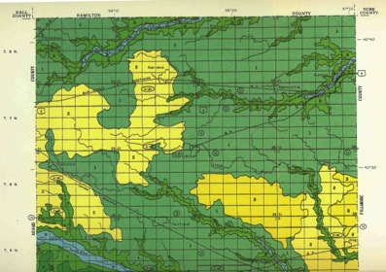
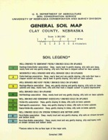
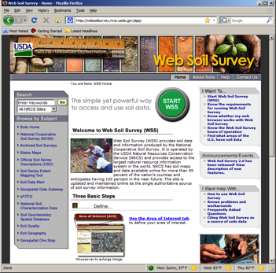
Collect information
Map fields
Soil map (printed soil survey or download)
Notes:
Great information about the soils and topography of a field are available from the USDA as either the standard printed county soil surveys or the web soil survey, which is a free, web-based archive of soil information available for all parts of Nebraska. Web soil survey is available at http://websoilsurvey.nrcs.usda.gov/app/.

Slide 15
Collect information
Consider recent weather
Environmental stresses may damage soybean and corn directly or make them more susceptible to some diseases.
Notes:
Consider recent weather that can contribute to plant stress. Weather stress can cause direct problems to any crop, or may make them more susceptible to some disease or insect damage. Flooding, hail, and drought conditions all can lead to predictable problems.

Slide 16
Collect information
Collect background information for the field
• Previous crops, adjacent crop and non-crop areas
• Chemicals used on or near the crop including herbicides, fertilizers, fungicides and insecticides; indicate when applied, how applied, rate of application, weather conditions during and following application
• Planting date, depth, and seedbed conditions
• Hybrid/variety information, including disease resistance
• Current soil test information (e.g., soil fertility, pH)
• Soil moisture and compaction
Notes:
Each scouting effort should document the hybrid or variety of crop being grown, as well as the date and crop stage. Look at neighboring fields and in neighboring ditches and areas to see if similar problems are present.
Many diseases (or insects or even some weeds) are either specific to soybean or corn or are more problematic in one or the other.
Remember that symptoms appearing at the same time and that are similar within an area on different species may suggest a problem that is not biological (a pathogen or even an insect).
In addition, keep a field by field set of records that may be useful as background information for each field. Good background information to have includes:
Previous crop history, both in the field and in adjacent fields
A history of chemicals applied on or near the crop, including herbicides, insecticides, fungicides, and fertilizers. For each, indicate when they were applied, how they were applied, what rate was used, and the weather conditions that occurred during and after application.
Date of planting, planting depth, and the seedbed conditions
Hybrid or variety characteristics including ratings for disease resistance or other varietal tolerances to field conditions (Bt corn, glyphosate resistance, iron chlorosis tolerance (soybean), soybean aphid resistance, etc.)
Current soil test information (soil fertility status and pH)
Estimates of soil moisture and noting areas like end rows or where field work was done in adverse conditions where compaction may be a concern

Slide 17
Collect information
Questions for the end of the season
How are plants standing?
What does the ear/pods look like?
What is stalk strength and health of root system?
Yield, why good or bad?
How was weed control?
Notes:
At the completion of the season (both just prior to and after harvest)
How well are plants standing?
Condition of ears and pods
Determine stalk strength and health of the root system (late season lodging can be a serious problem and leave volunteer crop plants for next year).
Were yields what you expected, and if there was a problem, are there ideas as to what caused the loss?
Was weed control effective, and if not, what species are problems and what caused the problem?

Slide 18
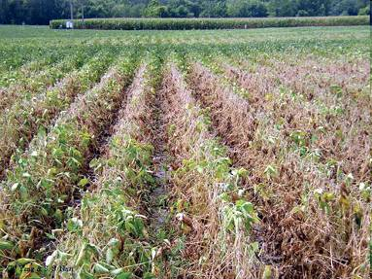
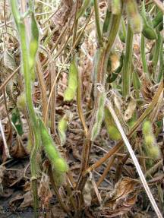
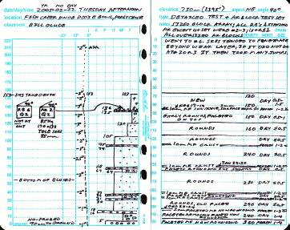
Basics of scouting
Look at the BIG picture (field level)
Look at the little picture (plant level)
Record information
Notes:
There are basically three things to do as you scout a field:
Look at the BIG picture (field level).
Look at the little picture (plant level).
Collect and record information accurately so it can be used in management planning both now and in subsequent growing seasons.

Slide 19
1. Look at the BIG picture (field)
Is the problem scattered randomly through the field or occurring in a pattern?
Is the problem more prevalent along a fence, field edge, entrance of a field or along a waterway?
Is the problem in the affected area more severe in certain soil types, low areas or on exposed slopes?
Does the pattern correspond to tillage, planting, spraying, harvesting or other field activities?
LOOK FOR PATTERNS
Notes:
Do a drive around, as best as possible, to get a feel for the field. Go to a high point and look out over the field and look for patterns or areas with differences in height, color, form, or other unevenness in the crop from place to place. You are looking for variations in patterns. If you see these variations, you then walk into the odd areas and examine more closely to determine the cause of the variation.
Keep in mind; you are looking for patterns that can help you diagnose problems. Then you can answer the question: Is the problem scattered randomly throughout the field, or is it tied to some other factor? Most patterns are associated with something that changes the crop growth environment slightly such as an old fence line, field drainage, soil types, previous tillage passes, crop residue, a fertilizer band, spray patterns, etc.
So looking at the big picture is looking for patterns, and the patterns may help you figure out the problem. Always LOOK FOR PATTERNS!

Slide 20
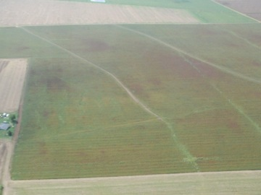
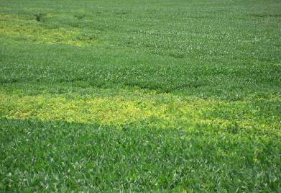
Look for patterns
Random
Aggregated
T. Allen, Miss. St.
Notes:
These are patterns of randomly scattered problems and aggregated problems. Random patterns are typically associated with foliar diseases—where the spores (act like seeds for fungi), etc. randomly enter the field from the air. The “random” image above is soybean rust (page 24, Soybean Field Guide 2nd Edition) in Mississippi. There is no clear pattern for this disease distribution. Aggregated (clumped) patterns are typically associated with soil-borne diseases or pathogens that require the micro-climates that occur at a position of the landscape or are associated with outside stresses dependent on micro-climate differences within the field.

Slide 21
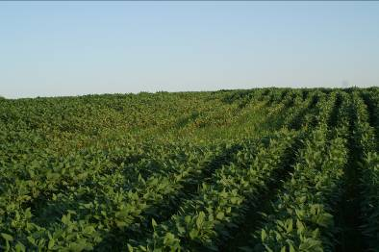
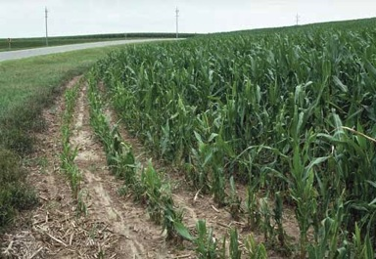
Look for patterns
Aggregated
Aggregated
© Marlin E. Rice
Slope
Notes:
21
Here are two examples of different aggregated patterns and what likely is causing them. On the left is a pattern that is associated with the slope, perhaps associated with eroded topsoil, lost nutrients, or directly washed out crop [image on left is actually a root rot on soybean]. On the right, the pattern is adjacent to a field edge, possibly indicating either a pathogen or insect that is entering the field from field edges [image on right is stalk borer damage on corn (page 52, Corn Field Guide)], or perhaps the field conditions have been altered by lime blown from the roadway, etc. In each case, the pattern is a basic key to diagnosing the problem.

Slide 22
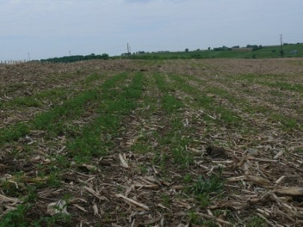
Look for patterns
Repeated
Equipment can often cause patterns that are repeated across fields.
For example, spray overlap every time the booms overlapped, compacted areas every "x" rows from combine tires the prior fall, etc..
Notes:
22
Equipment can often cause patterns that are repeated across fields.
For example, spray overlap every time the booms overlapped, compacted areas every "x" rows from combine tires the prior fall, etc..
[Image shows a weed problem caused by equipment failure – problem following the rows.]

Slide 23

Scouting patterns
Transect
Zig-zag
Diamond
Notes:
Several different scouting patterns (to examine the field systematically) are useful to gain an understanding of the condition of the field.
The simplest is a transect, which is just walking a somewhat straight line from one point to another and looking at the plants along the way.
Another pattern is the “Z” or “W” pattern, called a zig-zag, or
A diamond pattern that takes you to different quadrants of the field. The diamond pattern allows you to enter and leave the field at the same place, which is sometimes useful for access to vehicles, etc.
The point of going through a field and looking for problems or anomalies (especially plants showing signs of stress) is to see if there are areas that are different. Also, be sure that your scouting pattern covers those areas which looked problematic during the drive around.

Slide 24
2. Look at the little picture (plant)
Check individual plants for symptoms and signs
Compare damaged plants with healthy plants.
Check the entire plant and environment around it, including leaves, stems, roots, internal tissues, soil, pests not directly on plant, competition, etc.
A small hand lens, a pocket knife, a trowel, a shovel and the field guides are valuable tools.
Notes:
Next, turn to the “little” picture–the individual plant. Examine individual plants for symptoms and signs, doing the following:
Compare damaged plants with healthy plants.
Check the entire plant and environment around it, including leaves, stems, roots, internal tissues, soil, pests not directly on the plant, competition, etc.
Remember that a small hand lens, pocket knife, trowel, and a shovel are great tools you need to examine the plants and for gathering information.

Slide 25
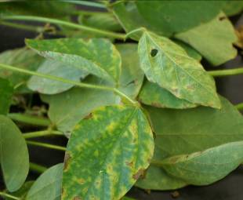
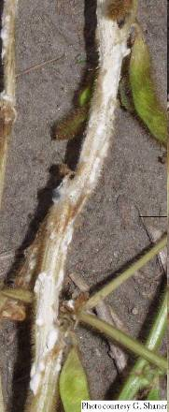
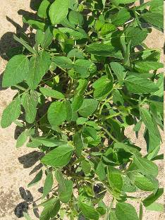
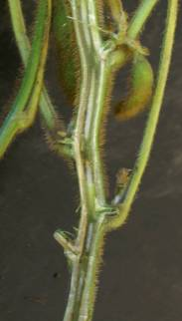
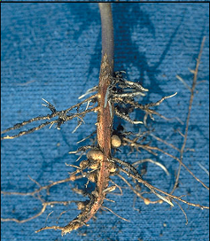
Check individual plants
Notes:
These are all pictures of diseases that could occur on different parts of individual plants.
[To the upper left are lesions from a foliar disease (sudden death syndrome (SDS) or brown stem rot (BSR), pages 28 and 29, Soybean Field Guide 2nd Edition), the upper right is white mold growth on soybean stems (page 30, Soybean Field Guide 2nd Edition), to the lower left is discolored pith, perhaps from brown stem rot, and to the lower right is the root system.]

Slide 26
Look at more than one plant
10
15
10
10
10
10
15
15
10
10
10
10
15
10
Aim to assess a minimum of 50-100 plants
Notes:
Remember the scouting pattern you are following, and expand the sampling to systematically examine individual plants to get a truer picture of what is really occurring in the field. Assess a minimum of 50 to 100 plants per field in a systematic way. For example, walk a transect through the field, and stop every x-number steps and look for 5 to 15 plants at each stop, then compile the information.
The more samples the better the precision when scouting, BUT consider the time when deciding on number of plants to examine.

Slide 27
Scouting patterns
Sampling patterns should be modified to account for variation in a field.
Random problem (e.g., some insects)
Fewer stops
More plants assessed at each stop
Aggregated (e.g., soilborne disease)
More stops (some in and out of problem areas)
Fewer plants assessed at each stop
Notes:
Modify your scouting pattern to account for the variation in the field. That means use common sense to make sure you truly sample the variability of the field to get a clear idea of the situation.
Is the problem (or problems) you find occurring randomly? If yes, you can make fewer stops, because each stop is likely to randomly “hit” the problem, but at each stop, assess additional plants.
If the problem appears aggregated into areas, for example as often happens with soilborne diseases, make more stops, some in and some out of the problem areas, and examine fewer plants at each stop in the field.

Slide 28
If possible, identify problem
After scouting field, identifying patterns, identifying plants that do not appear normal, etc. – use all the available information to identify the problem(s).
Notes:
Considering the symptoms and the patterns, try to diagnose the problem at this time. A complicating factor is when more than one thing is contributing to the problem.

Slide 29
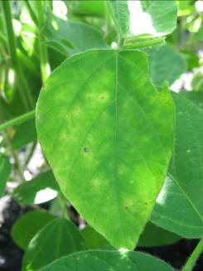
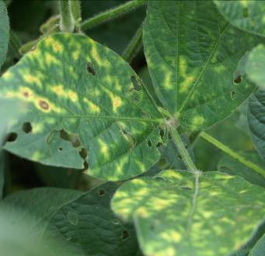
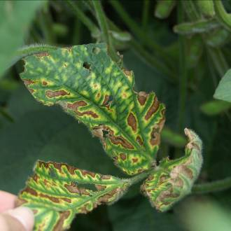
3. Record information
i. Check the prevalence and severity of the problem.
How often does the problem show up?
How damaging is the problem?
Notes:
29
Regardless of your sampling plan (part of what is called a protocol), you are trying to answer the questions of how often does the problem occur, and how damaging is it (how bad is it) – both now and potential damage in the future. As you examine plants, that information should be recorded in a clear way that you can compile and use later.

Slide 30
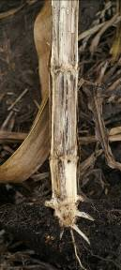
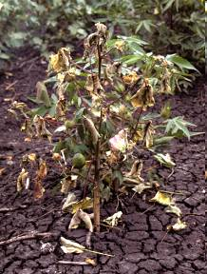

Assessment methods
Incidence = % plants diseased
Severity = % tissue diseased
Notes:
30
For this purpose there are two terms that are useful.
The first is the incidence of the disease or pest damage. This is simply the percentage of plants you examine that have the pest damage (for example, a field with 5 plants cut in 100 by ¾ inch black cutworms would mean a 5% incidence in that field).
The second is the severity of the disease or pest damage. This is the percent of the tissue that is damaged, or the percent of harvestable commodity lost (for example, 30% defoliated or 20% loss from a hail storm).

Slide 31
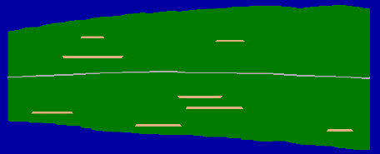
Foliar disease severity (%)
Gray leaf spot
1 %
2 %
5 %
10 %
Corn.Pro, Nutter, ISU
Notes:
31
Foliar disease severity can be difficult to assess, so we sometimes use guides to “calibrate” our assessments. Calibration is just standardizing what we see, measure or assess with a standard so that we are most accurate. Typically people tend to over-estimate damage, sometimes doubling the rating, especially if they aren’t trained. This chart is part of a training program developed at Iowa State University to assess gray leaf spot lesions on corn leaves, and can be carried into the field for side by side comparison to train the field scout for accuracy.

Slide 32
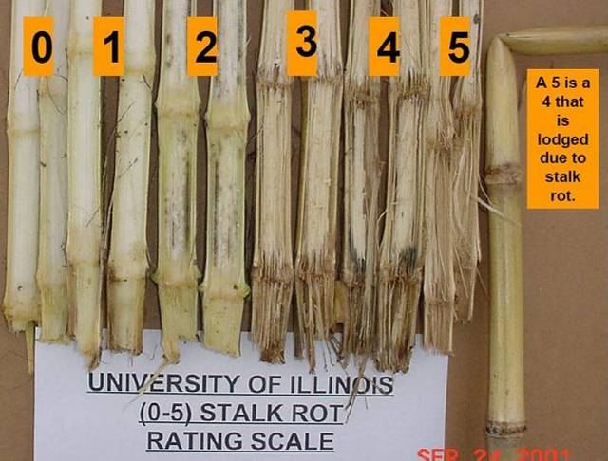
Stalk disease severity value
R. Hines, UIL
Notes:
32
Another example, utilized here for stalk damage from stalk rots, is using a rating scale that represents different stages of disease severity. Here the University of Illinois rates stalk damage on a 0 to 5 scale. The levels of stalk rot are represented by the plants shown.

Slide 33
Recording information
Field notebook
Clipboard with spreadsheet
 |  | Damage severity (%)
Field | Stop | 1 | 2 | 3 | 4 | 5 | 6 | 7 | 8 | 9 | 10
1 | 1
1 | 2
1 | 3
1 | 4
1 | 5
1 | 6
1 | 7
1 | 8
Notes:
33
The second part of collecting data is recording it in a clear and concise way so that the information can be saved and examined later, with hopefully no loss of data. That way you can go back and know where the problem was, and how severe it was in the field. There are Global Positioning System (GPS) technologies that can allow you to exactly spot problems, but even without them, your data can be quite useful. We will not cover GPS technologies in this presentation, but this technology can replace hand-written notes. Watch this YouTube video that explains how some may use this technology (http://www.youtube.com/watch?v=dFBQ6n3cDXY). It is best to pre-prepare data sheets to carry into the field on a clipboard that are laid out simply to match your path through the field.

Slide 34
Stumped?
If you are unsure of the problem or want a second opinion, you can send samples to Plant Diagnostic Clinics.
Notes:
Regardless of when an issue occurs or what the issue is, remember that no one knows everything. And when you cannot come up with a diagnosis of a problem there is help. There are several labs available, including one at the University of Nebraska-Lincoln.

Slide 35
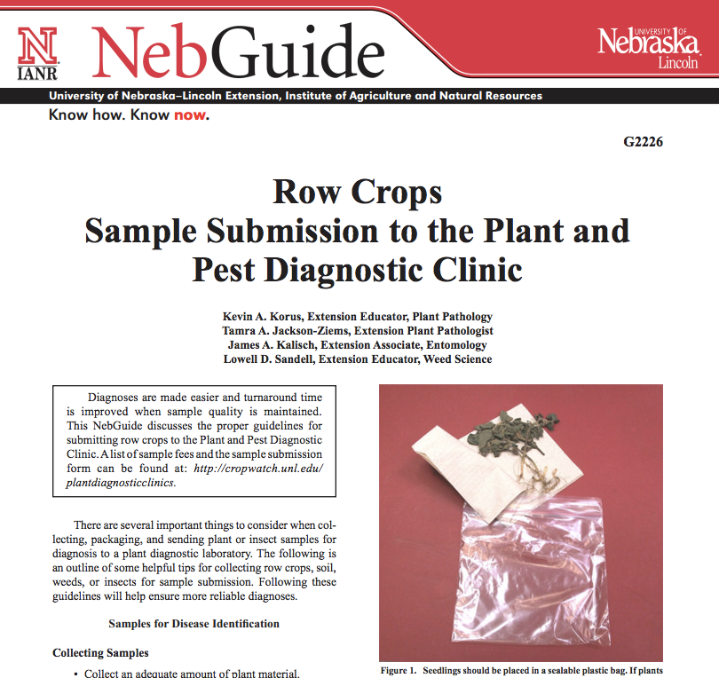
Information on submitting samples
Notes:
The field guides can help you take good samples along with sufficient information needed to give to diagnosticians to help you find a solution. This information is available on page 21 in the Corn Field Guide and page 11 in the Soybean Field Guide 2nd Edition. These guides include information on how to package samples for diagnosis at the UNL Plant Diagnostic Clinic.

Slide 36
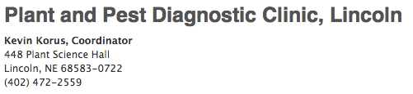
UNL Plant Diagnostic Clinic
If unsure of the cause of the problem, symptomatic specimens can be sent to the UNL Plant Diagnostic Clinic.

Slide 37
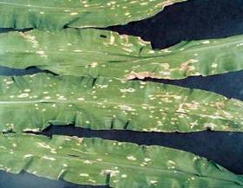
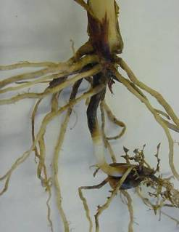
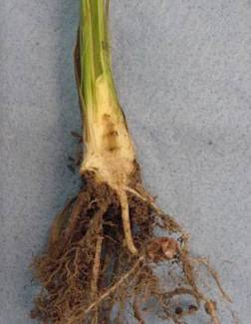

Submitting plants
Provide plenty of fresh material. When possible, send the entire plant, including roots.
Notes:
When you submit a plant sample for diagnosis, remember a few important guidelines:
Provide plenty of fresh material. Too little material and diagnosis can be impossible.
If possible, send the entire plant, including roots and top growth. Stalks can be folded to fit the whole plant in a box.

Slide 38

Submitting plants
Include enough plant material to show a range of symptoms.
Notes:
Also, try to submit plants that show all stages of symptoms from undamaged to the most severe. Some plant conditions are diagnosed by how the symptoms progress, and if all else fails, send more plant material rather than less.

Slide 39


Submitting plants
Provide appropriate background information for the field.
Notes:
Provide the appropriate background information for helping with the diagnosis. The card on the left is an example of what NOT to do. The clinic does have forms to complete to help you capture thorough background information.

Slide 40


Submitting plants
Wrap specimens in dry paper towels or clean newspaper (do not add moisture), then securely wrap sample.
Notes:
Wrap live plant materials in DRY paper towels or clean newspaper (Do NOT add water!!) and securely wrap the sample. These two images are the extremes. The box on the left is an example of what NOT to do. It has an assortment of soil and plant material with the information sheet crumpled up with the plant. The other extreme is a securely wrapped corn plant, shown on the right.

Slide 41

Submitting plants
Other tips
Do not send in dead tissue (the sample below is a problem).
Include photos when possible.
Notes:
Finally, do not submit dead tissue, and include photos when possible. Dead tissue often gets colonized by decay organisms that obscure the symptoms of the problem you want diagnosed. Digital photos can sometimes be used to send images directly to the clinic for diagnosis, but make sure you document as much information as possible to include with the image(s).

Slide 42
What next
Diagnosing a problem and properly recording this information can help with the next steps.
Management decisions, either for this year or subsequent years, can be implemented.
Proper identification can help pick the correct management strategy.
Realizing what can happen if the problem is not addressed.
Notes:
Diagnosing a problem and properly recording this information can help with the next steps.
Management decisions, either for this year or subsequent years, can be implemented.
Proper identification can help pick the correct management strategy.
Realizing what can happen if the problem is not addressed.

Slide 43



Summary
Do your homework.
Scout the field.
Can’t diagnose the problem? – Ask for help!
Notes:
To summarize:
Do your homework…use references to try to pin down what the problem possibly could be, and plan before you scout the field.
Scout the field systematically, and gather data that you can make sense of later.
If you cannot diagnose a problem yourself, ask for assistance…see the two spiral corn and soybean guidebooks we have included, and submit good samples if you need help.
All images © ISU, except where noted.
Thanks to ISU Extension and Outreach and North Central IPM Center for financial support.

