Slide 1

Subsurface Drip
Irrigation
Developed by Nebraska Extension
Notes:
In a moment, I will reveal a word or phrase. Upon seeing this word, write down everything you know about it! Capture your thoughts in your science journal.
Reveal the word “Center Pivot”. Allow students 1-2 minutes to write what they know or have experienced with center pivots. Once students are finished writing, ask students to share a few thoughts they captured.

Slide 2
Subsurface Drip Irrigation
What I KNOW
WANT to know
LEARNED
Notes:
Today we’ll be exploring a type of irrigation system called subsurface drip irrigation. Before we get started, let’s take a few moments to create a KWL chart with three vertical columns. The column on the left should be labeled “What I Know”, the middle column labeled “Want to Know”, and the column on the right labeled “Learned”.
Take the next two minutes to fill out the first two columns – the “What I Know” and “Want to Know” about subsurface drip irrigation.
Ask students to share one idea they listed for the “Know” and “Want to Know” columns. Capture this information on a KWL chart in the front of the class.

Slide 3
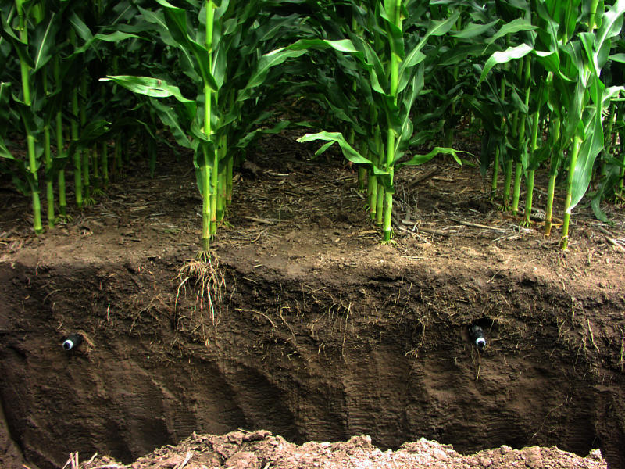
Key Terms
Subsurface drip irrigation (SDI): irrigation system where water is applied directly to the crop root zone using buried polyethylene tubing.
Dripline: tubing placed underground and between crop rows that carries water through the field laterally. Can vary in diameter and thickness.
Emitters: small holes where water passes through to irrigate soil.
Main line: located at the top end of the field and provides water to the driplines.
Filters: removes particles and impurities in the water.
Notes:
Direct students to search the room for note cards with key terms and definitions. Instruct students to work together to match the terms and definitions.
Have students read aloud the matching terms and definitions.
Capture these definitions in your science notebooks:

Slide 4
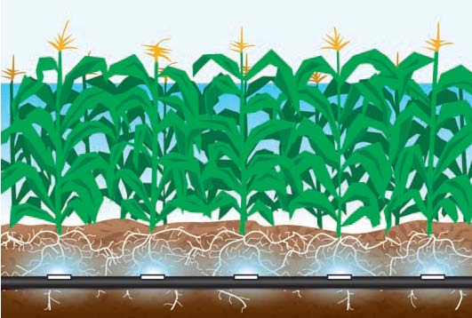
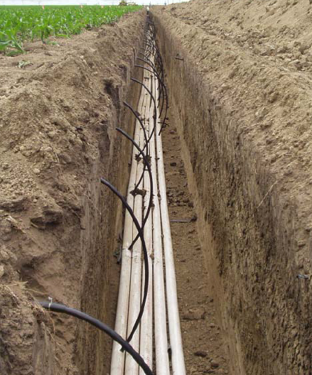
Subsurface Drip Irrigation
Irrigation system is beneath the soil surface
Waters the roots of the crop, rather than the entire land area the crops cover
When properly managed, losses of water due to wind, evaporation, deep percolation, and runoff are significantly lower compared to other irrigation systems
Notes:
The concept of subsurface drip irrigation systems is that the irrigation system is entirely underground. It targets the roots of the crop rather than the entire land area the crops cover to increase water efficiency. Water is applied to plants at a very low rate of application.
When managed correctly, subsurface drip irrigation has the potential to be the most efficient form of irrigation.

Slide 5
Draw and label the following:
    Main line
    Dripline
    Emitters
Notes:
Based on the definitions we just learned, draw and label the 1) main line, 2) dripline, and 3) emitters of subsurface irrigation in your science notebook,
Lead a discussion about how subsurface drip irrigation is similar and different from other irrigation systems that have been discussed in class or that students are familiar with, such as conventional furrow irrigation and center pivot irrigation. Consider the following questions:
How does subsurface drip irrigation appear to be similar to other irrigation systems we’ve learned about? (conventional furrow and center pivot irrigation)
How is it different?

Slide 6
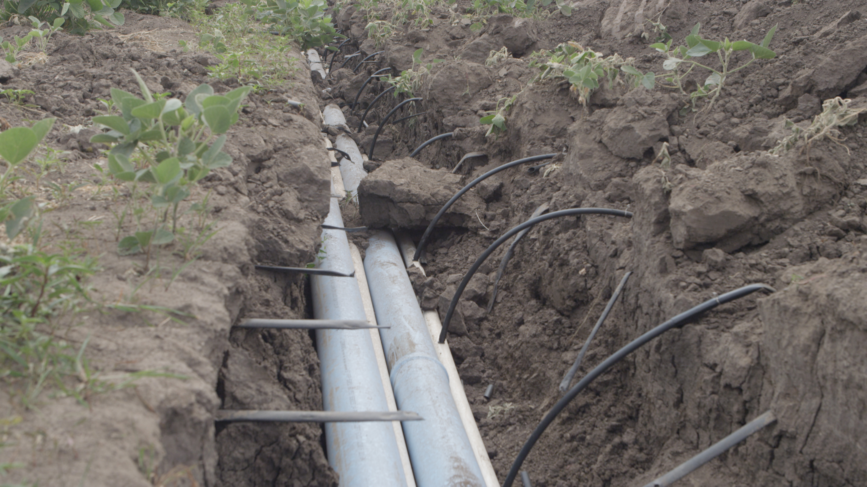
Time to Build!
Notes:
Instruct students to work in a group to build a model of a subsurface drip irrigation system. The goal is to soak a felt square, which represents soil in crop root zone, with the subsurface drip model. Students will build this model using two paper cups, a straw, felt square and thumb tack.
Hint: Students should poke a hole near the bottom of two cups so the end of a straw will fit snug. Using a thumbtack, poke several holes in the straw and connect the two cups with the straw. Lay felt over top of straw and pour water into one cup.
Upon construction, have students demonstrate and explain their model of a subsurface drip irrigation system.
Process:
How effective were our systems in soaking the felt square, or soil?
What changes could be made to improve the system?
What might be advantages to irrigating crops in this way? Disadvantages?
What do our models demonstrate about subsurface drip irrigation systems?
After building a model, let’s dig deeper into how subsurface drip systems are installed and operate.

Slide 7
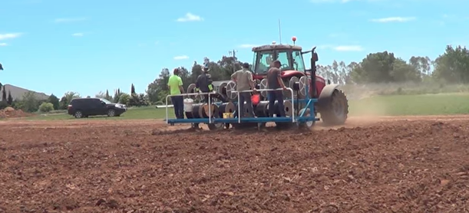
Subsurface Drip Installation Video
Click Here to View Video
Notes:
Show students the following video that demonstrates the installation of a subsurface drip irrigation system.
Encourage students to take notes in their science journal.

Slide 8
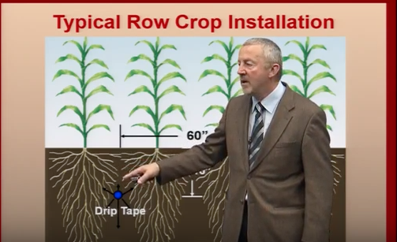
Subsurface Drip Management
Click Here to View Video
Notes:
Show students the following video to learn about the functionality and operation of subsurface drip irrigation from a Nebraska irrigation specialist.
Instruct students to answer questions in their science notebook.

Slide 9
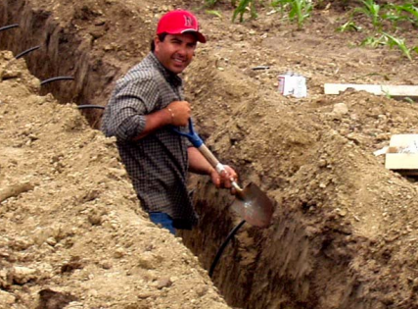
Amount of Water Delivered Depends on:
Dripline diameter
Emitter spacing
Emitter design
Emitter size
Operating pressure
Notes:
Once the water is in the soil, its movement depends on the physical characteristics of the soil. In fine-textured soil, water will tend to move laterally (sideways) and upward. In sandy soil, water tends to move mainly downward.
The amount of water that can be delivered through a drip system depends on:
Dripline diameter
Emitter spacing
Emitter design
Emitter size
Operating pressure

Slide 10
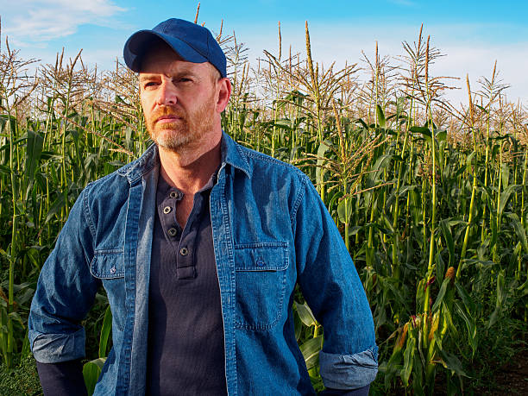
Input Needed
A local farmer asks you to provide information about subsurface drip irrigation!
Create a flow-chart describing the steps of installation and a one-paragraph summary of how the system works.
Notes:
A local farmer is interested in learning more about subsurface drip irrigation! The farmer asked you to provide information about how the system operates and the steps to install the system.
Create a flow chart to explain the installation process and a one-paragraph summary of how the system works.
Capture this information in your science notebook.

Slide 11
Subsurface Drip Irrigation
Advantages | Disadvantages
Water application efficiency
Investment cost
Potential water savings due to reduced
soil surface evaporation
Water supply and system capacity
Management time (requires learning in
first couple of years)
Potential yield increases
Labor requirements could be reduced
Limited dripline lengths
Enables field operations even during
an irrigation event
Inflexible design
Emitter clogging
Fits varying field sizes, shapes and
terrain
Rodents
Seed germination
Potential energy savings
Soil salinity
Not prone to tornado, hurricane or
other natural hazards
Dripline alignment
“Surfacing” or “chimney” effect
Ability to apply fertilizers and chemicals
injected directly through the system
Root intrusion (mainly for tree crops)

Slide 12
Information Gallery
Create a visual to share what you learned
Research card(s) you selected
at
water.unl.edu/article/agricultural-irrigation/subsurface-drip
Walk around the gallery to learn from others!
Hang your visual on a wall or place on desk
Notes:
Ask each student to select two to four cards from the advantage/disadvantage group. Each student will research and investigate the advantage or disadvantage they selected in further detail. Students will share what they learned with a visual presentation, such as a PowerPoint slide, poster, or infographic that will be displayed as a gallery for others to view. Encourage students to utilize the Agricultural Water Management Guide and this Nebraska Extension WebGuide to conduct their research.
Allow students 15 minutes to read and create a visual to share their information. Place these visuals around the room and have students gallery walk to learn more about the advantages and disadvantages of subsurface drip irrigation.
As students gallery walk, instruct them to capture important information about each advantage/disadvantage and write any questions they have that needs clarified.
Lead a discussion about what students learned from the gallery walk and what questions need clarified.
Would you recommend a farmer install a subsurface irrigation system? (over center pivot and conventional furrow systems?) Why?

Slide 13
Subsurface Drip Irrigation
What I KNOW
WANT to know
LEARNED
Notes:
Revisit the KWL chart from the beginning of the lesson. Provide students with 2-3 minutes to complete the “Learned” column of this chart. Ask students to share with a partner two things they learned during this lesson.

Slide 14
Extension is a Division of the Institute of Agriculture and Natural Resources at the University of Nebraska–Lincoln cooperating with the Counties and the United States Department of Agriculture.
University of Nebraska–Lincoln Extension educational programs abide with the nondiscrimination policies of the University of Nebraska–Lincoln and the United States Department of Agriculture.

