Slide 1
Soil pH
Unit: Soil Science

Slide 2
Objectives
Define: acidity, alkalinity, buffering capacity, soil pH
List and describe inherent factors that affect soil pH
Describe how to manage soil pH
Describe how soil pH affects soil function
Measure and interpret soil pH

Slide 3
Definitions
Acidity
Having a pH of less than 7
Alkalinity
Having a pH of greater than 7
Buffering Capacity
A soil’s ability to maintain its pH when changes are being made to the soil
Soil pH
A measure of the soil’s acidity or alkalinity

Slide 4
Soil pH
Indicates soil health
Affects
crop yields
crop suitability
plant nutrient availability
survival of soil microorganisms
Can be managed by
applying nitrogen and lime
using cropping practices that increase soil organic matter and overall soil health

Slide 5
Inherent Factors Affecting Soil: Climate
Climate
Increased temperature and rainfall cause increased leaching rates and increased soil mineral erosion rates
Increased leaching yields lower pH
Decreased leaching and rain cause pH to either increase or remain steady

Slide 6
Inherent Factors Affecting Soil: Mineral Content
Mineral Content
High organic matter content yields a higher buffering capacity
Organic matter amount can be changed through management practices

Slide 7
Inherent Factors Affecting Soil: Texture
Soil Texture
High clay content yields a higher buffering capacity due to slower leaching rates
Clay content amount cannot be changed
High sand content = low organic matter content = large pore space = high leaching = lower buffering capability lower buffering capacity due to large pore spaces and fast leaching rates

Slide 8

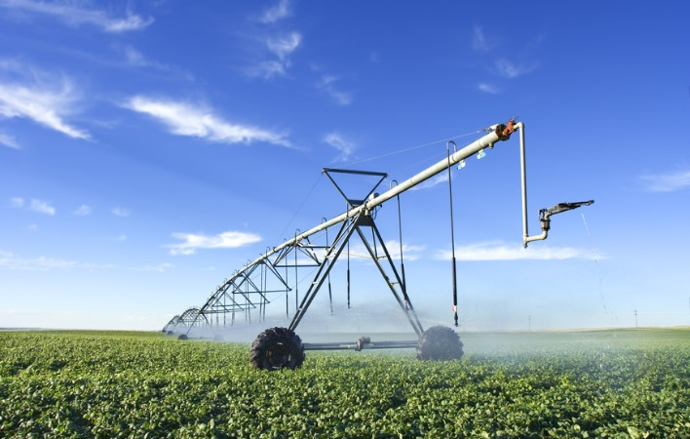

Land Management and pH

Slide 9
Soil Function and pH
Soil pH is affected by land use, management and vegetation
Forests have a high level of organic matter
Grasslands have a medium level of organic matter
Croplands have the lowest level or organic matter of these three types of land

Slide 10
Soil Function and pH
As land moves from forest to grassland and from grassland to cropland:
Organic matter is lost
Soil minerals are removed (during harvest)
Erosion increases
Nitrogen and sulfur are added to the soil
pH decreases

Slide 11
Soil Function and pH
Acidification can be limited or corrected by:
Adding lime yields an increased pH
Applying nitrogen and sulfur in the correct amounts and at the times when plants are using them
Diversifying crop rotations
Applying organic matter
Using no-till practices and cover crops

Slide 12
Soil Function and pH
A pH level that is too low or too high can cause
Nutrient deficiencies because of leaching
A decline in microbial activity because of improper environment for the microbes
A decrease in crop yields
A deterioration of overall soil health
An inhibition of the nitrogen cycle (low pH)
Limited effectiveness of herbicide and insecticide degradation
Limited solubility of heavy metals
A lack of effectiveness and carry-over of herbicides

