Slide 1
Soil Nitrogen
Unit: Soil Science

Slide 2
Objectives
Define: ammonification, ammonium, bulk density, denitrification, immobilization, leaching, mineralization, nitrate-N, nitrification, soil nitrogen fixation, volatilization
List and describe inherent factors that affect soil nitrogen
Describe factors of nitrogen management
Identify plants with nitrogen deficiency
Diagram the nitrogen cycle
Measure soil nitrate/nitrite and interpret results
Calculate: subsample soil water content, dry weight of soil, volume of water, adjusted ppm soil Nitrate-N, estimated bulk density, pounds of nitrate-N/acre/depth sampled and water nitrate content

Slide 3
Factors Affecting Soil Nitrogen
Soil drainage, soil texture and slope steepness all impact nitrogen transportation and transformation processes that limit the availability of nitrogen to crops or lead to loss.
Rainfall, temperature and site conditions all impact the rate of nitrogen mineralization from organic matter decomposition, nitrogen cycling and nitrogen losses through leaching, runoff or denitrification. Organic matter decomposition releases quickly in warm, humid and aerated soils; it releases slowly in cool, dry, less aerated soils.
Nitrogen in the nitrate nitrogen form can leach out of the root zone.
Leaching rate is affected by soil texture and soil water content.
  Large pore spaces = quick leaching
  Small pore spaces = water pools = loss of nitrogen as a gas

Slide 4
Managing Soil Nitrogen
Sandy Soil
  Leaching is a concern because of pore size
  Nitrogen rate selection is the first concern
  Rate is determined by assessing the amount of Nitrogen needed to optimize yield based on the agronomic, economic and environmental considerations.
  Increase the soil organic matter
  Avoid compaction
Time
  Apply adequate amounts when the plants are growing and will use the N quickly
  Apply N after the plants emerge (side dressing)
  Apply a portion of N prior to emergence and a portion following emergence
  Avoid applying urea materials during warm/humid conditions

Slide 5
Managing Soil Nitrogen
Source
  Anhydrous Ammonia (least expensive N source)
  Urea must be injected to reduce loss from ammonia volatilization
  Organic amendments or manure, must be applied uniformly
Placement
  Side dressing: applications after plants emerge
  Knifed applications: placing a band of fertilizer below the soil surface
  Broadcast applications: uniformly distribute nitrogen
  Sprinkler irrigation applications: applying fertilizer through the water distribution of an irrigation system
Irrigation Scheduling
  Goal: to supply enough water to optimize yield while avoiding excess water, which can increase costs and cause nitrogen to leach below the root zone.

Slide 6
Managing Soil Nitrogen
  Inject nitrogen if possible to avoid ammonia or volatilization losses
  Select an ammonium containing fertilizer
  Use nitrogen inhibitors when nitrogen is applied outside of the growing season
  Monitor crop nitrogen needs by scouting
  Conduct regular soil testing for nitrate and soil salt content
  Monitor for the common signs of nitrogen deficiency in plants
    Yellow “V”-shaped pattern
    Progresses from the leaf tip to the leaf collar and from lower leaves to upper

Slide 7
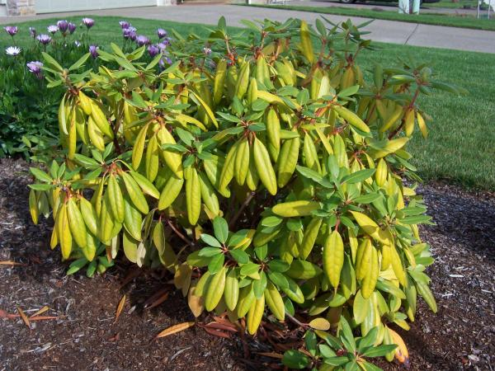
Managing Soil Nitrogen
http://pnwhandbooks.org/plantdisease/sites/default/files/imagecache/image_lightbox/images/rhododendronnitrogendef10-07b.jpg

