Slide 1
Overview of Irrigation Past and Present Developed by Nebraska Extension

Slide 2
Just Dance!
Click Here to View Video

Slide 3
How has agriculture evolved over time?
Notes:
Write responses to this question in Science Notebook.
Those are great examples of how agriculture has changed with time. From the machinery that’s used, to the way records are kept, and the increasing productivity, agriculture is still evolving and will look different in another century! Irrigation and water management practices are another area of agriculture that has evolved over time, which is the focus of today’s class.

Slide 4
Evolution of Irrigation in Nebraska
1856
1889
1890s
1893
Irrigation ditches are constructed in Nebraska
Nebraska has 214 irrigators and Nebraska passes its first irrigation law
Drought occurs and Nebraska’s irrigation systems are formed, primarily from surface water
Nebraska State Irrigation Association forms
Notes:
Nebraskans have long realized that using soil and water resources wisely is important, particularly since the state's economy relies on agriculture. Irrigation ditches were constructed in Nebraska as early as 1856. However, Nebraska's current extensive irrigation system stems from the droughts of the 1890s and 1930s (Dust Bowl Era).

Slide 5
Platte River
Loup River
Republican River
Notes:
Initially, Nebraska received all its irrigation water from streams and rivers practicing surface (gravity) irrigation method. These waterways continue to supply water for much of Nebraska's cropland today, especially in the western Nebraska. What rivers are most important from an irrigation perspective? The Platte, Loup and Republican rivers were especially important.

Slide 6
Evolution of Irrigation in Nebraska
1910-1936
1930s
1940
1950s & 1970s
Approximately 1200 irrigation wells
Drought occurs and Nebraska’s irrigation systems grow
Irrigation from wells increase dramatically
Irrigation wells peak
Notes:
Since 1940, however, irrigation from wells has increased dramatically. Of Nebraska's 8 million irrigated acres in 1990, about 7,000,000 million acres were irrigated from wells, with the rest coming from streams and rivers. The number of irrigation wells installed per decade peaked in the 1970s.

Slide 7
Irrigation Wells
irrigation well - A well in the ground that pumps groundwater to the surface.

Slide 8
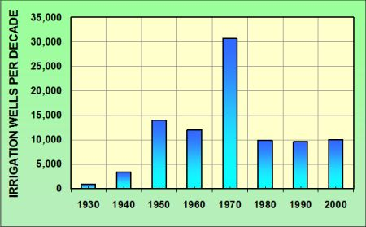
Irrigation Wells Installed per Decade
Notes:
The first irrigation wells were installed in the 1930’s and 1940’s. As power sources and well drilling methods became modernized in the late 1940s, the number of irrigation wells installed increased to approximately 14,000 wells per decade. New well installation peaked in the 1970s. Since the 70’s about 10,000 wells were installed each decade.

Slide 9
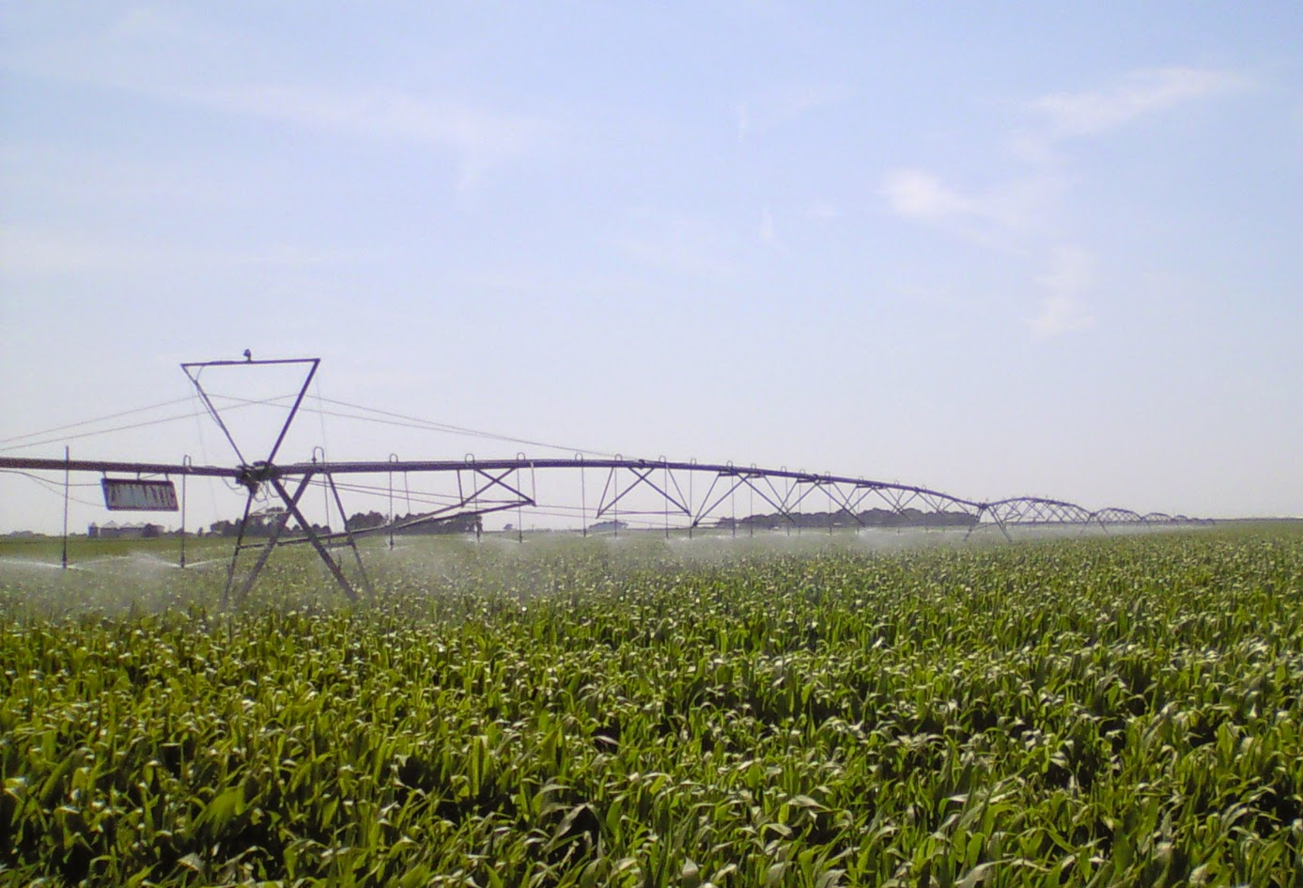
Evolution of Irrigation in Nebraska
1953
1975
1990
2005
2014
Center pivots are created
Corner pivot systems & lateral-move sprinkler systems develop
Nebraska has approximately 75,000 irrigation wells
Nebraska State Irrigation Association forms
Nebraska has over 112,000 irrigation wells

Slide 10
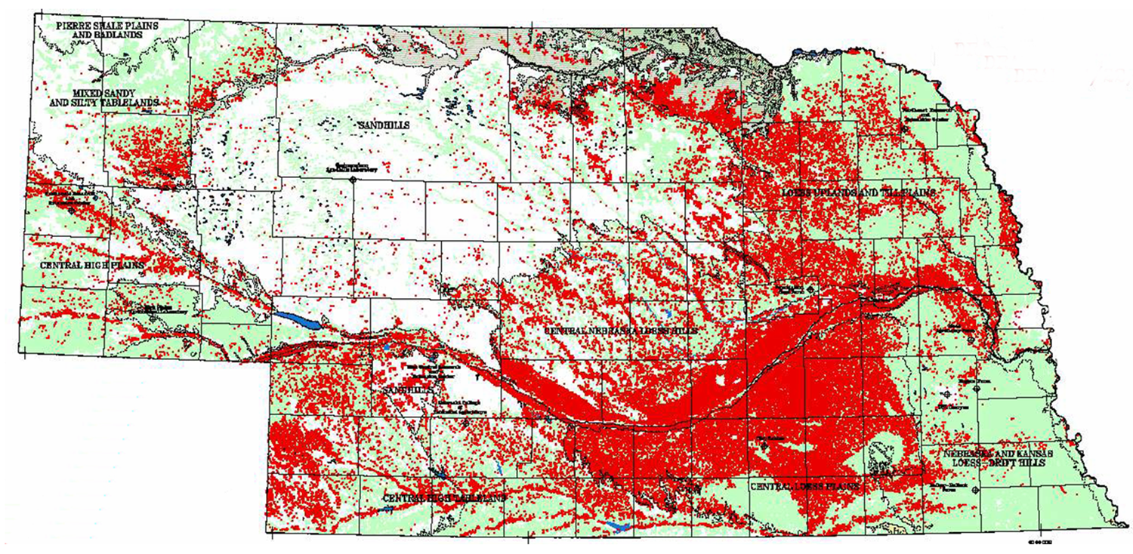
Irrigation Wells
Notes:
Currently, there are over 173,000 active irrigation wells in Nebraska. The highest density of wells are located in the Central Platte Valley where over 16 irrigation wells have been installed per square mile of land. The location of irrigation wells reflects the availability of groundwater, the suitability of the land for irrigation and the need for irrigation to meet crop water requirements. Distribution/density of active irrigation wells is presented in Figure below. Each red dot represents an irrigation well and most of the wells are located in the central and south central part of the state along the Platte River.

Slide 11
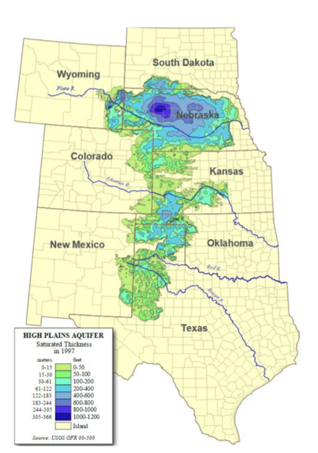
High Plains Aquifer
Much of Nebraska lies over the Ogallala, or High Plains Aquifer
High Plains Aquifer - the primary source for ground water in the High Plains region, most notably for agricultural use. This aquifer spans vertically over eight states.
View High Plains Aquifer Video Here
Notes:
Much of Nebraska is lying over the Ogallala Aquifer, or High Plains Aquifer.

Slide 12
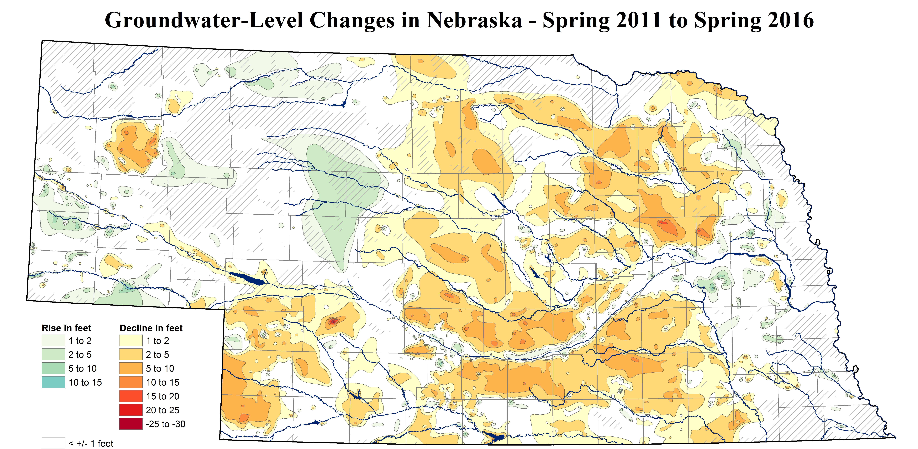
Groundwater level – depth to groundwater from soil surface
Natural Resources Districts (NRD’s) – local government entities created to protect natural resources
Notes:
Irrigation development has caused declines of groundwater levels (depth to groundwater from the soil surface) in some areas of the state. The most severely affected areas are the Box Butte area, western end of the Republican River Basin and parts of the Blue River Basin. Natural Resources Districts (NRDs) have implemented management plans in these areas to regulate groundwater resources use.

Slide 13
Select two counties in Nebraska…
Describe the irrigation well density in this county.
What is the primary source of irrigation water in this county?
How have groundwater levels shifted in this county over the last 10 years? Over the last 30 years?
What Natural Resources District (NRD) is this county part of?
Are there any water regulations in this county? If so, describe them.
Notes:
Select the county you live in and one county in a different region of Nebraska. For each of these counties, answer the following questions in your science notebook. Use the maps and resources provided in the Agricultural Water Management Guide to begin your research.

Slide 14
What percentage of U.S. farmland is irrigated?
6%
10%
43%
55%

Slide 15
What percentage of U.S. farmland is irrigated?
6%
10%
43%
55%
55.3
million acres of irrigated land in the U.S. in 2013
Notes:
What percentage of U.S. farmland is irrigated? Answer: 6% Additional info: In 2013, there were 55.3 million acres of irrigated land in the U.S.

Slide 16
Nebraska ranks _____ among states in number of irrigated acres.
2nd
3rd
1st
10th

Slide 17
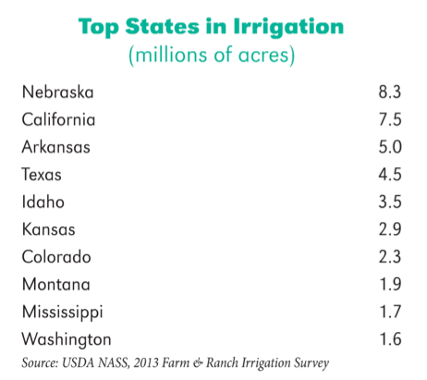
Nebraska ranks _____ among states in number of irrigated acres.
2nd
3rd
1st
10th
Notes:
Nebraska ranks ____ among states in number of irrigated acres? Answer: 1st Additional info: Nebraska has the highest number of irrigated acres at 8.3 million, followed by California at 7.5 million acres.

Slide 18
Cropland accounts for ______ of all irrigated land.
50%
95%
88%
80%
Notes:
Cropland accounts for ______ of all irrigated land. Answer: 95% Additional Info: Cropland accounted for 95% of all irrigated land while 5% accounted for permanent pasture/grassland.

Slide 19
Cropland accounts for ______ of all irrigated land.
Pasture
50%
95%
88%
80%
Cropland
Notes:
Cropland accounts for ______ of all irrigated land. Answer: 95% Additional Info: Cropland accounted for 95% of all irrigated land while 5% accounted for permanent pasture/grassland.

Slide 20
What type of irrigation covers the highest number of acres?
Sprinkler systems
Gravity systems
Subsurface drip

Slide 21
What type of irrigation covers the highest number of acres?
Sprinkler systems
Gravity systems
Subsurface drip
Sprinkler Systems: 34.9 M acres
Gravity
Gravity Systems: 21.5 M acres
Sprinkler
Drip/Trickle/Low-Flow Systems: 4.9 M acres
Notes:
What type of irrigation covers the highest number of acres? Answer: Sprinkler systems Additional Info: In 2013, 34.9 million acres were irrigated with sprinkler systems, followed by gravity systems at 21.5 million acres and lastly with a variety of drip, trickle, or other low-flow micro irrigation systems at 4.9 million acres.

Slide 22
What is the average annual amount of water (in acre-feet) applied to each acre from irrigation?
2 acre-feet
1.2 acre-feet
1.0 acre-feet
1.6 acre-feet

Slide 23
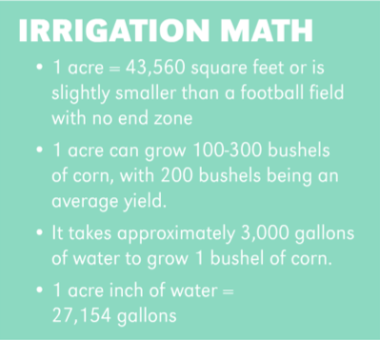
What is the average annual amount of water (in acre-feet) applied to each acre from irrigation?
2 acre-feet
1.2 acre-feet
1.0 acre-feet
1.6 acre-feet
Notes:
What is the average annual amount of water (in acre-feet) applied to each acre from irrigation? Answer: 1.6 acre-feet Additional info: Review the “irrigation math” chart.

Slide 24
Irrigation consumes _____ of all the groundwater pumped in Nebraska and ____ of the entire surface water diverted.
50%, 50%
90%, 20%
47%, 95%
95%, 47%

Slide 25
Irrigation consumes _____ of all the groundwater pumped in Nebraska and ____ of the entire surface water diverted.
50%, 50%
90%, 20%
47%, 95%
95%, 47%
Notes:
Irrigation consumes _________ of all the groundwater pumped in Nebraska and _________ of the entire surface water diverted. Answer: 95%, 47%

Slide 26
Nebraska
_______
Consider:
How common is irrigation? Why?
How many acres are irrigated in the state?
What crops are irrigated?
What types of irrigation systems are utilized?
Notes:
Compare the prevalence of irrigation in Nebraska to one other state. Create a Venn Diagram to summarize similarities and differences between states. Consider the following questions:
How common is irrigation? Why?
How many acres are irrigated in the state?
What crops are irrigated?
What types of irrigation systems are utilized?

Slide 27
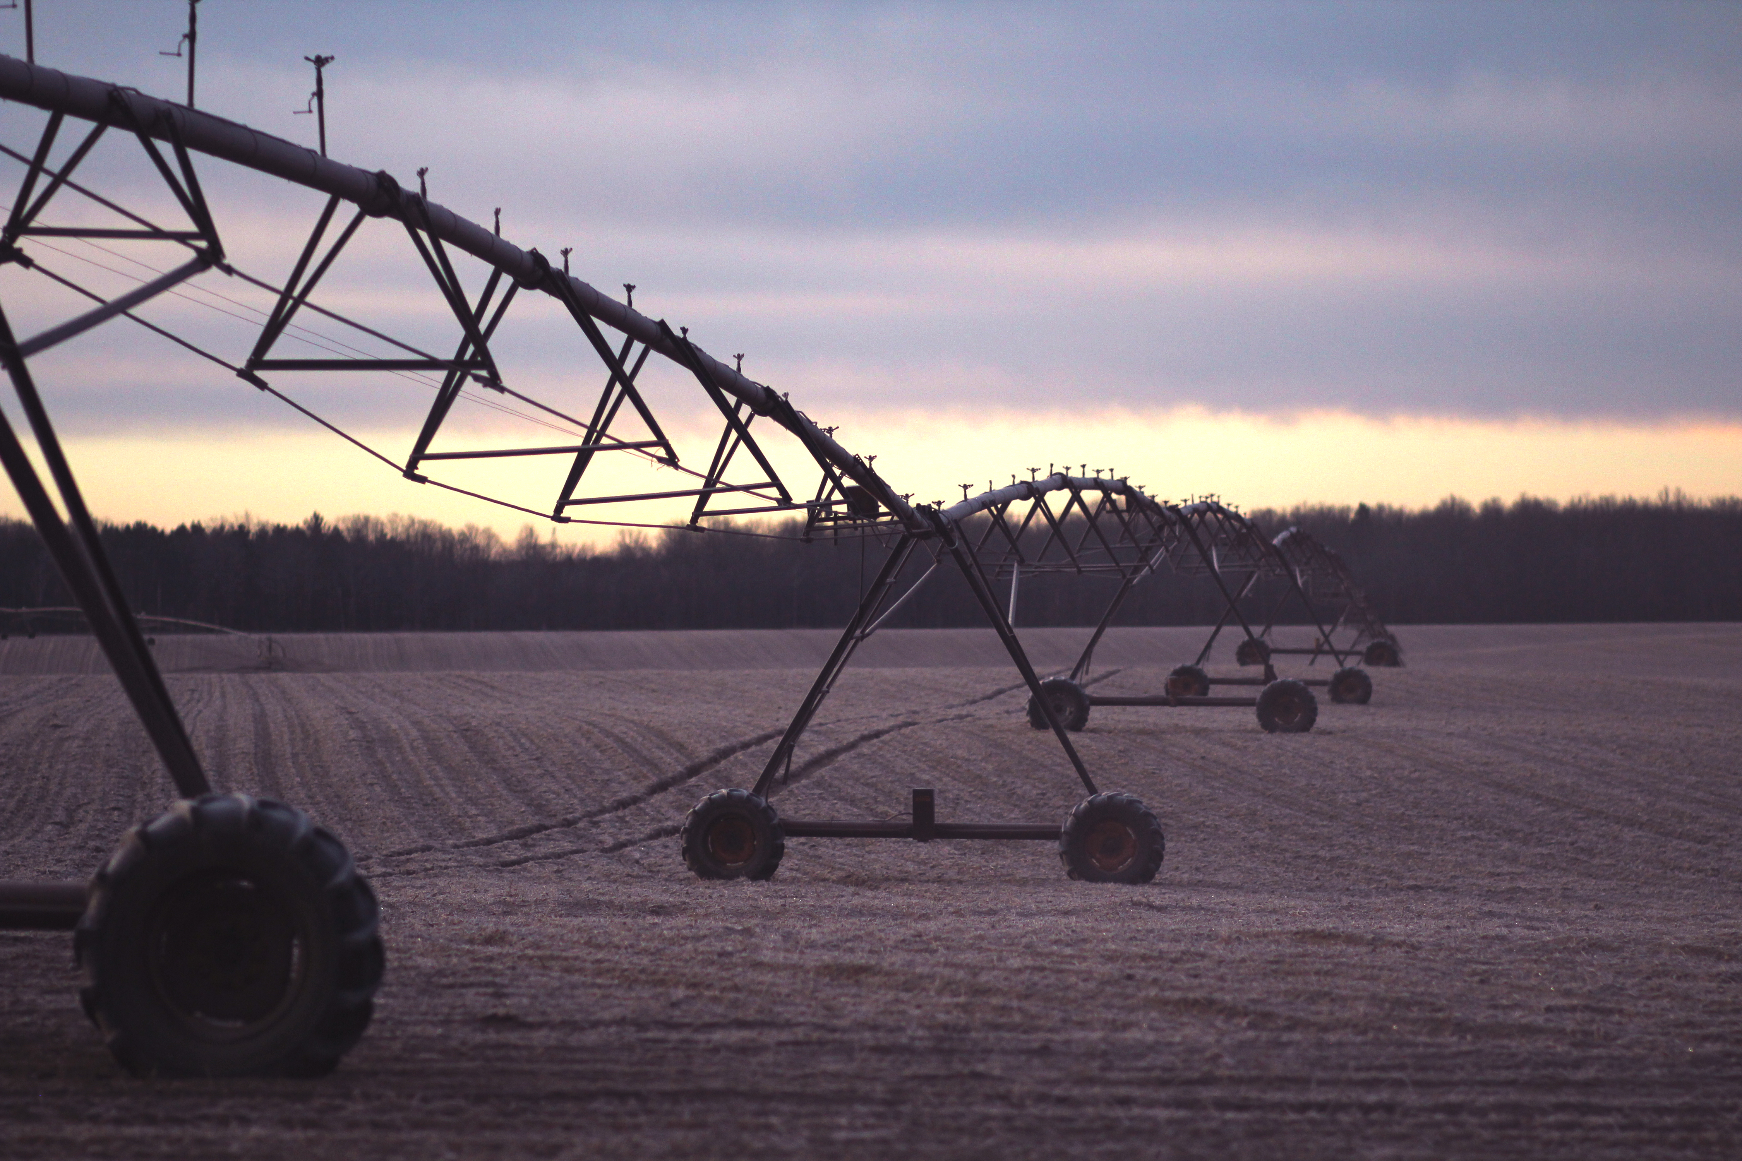
Irrigation in Nebraska…
Where has
it been?
Where is
it now?
Where is
it going?
Notes:
Ask students to reflect on and summarize what they learned about the history of irrigation in Nebraska, the current state of irrigation, and imagine the future of irrigation in the state.
Instruct students to journal about the following prompt in their science notebook.
Irrigation in Nebraska…
Where has it been?
Where is it now?
Where is it going?

Slide 28
Extension is a Division of the Institute of Agriculture and Natural Resources at the University of Nebraska–Lincoln cooperating with the Counties and the United States Department of Agriculture.
University of Nebraska–Lincoln Extension educational programs abide with the nondiscrimination policies of the University of Nebraska–Lincoln and the United States Department of Agriculture.

