Slide 1
Irrigation Management Overview Developed by Nebraska Extension

Slide 2
Water in the World
Notes:
Fill a one-gallon container (such as a plastic ice cream bucket) with water. Explain to students
this represents all the water on Earth.
Where is most of this water located? (Listen for: ocean) What percentage of water Earth’s water is salt water? (Listen for 97%)
We cannot use salt water without first removing the salt in a process known as desalination. While technology is improving this process, it is still very expensive.
Pour one half-cup of water from the one-gallon container into a cup or bowl.
Explain to students that the water in the cup or bowl represents all of the freshwater on Earth, which is less than three percent of the total water on Earth.
Where is freshwater found? (Listen for: ice caps, lakes, streams, groundwater)
With an eyedropper, place one drop of water from the half-cup onto a small plate.
80% of Earth’s fresh water is frozen in ice caps and glaciers! This small drop represents the freshwater that is available for our use – from rivers, lakes, and aquifers.
Process and Transition:
What does this demonstrate about water? (Listen for: it’s a limited natural resource)
How can we be good stewards of this natural resource?
How can agricultural producers help to conserve and protect freshwater?

Slide 3
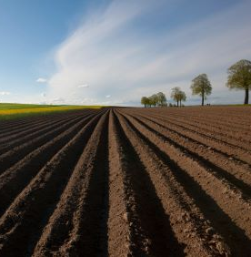
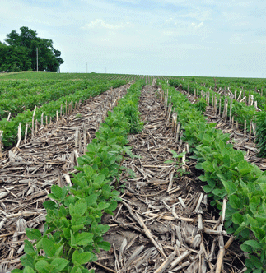
Factors Affecting Irrigation Efficiency
Notes:
Place two pots of soil in front of the class. One pot should be bare soil, and the second should have crop residue covering the surface (could use mulch to demonstrate crop residue).
Process:
What do you observe about these pots?
Imagine that these pots represent fields. How would you describe the tillage of these fields? (Listen for: tilled vs. non-tilled soil)
Which of these pots – or tillage practices – is more useful in water conservation? Why? Allow students to share their ideas.
What other factors might influence the efficiency of irrigation? (Listen for: water-holding capacity of soil, crop root depth, soil type, recent precipitation)
These are excellent ideas to consider. Let’s dive deeper into what production practices influence water management. We’re about to hear an expert’s opinion on what practices reduce the need for irrigation. Capture what you learn from this video in your science notebook.

Slide 4
Click Play!

Slide 5
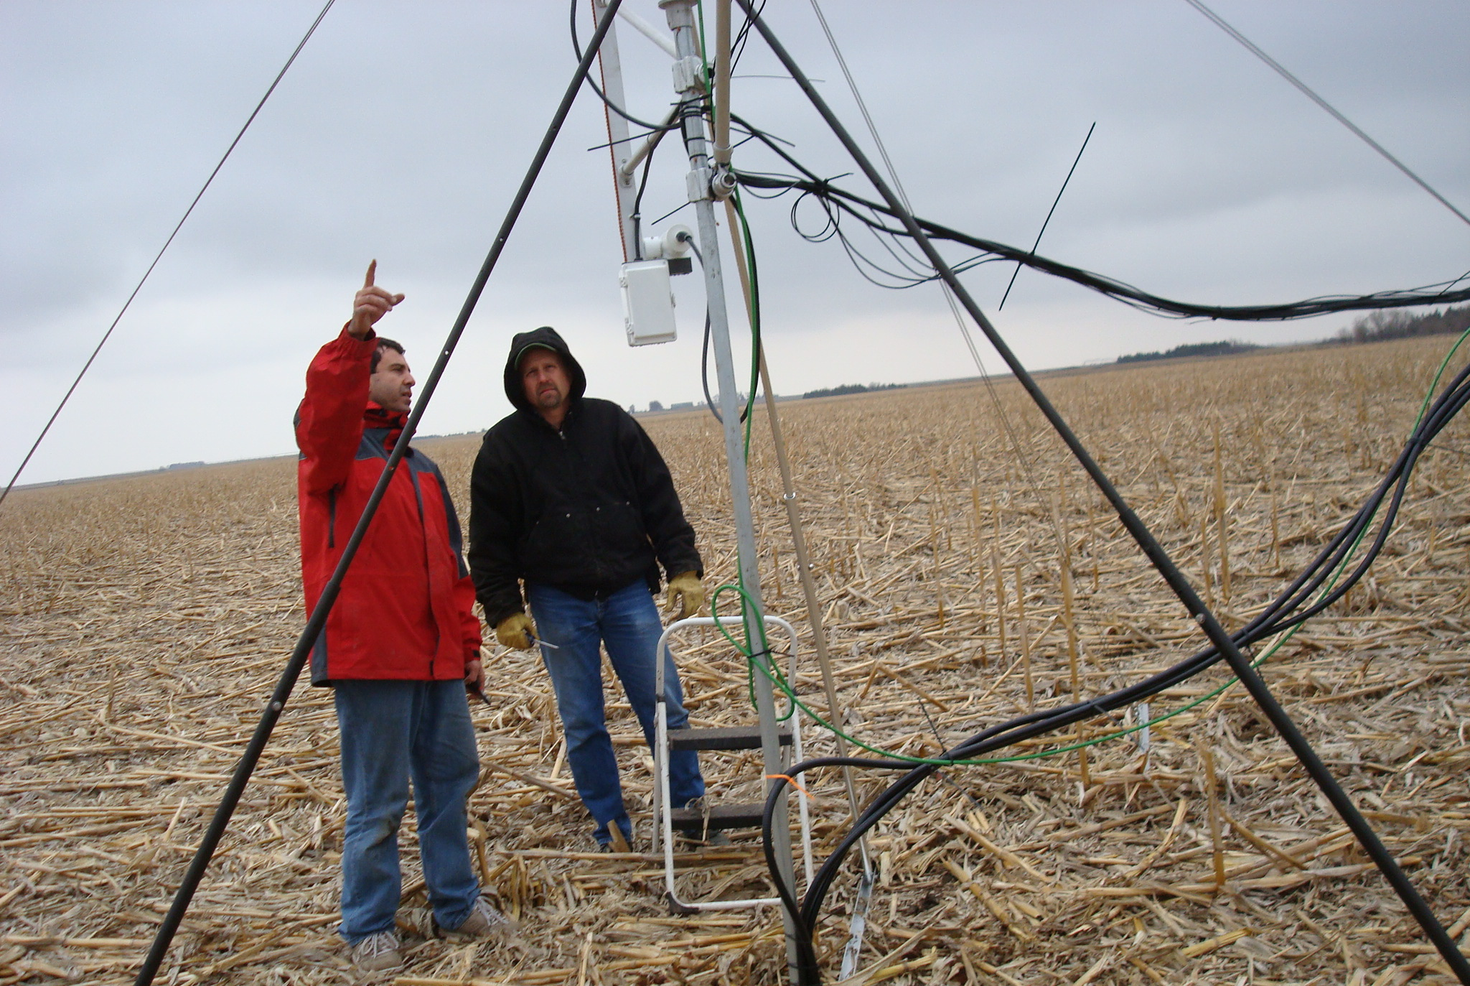
Long term, no-till leads to:
better soil structure
less soil crusting
greater infiltration of water
less surface runoff

Slide 6
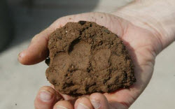
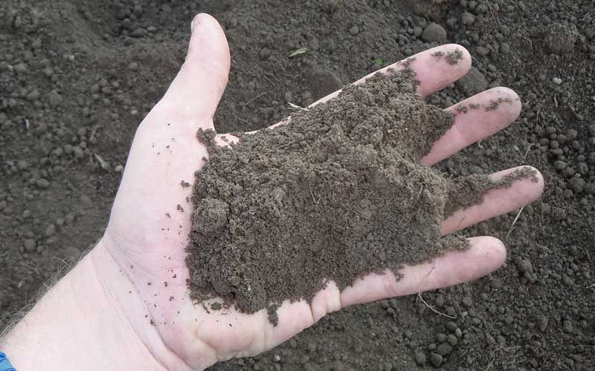
Which soil type holds more water?
Fine Soil
Coarse Soil
Small pores
Many of them!
Larger pores
Fewer of them
Has 2+ in. of water per foot of soil depth
Has 0.5-1 in. of water per foot of soil depth
Notes:
Which soil type hold more water?
Crops can use about half of the available water without experiencing water stress and associated yield reduction. With the large range of available water for different soil types, a better understanding of soil water and soil physical properties is needed before fine tuning an irrigation schedule.

Slide 7
Talk – Write – Draw
What factors influence the efficiency of irrigation?
How does crop residue facilitate water efficiency?
How does pore size affect water availability for crops?
Notes:
Students will answer the following questions. Provide students a choice of how to process – talking, writing, or drawing. Designate “processing stations” around the room and ask students to answer the following questions:
What factors influence the efficiency of irrigation?
How does crop residue facilitate water efficiency?
How does pore size affect water availability for crops?

Slide 8
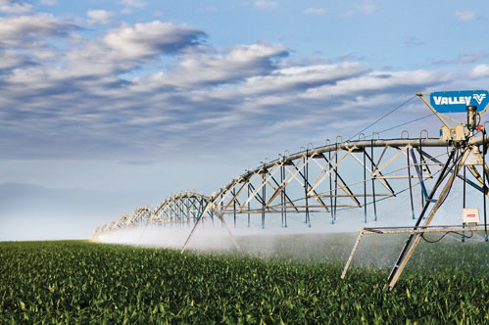
Irrigation Management
Full irrigation - irrigating to prevent crop water stress during the entire growing season at any plant growth and development stage
Will irrigate at any point in the growing season
Notes:
Managing irrigation to prevent crop water stress during the entire growing season at any plant growth and development stage is usually referred to as full irrigation management.
full irrigation management – irrigating to prevent crop water stress during the entire growing season at any plant growth and development stage
As we discussed, full irrigation management is not always an option due to the effects of drought, declining water table depths, reduced stream flow, water allocations, irrigation system design capacity, water quality issues, etc. Therefore, less irrigation than what is required to meet the crop water requirement is applied, which has led to the development of limited and deficit irrigation management practices.

Slide 9
Irrigation Management
Deficient irrigation - withholding water at crop growth stages that are less sensitive to water stress than others
Deficit irrigation ­– consists of withholding water at crop growth stages that are less sensitive to water stress than others
limited irrigation – distributes the total seasonal available water with fixed amounts throughout the growing season, independent of crop growth stage
Irrigate only when it matters most!
Notes:
Deficit irrigation ­– consists of withholding water at crop growth stages that are less sensitive to water stress than others

Slide 10
Irrigation Management
Limited irrigation - distributes the total seasonal available water with fixed amounts throughout the growing season, independent of crop growth stage
Irrigate in fixed amounts throughout growing season
Notes:
limited irrigation – distributes the total seasonal available water with fixed amounts throughout the growing season, independent of crop growth stage
Therefore, the main difference between deficit and limited irrigation practices is that deficit irrigation management accounts for crop growth stages and limited irrigation management does not.

Slide 11
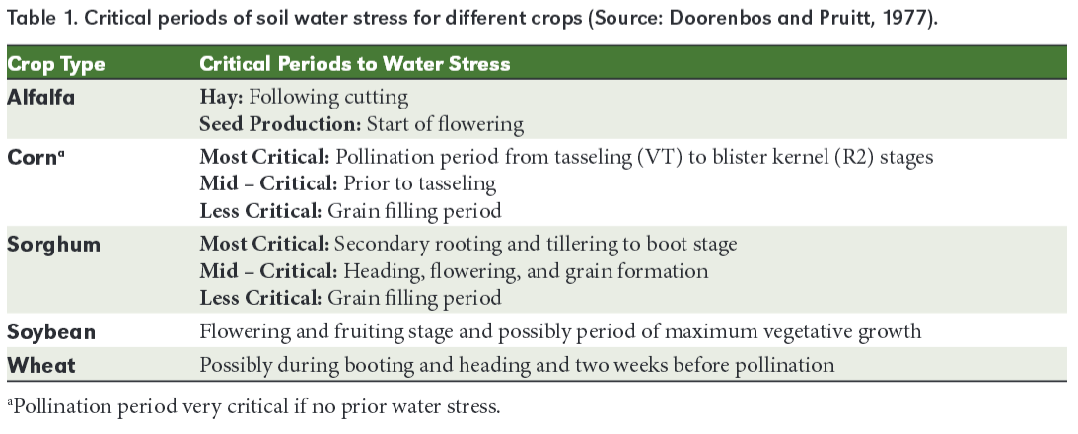

Slide 12
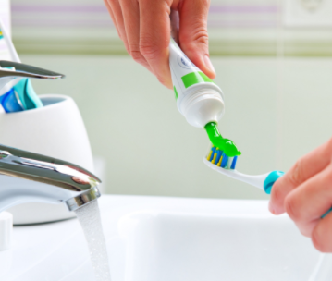
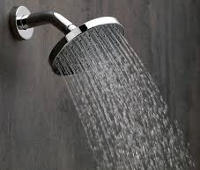
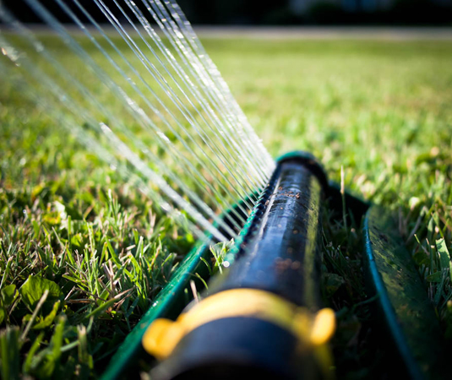
How do you use water?
How can you be more efficient with water?
Notes:
Agricultural producers who utilize irrigation must be good stewards of the natural resources they use, including water. Even those of us who aren’t involved in production agriculture use water everyday. We too play a role in being a good steward of water. What are ways that we use water? How can we be more efficient in our water usage?
Instruct students to capture their thoughts in their science notebook. Elicit responses from students.

Slide 13
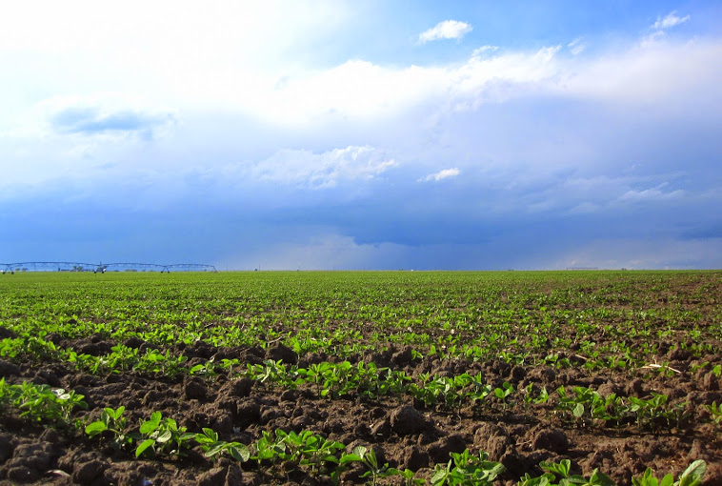
How do producers know when to irrigate?
Notes:
How do producers know when it’s time to irrigate? (Elicit responses from students)
Knowing when to irrigate can take time and experience. The evolution of technology has certainly influenced irrigation management. There are now tools available that help producers make irrigation decisions. Let’s explore these tools and how they work.
Divide the class into two groups. Each group is responsible for researching a tool used for water and irrigation management, and subsequently teaching the class about this tool. Encourage students to utilize the Agricultural Water Management Guide and other online resources. Provide students with about 20 minutes to research and prepare a 3-minute presentation. Students can present this information through a demonstration, activity, or skit.
Tools to Research:
ET Gauge­
Soil Moisture Sensors
During the presentation, instruct students to capture important information in their science notebook. Ensure the following points are covered in the student presentations

Slide 14
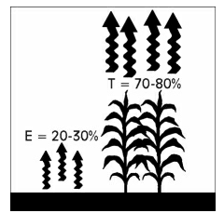
ET Gauge
ET Gauge – a device used to measures evaporation and transpiration, or EVAPOTRANSPIRATION, from soil and plants
Evaporation – loss of water from soil surface
Transpiration – loss of water from the leaves of crop

Slide 15
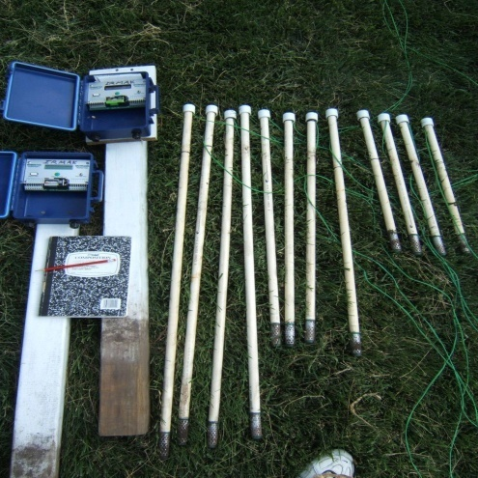
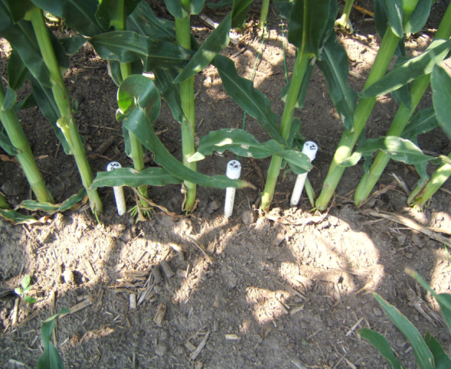
Soil Moisture Sensors
Soil Moisture Sensors - a device that measures the quantity of water contained in soil

Slide 16
Irrigation Management Plan
Consider:
Type of tillage practice
Type of irrigation system
Number of inches corn needs during growing season
Historical precipitation (in science notebook)
Irrigation technology/tools
Pat & Pam Producer
Notes:
Develop an Irrigation Management Plan (can be assigned as homework)
Pat and Pam Producer grow corn and soybeans in Nebraska. They’ve decided to turn 140 dryland acres into irrigated acres and need your help with the water and irrigation management strategy. Pat and Pam plan to grow corn on these acres in the coming year. They have hired you to develop an irrigation management strategy for the growing season.
Work with a partner to develop an irrigation management plan for Pat and Pam. Make sure the plan addresses the following questions.
Consider:
What type of tillage practice should Pat and Pam utilize?
What type of irrigation system should Pat and Pam develop? Why?
If implementing full irrigation, how many inches of water does their crop need from April – October?
Assume the 140 acres receives the amount of precipitation outlined in the chart below (indicated by the bar chart). How much irrigated water should be applied each month from April – October?
What tools do you recommend Pat and Pam install? How will these help Pat and Pam?
To provide students with local precipitation history, check out the precipitation recorded in your county here.

Slide 17
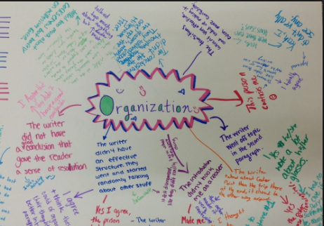
Chalk Talk!
Notes:
Prompt: Irrigation and water management…
Chalk Talk is a silent activity. Students are provided a prompt and respond to the response through writing. Students may pose additional questions and respond to one another’s comments. All communication happens by writing and drawing connections to questions or ideas. The instructor can participate and prompt conversation by writing additional questions.
The writing can take place on a spacious whiteboard or a long sheet of paper on the wall or floor.
In the chalk talk, students will review what they have learned about irrigation and water management. To start off the chalk talk, the instructor will write the prompt:
“Irrigation and water management…”
Provide each student with a marker to share thoughts and ideas in silence.
As the instructor, join in on the conversation by writing questions such as,
Why is irrigation management important?
What will you do to conserve water in your household?
How can producers be good stewards of water resources?
After providing adequate time for students to read and respond to the prompts and comments, summarize what was shared in the chalk talk.

Slide 18
Extension is a Division of the Institute of Agriculture and Natural Resources at the University of Nebraska–Lincoln cooperating with the Counties and the United States Department of Agriculture.
University of Nebraska–Lincoln Extension educational programs abide with the nondiscrimination policies of the University of Nebraska–Lincoln and the United States Department of Agriculture.

