Slide 1
Conventional Furrow Irrigation Developed by Nebraska Extension

Slide 2
Move the ball across the table… without touching!
Point A
Point B
Point C
Notes:
Your goal is to get the ball from one end of the table (Point A) to cross each “X” (Point B and Point C) – without touching the ball. If the ball falls on the floor, you will start at the beginning. Students are free to use materials in the front of the room (include straws in materials), but the materials cannot touch the ball.
Process and Transition:
What was the overall goal?
What was difficult about achieving this goal?
Think about agricultural production. What agricultural objects might the Ping-Pong ball represent – objects that farmers must move from one point to another? (Listen for: water)
Why is it important for producers to distribute these objects from one point to another?
Learning Objectives
By the end of the lesson, students should be able to:
Define conventional furrow irrigation.
Demonstrate how conventional furrow irrigation systems are designed and operate.
Discover the factors that influence the effectiveness of conventional furrow irrigation systems.
Discuss strategies to enhance the efficiency of conventional furrow irrigation systems.

Slide 3
How is water delivered to crops?
Convention
Furrow
Irrigation
Notes:
Have students answer this question in their science notebook. Have students share with class.
Listen for: gravity irrigation, surface irrigation, flood irrigation, furrows, or pipe.

Slide 4
Prevalence of Surface Irrigation
In the U.S.,
Surface Irrigation accounts for
28%
43%
of all irrigated acres
Of land in Nebraska is surface irrigated, with the majority using furrow systems.

Slide 5
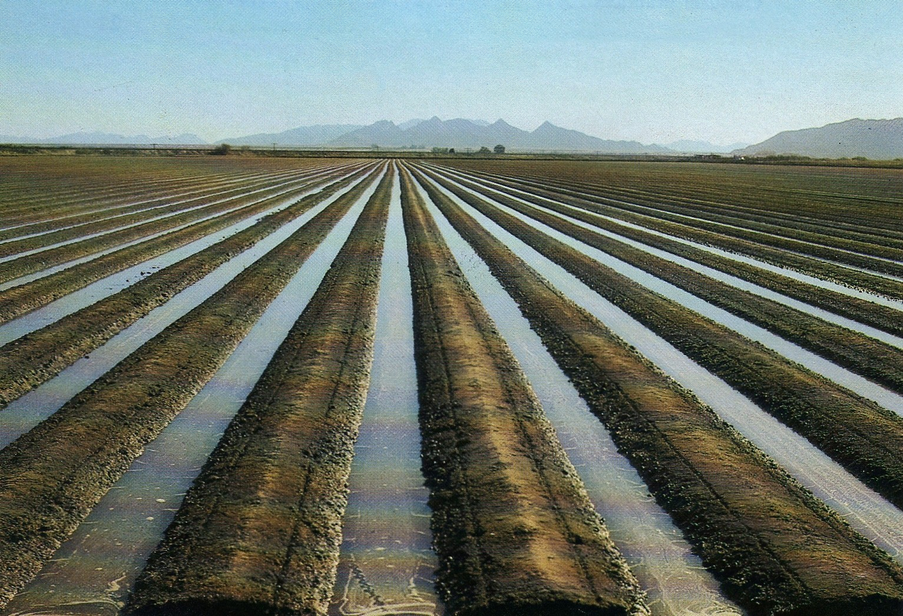
Key Terms
Conventional furrow irrigation – a type of surface irrigation where water applied to the field is guided by narrow channels – furrows ­– dug between the rows of crops.
Furrows ­– sloping, parallel channels cut into the soil surface between crop rows.
Ridges – long, raised strips of land.
Soil infiltration rate – water movement in the soil. Pore space in soil is the channel that allows water to infiltrate and percolate, or move downward through the soil.
Notes:
Capture these definitions in your science notebooks:

Slide 6
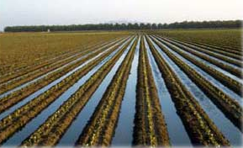
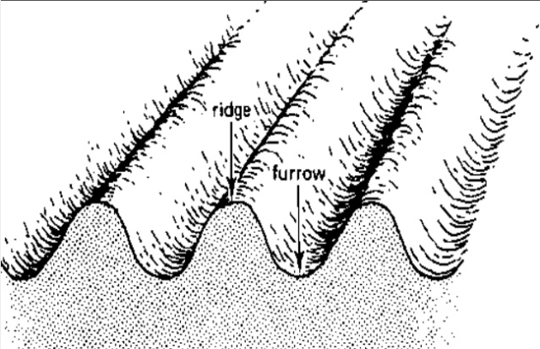
Label/Draw the following:
Ridge
Furrow
Soil Infiltration
Location of Seed/crop
Where water flows
Notes:
Ask students to identify the 1) ridge, 2) furrow, and 3) soil infiltration in the images their science notebook. Next, have students draw where the seed/crop is located and where the water flows in a furrow irrigation system.

Slide 7
Build Irrigation System!
As a team
Build a
system
To move two
cups of water
A distance of
ONE foot
Into TWO
containers
Notes:
Provide students materials such as paper cups, straws, tape, paper clips, clay, water, etc. to build their irrigation system. Upon construction, have students demonstrate and explain their system.
Process:
What worked well?
What was challenging?
If you could redesign your system, what would you do differently?
What have you learned about surface irrigation after designing your own irrigation system?

Slide 8
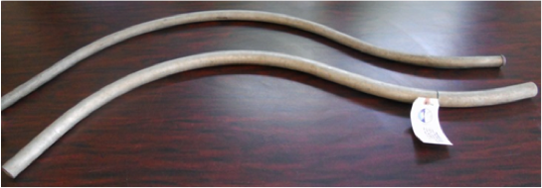
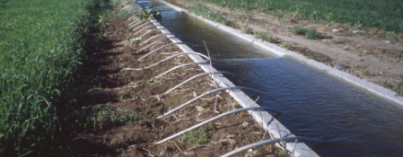
How Conventional Furrow Irrigation Works
Water is delivered to the top of each row using
siphon hoses or gates. The crop is irrigated as
water flows from the top to the bottom of each row.
Head Ditch & Siphon
Notes:
Head Ditch and Siphon: Water is pumped into the head ditch that stretches across the field. The head ditch is the reservoir from which the siphon transfers water into the furrows.
The widespread use of these tubes for irrigation was due to their development in 1934 and marketing by a Cozad, NE irrigator.

Slide 9
Key Terms
Siphon tubes – small curved pipes, ½ - 4 in. in diameter, that deliver water to the furrows. Siphon tubes transfer water from the head ditch to the furrows.
Gated pipe – large portable pipe (up to 17 inches in diameter) with gate openings spaced to deliver water to the furrows. Water is pumped from the source through a pipe, and openings of the gated pipe can be regulated to control the amount of water allows into the furrows
The set size – the number of gates opened or tubes set ­– significantly impacts both how fast water advances across the field and the amount of water being applied.
Notes:
Capture these definitions in your science notebooks:

Slide 10
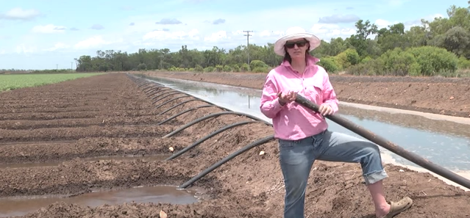
Siphon Irrigation Video
Click Here to View Video

Slide 11
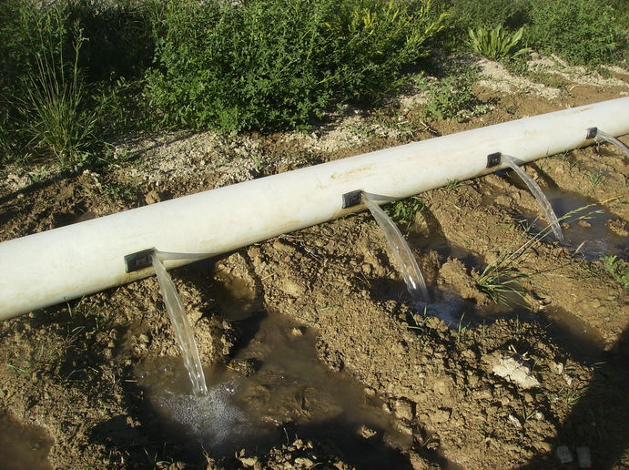
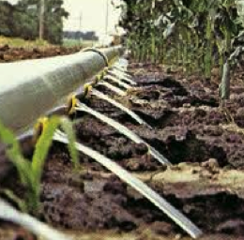
How Conventional Furrow Irrigation Works
Water is delivered to the top of each row using
siphon hoses or gates. The crop is irrigated as
water flows from the top to the bottom of each row.
Gated Pipe
Notes:
Water is pumped through a pipe that stretches across the field. The gates along the pipe slide, and are adjustable. This allows the producer to regulate the amount of water released into the furrows.
Point to the pipe and gates in the image.
Gated pipe was first produced in California – but the second company to produce gated pipe is Hastings Irrigation Pipe!

Slide 12
3 Factors that Influence Irrigation Effectiveness
Soil Texture
Soil Surface Conditions
Slope of Field
Notes:
Uniform application of water is not possible with a conventional furrow irrigation system. However, understanding the irrigation system and factors that influence its effectiveness can help improve uniformity.
3 factors that influence the effectiveness of conventional furrow irrigation systems:
Soil texture: Furrows can be used on most soil types. However, very coarse sands are not recommended because percolation losses can be high.
Soil surface conditions: Very loose or recently tilled soil can result in a very high infiltration rate, and result in too much water being absorbed at the furrow inlet. On the other hand, if the soil has been packed by heavy rains or by water flowing over the surface, infiltration may be reduced. Considering if the soil is loose or tightly packed, wet or dry will influence the infiltration rate in furrow systems.
Slope of field: Uniform flat or gentle slopes are preferred for furrow irrigation.

Slide 13
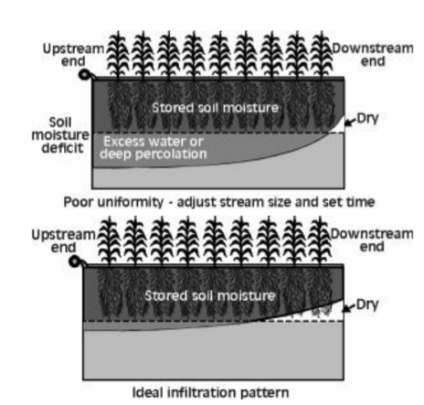
Soil infiltration rate is critical to furrow irrigation systems!
Notes:
Soil infiltration rate is critical to furrow irrigation systems. If the infiltration rate is too high, the depth of water that infiltrates near the furrow inlet will be much larger than at the end of the field. The infiltration rate of soil ultimately determines the feasibility of furrow irrigation. To efficiently operate a furrow irrigation system, management practices must be adapted to the field conditions at the time ­of the irrigation.
Discuss what soil conditions lead to excess water. Note that the Infiltration rate varies from one irrigation to the next and from season to season.

Slide 14
Advantages
Inefficiencies
Solutions
Lower cost of
initial equipment
Wear and tear of irrigation pipe and gates can lead to water leaks
Flag and repair leaky gaskets and gates.
Lower cost of pumping per acre-inch of water
Time and labor required during irrigation season
Replace damaged gaskets and gates during the offseason
Water is not applied uniformly, water loss due to runoff, percolation beneath root zone, and evaporation from furrow channel
Block furrow ends to reduce runoff
Utilize runoff by incorporating reuse system
Notes:
Instruct students to work as a group to identify and list advantages and inefficiencies of conventional furrow irrigation systems in their science notebook. Encourage students to use the Agricultural Water Management Guide and other online resources to support their answers.
Next, ask students for ideas on how to improve upon these inefficiencies. Create a new column entitled “Solutions” to list their ideas. Use the following table to guide discussion.
Minimizing inefficiencies to irrigation systems can save money and labor. Normal wear and tear associated with piecing together sections of irrigation pipe and opening and shutting gates can cause significant inefficiencies to irrigation over time.
The efficiency of any irrigation system, including furrow systems, is strongly influenced by how the system is managed. Almost filling the crop root zone, applying water uniformly, and either minimizing or utilizing runoff results in efficient irrigation.

Slide 15
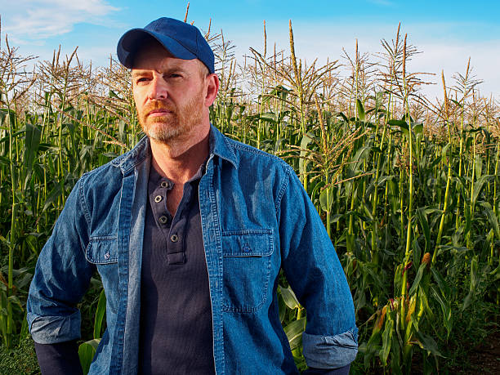
Input Needed!
A local farmer asks you for information about conventional furrow irrigation!
Create a summary sheet about this type of irrigation and what the farmer should know about its advantages and limitations.
Notes:
A local farmer is considering converting a dryland field into an irrigated one, and wants information about a conventional furrow irrigation system. The farmer asks for your input and recommendation! Create a summary sheet about this type of irrigation and what the farmer should know about its advantages and limitations.

Slide 16
What did you learn today about Conventional Furrow Irrigation?
Pop out of your chair and share!
Notes:
Apply/Generalize to Your Life
So now you are all agronomists! What are were some things you found out as you learned about irrigation?
EXTRA REVIEW
Create a chart labeled What We Learned in your Science Notebook, which might include: irrigation management goal, terms defined, careers related to irrigation, impacts of over/under irrigation, etc.

Slide 17
Extension is a Division of the Institute of Agriculture and Natural Resources at the University of Nebraska–Lincoln cooperating with the Counties and the United States Department of Agriculture.
University of Nebraska–Lincoln Extension educational programs abide with the nondiscrimination policies of the University of Nebraska–Lincoln and the United States Department of Agriculture.

