Slide 1
Center Pivot Irrigation Developed by Nebraska Extension
Notes:
In a moment, I will reveal a word or phrase. Upon seeing this word, write down everything you know about it! Capture your thoughts in your science journal.
Reveal the word “Center Pivot”. Allow students 1-2 minutes to write what they know or have experienced with center pivots. Once students are finished writing, ask students to share a few thoughts they captured.

Slide 2
Center Pivot
Notes:
Reveal the word “Center Pivot”. Allow students 1-2 minutes to write what they know or have experienced with center pivots. Once students are finished writing, ask students to share a few thoughts they captured.

Slide 3
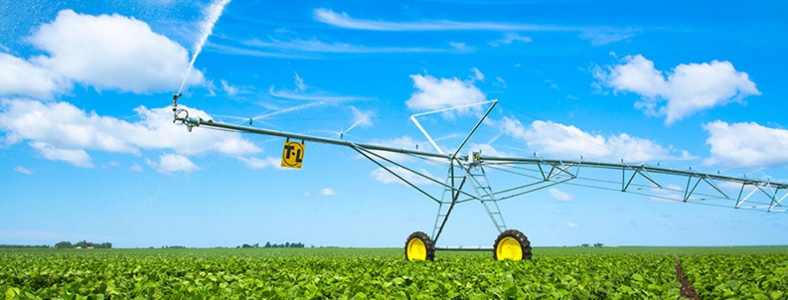
Center Pivot Irrigation
Used to irrigate 6.8 million acres of Nebraska cropland
Requires less labor
Increases producer’s ability to manage and automate water application
Notes:
Center pivots are the most widely used sprinkler system. Center pivots have been adapted to operate on many soils, to extremely variable terrain, and to provide water to meet many management objectives­. In Nebraska, center pivots are used to irrigate about 6.8 million acres of cropland. The number of acres irrigated by center pivots is increasing each year largely because the system requires less labor and provides substantial improvements in the operator’s ability to manage and automate irrigation water applications

Slide 4
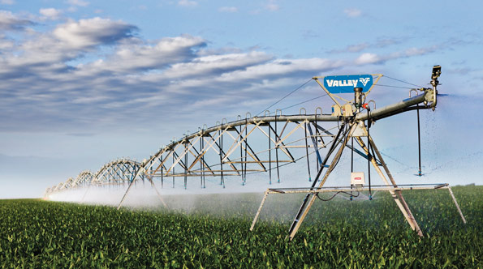
Key Terms
Center pivot irrigation – a water distribution pipeline anchored at one end and allowed to rotate or pivot from the stationary end.
Pivot Point ­– stationary end of the water distribution
pipeline. Connects the water source to the
main arm of the pivot.
Notes:
Capture these definitions in your science notebooks:

Slide 5
Length of Center Pivots
Varies from 300 feet → 2600 feet
Most center pivots measure 1300 feet – or 1/4 mile long
Irrigates 130 acres
130 acres
Notes:
About how long do you think a center pivot is?
The length of center pivots can vary from 300 feet to more than 2600 feet. However, most center pivots measure 1/4 mile long – about 1300 feet - with 6 or more towers that irrigate approximately 130 acres.
Lead a discussion about center pivot irrigation. Consider the following questions to help guide the discussion:
Why is center pivot irrigation important to Nebraska?
How does it compare to other irrigation systems we’ve discussed?
Why do you think center pivot irrigation is the most commonly used irrigation system in the state?

Slide 6
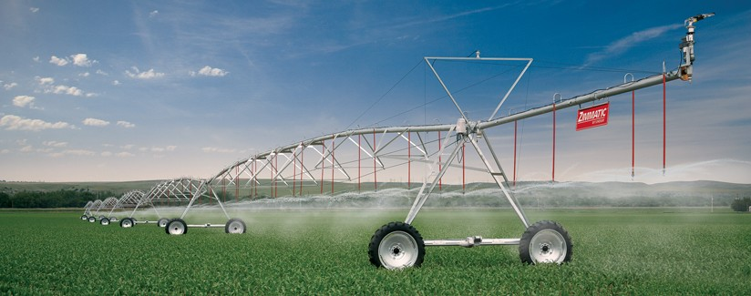
Time to Build!
Notes:
Students will work in teams of 2-3 to design and build a model of a center pivot irrigation system. Provide students materials such as, large drinking straws, small coffee stirring straws, tape, pipe cleaners, paper clips, rubber bands, scissors, yarn, thumb tack, tube, syringe, clay etc. to build their irrigation system. Upon construction, have students demonstrate and explain their system. Ask them to explain:
How water enters the center pivot (Listen for: Water is pumped into the pivot point from groundwater or surface water.)
How water is applied to crops (Listen for: water is pushed down the length of the pivot arm and out of the nozzles)
How center pivots move (Listen for: a motor powers the system to move on wheels in a circular motion)
Process:
What factors influence water distribution in center pivot systems? (Listen for: rate the system is moving, water pump rate, nozzle size)
What are potential inefficiencies when it comes to center pivot systems? (Listen for: evaporation)
How could the design improve to reduce evaporation? (Listen for: lower the nozzles closer to the ground, known as a dropped tube)
What have you learned about center pivot irrigation after designing your own system?
We have modeled a center pivot irrigation system, now let’s put a name to the components we’ve built.

Slide 7
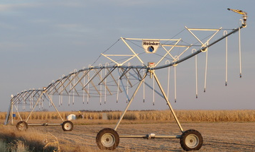
Components of Center Pivot Irrigation
Pivot Arm– The large pipe extending from the pivot point to the end of the field. The arm span is supported by the towers and moved by the wheels. Transports water to the nozzle while the system moves over the crop.

Slide 8
Components of Center Pivot Irrigation
Towers: Structures with wheels that transport the pivot arm.

Slide 9
Components of Center Pivot Irrigation
Drop Tubes: A hose that hangs from the pivot arm and delivers water closer to the soil surface. Used to decrease water lost to evaporation

Slide 10
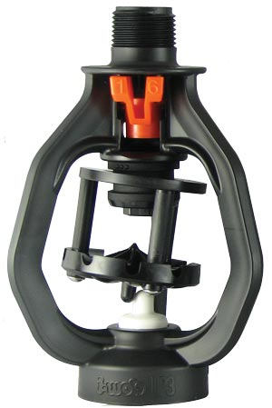
Components of Center Pivot Irrigation
Nozzles: A hollow tube that directs water to be deflected off a sprinkler pad. The size of the nozzle opening can alter the pressure of the water being pushed through it. Nozzles are attached to the top of the pivot arm or the end of a drop tube.

Slide 11
Components of Center Pivot Irrigation
Sprinkler Pad: a circular pad that distributes water in a pattern over the crop. The pattern and droplet size is determined by the surface texture, while the distance each droplet is determined by the pad’s curvature and motion.

Slide 12
Components of Center Pivot Irrigation
End guns – High-powered nozzles used to extend the reach of water to the corners of a field.
Notes:
With these components, water is supplied to the pivot point and distributed through the pivot arm and sprinkler nozzles where the water hits a sprinkler pad and is applied to the crop.

Slide 13
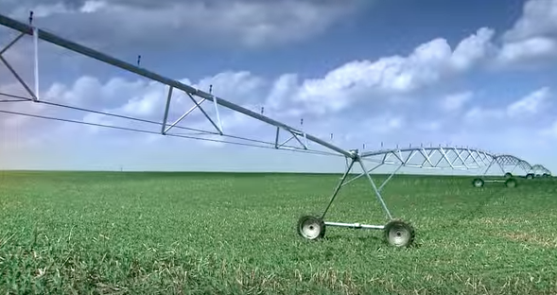
Center Pivot Irrigation Video
Click Here to View Video
Notes:
Show students this short video to watch how center pivot irrigation systems are made and operate.

Slide 14
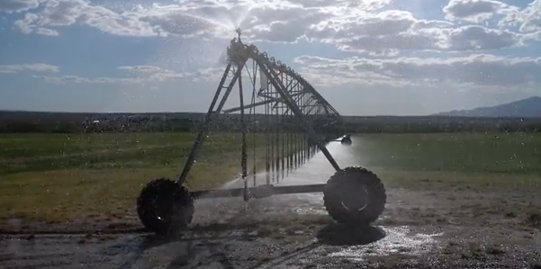
Draw and label the following:
Pivot Point
Pivot Arm
Towers
Drop Tubes
Nozzles
Sprinkler Pad
End Gun
Notes:
In your science notebook, draw a center pivot irrigation system. Next, label the following components of the system. Draw arrows to represent the flow of water through the system.
Pivot Point
Pivot Arm
Towers
Drop Tubes
Nozzles
Sprinkler Pad
End gun
What components of the center pivot systems are represented in our own center pivot models? Are there any components missing?
If time allows, allow students to add additional components (such as drop tubes) to their irrigation systems.

Slide 15
Research and Explore
?
What other sprinkler irrigation systems exist?
How do they work?
Notes:
Center pivots are one type of sprinkler irrigation systems. While center pivots are the most common, there are other sprinkler systems that are used today. Let’s take a few minutes to investigate online resources to identify at least one alternative sprinkler irrigation system. Be prepared to share the name of a different sprinkler irrigation system and a general description of how it works.
Provide students about 5 minutes to search online to identify other sprinkler irrigation systems. Have students share with the class what they learned. Summarize the systems they’ve shared using the following points.

Slide 16
Other Sprinkler Systems
Tow Line Sprinklers ­– Invented in 1950s in Portland Oregon.
Consists of sections of pipe coupled together and tall sprinklers every 40 to 60 feet.
Can be moved by hand or tractor.
Traveling Volume Gun Sprinklers ­– Has large sprinkler (big gun) mounted on a wheeled cart that is mechanically moved across the field.
Good for irregularly shaped or long rectangular fields.
Could be cable-tow travelers or hose-pull travelers.
Lateral (linear) move systems ­– Similar to center pivot, except entire system moves horizontally across the field.
Primarily for rectangular shaped fields.
Fed water from ditch that extends across field or from a large hose
Notes:
Label the various types of sprinkler irrigation systems in your science notebook. Include a brief description of how the system operates.

Slide 17
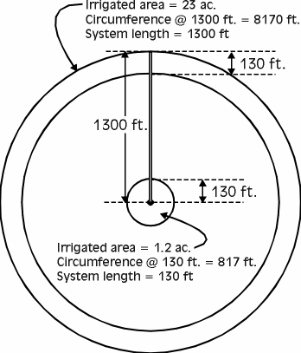
Requires 19x more water than first 130 feet
Has 1/7 the time to apply water
Notes:
Beginning at the pivot point, each additional foot of the system must irrigate an increasing area. For a 1300-foot-long center pivot making a complete circle, the first 130 feet of the system irrigates 1.2 acres, and the last 130 feet of the system irrigates 23 acres.
To distribute the same amount of water to every­ portion of the field, the last 130 feet of the system must receive more than 19 times more water than the first 130 feet.
Combining the travel speed and the area irrigated means that 19 times the area must receive water in one-seventh of the time.

Slide 18
Factors that Influence Center Pivot Water Application
Speed of Pivot
Flow Rate
Sprinkler Package (nozzle & sprinkler pad)
Notes:
So what influences the amount of water that is distributed? The primary factors include 1) The speed of pivot and 2) the amount of water being pumped into the system, and 3) the sprinkler package.

Slide 19
Factors that Influence Center Pivot Water Application
Speed of Pivot
Controlled by producer
The faster the center pivot rotates around the field, the lighter the application of water.
Last 130 feet of the system must receive more than 19 times more water than the first 130 feet in one-seventh of the time.
Notes:
Speed of pivot – The producer controls speed of movement. The faster the center pivot rotates around the field, the lighter the application of water. Towers do not move at equal speeds. To distribute the same amount of water to every­ portion of the field, the last 130 feet of the system must receive more than 19 times more water than the first 130 feet in one-seventh of the time.

Slide 20
Factors that Influence Center Pivot Water Application
Flow Rate
Controlled by producer
Amount of water being pumped into the irrigation system.
Measured in gallons per minute (gpm).
Notes:
Flow rate ­– Amount of water being pumped into the irrigation system and is controlled by the producer. Measured in gallons per minute (gpm). A system pumping 700 gpm will apply more water than a system pumping 500 gpm.

Slide 21
Factors that Influence Center Pivot Water Application
Includes a nozzle and sprinkler pad
Nozzles vary in diameter to control volume and pressure of water being applied to sprinkler pad (smaller diameters near the pivot point)
Sprinkler pad enlarges the area over which the nozzle applies water
Sprinkler pads can rotate and have varying textures to alter area covered and water droplet size
Sprinkler Package (nozzle & sprinkler pad)
Notes:
Sprinkler package – A sprinkler package is composed of a nozzle that directs a stream of water under pressure to a circular sprinkler pad, which enlarges the area over which the nozzle applies water.
Nozzles have varying diameters, which help control the volume and pressure of the water being applied to the sprinkler pad. Nozzles near the pivot point will have smaller diameters than those at the end of the system.
Some sprinkler pads are designed to rotate; these spinner pads throw water at greater distances. The surface of a sprinkler pad can range from smooth, to shallow grooves, or deep grooves. The texture of the pad determines the area covered and water droplet size. The deeper the grooves, the larger the water droplet. Larger droplets reduce water loss to evaporation, but could also compact the soil surface.

Slide 22
EVAPORATION
Lower water pressure
Lower spray height
Decrease distance of spray (from pads)
Select larger diameter nozzles
Use deeper grooved sprinkler pads
Notes:
Instruct students to draw an image in their science notebooks that represents factors that influence the water application of center pivot irrigation systems.
Next to the images, have students describe why this factor influences irrigation efficiency.

Slide 23
High-Five Hustle
Water from sprinkler systems are subject to this type of water loss.
One strategy to reduce evaporation, thereby increasing water efficiency is…
One interesting nugget I learned today was…
Notes:
High-Five Hustle
Ask students to stand up, raise their hands and high-five a peer -- their short-term high-five buddy. When all students have found a buddy, ask a question for them to discuss. Solicit answers from two students. Tell them to “Hustle” and find a different high-five buddy for the next question. Repeat for the third question.
Water from sprinkler systems are subject to this type of water loss. (evaporation)
One strategy to reduce evaporation, thereby increasing water efficiency is…
One interesting nugget I learned today was…

Slide 24
Extension is a Division of the Institute of Agriculture and Natural Resources at the University of Nebraska–Lincoln cooperating with the Counties and the United States Department of Agriculture.
University of Nebraska–Lincoln Extension educational programs abide with the nondiscrimination policies of the University of Nebraska–Lincoln and the United States Department of Agriculture.

