Slide 1

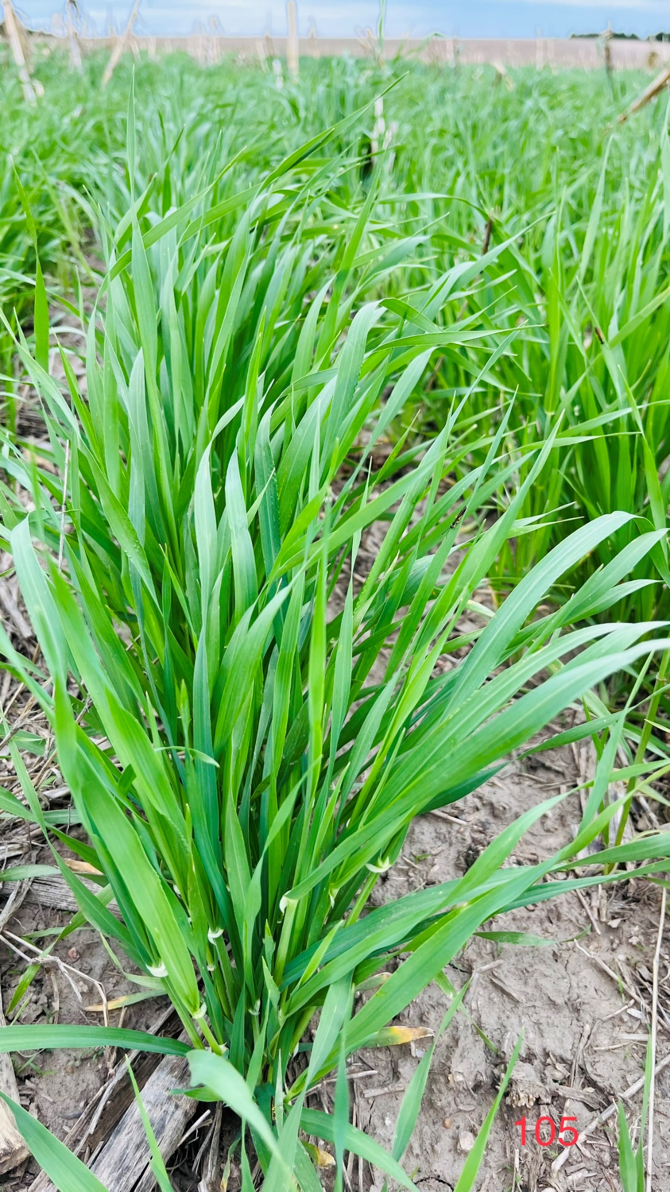



Webinar series: Session-4
Addressing common cover crop
Challenges & questions in Nebraska
How Much Cover Crop Biomass to Expect in Nebraska?
Vesh Raj Thapa
Postdoctoral Research Associate
Department of Agronomy and Horticulture
University of Nebraska-Lincoln

Slide 2
Outline
01
Introduction and why biomass matters?
02
Influencing factors
03
Research and evidence
04
Summary

Slide 3
Introduction and Why Biomass Matters?

Slide 4
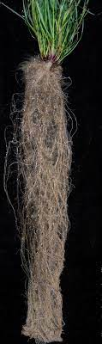
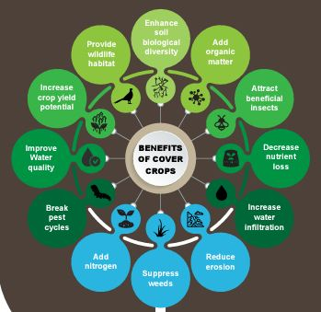
Definition & Significance
Above- and below-ground plant productivity
Above-ground: Shoots
Below-ground: Roots
CCs provide 50-75% of their photosynthesized carbon to soil through roots
Benefits of CCs is linked to biomass production
Annual rye grass
https://www.nrcs.usda.gov/sites/default/files/2024-07/South%20Dakota_Cover-Crop_Poster.pdf

Slide 5
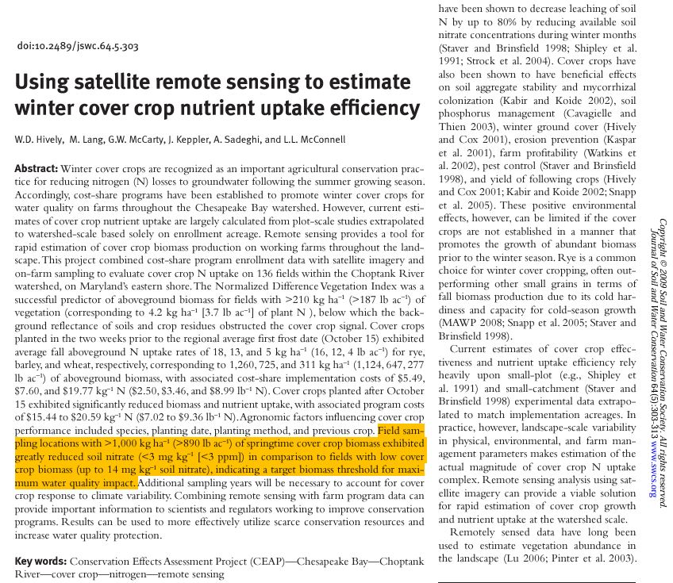
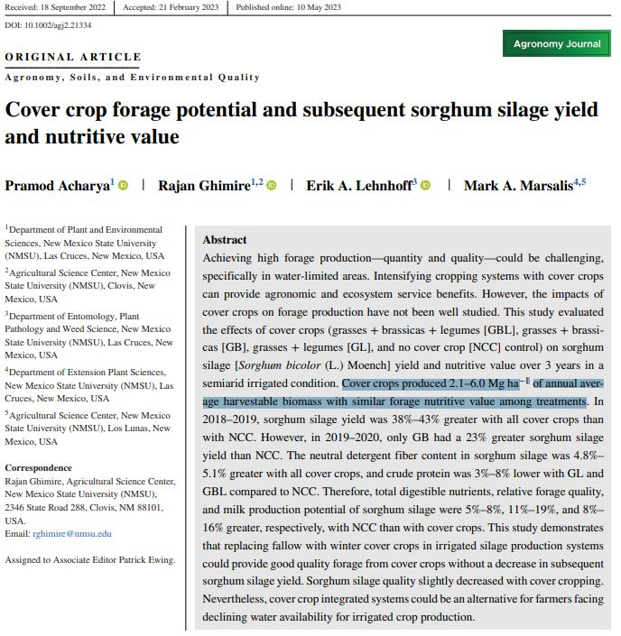
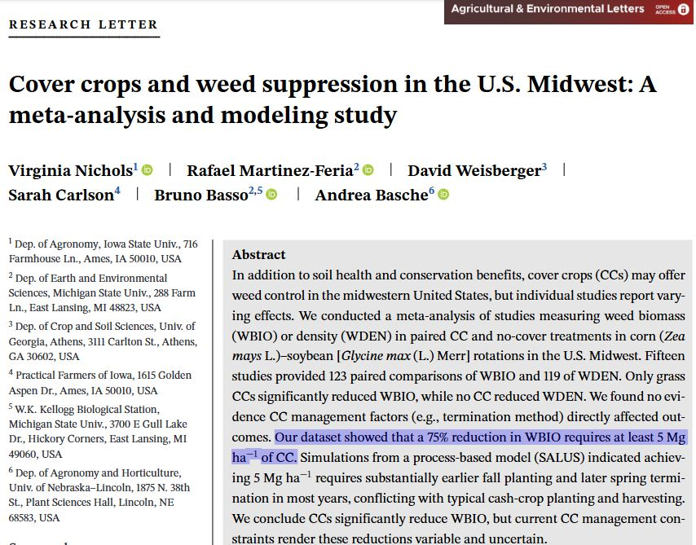
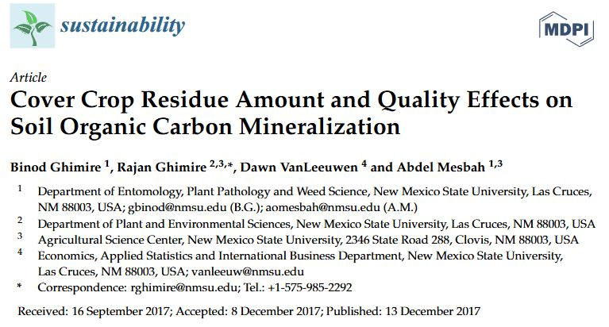
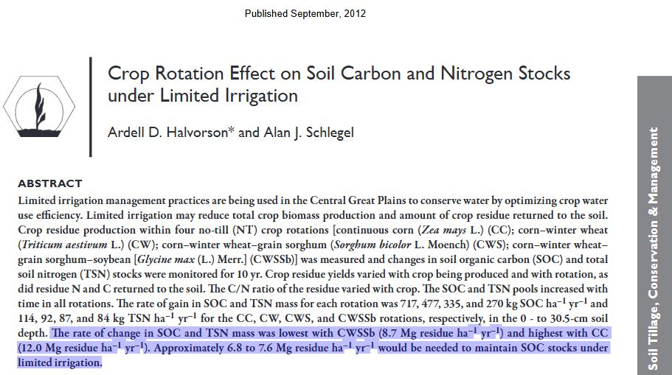

Biomass Thresholds
Ghimire et al., 2017
Nichols et al., 2023
Acharya et al., 2023
Halvorson and Schlegel, 2012
Hively et al., 2009

Slide 6
Influencing Factors

Slide 7
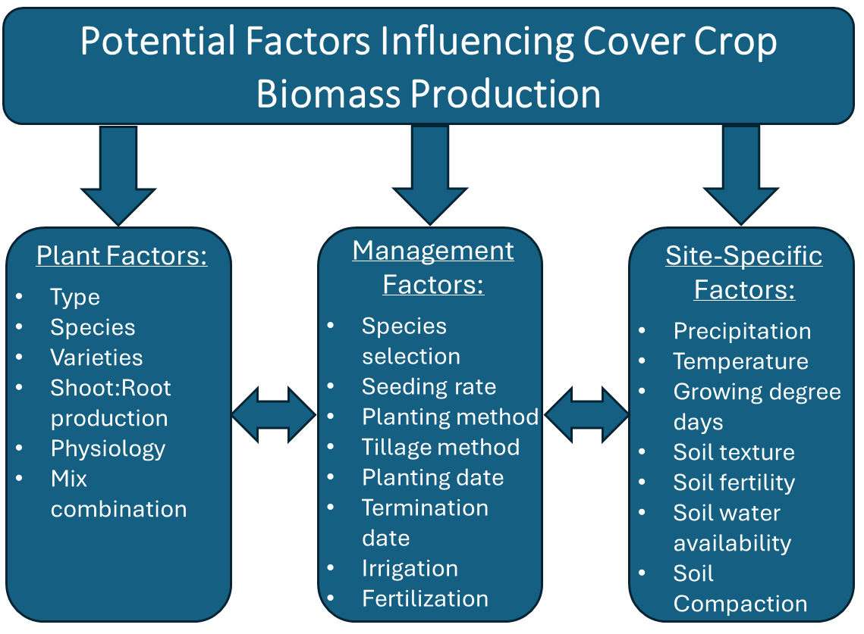
What Affects Biomass Production?
Species selection
Regional climate
Soil type and fertility
Growing window
Ruis et al., 2019

Slide 8
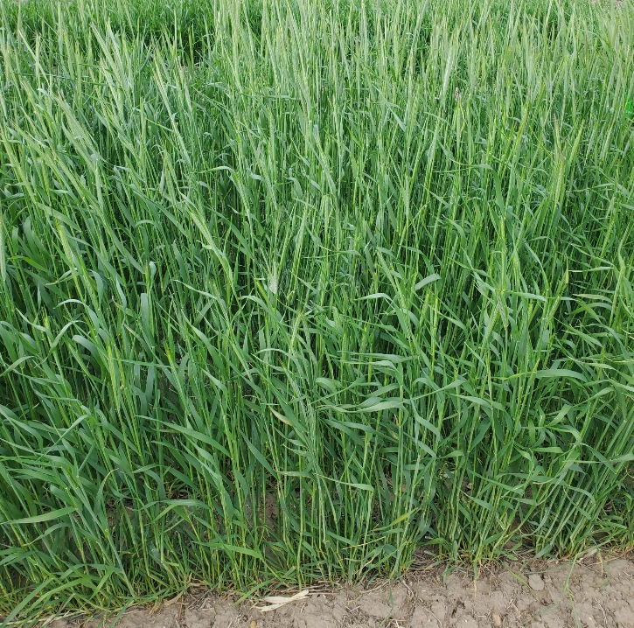
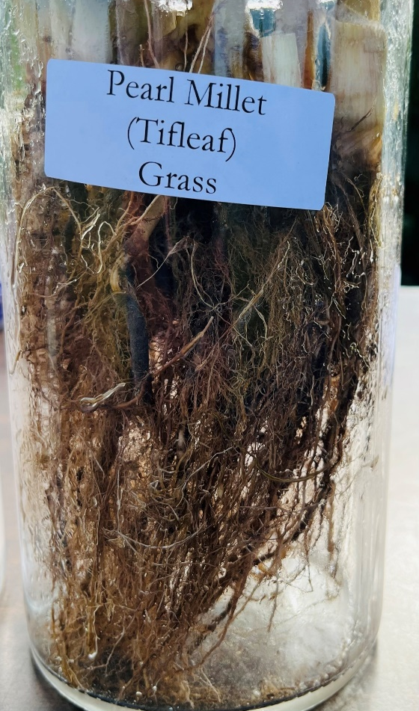
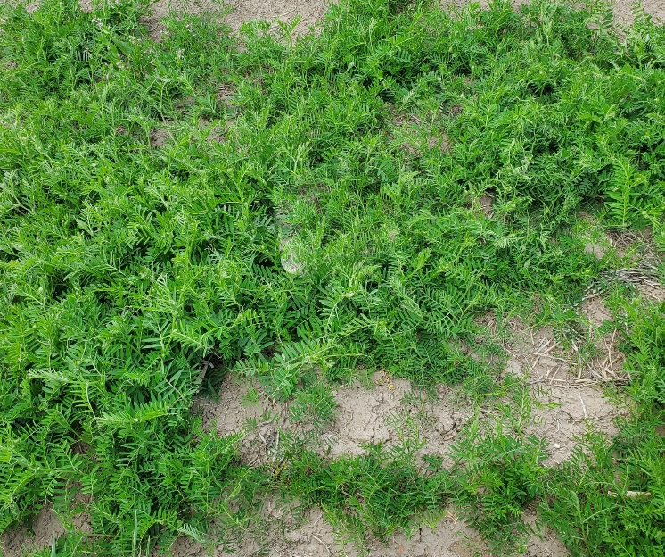
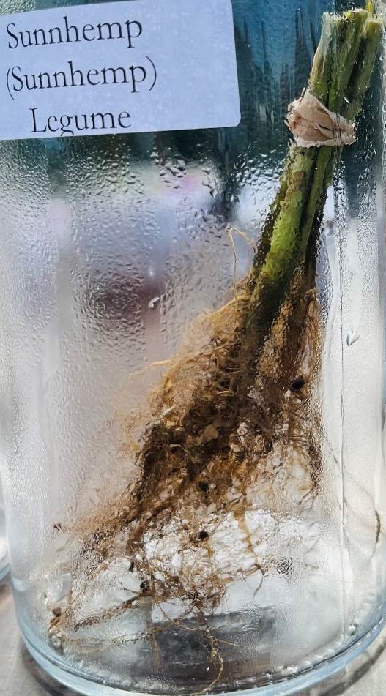
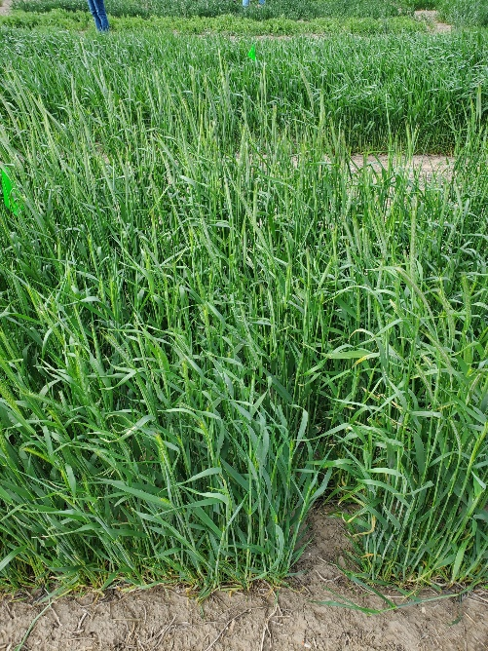
Cover Crop Species and Biomass Potential
Variables | Grasses | Legumes | Broadleaves | Mixtures
Root system | Fibrous | Taproot | Taproot or fibrous | Combination
C:N ratio | High (> 25:1) | Low (<20:1) | Variable | Balanced
Biomass (lbs./ac) | 2,000-4,000 | 1,000-2,000 | 500-2,500 | Dependent on species ratios
Examples | Cereal rye, Triticale, Oat | Hairy vetch, Cowpea, Pea | Radish, Turnip, Rapeseed | Rye + Hairy vetch + Radish
Yankee rye
NE hairy vetch
Elbon rye + AU-Merit hairy vetch

Slide 9
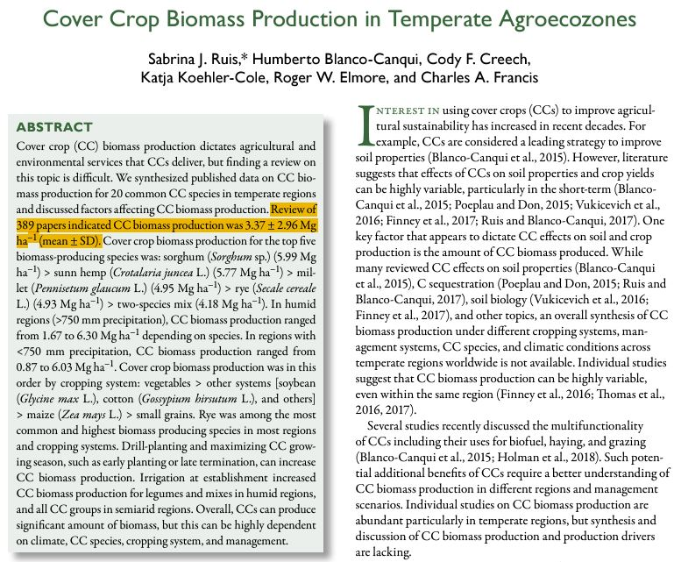
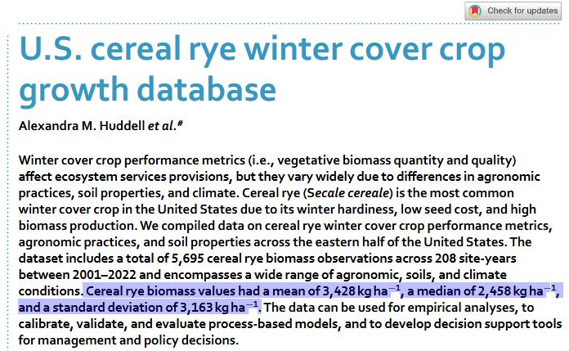
Consider the Range, Not Just the Mean
Consider the range to better understand species potential
Consider the range to better understand species potential
Many studies report mean biomass values
Focusing only on the mean overlooks variability
Many studies report mean biomass values
Focusing only on the mean overlooks variability
Biomass (kg ha⁻¹):
Mean: 3,428
Median: 2,458
Standard deviation: 3,163
Range: 265 to 6,591
Huddell et al., 2024
Ruis et al., 2019

Slide 10
Context of Nebraska

Slide 11
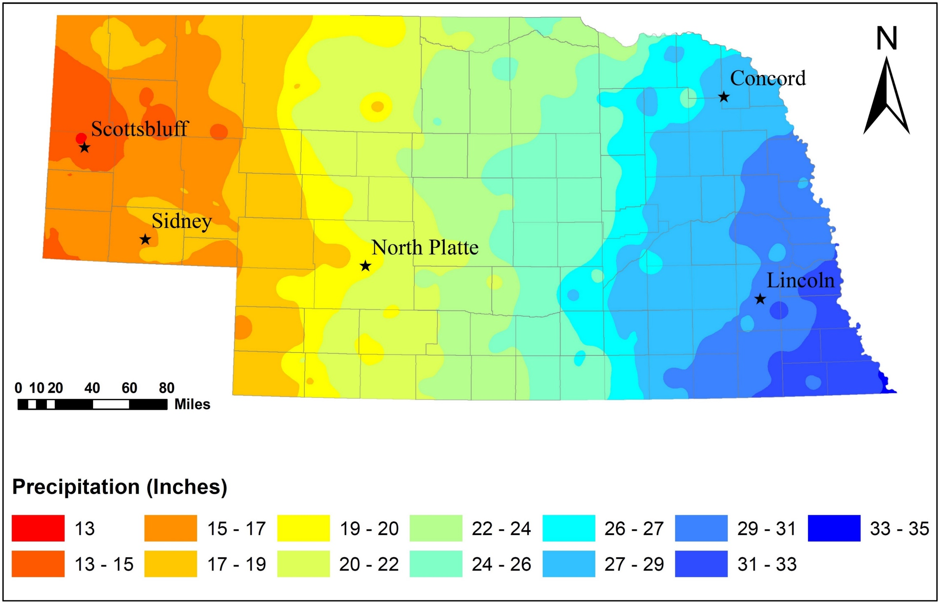
Nebraska’s Agro-Climatic Zones
Eastern Nebraska:
Higher precipitation (29 to 35 inches)
Longer growing season
Fine- or medium-textured soils with high fertility and adequate water availability
Central Nebraska:
Moderate precipitation (22 to 27 inches)
Diverse soil types with moderate fertility
Western Nebraska:
Limited precipitation (< 20 inches)
Shorter growing season
Harsh winters (cold & dry)
Coarse-textured soils with low fertility and water scarcity

Slide 12
Research and Evidence

Slide 13
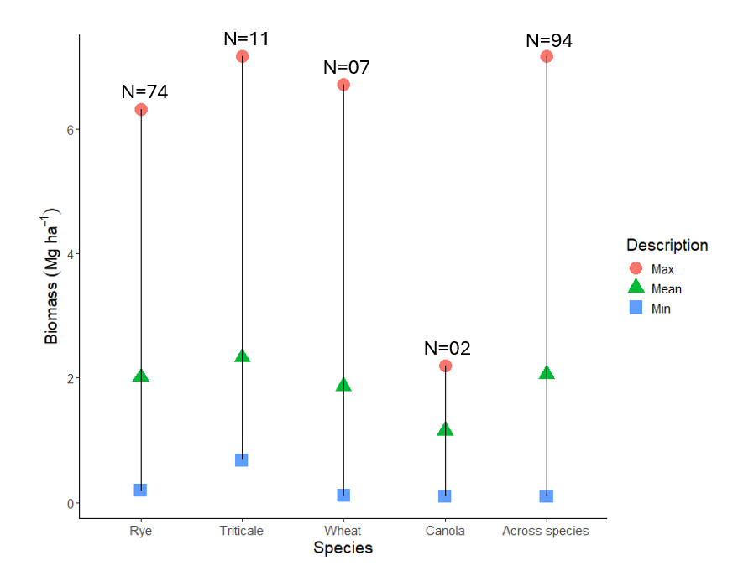
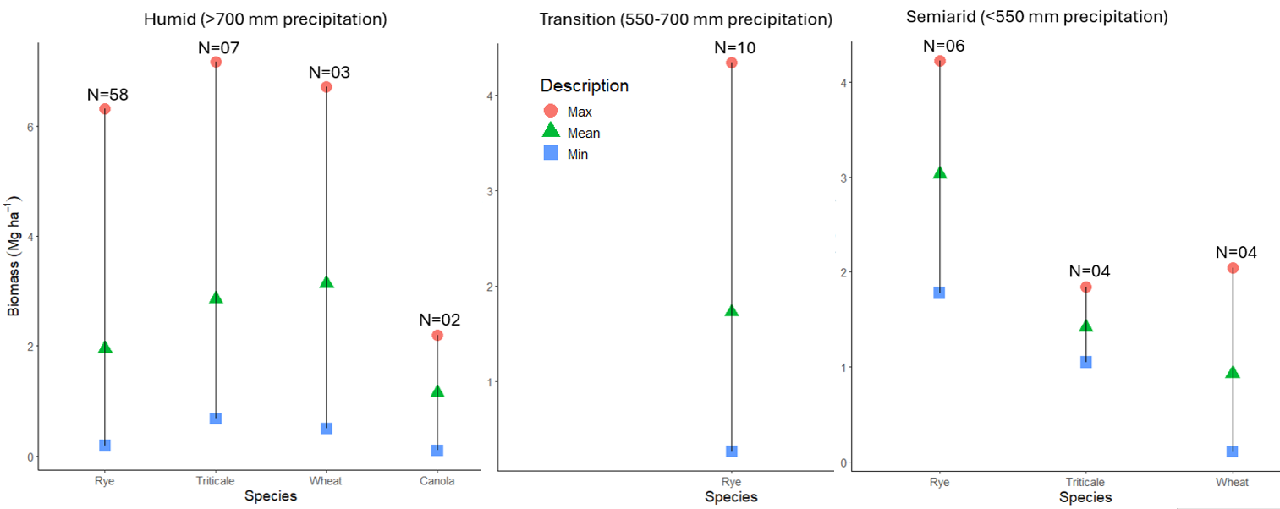
Review of Biomass across Nebraska
100 to 7,160 kg ha⁻¹
270 to 4,340 kg ha⁻¹
110 to 4,220 kg ha⁻¹
Biomass (kg ha⁻¹) across species and locations:
Mean: 2,105
Range: 100 to 7,160
Biomass range (kg ha⁻¹) by species:
Rye: 190 to 6,310
Triticale: 750 to 7,160
Wheat: 110 to 6,710
Canola: 100 to 2,200
1,780 to 4,220 kg ha⁻¹
100 to 2,200 kg ha⁻¹
2,170 to 6,710 kg ha⁻¹
190 to 6,310 kg ha⁻¹
750 to 7,160 kg ha⁻¹
1,650 to 1,840 kg ha⁻¹
110 to 2,040 kg ha⁻¹
≥ 1958 kg ha⁻¹

Slide 14
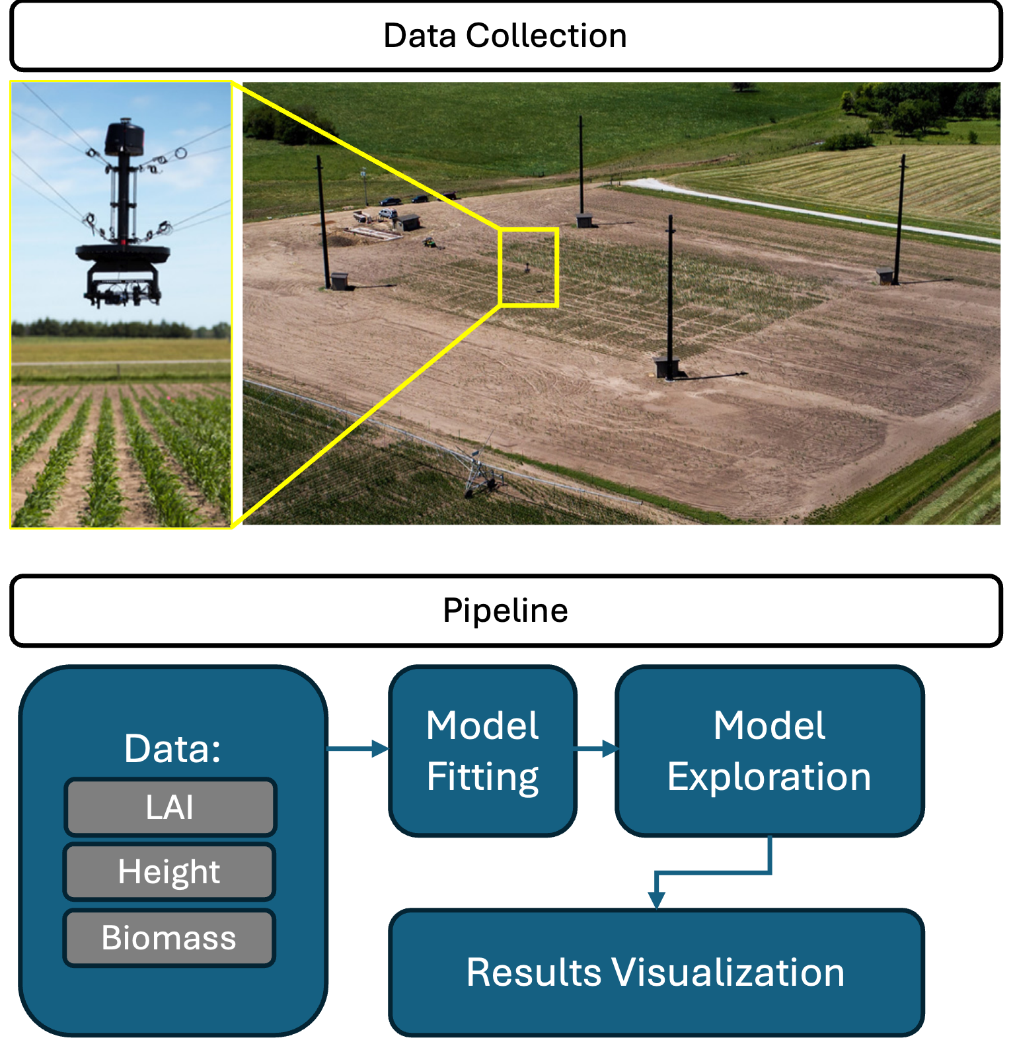
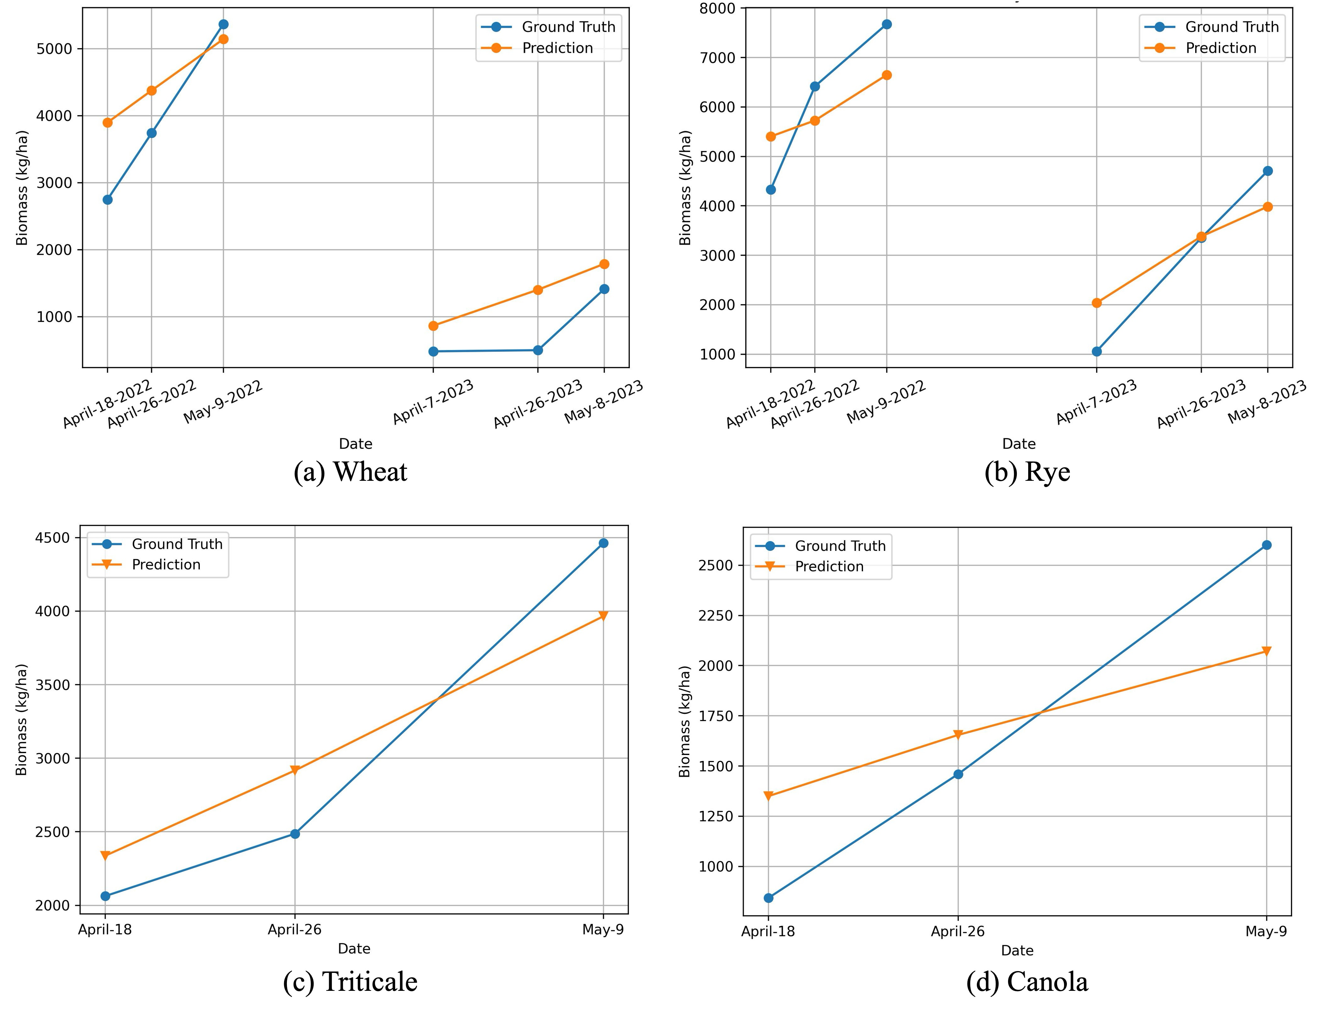
Winter Biomass Potential
2021 – 2022 growing season |  |  | 2022 – 2023 growing season
Planting date | Sampling dates | Termination date | Planting date | Sampling dates | Termination date
Sep 27 | April 18 April 26 May 09 | May 10 | Sep 26 | April 07 April 26 May 08 | May 09
Spidercam experiment, a unique field phenotyping site in Mead, NE

Slide 15
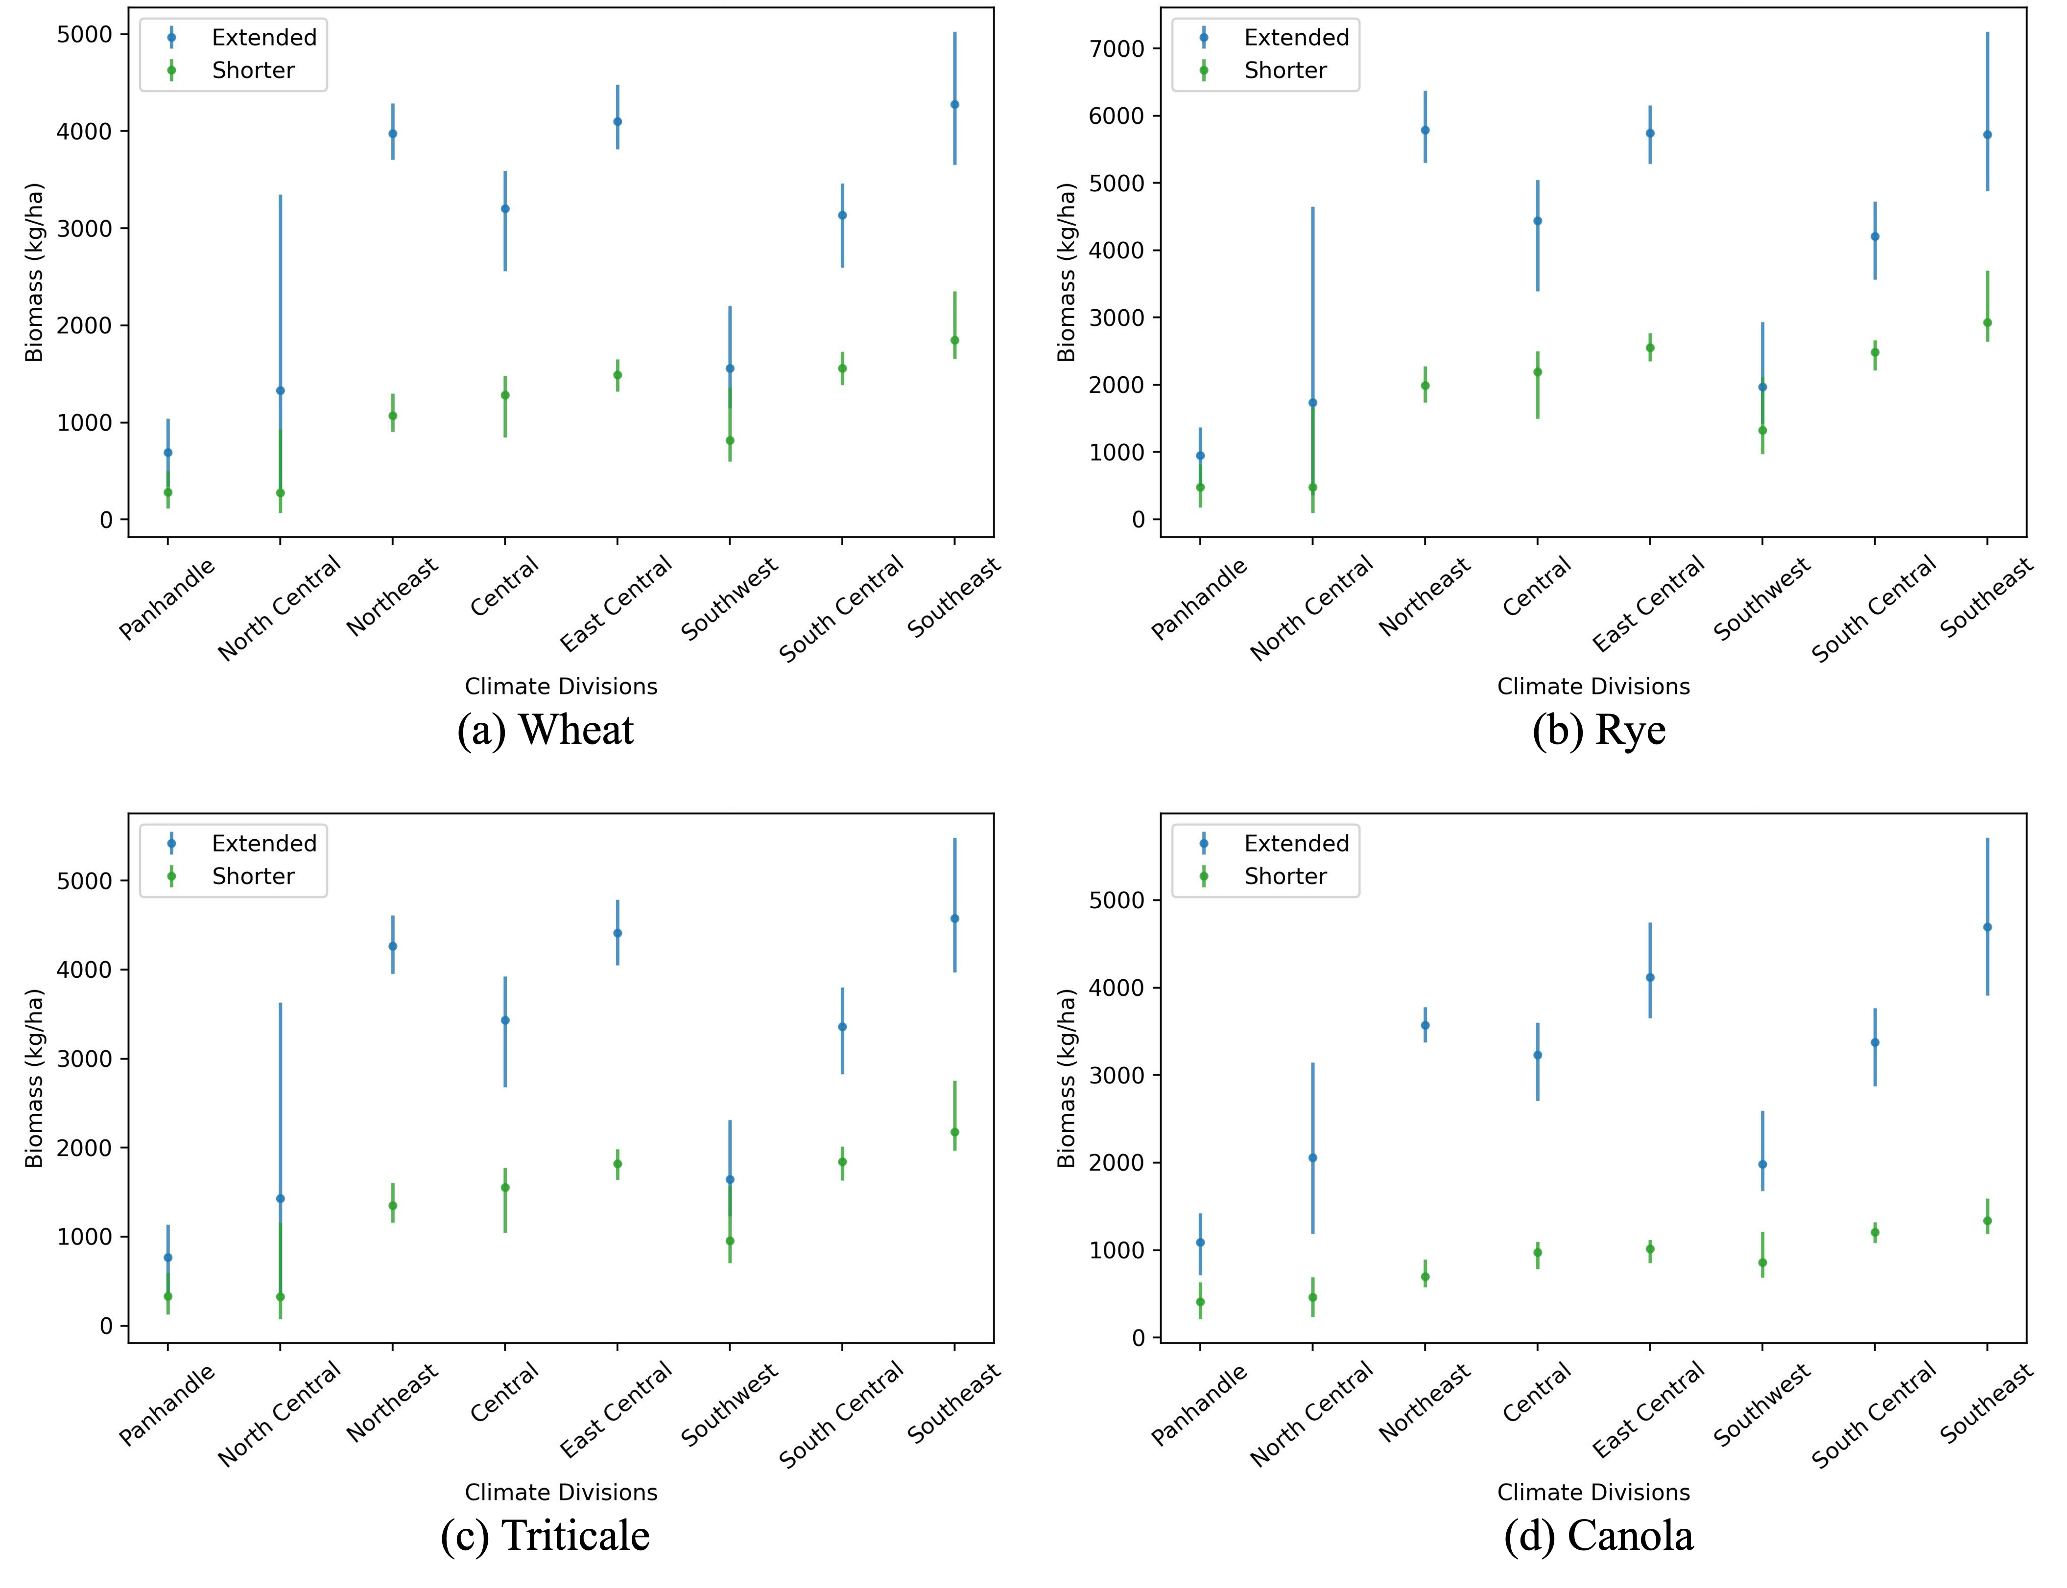
Cover crop growth gap (β_{g})
Shorter growing interval:
Early-Oct to Mid-April (Oct 10 to April 13)
Extended growing interval:
Mid-Sep to Early-May (Sep 14 to May 09)
β_{g} = β_{max} in extended – β_{min} in shorter
Average biomass losses in shorter growing interval:
Region | Wheat | Rye | Triticale | Canola
 | (%)
Panhandle | 40 | 50 | 43 | 37
North Central | 21 | 27 | 23 | 22
Northeast | 27 | 34 | 32 | 20
Central | 40 | 49 | 45 | 30
East Central | 36 | 44 | 41 | 25
Southwest | 53 | 67 | 58 | 43
South Central | 50 | 59 | 55 | 36
Southeast | 43 | 51 | 48 | 28

Slide 16
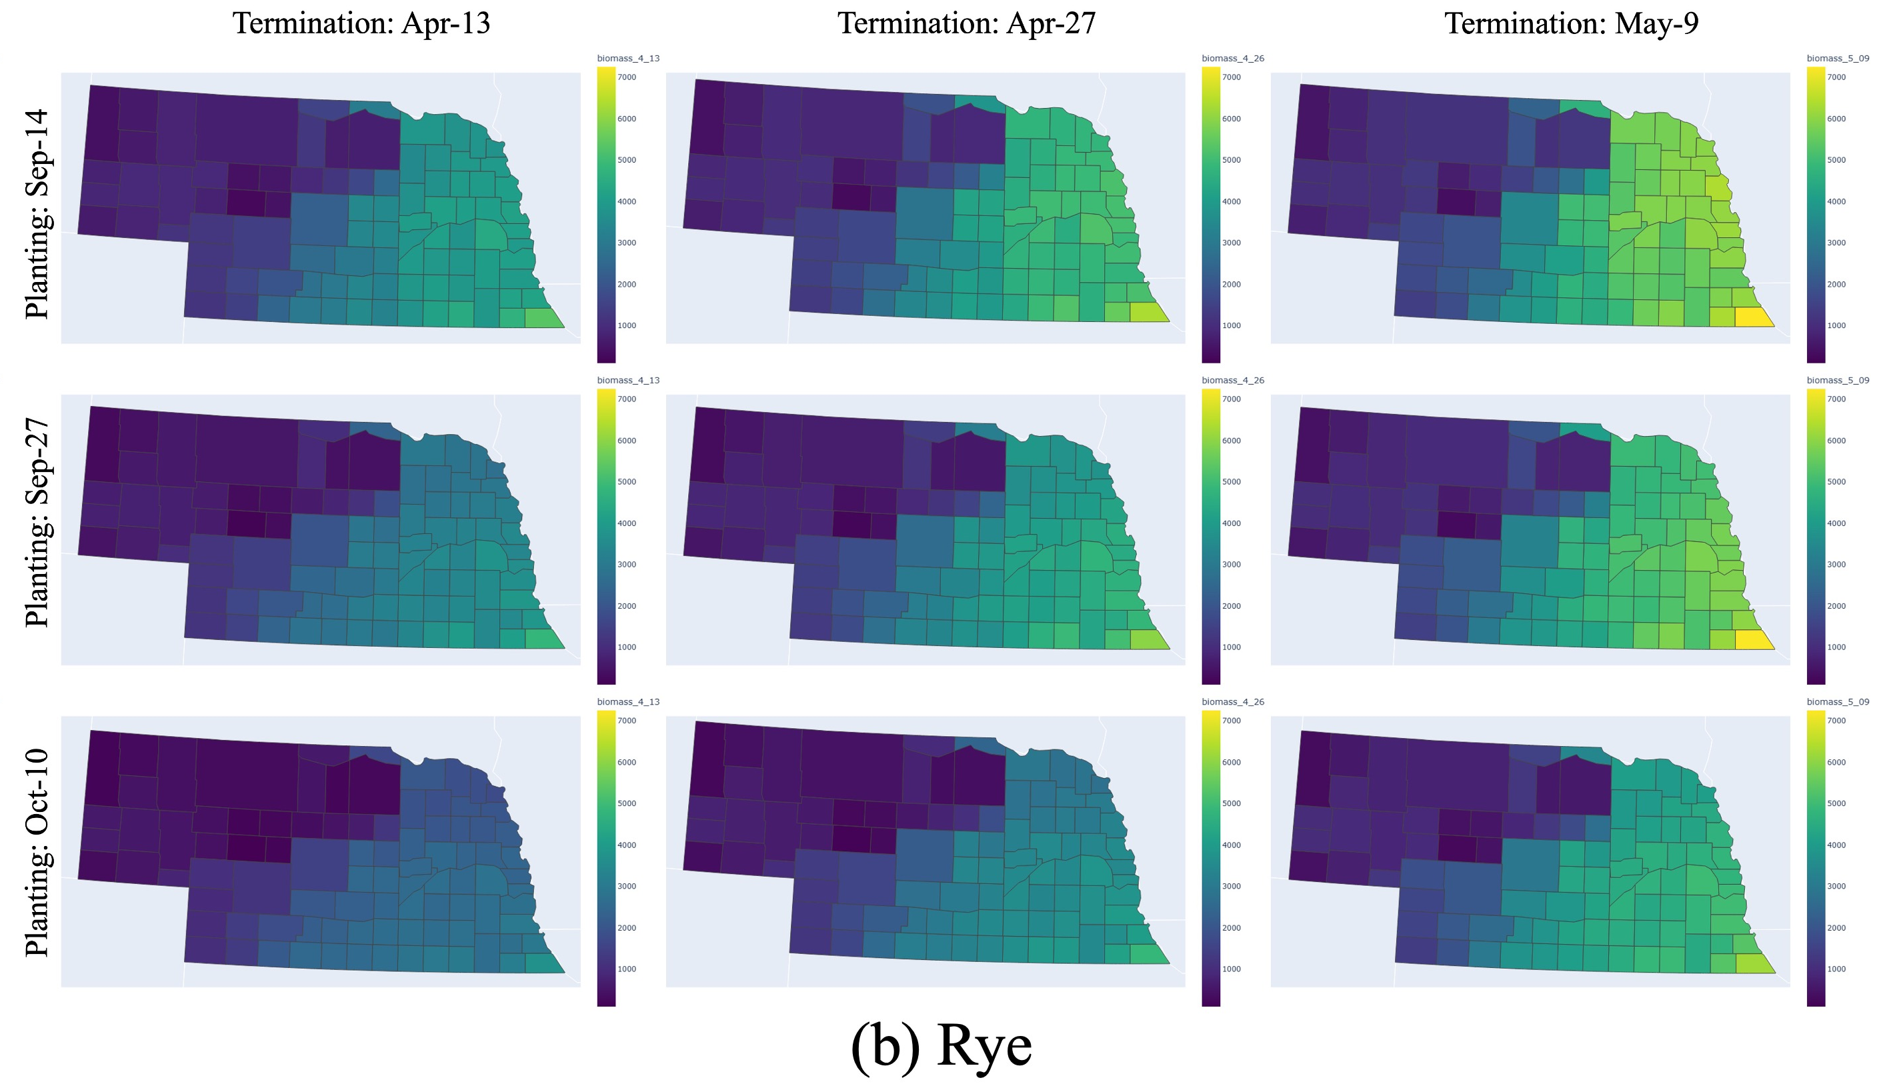
Cover crop growth gap (β_{g})
If planting is delayed and termination is early, there is the potential to have a gap or loss of approximately:
Region | Wheat | Rye | Triticale | Canola
 | (kg ha⁻¹)
Panhandle | 924 | 1197 | 1009 | 1210
North Central | 3280 | 4557 | 3557 | 2909
Northeast | 3386 | 4632 | 3452 | 3201
Central | 2744 | 3546 | 2877 | 2814
East Central | 3158 | 3803 | 3151 | 3891
Southwest | 1602 | 1962 | 1605 | 1908
South Central | 2074 | 2506 | 2169 | 2683
Southeast | 3369 | 4608 | 3519 | 4525

Slide 17
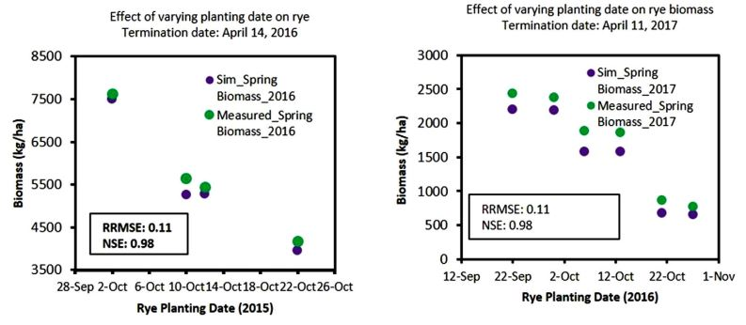
Cereal Rye Biomass Yield in South Central Nebraska
Chatterjee et al., 2020

Slide 18
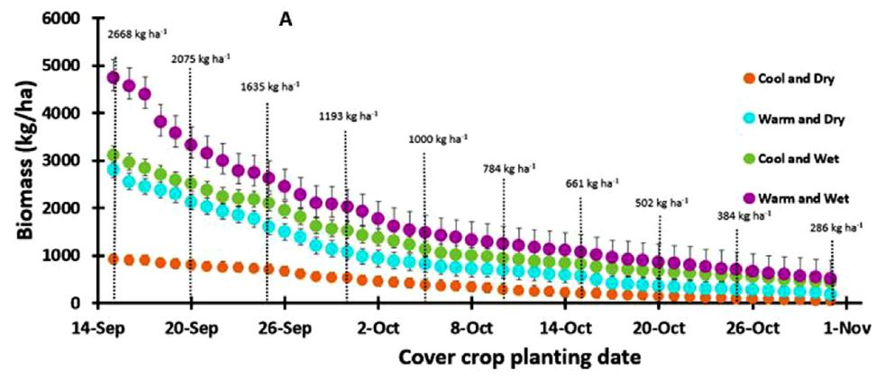
Fall planting dates with mid-April termination
Mean biomass of 55 lbs./ac per day
Biomass accrual is highly dependent on weather during the CC growing season (i.e., either adequate temp. or rainfall)
-89%
<15 ⁰C & <225 mm
>15 ⁰C & <225 mm
<15 ⁰C & >225 mm
>15 ⁰C & >225 mm
Chatterjee et al., 2020

Slide 19
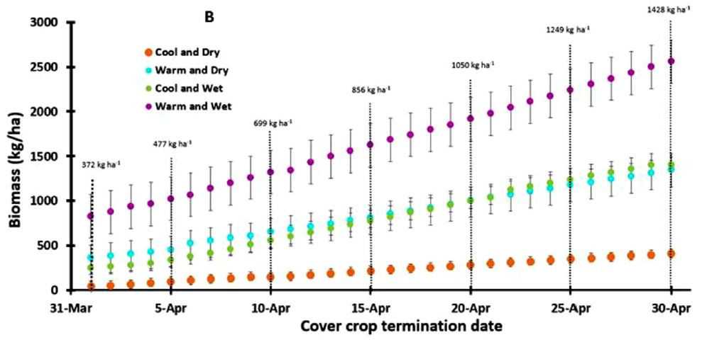
Spring termination dates with Oct 10 planting
Mean biomass of 31 lbs./ac per day
+284%
Chatterjee et al., 2020

Slide 20
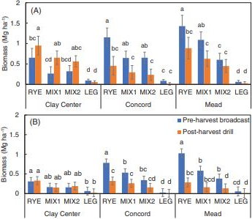
Planting Practice Influence Biomass Yield
Clay Center (irrigated):
Transition between sub-humid and semi-arid; 689 mm annual precip.
Soil: silt loam
Irrigation: 6 – 7 times between June and Aug, each time with 3.4 cm water
Concord (rainfed):
Sub-humid; 755 mm annual precip.
Soil: silty clay
Mead (rainfed):
Sub-humid; 768 mm annual precip.
Soil: silty clay loam
Treatments:
RYE: monoculture cereal rye (Elbon)
MIX1: cereal rye, forage radish (Nitro), hairy vetch (VNS), and winter pea (Whistler)
Mix2: cereal rye, black oat (Cosaque), Collard (Impact), radish, hairy vetch, winter pea, and either balansa or red clover (VNS)
LEG: hairy vetch and winter pea
Soybean – Corn rotation
Corn – Corn rotation
At the sites with wet fall weather, pre-harvest broadcasting increased biomass by 90%, to 1.29 Mg ha⁻¹ for RYE and 0.87 Mg ha⁻¹ for MIX1 in soybean–corn, and to 0.56 Mg ha⁻¹ and 0.39 Mg ha⁻¹ in corn–corn, respectively
At the drier site, post-harvest drilling increased biomass of RYE and MIX1 by 95% to 0.80 Mg ha⁻¹ in soybean–corn
Koehler-Cole et al., 2023

Slide 21
Biomass for Spring-Planted Cover Crops at Sidney
Year | Cover crop | Dryland |  | Irrigated
 |  | (kg ha⁻¹) |  |  |  | % change
2012 | Flax | 1,940 | ab | 2,860 | b | +47
 | Oat | 2,560 | a | 4,230 | ab | +65
 | Pea | 2,510 | a | 4,400 | a | +75
 | Rapeseed | 1,370 | b | 3,070 | ab | +124
 | Mixture | 2,540 | a | 3,770 | ab | +48
 | Average | 2,184 |  | 3,666 |  | +68
2013 | Flax | 3,010 | c | 2,920 | b | -3
 | Oat | 5,160 | a | 4,840 | ab | -6
 | Pea | 4,990 | a | 5,130 | ab | +3
 | Rapeseed | 3,170 | bc | 4,400 | ab | +39
 | Mixture | 4,790 | ab | 5,590 | a | +17
 | Average | 4,224 |  | 4,576 |  | +8
Cover crop drilled:
2012: April 04
2013: April 30 (delayed because of wet conditions)
Cover crop termination:
2012: June 15
2022: July 18
Growing season precipitation + irrigation:
2012: (71 + 44) mm = 115 mm (4.5 inches)
2022: (109 + 41) mm = 150 mm (5.9 inches)
CCs were irrigated bi-weekly
Mixture: 10-species mix of Rapeseed, Flax, Oat, Pea, Lentil, Common Vetch, Berseem Clover, Barley, Phacelia, and Safflower
Nielsen et al., 2015

Slide 22
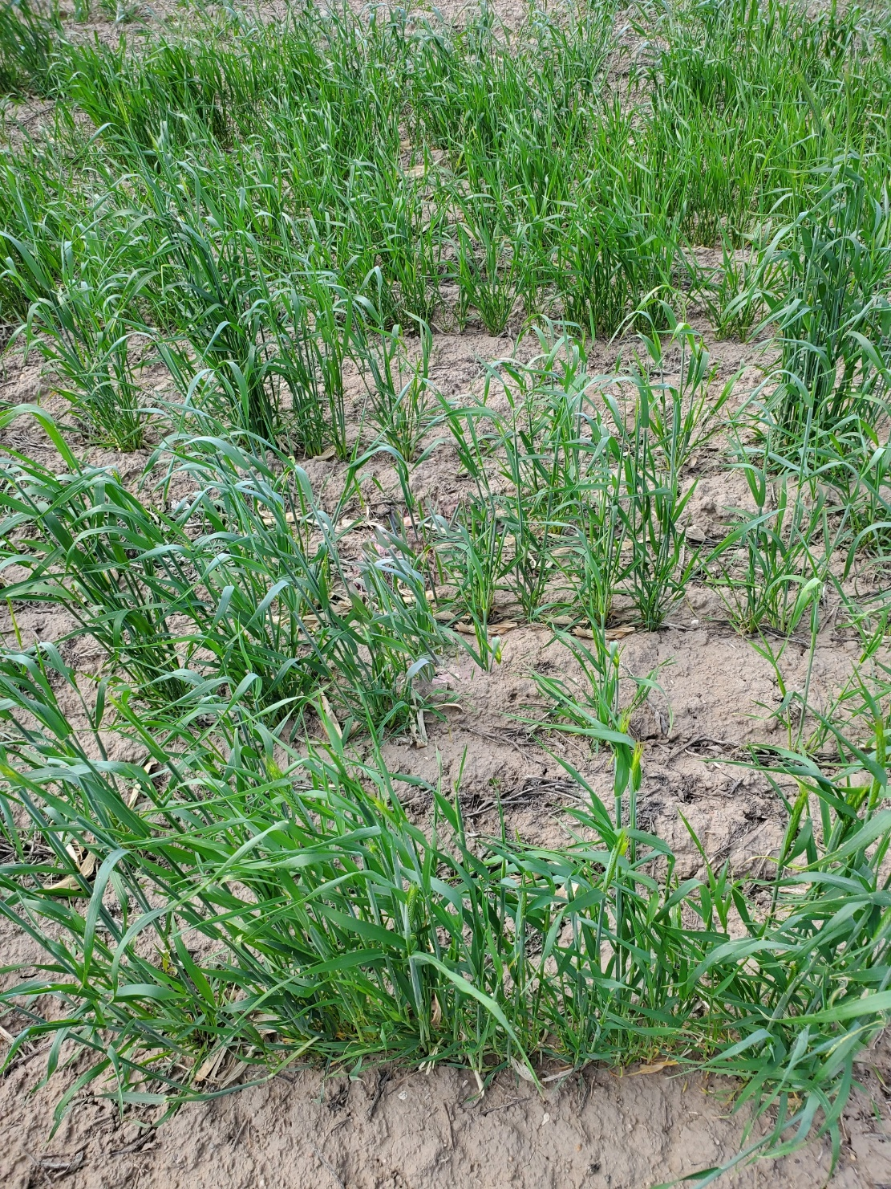
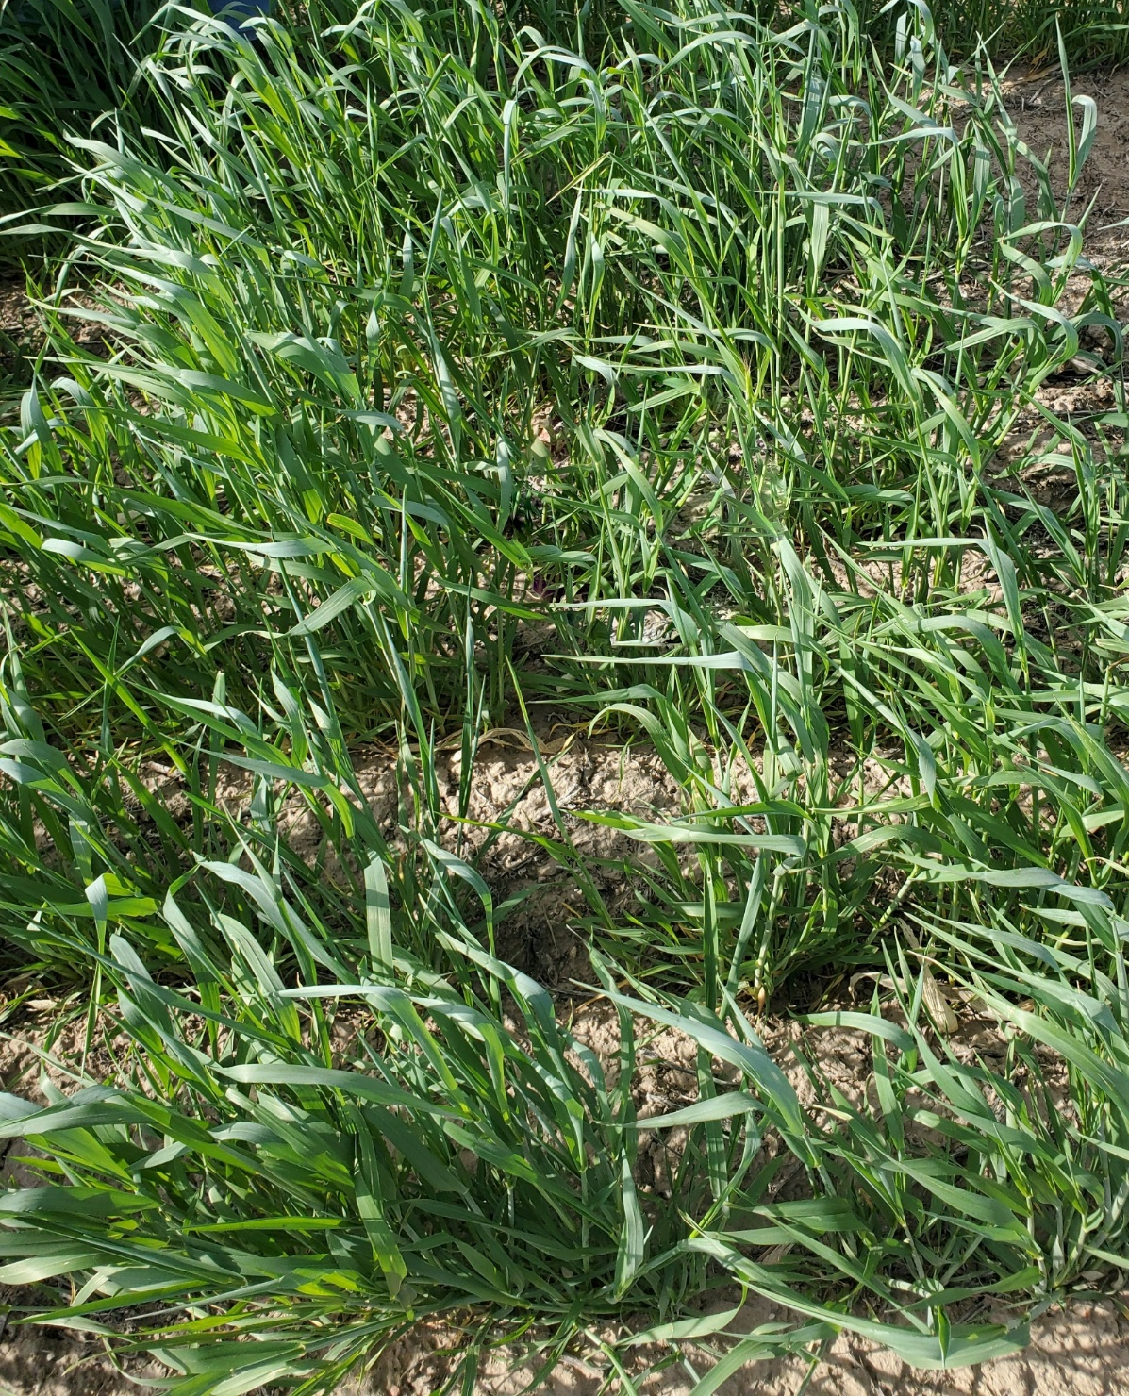
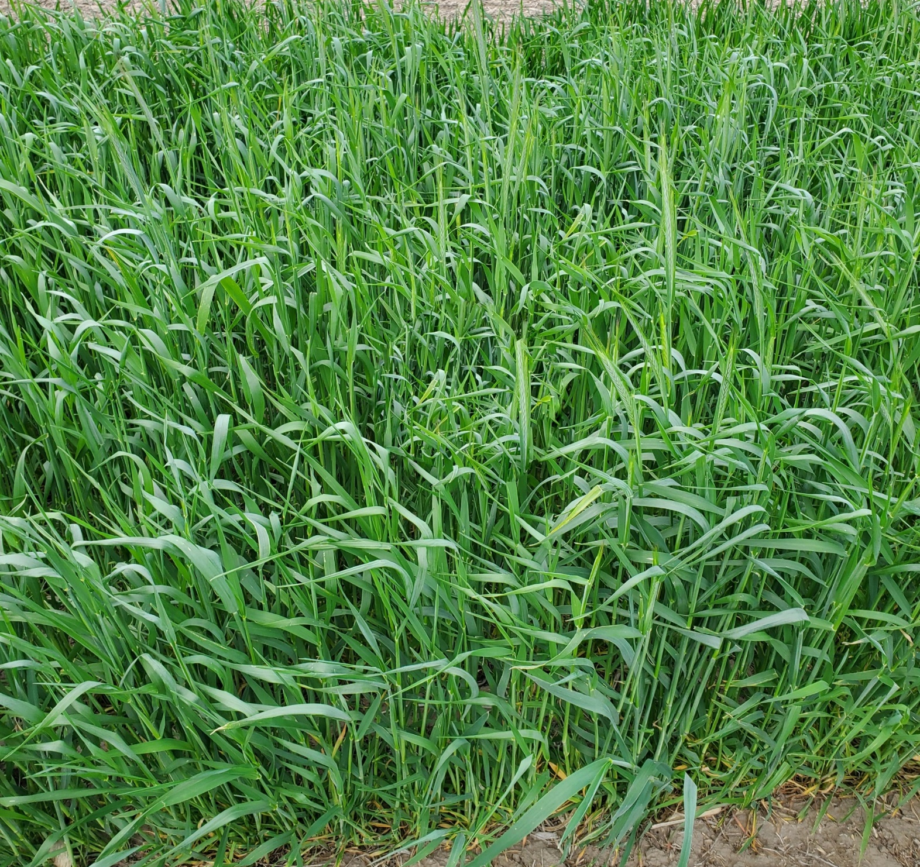

Plant density & height as a proxy for biomass
Elbon rye
Yankee rye
Yankee rye
25%
68 cm
66%
61 cm
90%
79 cm
Soil N
1329 kg ha⁻¹
3161 kg ha⁻¹
7670 kg ha⁻¹

Slide 23
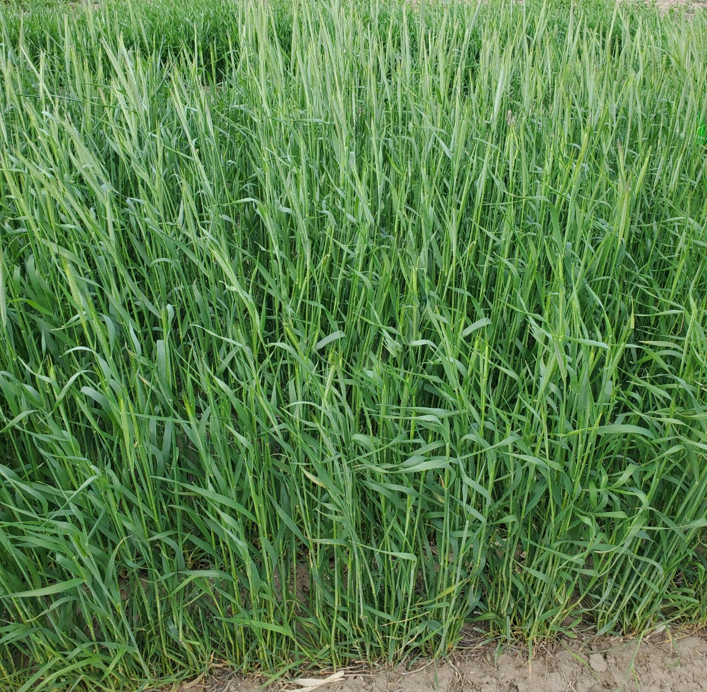
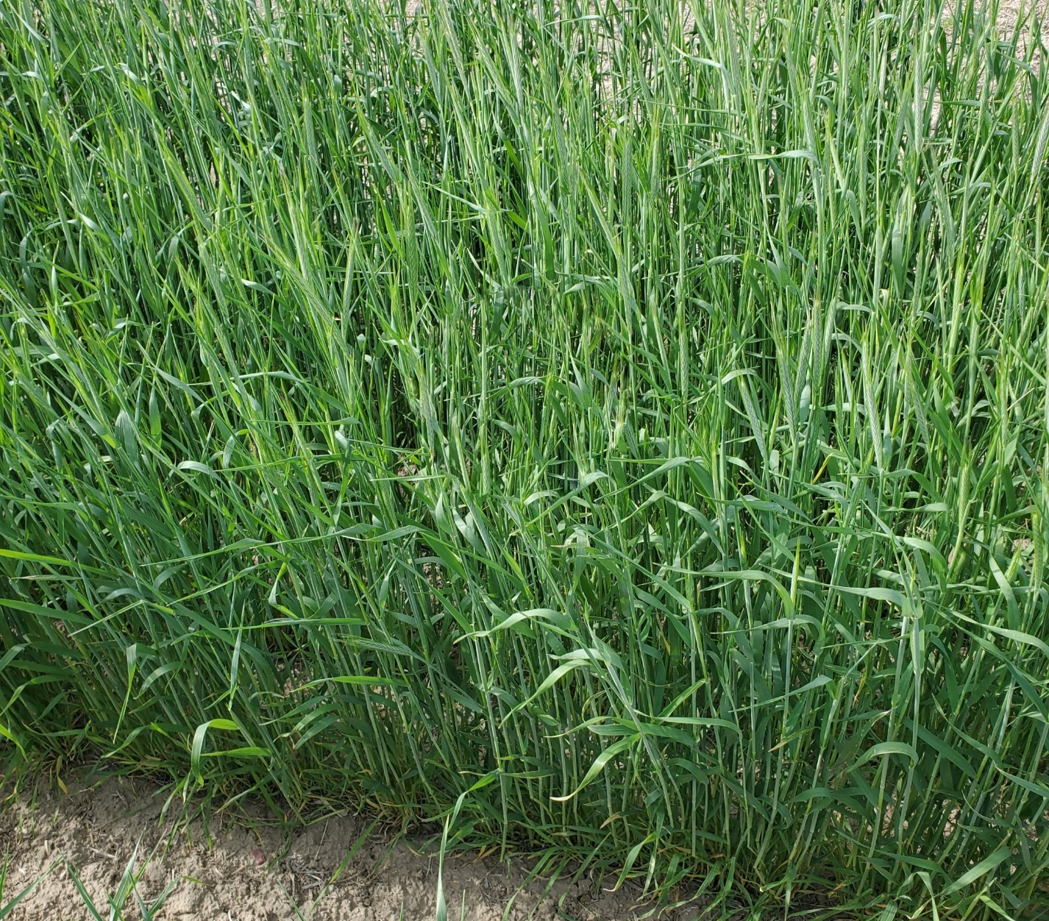
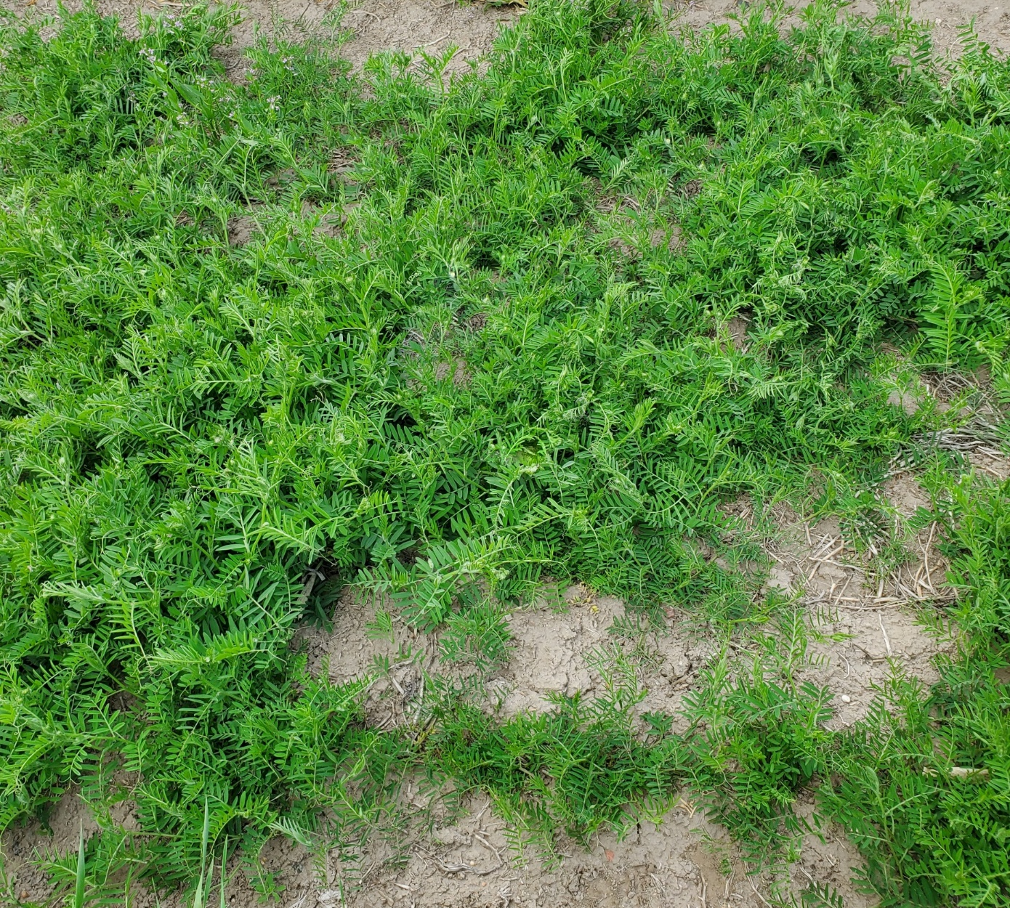
Plant density & height as a proxy for biomass
Elbon rye
Elbon rye
NE hairy vetch
Soil N
88%
99 cm
93%
97 cm
70%
22 cm
12099 kg ha⁻¹
12855 kg ha⁻¹
1760 kg ha⁻¹

Slide 24
Summary of research evidence
► Cover crop planted by mid-Sep produced ten times more biomass than those planted in late-Oct, with termination occurring in mid-April
► Delaying spring cover crop termination from early to late April increased biomass production by four times for cover crops planted in early-Oct
► A warm-wet growing season can produce four times more rye biomass compared to a cool-dry season
► Biomass production ranged from 110 to 6710 kg ha⁻¹ for wheat, 190 to 6310 kg ha⁻¹ for rye, 750 to 7160 kg ha⁻¹ for triticale, and 100 to 2200 kg ha⁻¹ for canola
Extended growing periods, particularly with early planting (mid-Sep) and late termination (early-May), produced greater biomass by 158% for wheat, 112% for rye, 131% for triticale, and 247% for canola compared to shorter growing intervals (early-Oct to mid-April)
Year-to-year weather variability can affect biomass yields, even with cover crops planted on similar dates
Setting realistic biomass goals is essential, especially considering the harsh winter conditions that can limit productivity
Adjusting planting and termination timing (focusing on a longer interval such as mid-Sep to early May rather than early Oct to mid-April) can help maximize biomass yields under diverse environmental conditions in Nebraska
Soil N

Slide 25
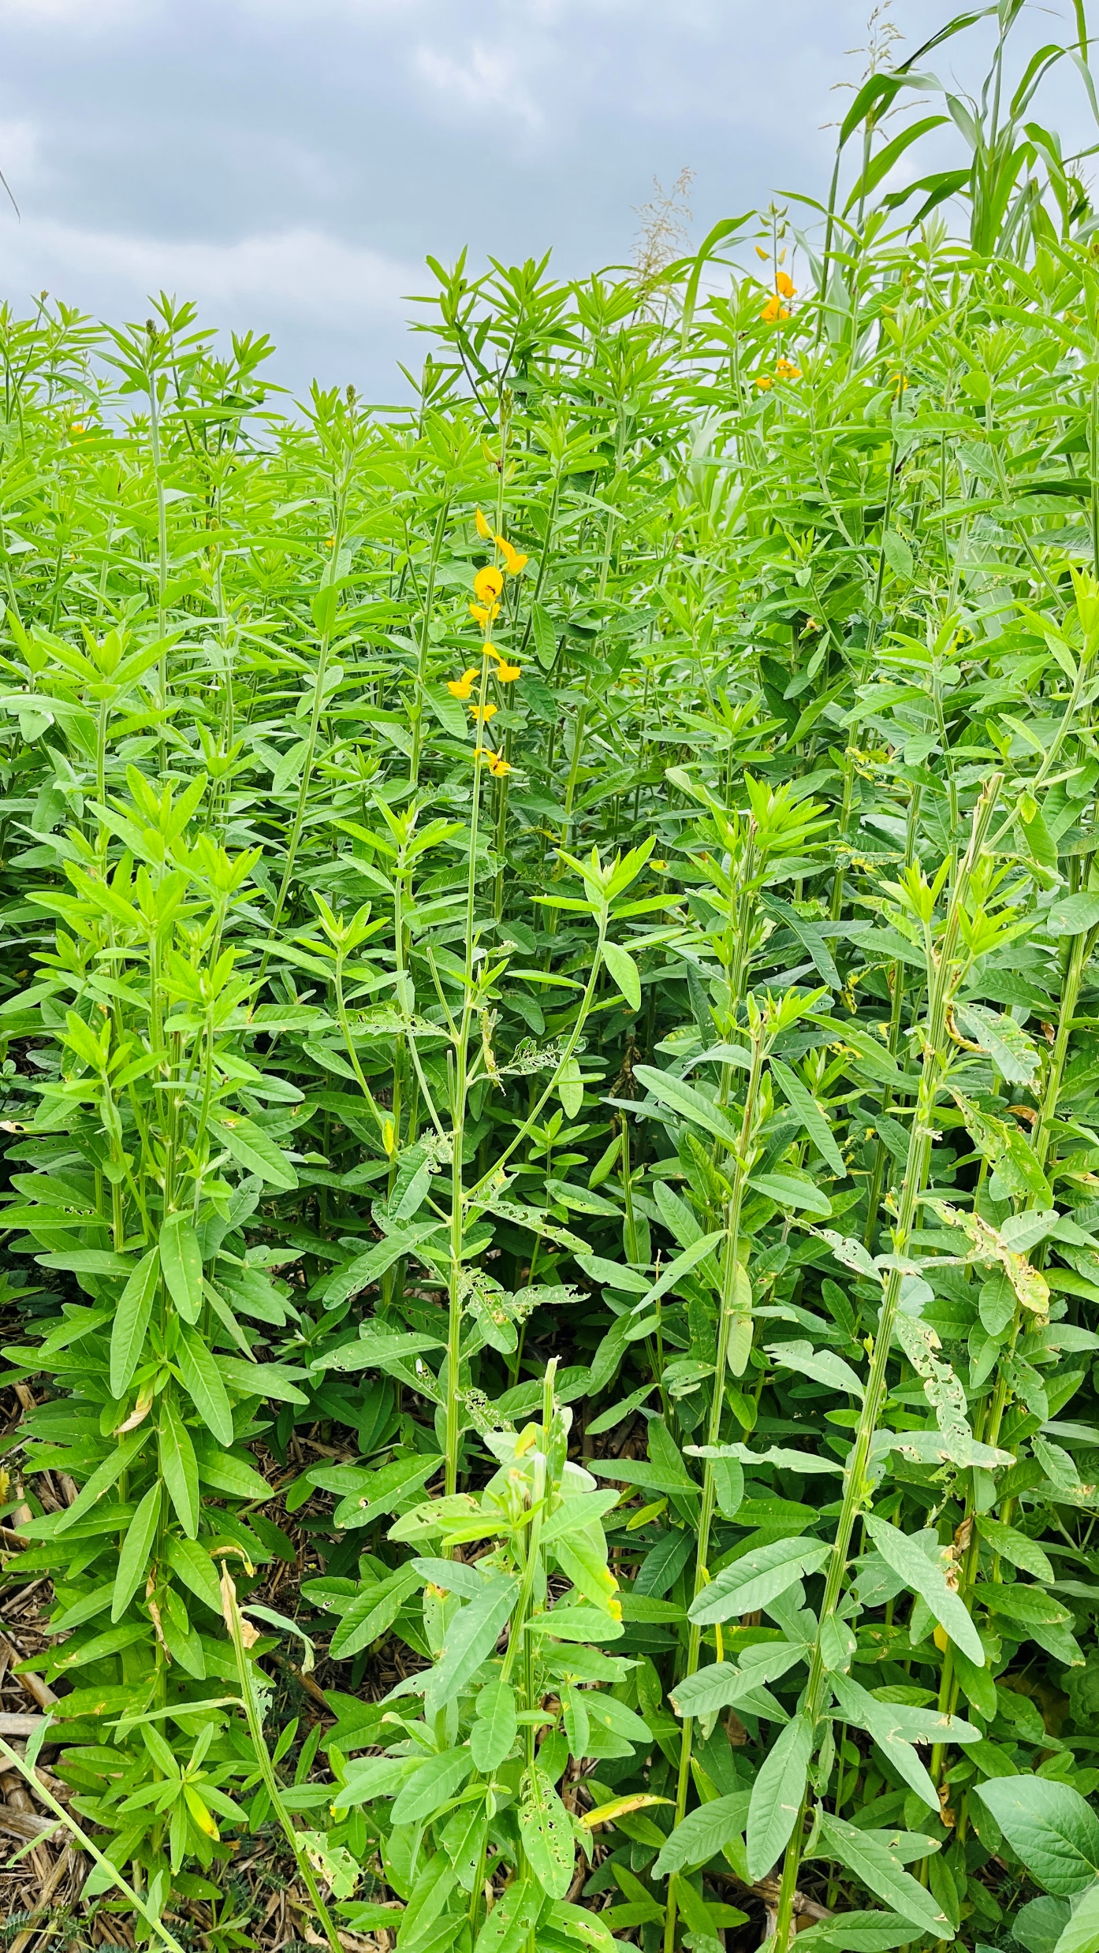





University of Nebraska-Lincoln
THANK YOU
Vesh Raj Thapa
(575) 520-0030
vthapa2@unl.edu
4502 Ave I, Scottsbluff, NE 69361

