Slide 1



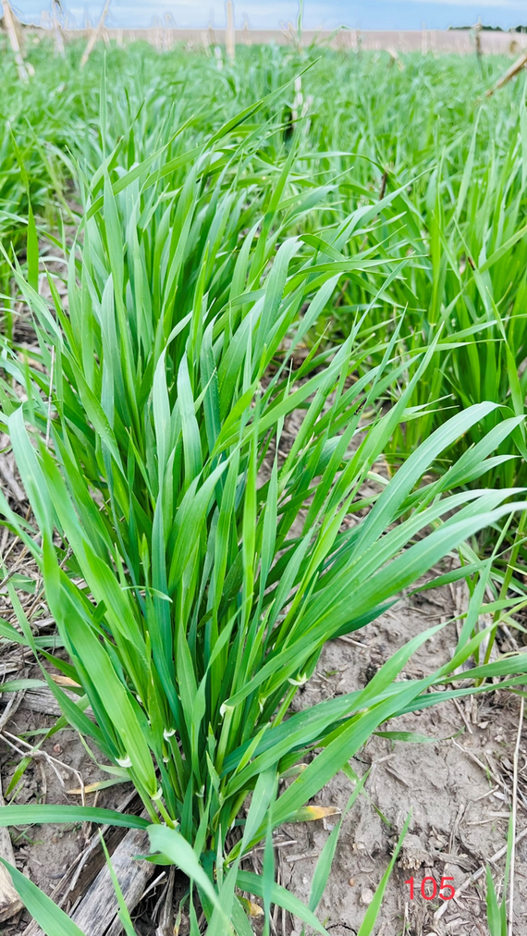
Cover Crop Impacts on Subsequent Cash Crop Yields
Vesh Raj Thapa, Ph.D.
Department of Agronomy and Horticulture
University of Nebraska-Lincoln
Webinar series: Session-I
Addressing common cover crop
Challenges & questions in Nebraska

Slide 2
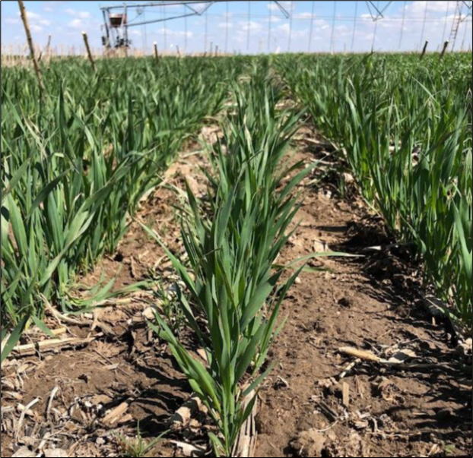
Outline
  Introduction
  Mechanisms of Yield Influence
  Context of Nebraska
  Evidence in Action
  Key Takeaways

Slide 3
Defining Cover Crops
  What Are Cover Crops?
    Seasonal Coverage: Protects soil when main crops aren’t growing.
    Not Harvested: Terminated before seed formation to maximize soil benefits.
  USDA Definition:
    Includes grasses, legumes, and forbs used for conservation.
    Primarily for erosion control, soil health improvement, and water quality.
    May be grazed or harvested as hay/silage but not for grain/seed.
    Termination methods: frost, chemicals, crimping, rolling, tillage, or cutting.
  Key Takeaways
  ✅ Protects soil in off-seasons
  ✅ Improves soil health and prevents erosion
  ✅ Cannot be harvested for grain

Slide 4
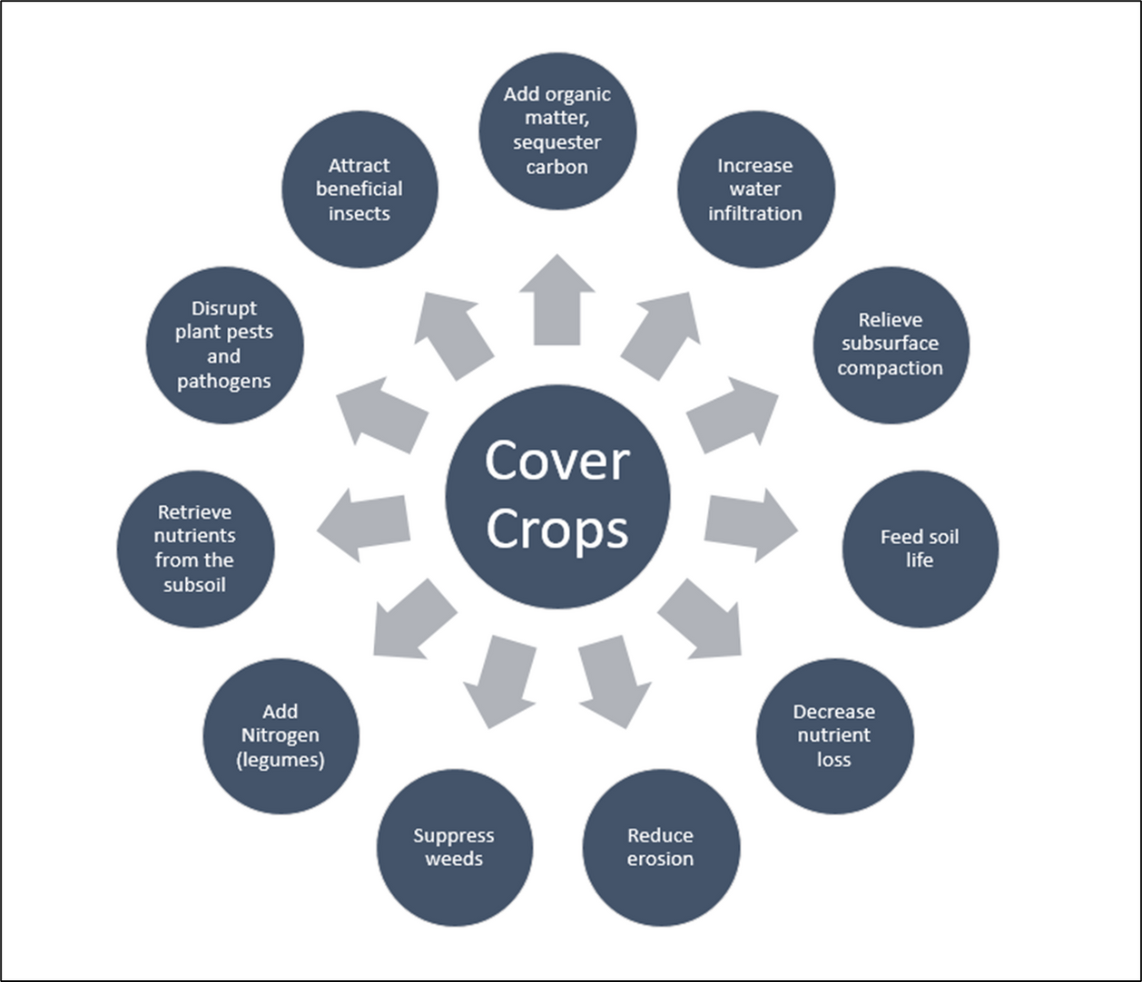
Cover Crops Benefits

Slide 5
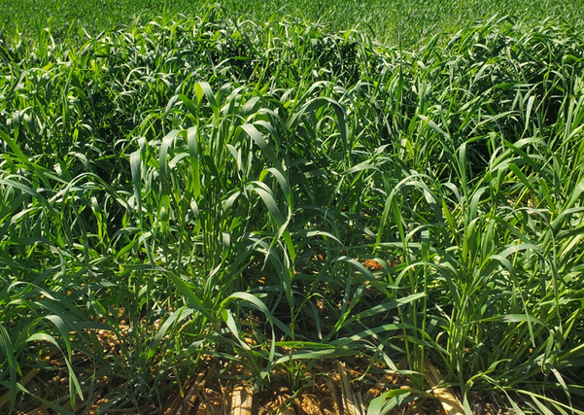
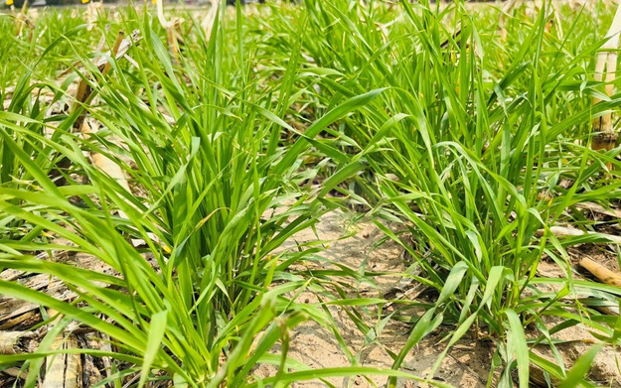
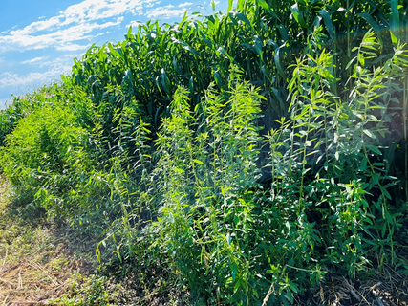



Cover Crop Examples
►Fall planted: cool season species planted after fall harvest and terminated following spring.
•Rye, Barley, Winter pea, Hairy vetch, Rapeseed and Radish
►Spring planted: short season species typically remain in the ground for 60-90 days before cash crop planting.
•Barley, Oat, Triticale, Pea, Aba bean and Collard
►Summer planted: warm season species planted in late June or early July and terminated in early fall.
•Sudan-grass, Forage-sorghum, Millet, Buckwheat ,Cowpea, and Sunn-hemp

Slide 6
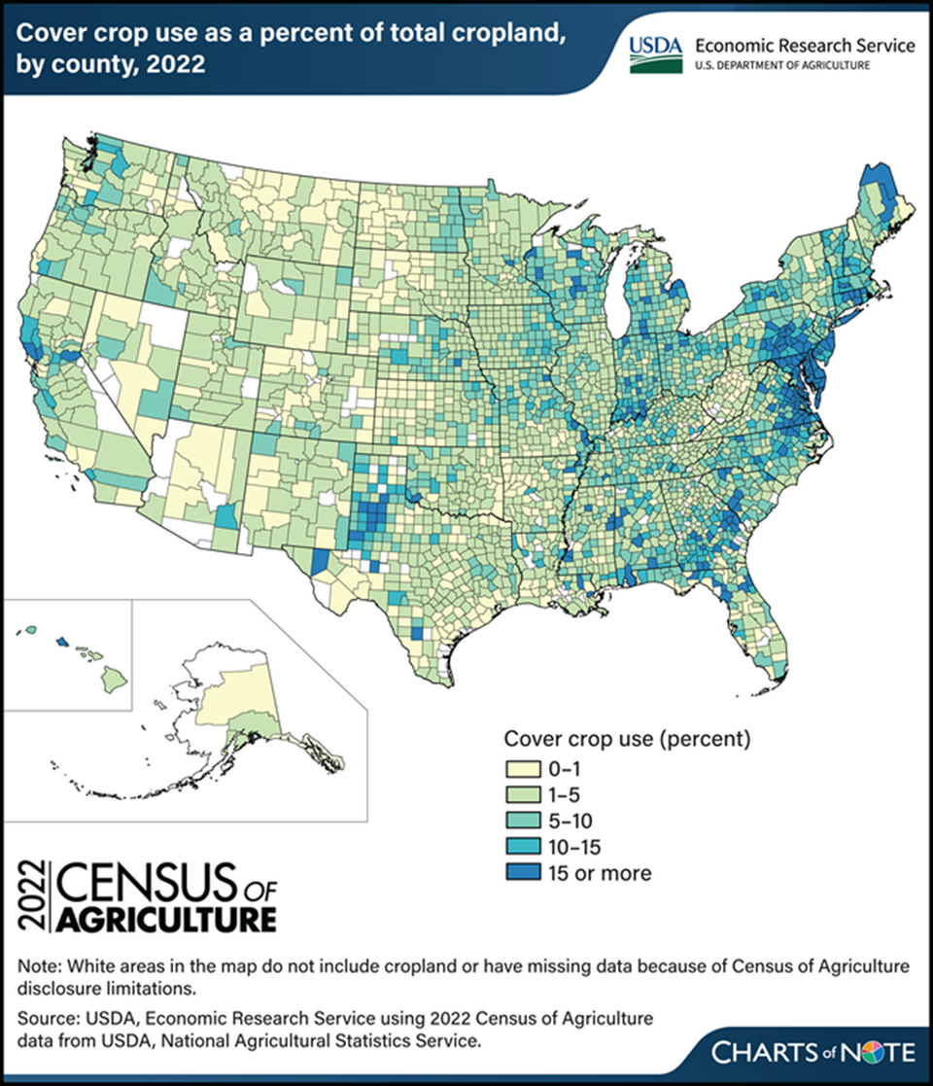
Adoption Trends Over Time
5.1 M
50 %
Acres
Increase in cover crop acreage in the US from 2012-2017
A 50% increase in cover crop adoption from 2012-2017
National Landscape
Cover crop acreage in the U.S. has steadily grown, with a 50% increase between 2012 and 2017. However, growth has slowed, with an increase of 17% or 2.6 million acres from 2017-2022.

Slide 7
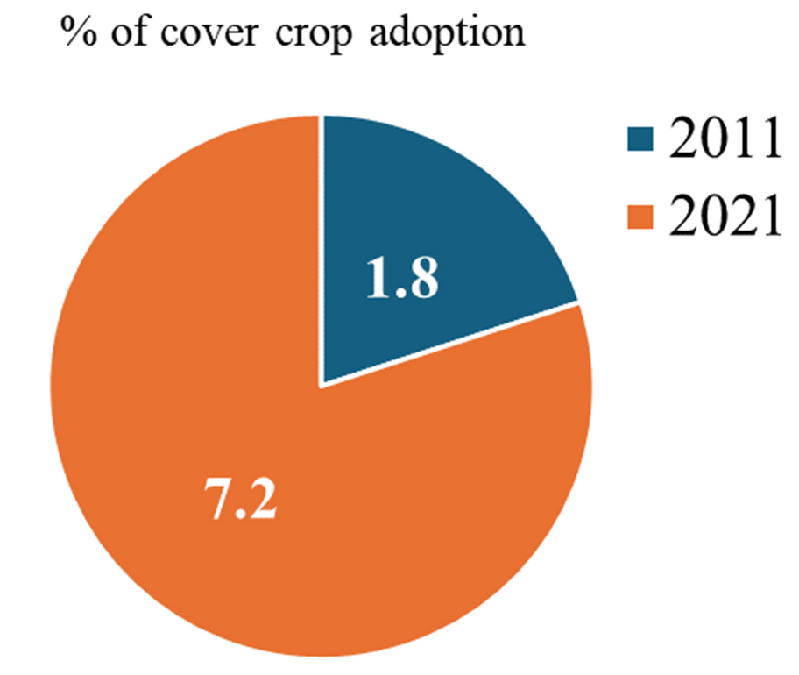
tt
Regional Trends Throughout Midwest
  From 2000 to 2021, cover crop adoption in the Midwest quadrupled, increasing from 1.8% in 2011 to 7.2% in 2021
  Cover crop adoption is strongly correlated with federal and state conservation incentives
  Satellite data analysis showed that government policies have significantly influenced the rate of adoption.
  Zhou, et al. (2022)
Corn Belt remote sensing analysis

Slide 8
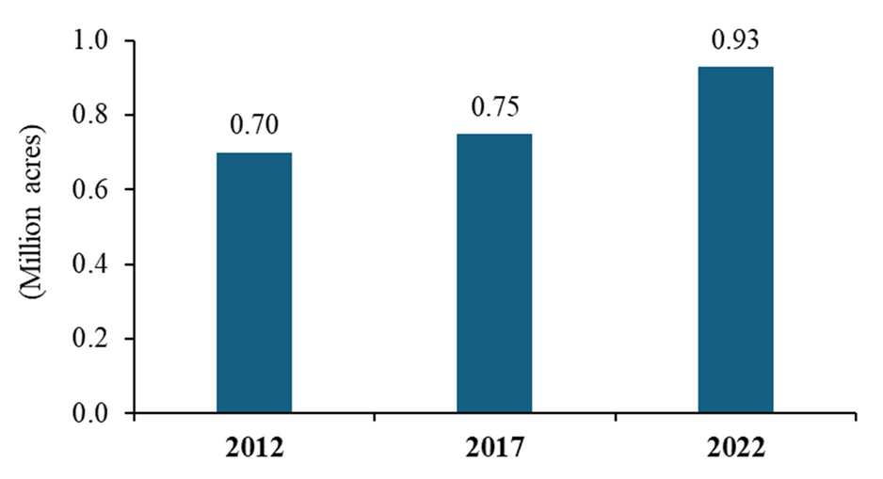


tt
Cover crop acreage in NE
  Nebraska's adoption rate varies geographically. The eastern region, known for its higher rainfall, sees a higher cover crop adoption rate (4.3%) compared to the drier western region (2.4%).
  Koehler-Cole, K., Basche, A., Thompson, L., & Rees, J. (2023)
  Acres of cover crop increased by 33% in 2022 from 2012 across Nebraska, from .70 million acres to .93 million acres
  United States Department of Agriculture (2024)
U
Acres of cover crop in NE 2012 to 2022

Slide 9
Cover Crop Benefits on Yield
Pest and Disease Management: Habitat for beneficial insects, disrupt pest and diseases cycle
Soil Health: Increases organic matter, enhances microbial activity.
Weed Suppression: Improves infiltration, better retention
Nutrient Management: N fixation (legumes), reduce nutrient leaching, nutrient release upon decomposition
Water Management: Improve soil structure, enhance water infiltration, better water retention
Erosion Control: Reduce loss of nutrient-rich top-soil layer, protect soil structure

Slide 10
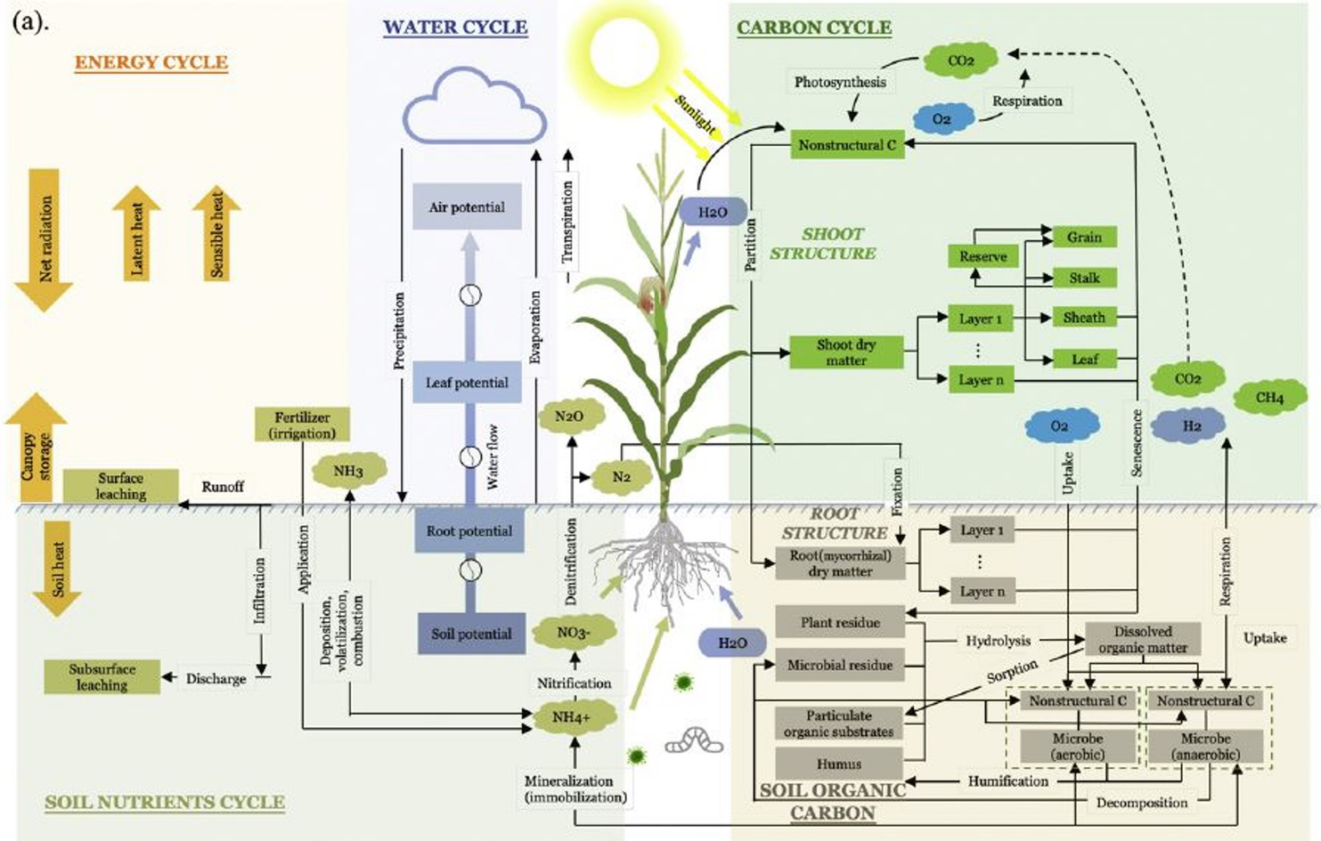
Mechinisms of Yield Influence
  The mechanistic pathways of cover crops effect cash crop yields
  Cover crops strongly influence the ecosystem carbon, nitrogen, and water cycle processes.

Slide 11
tt
Carbon Fixation & Storage
  Photosynthesis:
    Cover crops absorb CO₂ from the atmosphere.
    Convert CO₂ into organic carbon stored in leaves, stems, and roots.
    Carbon is used for plant growth.
  Decomposition & Nutrient Cycling:
    When plants die, their organic matter transfers carbon to the soil.
    Microorganisms (bacteria & fungi) break down plant residues.
    Nutrients from decomposition become available to the next crop.

Slide 12
tt
Carbon Loss (Respiration)
  Respiration (Carbon Release):
    Breakdown of plant carbohydrates releases CO₂ + H₂O.
    Occurs in plants and soil microbes.
  Photosynthesis vs. Respiration:
    Photosynthesis stores carbon → growth & soil improvement.
    Respiration releases carbon → energy for plant processes.
  Tradeoff in Yield:
    The balance between photosynthesis (carbon gain) and respiration (carbon loss) affects yield potential.
    Cover crop management influences how much carbon stays in the soil.

Slide 13
Nitrogen Cycle and Cover Crops
  Nitrogen Fixation:
    Legume cover crops (e.g., clover, vetch) host nitrogen-fixing bacteria in root nodules, converting atmospheric nitrogen (N₂) into ammonium (NH₄⁺).
    Adds nitrogen to the soil, reducing synthetic fertilizer needs.
  Ammonification:
    Soil microbes decompose organic residues from cover crops, releasing ammonium (NH₄⁺).
  Nitrification:
    Nitrifying bacteria convert ammonium into nitrites (NO₂⁻) and then nitrates (NO₃⁻), making nitrogen available for cash crops.
  Assimilation:
    Cash crops absorb ammonium and nitrates for growth, benefiting from nutrients provided by decomposing cover crops.
  Denitrification:
    In some conditions, denitrifying bacteria convert nitrates back to atmospheric nitrogen (N₂), completing the cycle.

Slide 14
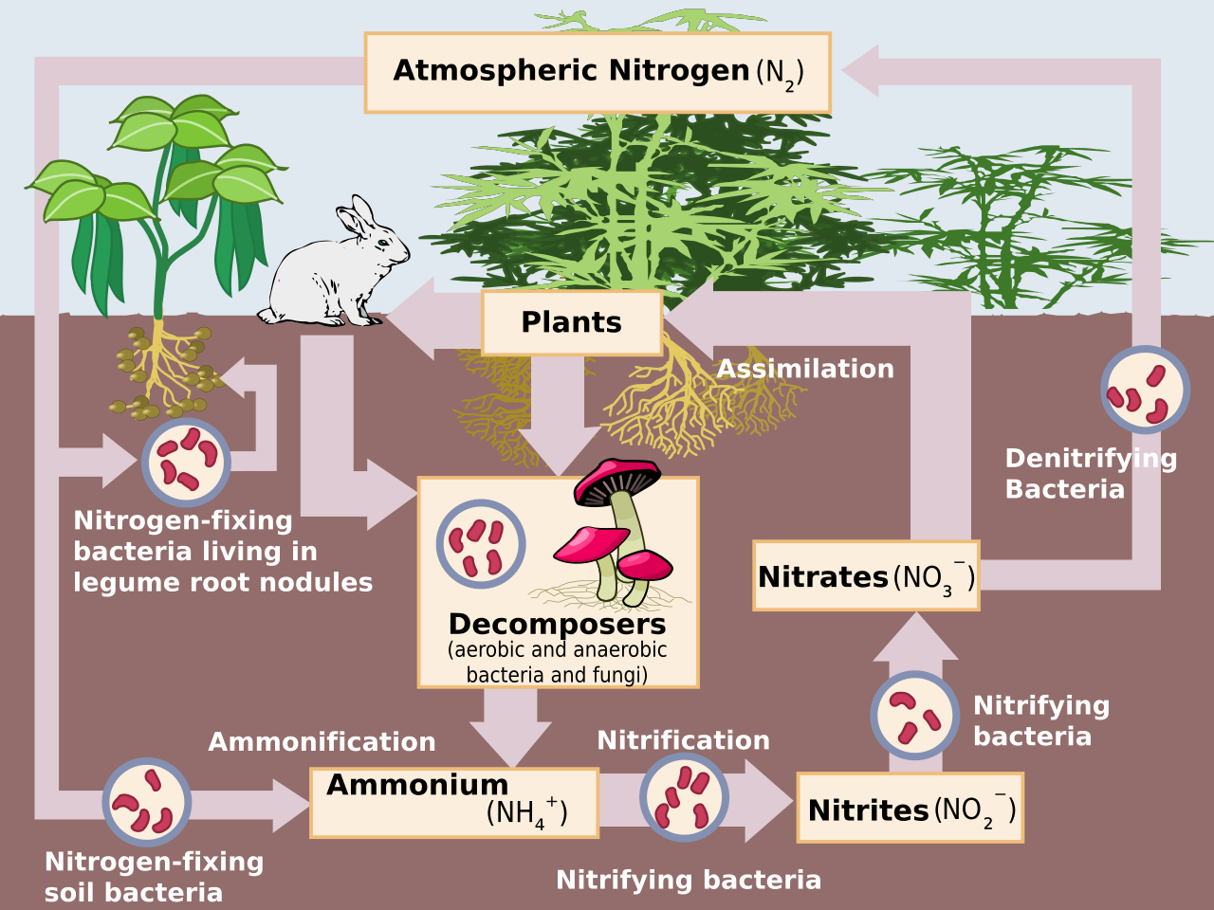

Slide 15
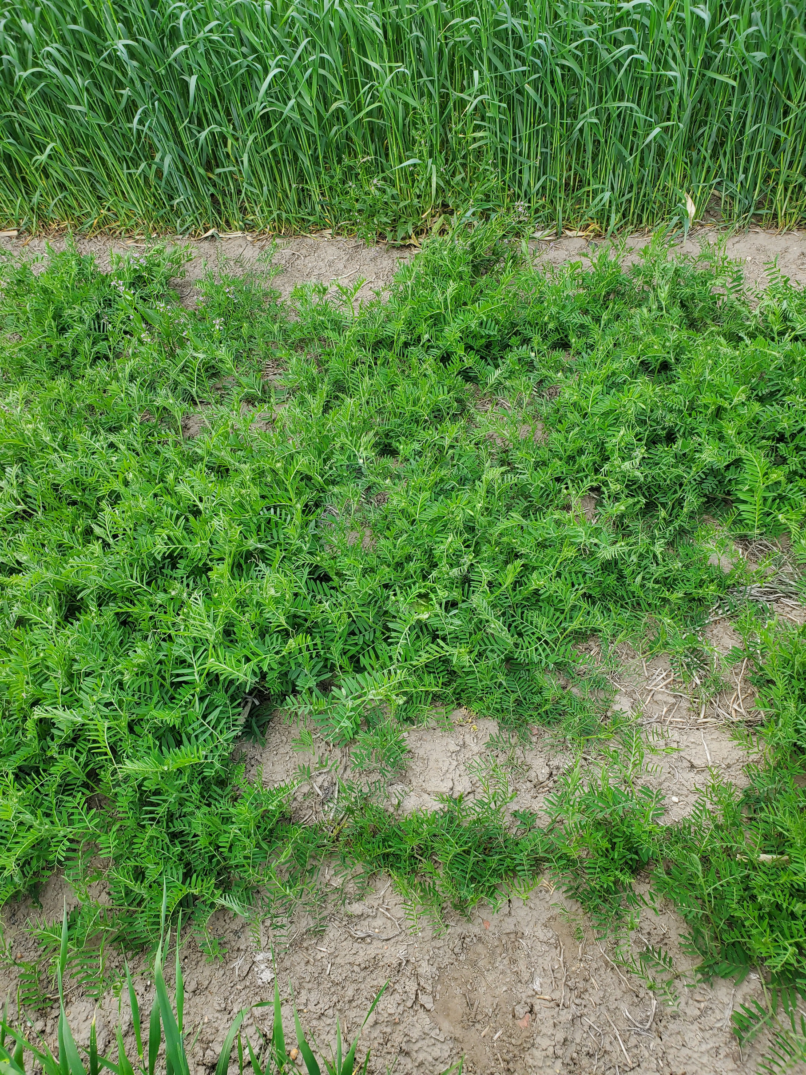
Impact of Cover Crops on the Nitrogen Cycle
Legume Cover Crops:
  Provide nitrogen through fixation.
  Quickly release nitrogen during decomposition due to low C:N ratio.
Grass Cover Crops:
  Capture residual soil nitrogen, reducing leaching.
  High C:N ratio slows nitrogen release, potentially causing short-term immobilization.

Slide 16
Water Movement and Cover Crops
  Water Movement in Soil and Plants:
    Water flows through the soil-to-root-to-canopy pathway.
    Cover crop roots create channels that:
      Break up compacted soil.
    Improve water infiltration.
    Store water in deeper soil layers, reducing surface runoff.
  Soil Water Potential:
    Water moves from higher potential (soil) to lower potential (roots).
    Capillary and adhesion forces drive water into plant root hairs.

Slide 17
Transpiration and Evapotranspiration
  Transpiration (Water Movement in Plants):
    Stomata in leaves regulate water loss by opening and closing.
    Driven by environmental factors like temperature, humidity, and wind.
    Creates negative pressure in the xylem, pulling water upward.
  Evapotranspiration (Water Loss):
    Combination of evaporation (soil) and transpiration (plants).
    Cover crops reduce evaporation by:
      Shading the soil, lowering temperature.
      Acting as windbreaks, limiting water loss from the soil.

Slide 18
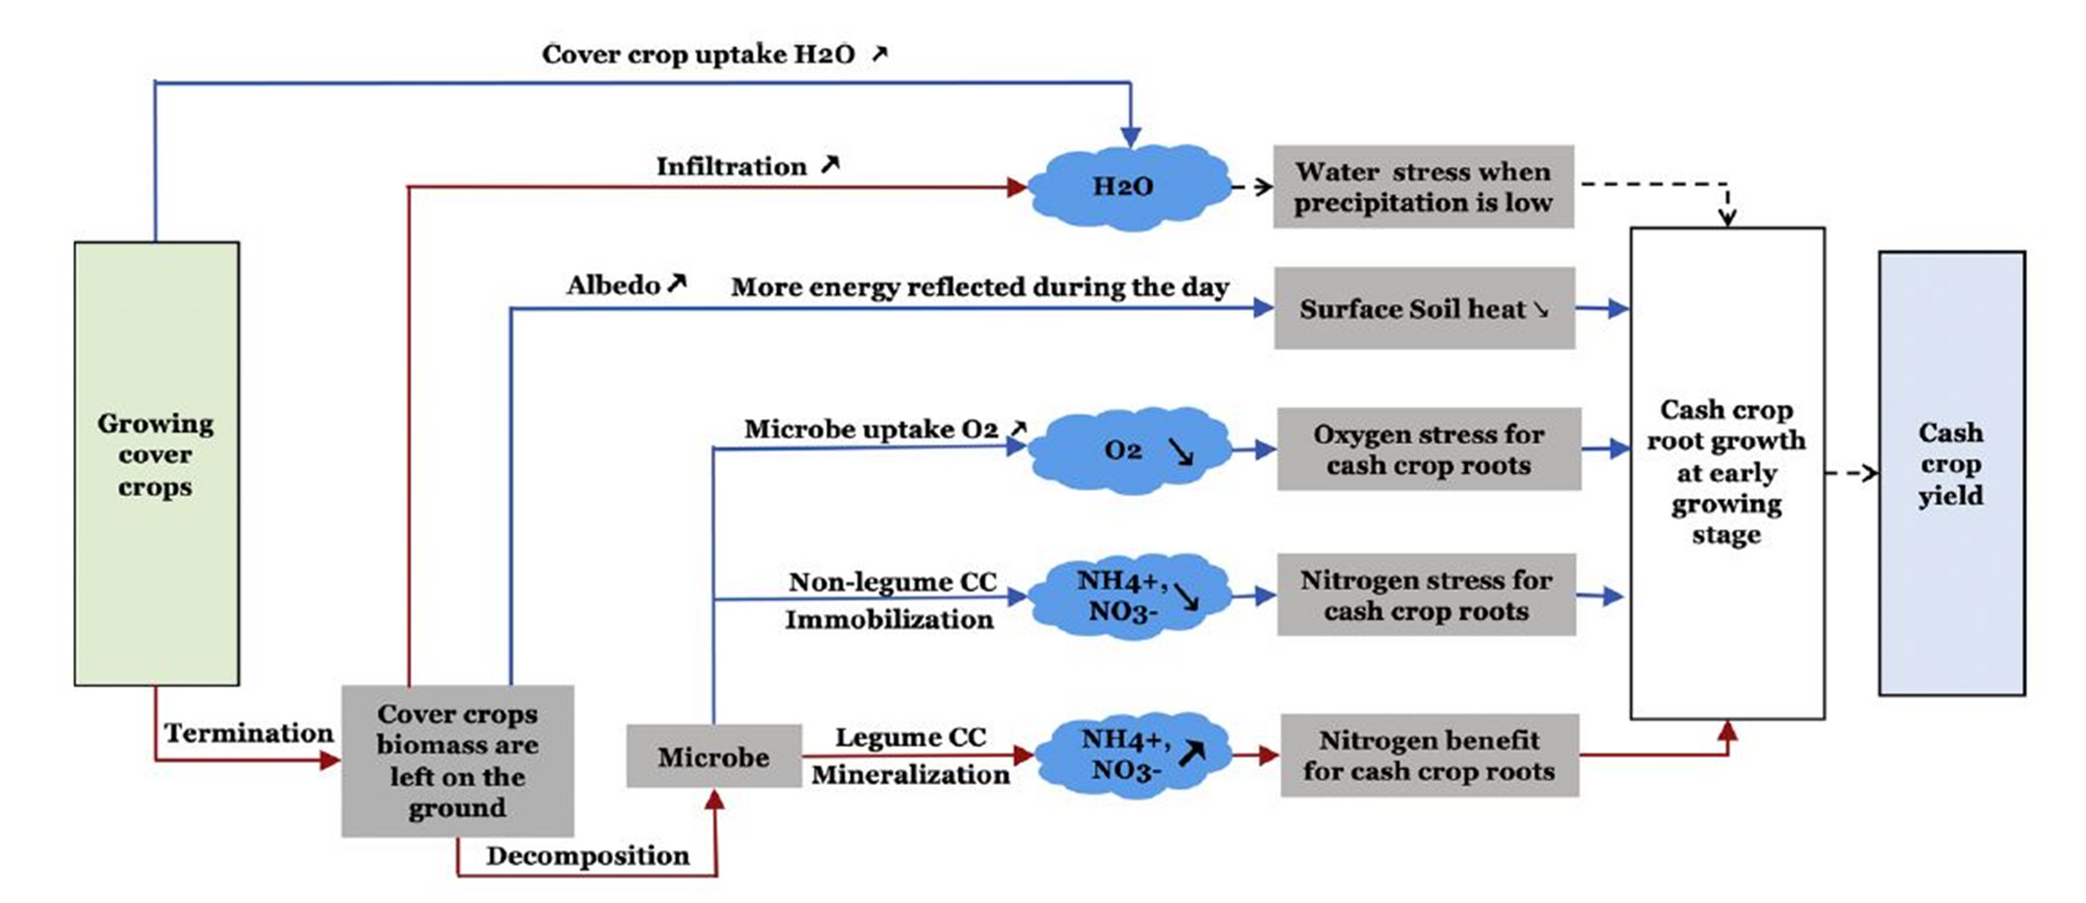
Diagram of Mechanistic Pathways
Qin et al., 2021

Slide 19
tt
Understanding C:N Ration
  What is C:N Ratio?
    The ratio of carbon to nitrogen in a substance
    High C:N (>25:1) → Slow decomposition, can immobilize nitrogen.
    Low C:N (<25:1) → Fast decomposition, releases nitrogen.
    Optimal Balance (24:1) → Efficient breakdown, supports microbial health.
  Effects on Soil & Crops
  ✅ High C:N (grasses) → Captures excess nitrogen but may limit availability to cash crops.
  ✅ Low C:N (legumes) → Releases nitrogen quickly, reducing fertilizer needs.

Slide 20
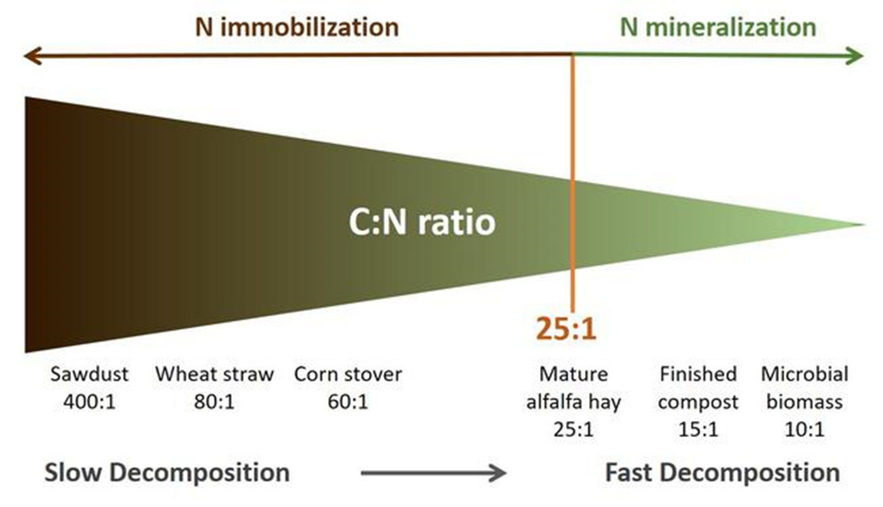
Adapted from: Gasch and DeJong-Hughes, 2019

Slide 21
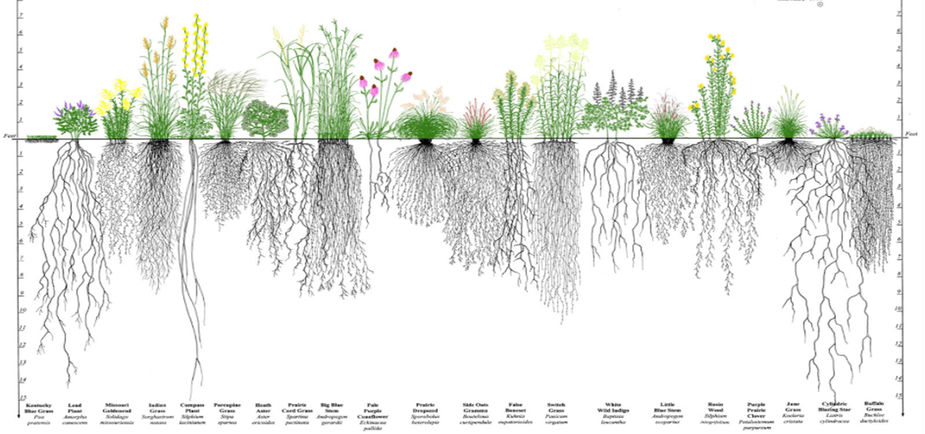
Maximize living roots-why?
  Because carbon is the heart of soil health
  Plants provide one half to 75% of their photosynthesized carbon to soil through roots – Liquid carbon
  Liquid carbon is the plant’s sugars/carbohydrates
  Liquid carbon builds SOM 5-30 times faster than above ground biomass

Slide 22
Soil Organic Matter – The Foundation of Soil Health
  Soil Organic Matter Benefits:
    Improves water retention: 1% increase = 20,000 gallons of water per acre.
    Supports microbial activity and soil health.
  Erosion Control:
    Nebraska soils: Prone to wind and water erosion (5 tons/acre/year, $10/acre loss).
    Cover crops reduce erosion by:
      Forming a vegetative mat.
      Slowing wind and raindrop impact.
  Temperature Regulation:
    Cover crops keep soil cooler, reducing evapotranspiration.
    Bare soil: Up to 133°F.
    Vegetative cover: Reduces temperature to ~100°F.

Slide 23
Erosion Control with Cover Crops
  Challenges in Nebraska Soils:
    Prone to wind and water erosion:
    5 tons of soil loss per acre/year, costing $10/acre annually.
    Semi-arid soils: Loose, coarse-textured, and unprotected, with frequent strong winds and droughts.
  How Cover Crops Help:
    Vegetative Mat Formation:
      Reduces wind and water velocity, preventing soil loss.
    Raindrop Impact Reduction:
      Limits soil displacement during precipitation.
    Temperature Regulation:
      Keeps soil cooler, reducing evapotranspiration and conserving water.

Slide 24
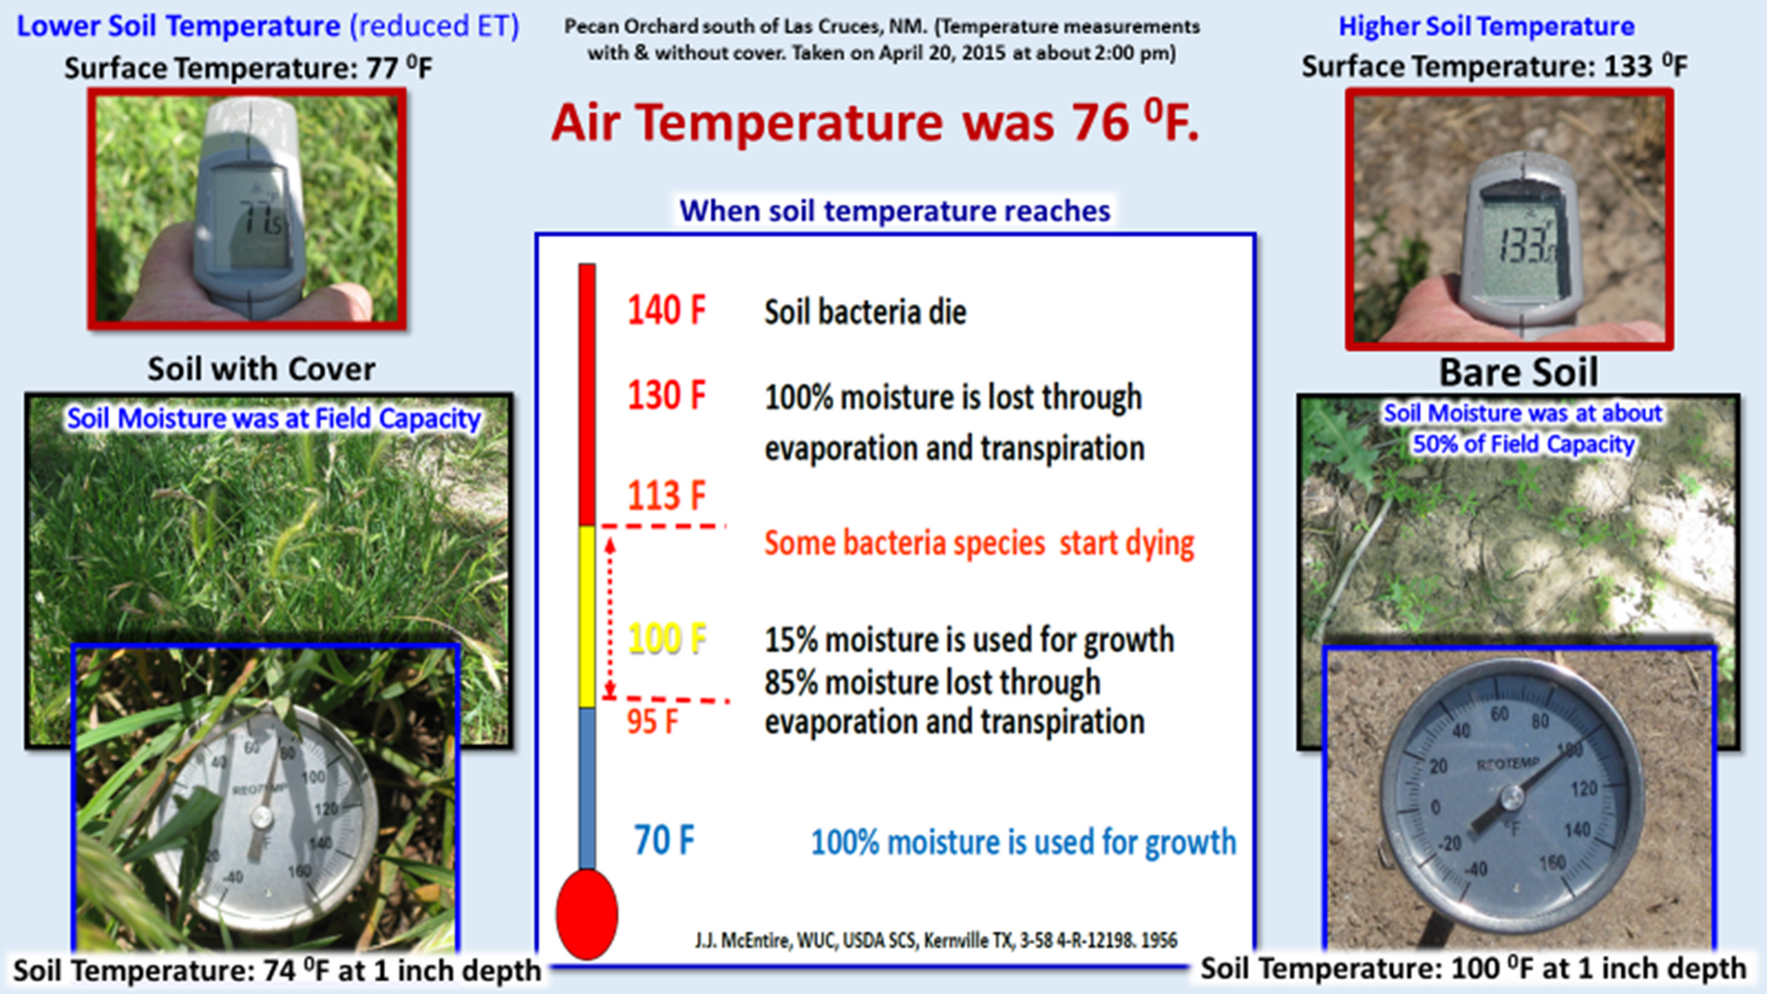

Slide 25
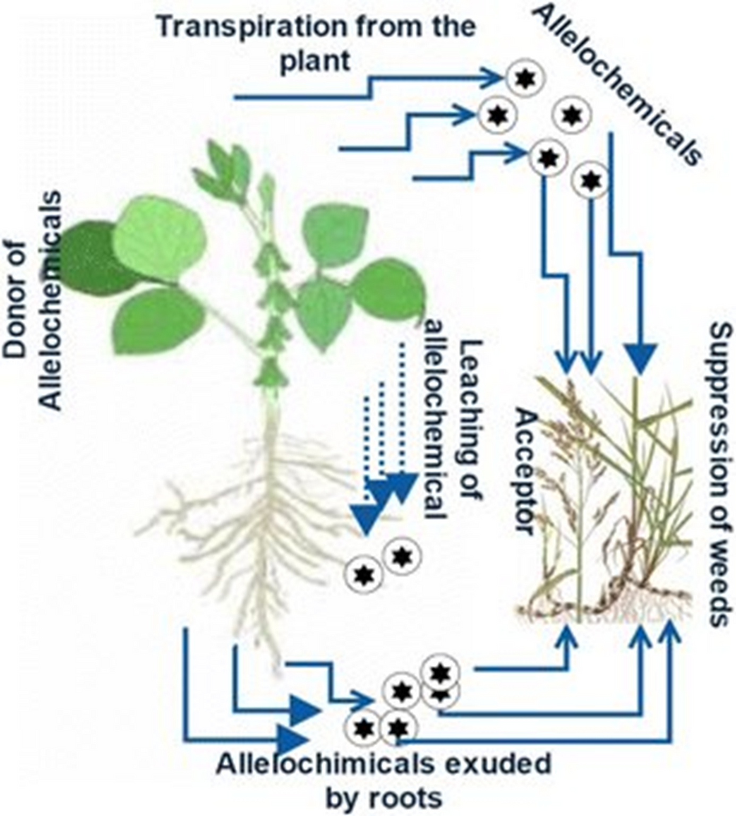
Weed Suppression Mechanisms
  Active Growing Phase:
    Competition for Resources: Light, nutrients, moisture.
    Microclimate Modification: Cooler soil, reduced weed germination.
    Allelopathy: Release of compounds (e.g., phenolics, terpenes) that suppress weeds.
  Post-Termination Phase:
    Mulch Effect: Residues act as a barrier to weed emergence.
    Biocontrol Agents: Encourage seed predation by omnivorous predators.

Slide 26
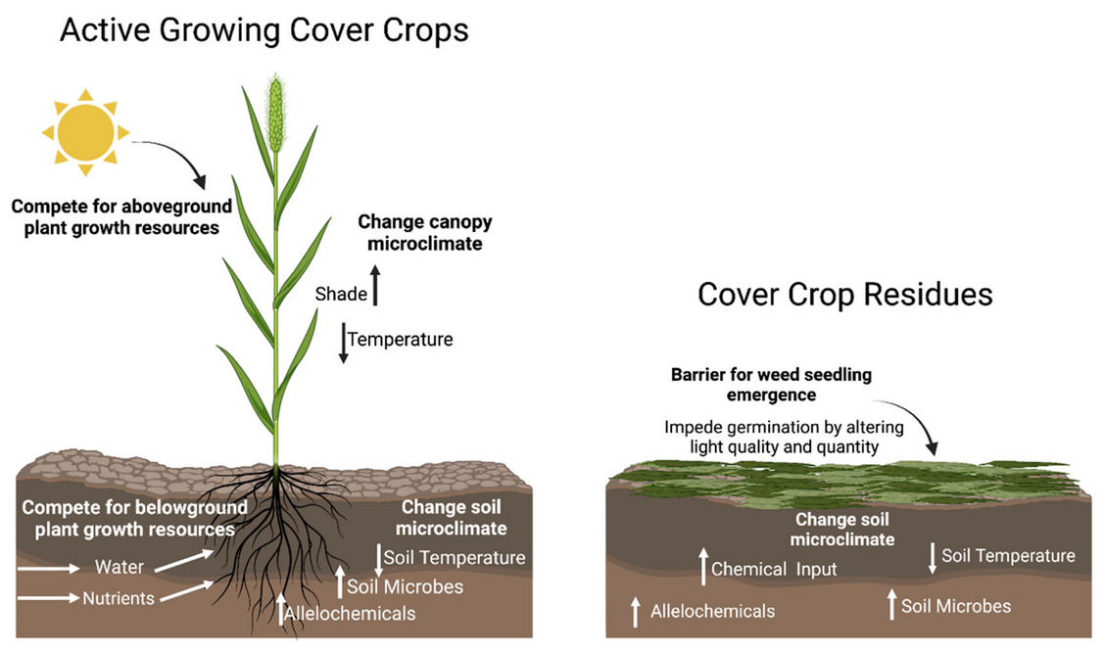

Weed Suppression Cont.

Slide 27
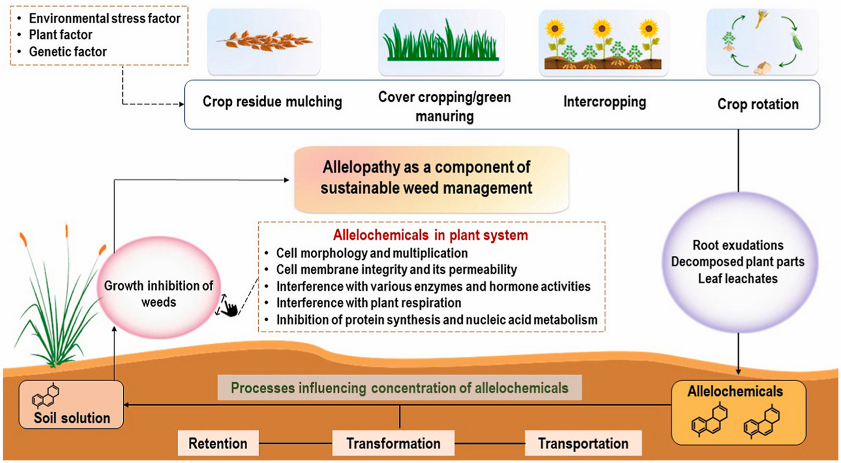

Slide 28
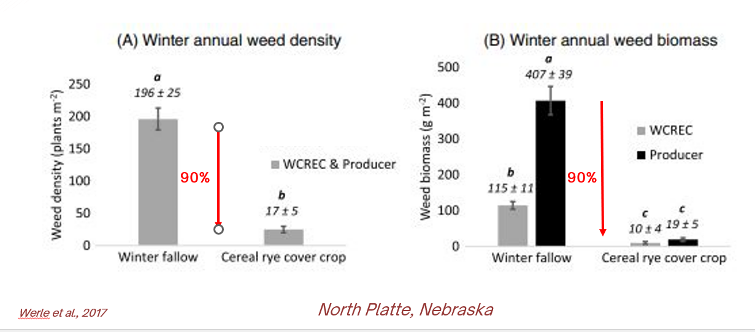
Weed Suppression Potential

Slide 29
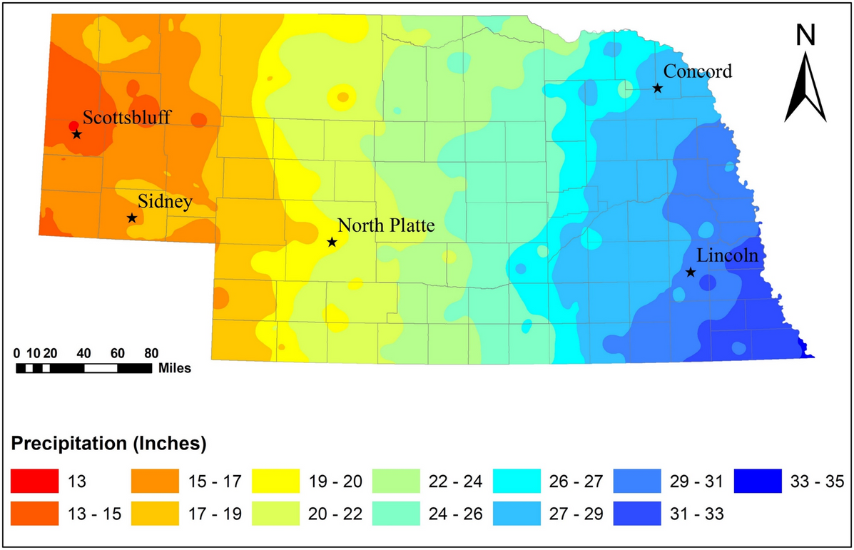
Nebraska Context
  Precipitation Variation:
    Western Nebraska: ~13 inches/year.
    Eastern Nebraska: ~35 inches/year.

Slide 30
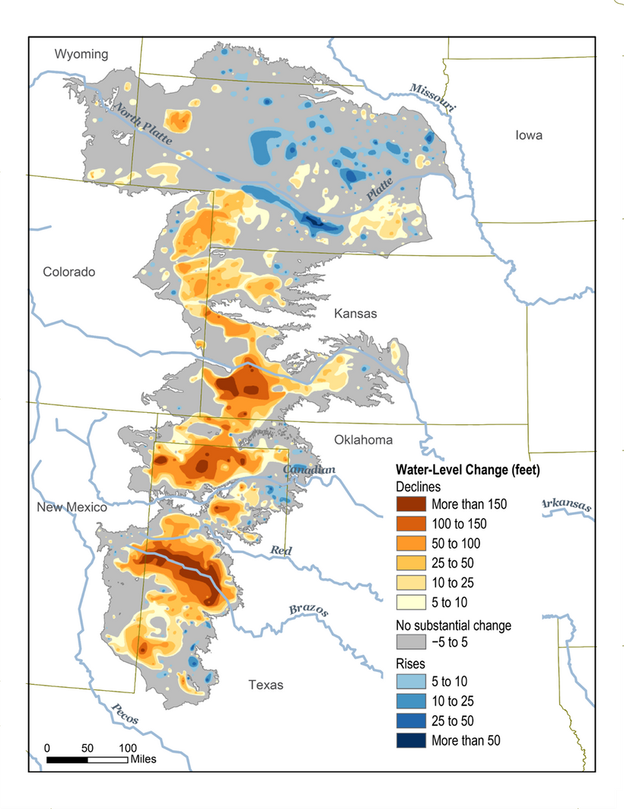
Nebraska Context Cont.
  Ogallala Aquifer Challenges:
    High irrigation demand → Declining water levels.
    35% of irrigated acreage may transition to dryland farming within 30 years.
  Cropping Systems:
    Wheat-fallow systems in the west: Soil erosion and degradation risks.
    Corn-soybean rotation in the east: Reduced diversity, pest outbreaks, and nitrogen runoff.

Slide 31
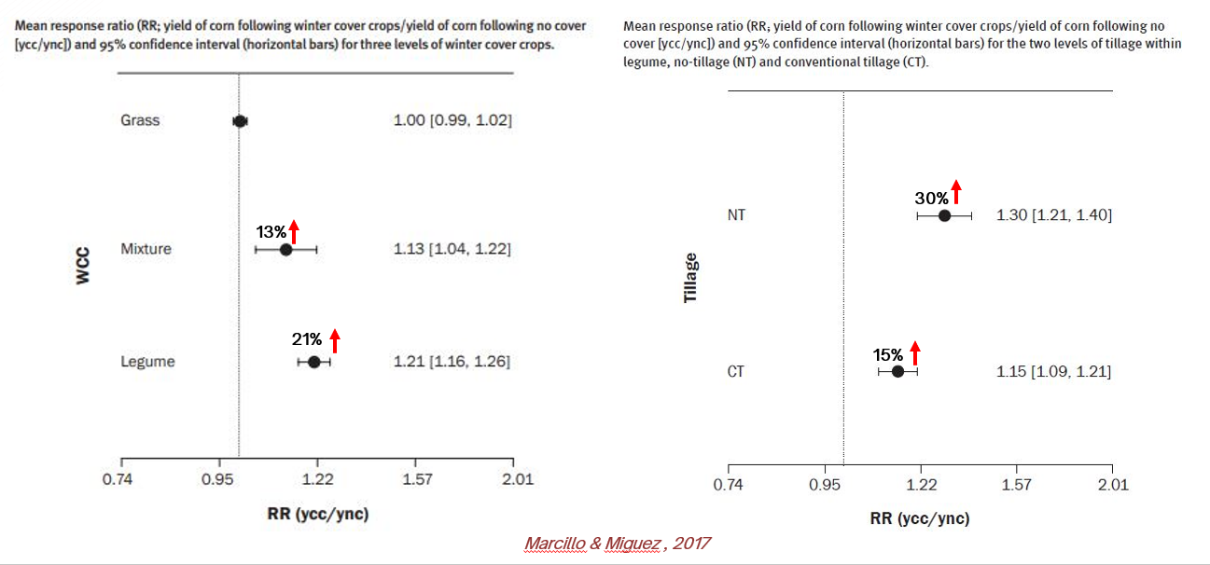
Yield Impacts from Studies: Meta- Analysis
tt
    Grass cover crops: Neutral yield impact.
    Legume cover crops: +21% yield.

Slide 32
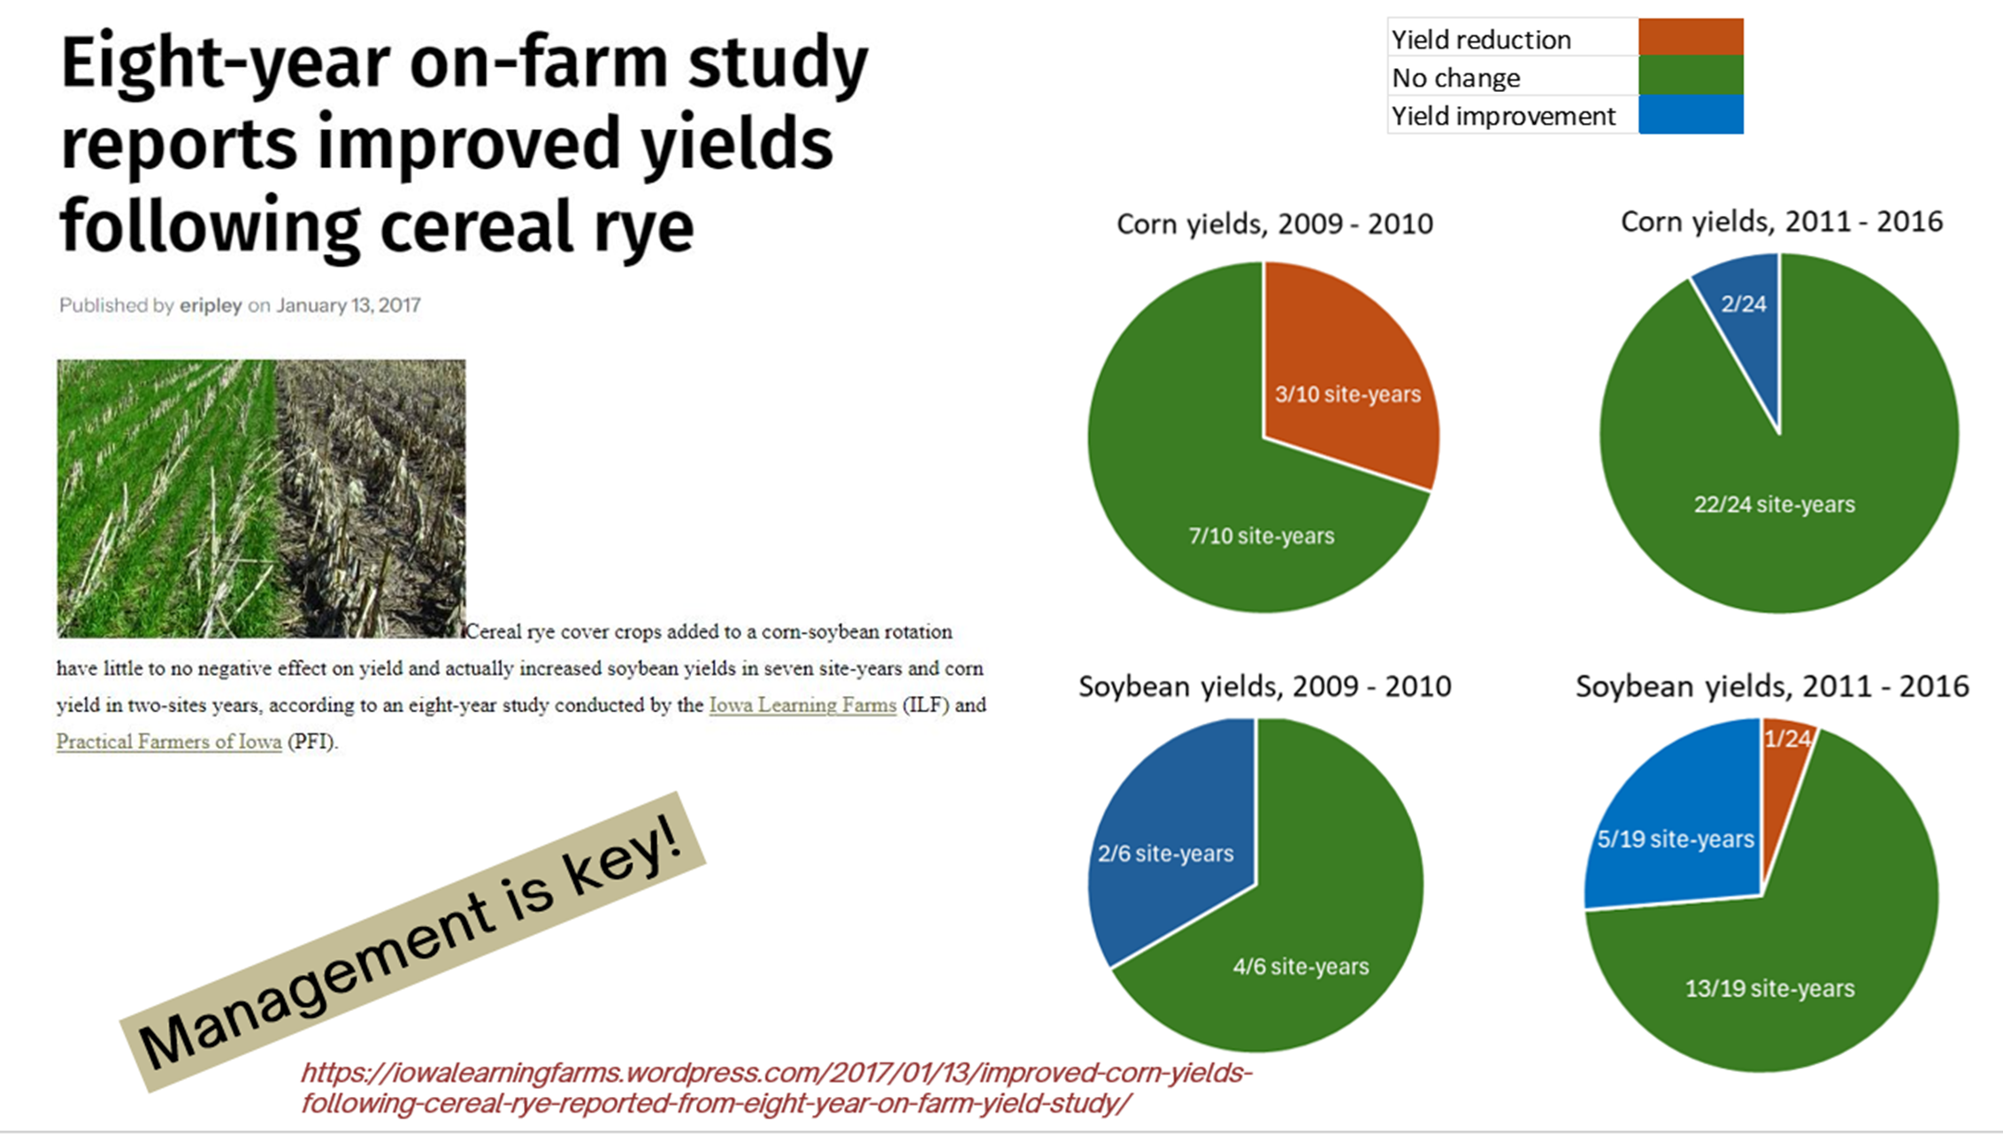
tt
Yield Impacts from Studies Cont.
  On-Farm Study (Iowa):
    Cereal rye reduced corn yield in early years but boosted soybean yield in 7 site-years.
    Soybean more flexible with termination timing than corn.

Slide 33
tt
On- Farm Study
  Trial Overview:
    Farmer-Led Trials: 89 field-scale trials on diverse soils, including sandy soils.
    Researcher-Led Trials: 290 small-plot trials, excluding sandy soils.
  Findings:
    Biomass Production:
      Farmer-led: 600 kg/ha.
      Researcher-led: 2,000 kg/ha.
    Yield Impact:
      Farmer-led: -3.4% (SE ±11%).
      Researcher-led: -7.0% (SE ±5.6%).
  Conclusion:
    Cover crops had no significant impact on cash crop yields in either trial type.

Slide 34
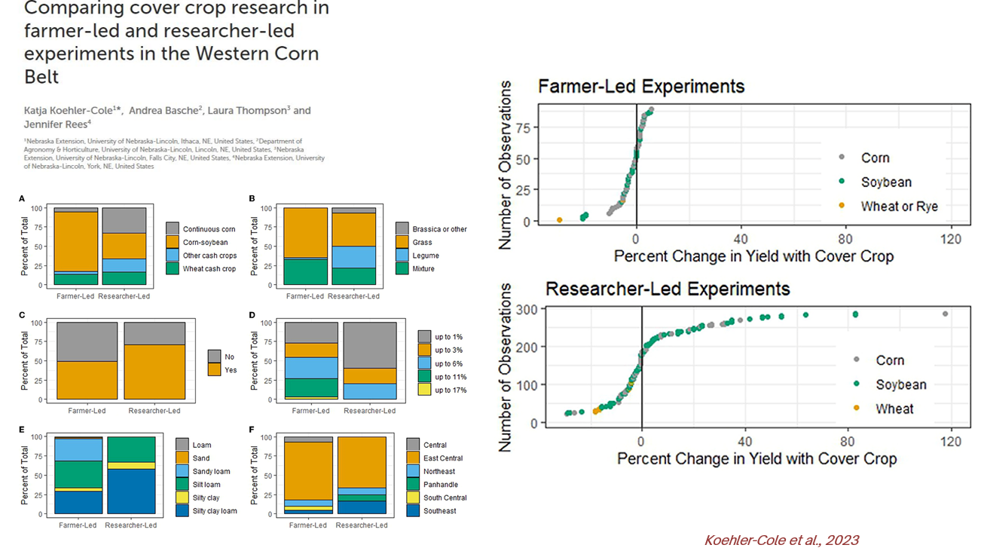
tt

Slide 35
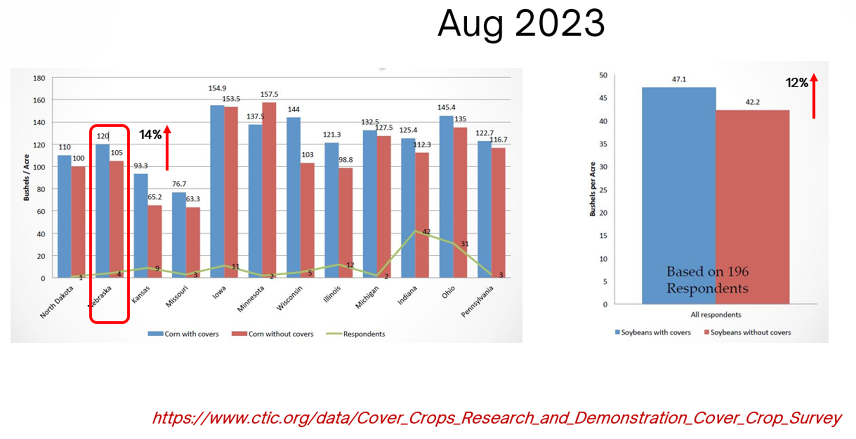
tt
CTIC/SARE farmer survey
  Survey Overview:
    Conducted in the Midwest region (2022-2023).
    Focused on cash crops: Corn and Soybean.
  Yield Results:
    Corn Yield:
      Increased by 14% with cover crops compared to no cover.
    Soybean Yield:
      Increased by 12% with cover crops compared to no cover.

Slide 36
tt
Corn Yield
  Cover crop termination timing:
    10 days before cash crop planting (early)
    11 days after cash crop planting (late)
  Corn growing season precipitation:
    2021: 606 mm
    2022: 269 mm
  After soybean harvest:
    CC planting:
      Sep 30 in 2020 & Sep 29 in 2021
    CC termination:
      2021: April 29 (early) & May 21 (late)
      2022: May 10 (early) & May 31 (late)
    Corn planting:
      May 13 in 2021 & May 20 in 2022
  Results:
    In a very dry year, late termination caused a 28.1% reduction in corn yields.

Slide 37
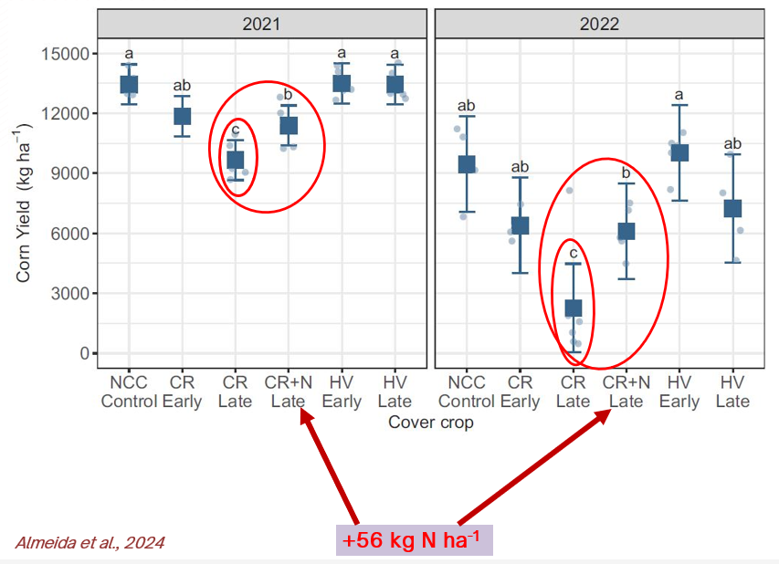
tt

Slide 38
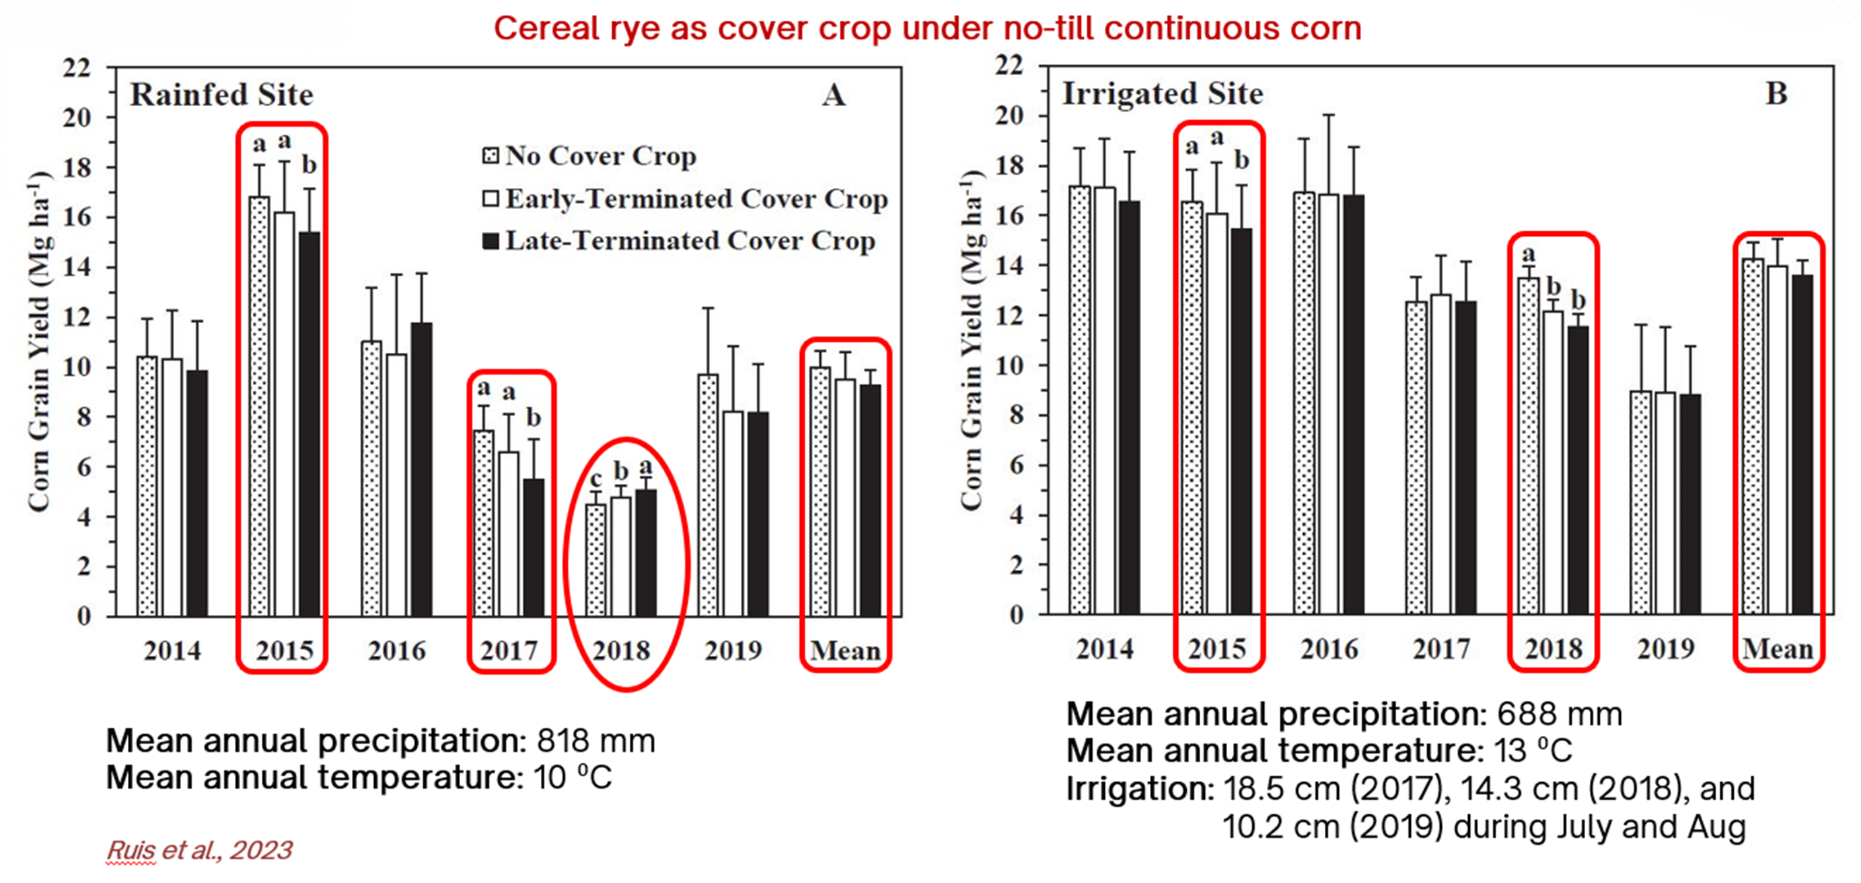
tt
Dryland and Irrigated Sites
  Study Overview:
    Duration: Six years of planting green.
    Locations: Dryland and irrigated sites.
  Results:
    No average yield differences observed over six years.
    Corn Yield Declines:
      Four site-years reported decreases of 1.11–1.95 Mg ha⁻¹.
    Corn Yield Increase:
      One site-year showed a yield increase.

Slide 39
tt
Soy-bean Yield Cont
  Sufficient rain and snowfall occurred in fall 2020 and winter 2021
  Below-average rain and snow in fall 2021 and winter 2022
  Results:
    Yield declined by 23% in dry years with hail/windstorms.
    Yield increased by 28% in a favorable year.
  Cover crop drilled:
    2020: after corn harvest on Oct 16
    2021: after soybean harvest on Nov 15
  Cover crop termination timing:
    2 weeks before planting soybean
    2021: April 24
    2022: April 28
    2 weeks after planting soybean
    2021: May 26
    2022: May 31
  Soybean planting:
    2021: May 12
    2022: May 18

Slide 40
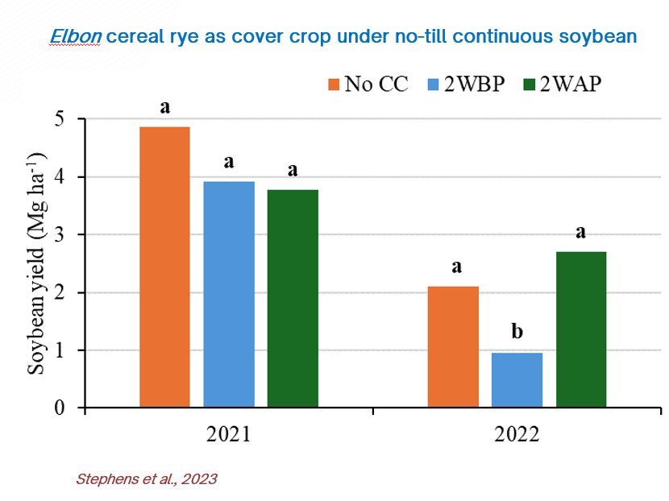
tt

Slide 41
tt
Soy-bean Yield Cont
  Clay Center (irrigated):
    Transition between sub-humid and semi-arid; USDA hardiness zone 5b; 689 mm annual precipitation
    Soil: silt loam
    Soybean irrigation: six to seven times between July and August, each time with 3.4 cm of water
  Concord (rainfed):
    Sub-humid; zone 5a; 755 mm annual precipitation
    Soil: silty clay
  Mead (rainfed):
    Sub-humid; zone 5b; 768 mm annual precipitation
    Soil: silty clay loam
  Treatments:
    RYE: monoculture cereal rye (Elbon)
    MIX: mixture of cereal rye, forage radish (Nitro), hairy vetch (VNS), and Austrian winter pea (Whistler)
    CON: without cover crops
  Cover crops planting:
    After corn harvest in mid-Oct to late Nov
  Cover crops terminating:
    Following spring (approximately 2 wks. before planting soybean)
  Soybean planting: Late April to mid-May
  Soybean harvest: Oct to Nov
  Results:
    Mostly neutral soybean yield effects over four years.
    One year: 13% yield decline after a cover crop mixture.
    Another year: 18% yield increase after a cover crop mixture.

Slide 42
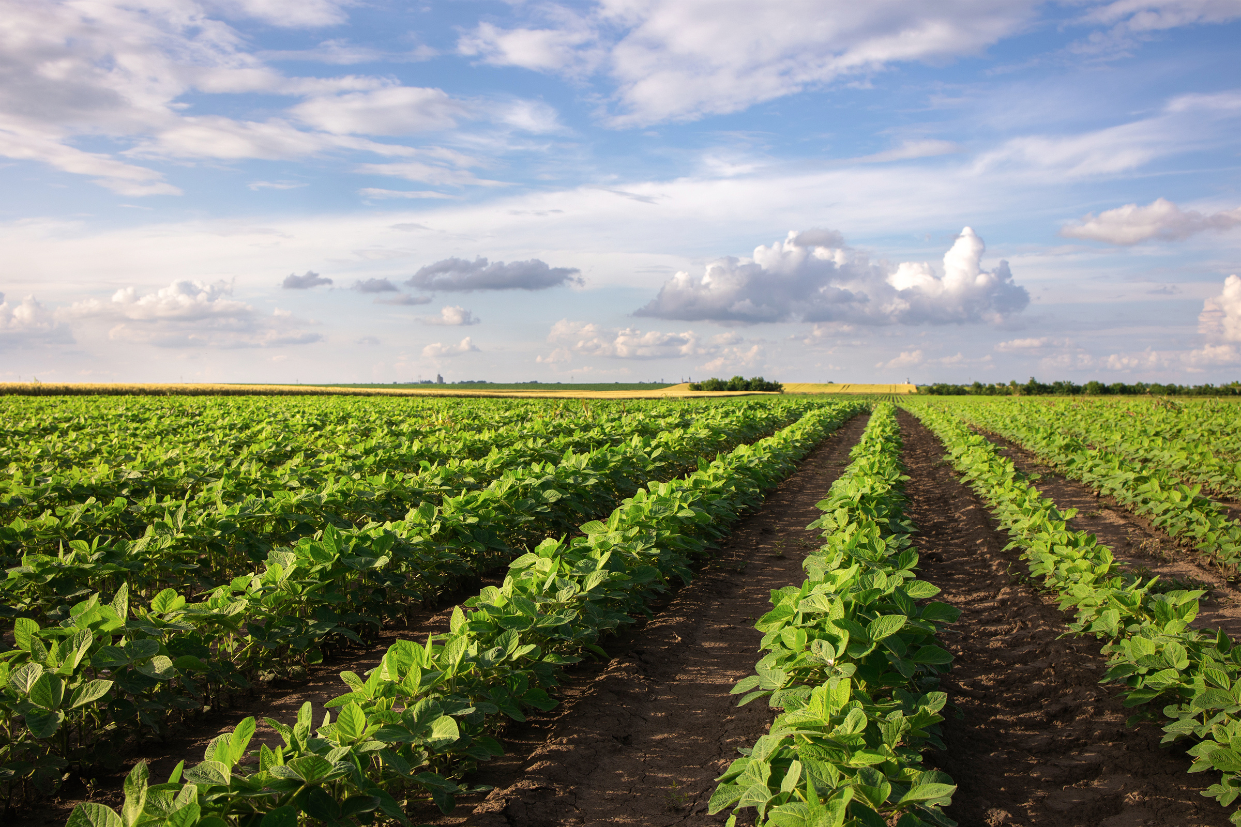
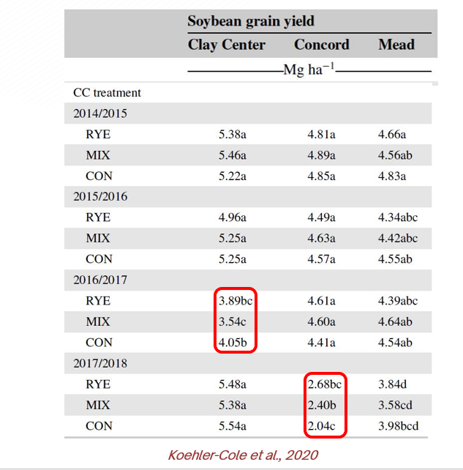

Slide 43
tt
Wheat yield in semiarid regions
  Cover crop treatments:
    Four monoculture species: flax, oat, pea, and rapeseed
    One 10-species mixture of rapeseed, flax, oat, pea, lentil, common vetch, berseem clover, barley, phacelia, and safflower
    Fallow: no-till control with proso-millet residue
  Results
    Two-year study: 10% yield reduction under both irrigated and dryland conditions.

Slide 44
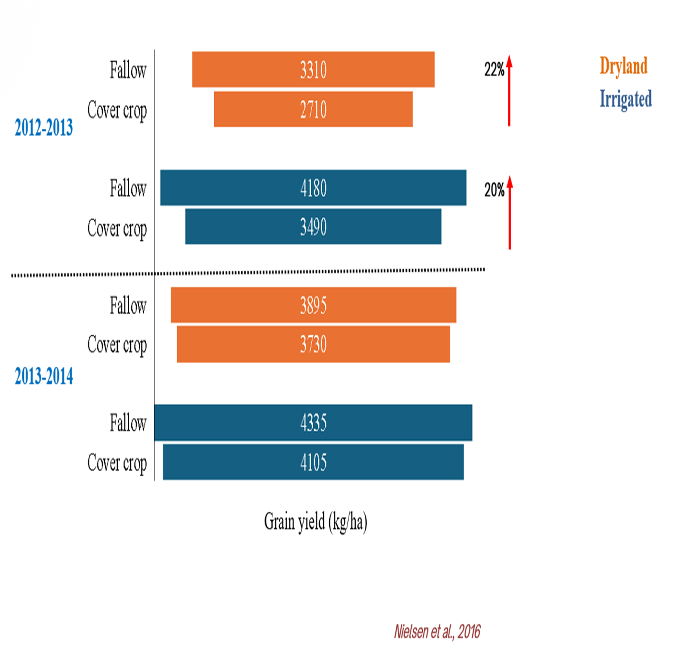
tt
Corn yield in semiarid regions
  Crop rotation:
    Winter wheat – maize – fallow
  Cover crop planting:
    Within 7 - 30 days after winter wheat harvest
    Sep (2016-2017) and Aug (2017-2018)
  Cover crop terminating:
    At maize planting in 2017 and two weeks before maize planting in 2018
  Results:
    Two years of trials showed most cover crop species reduced corn yields by up to 30%, except for spring oats

Slide 45
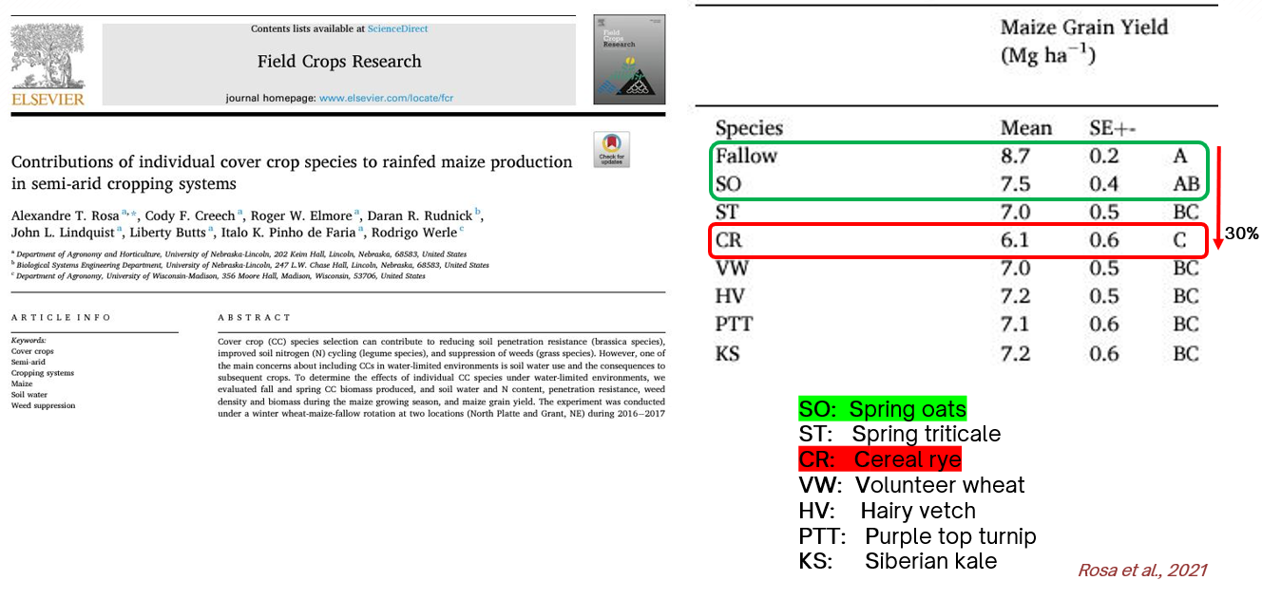

Slide 46
Key Takeaways from Yield Impact Studies
  Cover Crop Effects on Yield: What We Learned
    Legume Cover Crops: Can increase yield by +21% (Meta-analysis data).
    Grass Cover Crops: Generally neutral or slightly negative in dry years.
    Termination Timing Matters:
      Corn: Terminate 10-14 days before planting to prevent competition.
      Soybeans: Can be planted green, allowing for later termination.
    Long-Term Benefits: Yield increases become more frequent after multiple years of use.
    Regional Considerations:
    Semi-arid areas: Spring oats may be a better alternative to cereal rye.
    Irrigated systems: Cover crops work well, especially legumes and mixtures.
  Best Practices for Farmers
  ✅ Select species based on soil and climate.
  ✅ Optimize termination timing to reduce competition.
  ✅ Monitor water and nutrient availability in dry conditions.

Slide 47
Management is Key
  Species Selection: choose species based on local climate, soil type, and rotation crops (e.g., legumes for nitrogen fixation)
  Optimal Termination Timing: Ensure timely termination to avoid water/nutrient competition
  Inter-seeding: Incorporate cover crops without affecting the main crop’s growth cycle
  Water Use Concerns: Implement species with low water demands and plan termination based on soil moisture availability
  Manage Water and Nutrient Competition: Apply supplemental fertilization or irrigation where necessary

Slide 48
Sources
Almeida, T. F., Robinson, E., Matthiesen‐Anderson, R., Robertson, A. E., & Basche, A. (2024). Effect of cover crop species and
termination timing on corn growth and seedling disease. Agronomy Journal.
Koehler‐Cole, K., Elmore, R. W., Blanco‐Canqui, H., Francis, C. A., Shapiro, C. A., Proctor, C. A., ... & Ferguson, R. B. (2020). Cover
crop productivity and subsequent soybean yield in the western Corn Belt. Agronomy Journal, 112(4), 2649-2663.
Koehler-Cole, K., Basche, A., Thompson, L., & Rees, J. (2023). Comparing cover crop research in farmer-led and researcher-led
experiments in the Western Corn Belt. Frontiers in Sustainable Food Systems, 7, 1064251.
Nielsen, D. C., Lyon, D. J., Higgins, R. K., Hergert, G. W., Holman, J. D., & Vigil, M. F. (2016). Cover crop effect on subsequent wheat
yield in the central Great Plains. Agronomy Journal, 108(1), 243-256.
Marcillo, G. S., & Miguez, F. E. (2017). Corn yield response to winter cover crops: An updated meta-analysis. Journal of Soil and
Water Conservation, 72(3), 226-239.
Rosa, A. T., Creech, C. F., Elmore, R. W., Rudnick, D. R., Lindquist, J. L., Butts, L.,... & Werle, R. (2021). Contributions of individual
cover crop species to rainfed maize production in semi-arid cropping systems. Field Crops Research, 271, 108245.
Ruis, S. J., Blanco-Canqui, H., Jasa, P. J., Slater, G., & Ferguson, R. B. (2023). Increasing rye cover crop biomass production after
corn residue removal to balance economics and soil health. Field Crops Research, 302, 109076.
Stephens, T., Blanco‐Canqui, H., Knezevic, S., Rees, J., Koehler‐Cole, K., & Jhala, A. J. (2023). Impact of planting green on soil
properties under irrigated no‐till soybean. Agrosystems, Geosciences & Environment, 6(4), e20443.
https://iowalearningfarms.wordpress.com/2017/01/13/improved-corn-yields-following-cereal-rye-reported-from-eight-year-onfarm-
yield-study/
https://www.ctic.org/data/Cover_Crops_Research_and_Demonstration_Cover_Crop_Survey

