Slide 1
Cover crops, water use, the water cycle: what does the evidence tell us
Andrea Basche, Ph.D.
Department of Agronomy and Horticulture
University of Nebraska-Lincoln
Webinar series: Session-II
Addressing common cover crop
Challenges & questions in Nebraska

Slide 2
Outline
Session one revisit: Yield effects
Partial budgeting and direct cover crop costs
Research and evidence
Key Takeaways

Slide 3
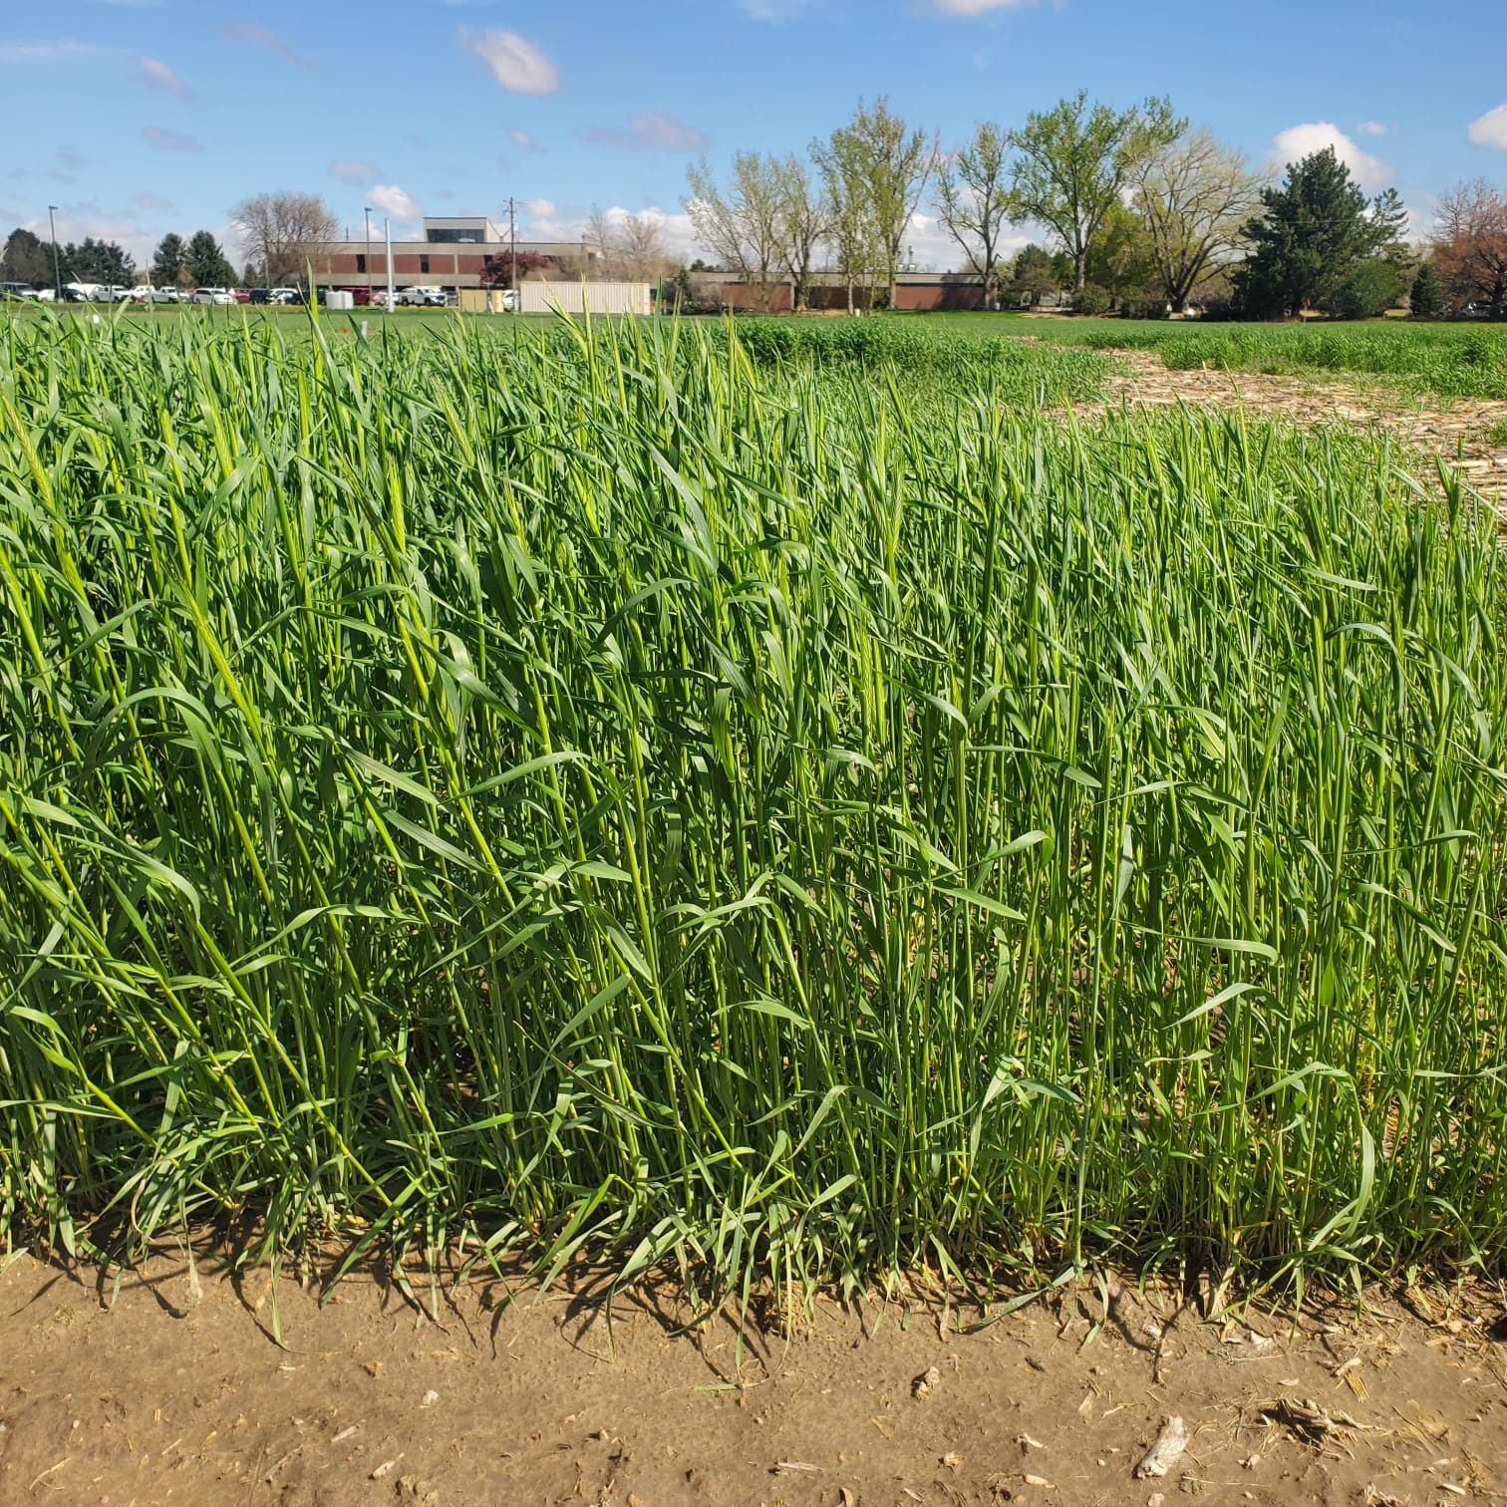
How do cover crops effect yield?
✅ Soil Health & Water Benefits
🍂 Increase organic matter → Enhance microbial activity, improve nutrient cycling
🌾 Physical coverage blocking sunlight → Weed suppression
🏞️ Improve soil structure → Better water retention & infiltration
🌱 Fix nitrogen (legumes) → Reduce nutrient leaching
⚠️ Potential risks → Competition for water, termination timing issues

Slide 4
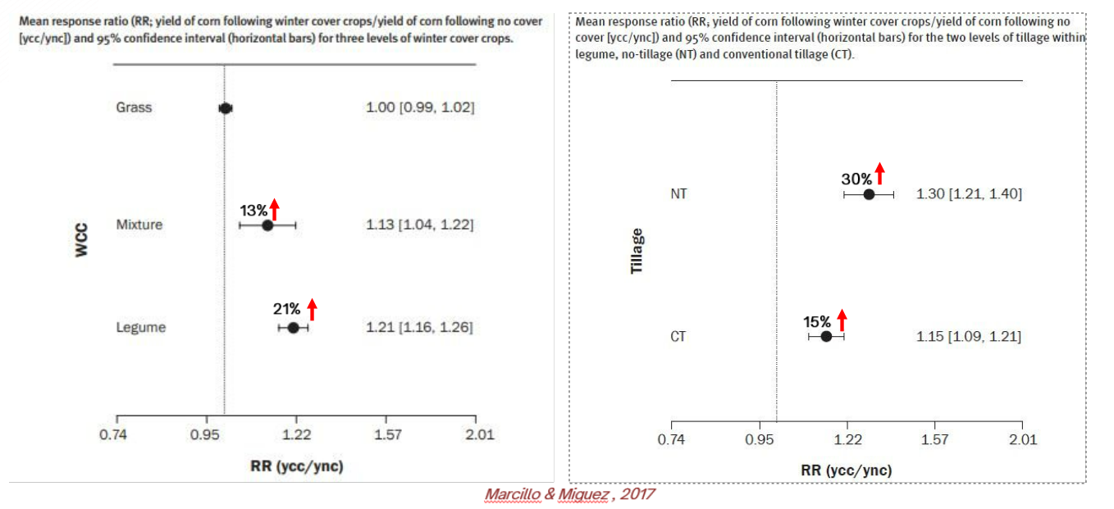
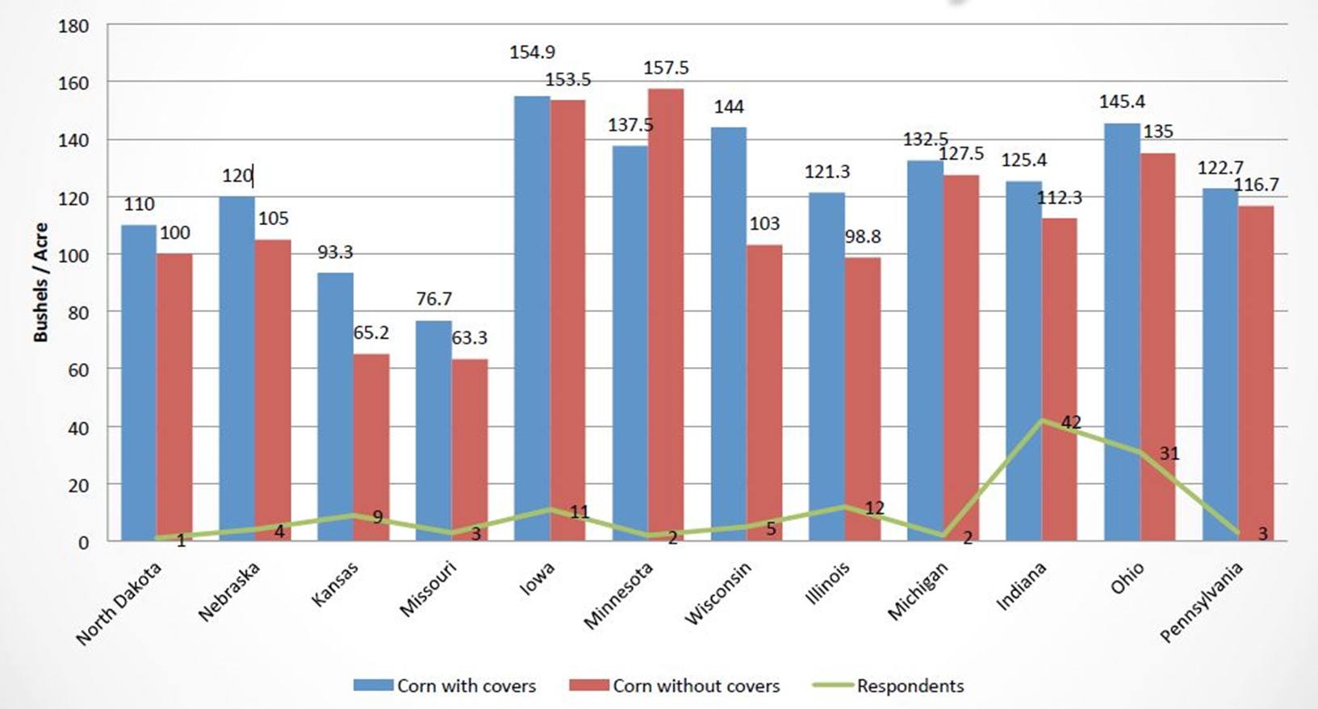
tt
Corn Yield Impacts: Insights from Research
CTIC/SARE Farmer Surveys (2023)
Farmers reported 14% corn yield increase with cover crops
Soybean yields improved by 12%
Meta-analysis Findings (Marcillo & Miguez, 2017)
Corn yield increase with legumes (+21%)
Neutral or slight decline with grasses (-3 to -7%)

Slide 5
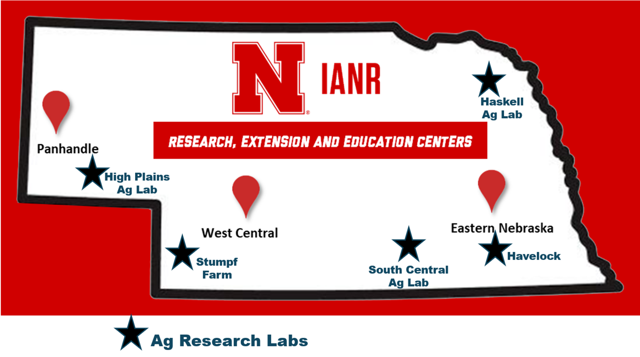
Nebraska-Specific Cover Crop Data
Multiple Nebraska field trials across the state evaluated cover crop effects on corn, soybeans, and wheat.
Key research topics:
Yield impacts in dryland vs. irrigated systems
Influence of termination timing
Cover crop species-specific effects.

Slide 6
Nebraska-Specific Cover Crop Data Cont.
tt
✅ Corn Yield
Mostly neutral effects, but late termination reduced yields in dry years (Almeida et al. 2024, Ruis et al. 2023).
Soybean planting green showed mixed effects, with one yield decline in dry conditions and one increase in favorable moisture (Stephens et al. 2023).
✅ Soybean & Wheat Yield
Soybean trials across multiple sites showed neutral effects, with one year of yield increase from cover crop mixtures (Koehler-Cole et al. 2020).
Wheat following cover crops saw small yield reductions, especially in dryland conditions (Nielsen et al. 2016).
✅ Water Use & Soil Impacts
Cover crops improved infiltration in Nebraska trials (Krupek et al. 2022).Minimal long-term impact on soil moisture, but later termination increased water competition in dry years..

Slide 7
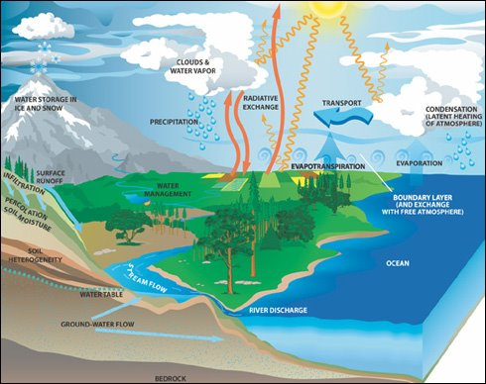
The Water Cycle & Cover Crops – Key Processes
✅ Water Inputs:
Cover crops influence how precipitation & irrigation move through the system.
✅ Infiltration & Runoff:
More root channels = More infiltration & Less runoff.
✅ Storage & Drainage:
Cover crops increase soil organic matter, holding more water while improving drainage.
✅ Water Losses:
Cover crops reduce evaporation but transpire moisture as they grow.
✅ Management Implications:
Helps in wet years, but termination timing is key in dry years to avoid competition.

Slide 8
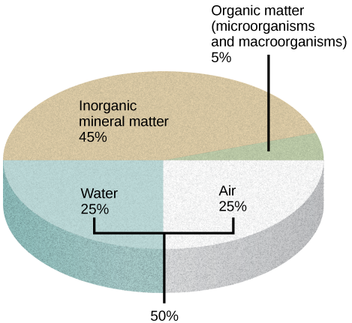
The Soil Surface – Where the Water Cycle Happens
✅ Soil as a Matrix:
Pore space & organic matter regulate water infiltration, storage, and movement.
✅ Cover Crop Effects:
More infiltration = Less runoff & erosion
More storage = Drought resilience
Better soil structure = Increased water availability
✅ Takeaway:
Managing the soil surface directly impacts water availability for crops

Slide 9
tt
Cover Crops & Water Management
✅ In Wet Years:
Cover crops reduce erosion, store water, & improve infiltration.
Help manage excess moisture.
✅ In Dry Years:
Cover crops compete for water before termination.
Late termination can reduce cash crop yields (especially in semi-arid regions).
✅ Best Management Practices:
Terminate early in dry regions to avoid water stress.
Choose species based on soil moisture needs.
Monitor soil moisture to refine decisions.

Slide 10
Cover Crops & the Water Cycle: Research Findings
tt
✅ Global Research Findings:
Cover crops increase infiltration by up to 34.8% in one year (Basche et al., 2019).
Improve soil hydrology – increase porosity, field capacity, and water storage (Stewart et al., 2018).
Reduce deep drainage losses – decrease by 27mm on average (Meyer et al., 2019).
Lower evapotranspiration & increase water use efficiency (Wang et al., 2021).
✅ Nebraska & Iowa Studies:
Nebraska on-farm research (Krupek et al., 2022) – 3 of 4 farms saw infiltration increase within 3 years. Multi-year Nebraska trials – minimal impact on soil moisture in long-term studies.
Iowa studies (2008-2014) – cover crops increased water storage in wet & dry years (Basche et al., 2016).Yield reductions observed in dry years in Western Nebraska (Rosa et al., 2021; Nielsen et al., 2016).

Slide 11
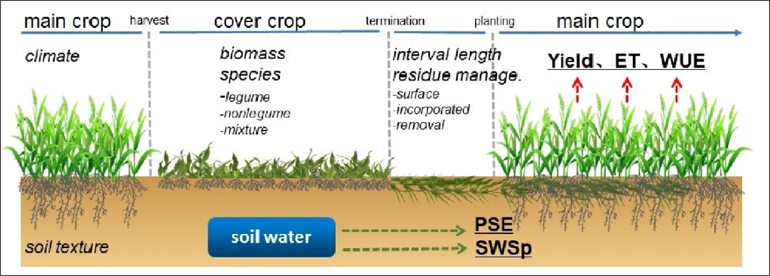
Cover crops and water use efficiency​
Synthesis of 117 studies reporting soil moisture with and without cover crops​
Cover crops reduced evapotranspiration but along with water in soil during fallow​
Cover crops also increased water use efficiency = Yield / ET

Slide 12
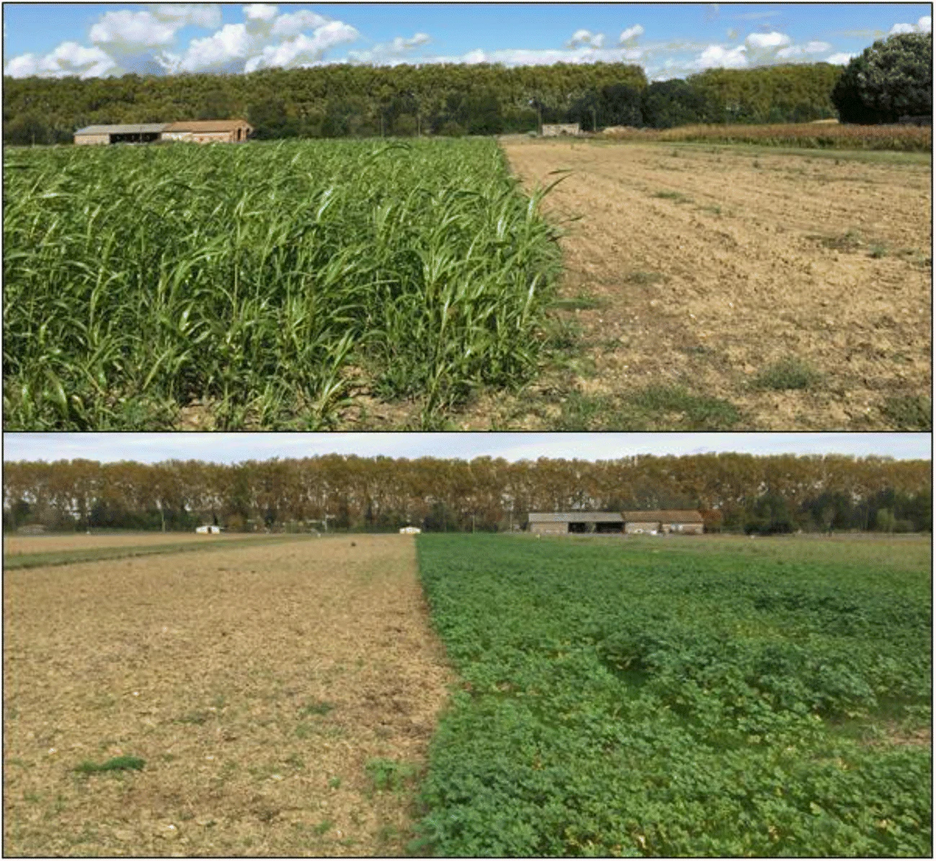
Cover Crops Reduce Water Drainage
✅ Findings from a Synthesis of 28 Studies:
Cover crops reduced drainage water loss (water unavailable to plant roots).On average, drainage decreased by 27mm, keeping more water in the root zone.
✅ Nebraska & Iowa Studies:
Iowa (2008-2014):
Cover crops increased plant available water without reducing planting-time soil moisture (Basche et al., 2016).
Nebraska(Rosa et al., 2021):
Cover crops had minimal soil moisture impact in above-average rainfall years.
Meyer, N., Bergez, JE., Constantin, J. et al. Cover crops reduce water drainage in temperate climates: A meta-analysis. Agron. Sustain. Dev. 39, 3 (2019). https://doi.org/10.1007/s13593-018-0546-y

Slide 13
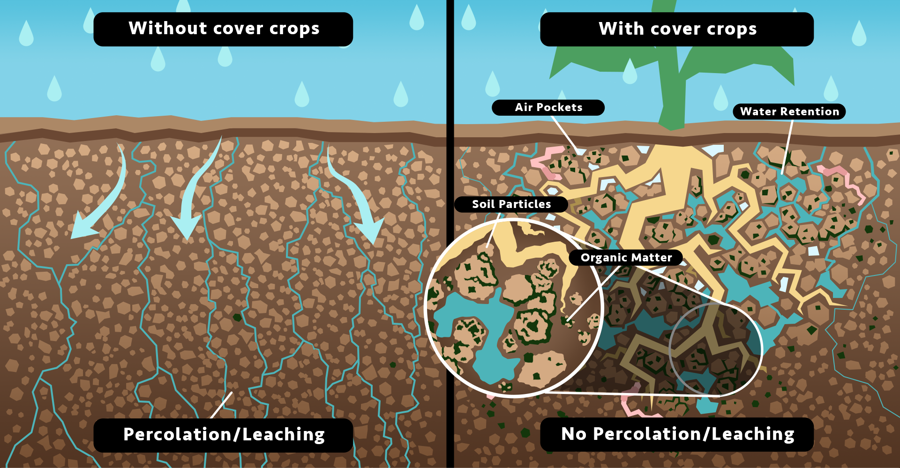
Cover Crops & Soil Infiltration
✅ Short-Term Infiltration Gains:
Meta-analysis (Basche & DeLonge, 2019):
Cover crops increase infiltration by 34.8% in one year.
On-farm Nebraska research (Krupek et al., 2022):
3 of 4 farms showed infiltration improvement within 3 years.
Supported by other meta-analyses (Stewart et al., 2018).
USDA Natural Resources Conservation Service. Retrieved from https://arid.nmsu.edu/cover-crop.html.

Slide 14
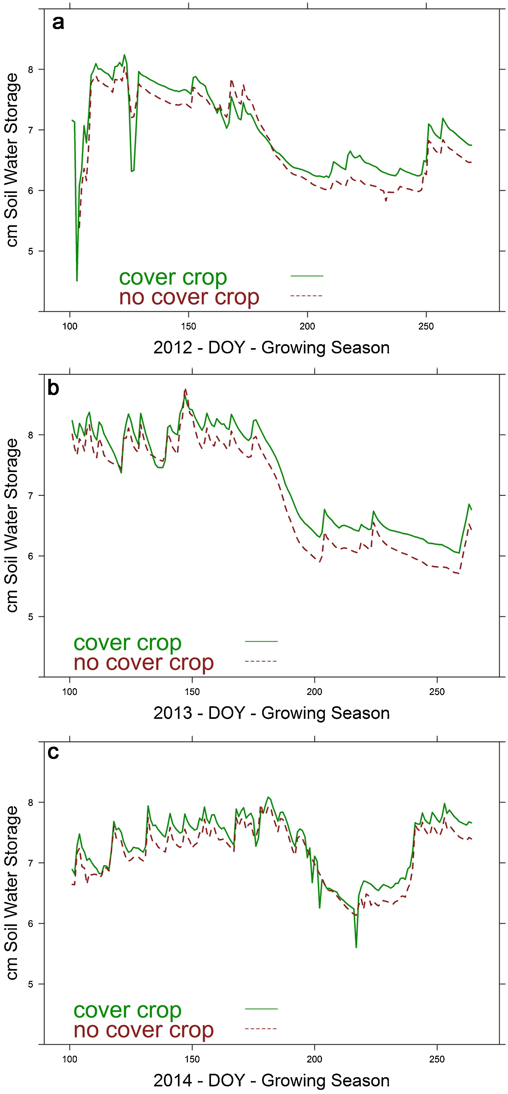
Cover Crops & Soil Water Storage Capacity
✅ Iowa Long-Term Study (2008-2014):
Greater water storage across both wet and dry years.
No negative impact on soil moisture at corn/soybean planting.
✅ Nebraska 3-Year Study (Brule, Mead, Clay Center, Concord):
Soil water monitored using neutron probes & gravimetric approaches.
Cover crop biomass ranged up to 3 tons per acre.
Minimal impact on soil water content in most cases.
Basche, A.D., Kaspar, T.C., Archontoulis, S.V., Jaynes, D.B., Sauer, T.J., Parkin, T.B. and Miguez, F.E., 2016. Soil water improvements with the long-term use of a winter rye cover crop. Agricultural Water Management, 172, pp.40-50.​

Slide 15
Cover Crops & Soil Water Content in Nebraska
✅ Western Nebraska Studies:
Grant & North Platte (Rosa et al., 2021):
Above-average rainfall years = minimal water impacts.
Later termination reduced soil water availability for following crops.
Sidney & Akron, CO (Nielsen et al., 2016):
Cover crops reduced wheat yield by 10% due to increased water use.
However, water use efficiency improved in the second year.

Slide 16
Cover Crops & Water Cycle Processes
✅ Key Takeaways:
🌊 More infiltration = Less runoff & erosion
💧 More water storage = Greater drought resilience
🌾 Balanced drainage = More efficient water use
⚠️ Management is key – Early termination is critical in dry years

Slide 17
Sources
New Mexico State University – Arid Lands Cover Crops: https://arid.nmsu.edu/cover-crop.html
Wang, L., Basche, A., & Groh, T. (2021). Cover Crops and Water Use Efficiency: A Meta-Analysis. Journal of Soil and Water Conservation.
Basche, A., & DeLonge, M. (2019). The Impact of Cover Crops on Infiltration Rates: A Synthesis of Research.
Meyer, L. D., Dabney, S. M., & Harmon, W. C. (2019). Effects of Cover Crops on Deep Drainage in Agricultural Systems.
Rosa, D., Nielsen, D., & Aiken, R. (2021). Cover Crop Impacts on Soil Moisture in Semi-Arid Systems.
Krupek, A., Ruis, S., & Blanco-Canqui, H. (2022). Infiltration Increases with Cover Crops in Nebraska Soils.
USDA Natural Resources Conservation Service. Soil & Water Cycle Diagrams.
UNL Extension Publications. Nebraska Research Location Maps.

