Slide 1

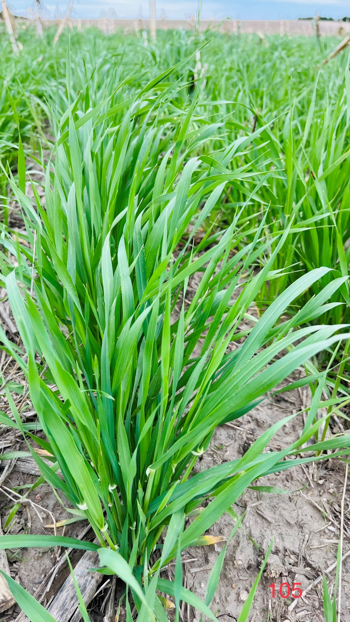



Webinar series: Session-3
Addressing common cover crop
Challenges & questions in Nebraska
Considering how cover crops offer returns on investment
Andrea Basche
Associate Professor
Department of Agronomy and Horticulture
University of Nebraska-Lincoln

Slide 2
Outline
01
Partial budgeting and direct
cover crop costs
02
Research and evidence
03
Summary

Slide 3
Partial budgeting and direct cover crop costs

Slide 4
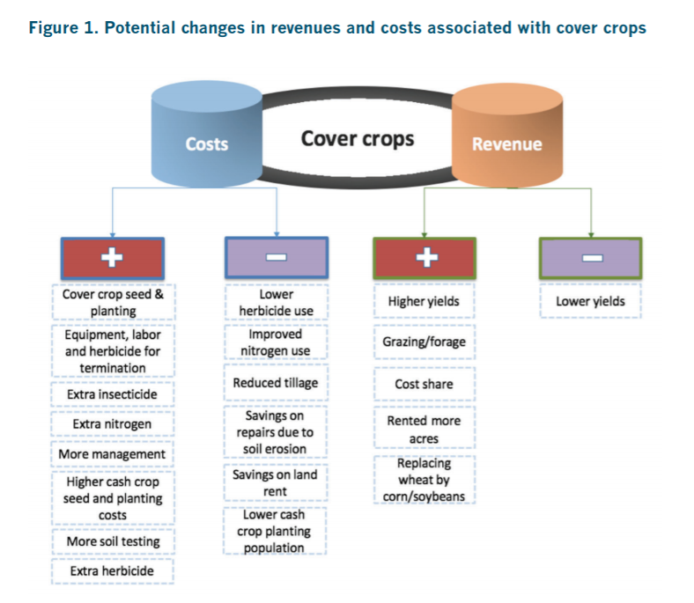
Partial budget analysis
Partial budgets estimate net annual private (on-farm) economic benefits or losses associated with use of cover crops
Identify and monetize any differences in management of any production system with or without cover crops
Plastina, Alejandro; Liu, Fangge; Sawadgo, Wendiam; Miguez, Fernando E.; and Carlson, Sarah, "Partial Budgets for Cover Crops in Midwest Row Crop Farming" (2018). Economics Publications. 621. https://lib.dr.iastate.edu/econ_las_pubs/621

Slide 5
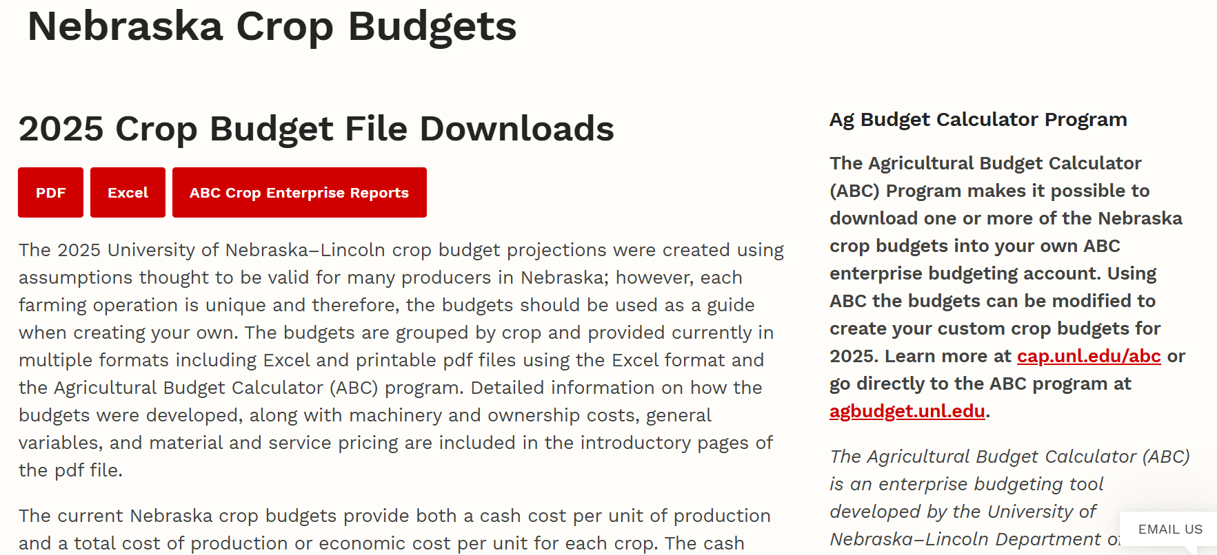
Budget examples and resources
https://cap.unl.edu/cropbudgets/

Slide 6
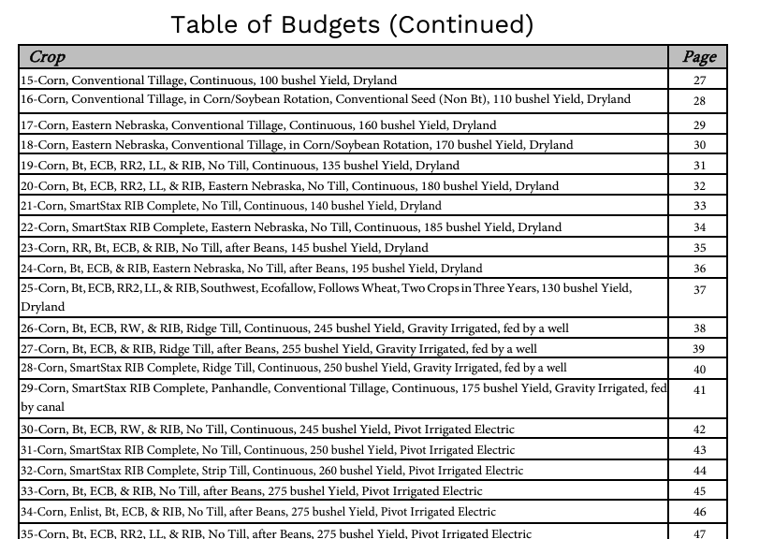
Budget examples and resources
Platform includes excel and pdf versions of different “scenarios” – can be tailored for most closely related situation
Crops
Dryland or Irrigated
Yield goals
Location
Tillage
Rotation
https://cap.unl.edu/cropbudgets/

Slide 7
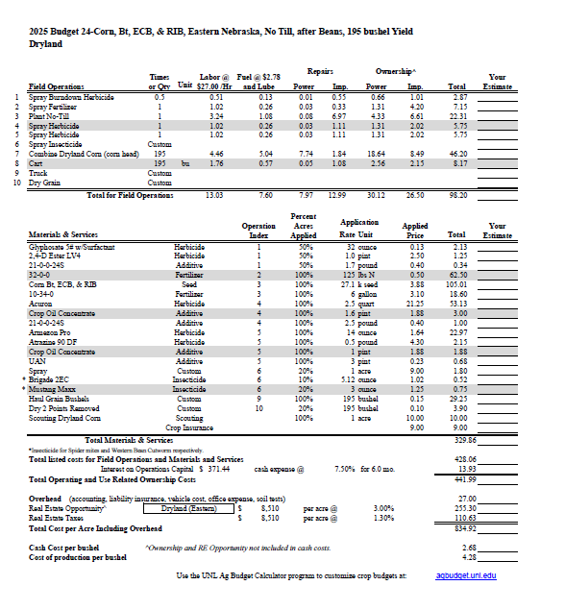
Budget examples and resources
Budgets include
-Field operations
#s correspond to …
-Materials and services
Fertilizers
Herbicides
-Includes overhead costs such as real estate taxes
Calculate costs per bushel
An amazing resource! Can compare changes in management considering only elements of budget (i.e. materials and services), estimate costs in absence of other information
https://cap.unl.edu/cropbudgets/

Slide 8
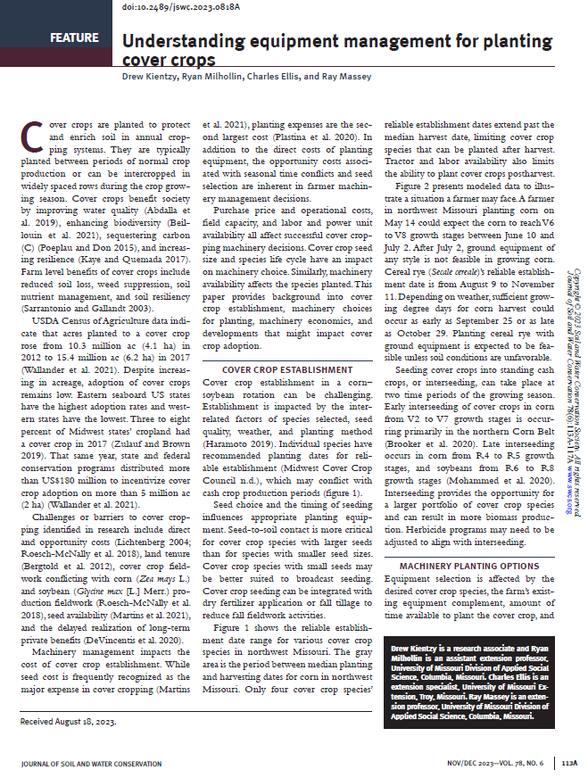
How to estimate equipment costs and needs?
Helpful guide to consider equipment needs associated with cover crops specific to planting
Discusses pros/cons of planters, drills, spreaders, interseeders, aerial application approaches, and more
Economics included as well as ideas for equipment modification or sharing
Kientzy, D., Milhollin, R., Ellis, C. and Massey, R., 2023. Understanding equipment management for planting cover crops. Journal of Soil and Water Conservation, 78(6), pp.113A-117A.

Slide 9
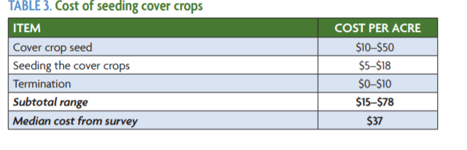
Costs for seed, planting and termination
Other considerations
Equipment is owned or needs to be hired custom
Seeding rates depend on goals, species, seed costs, planting method
Based on data from ~500 farmers/year through the SARE/CTIC National Cover Crop Survey.

Slide 10
Returns on investment:
Research and evidence

Slide 11
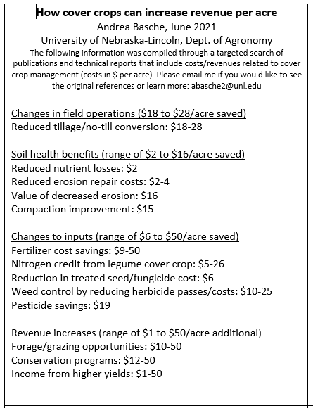
Understanding how cover crops can pay
There are several reports and publications that have attempted to answer questions related to how cover crop and soil health management systems offer return on investment
These typically include surveys of farmers or case study examples
My team and I attempted to address these questions in 2020 by compiling reports, creating ranges of savings from categories included

Slide 12
Understanding how cover crops can pay
Objective: Create a spreadsheet that represents costs plus returns on investments for cover crops
Methods: Review pre-existing reports, targeted keyword search in Google Scholar, include all types of publications such as reports, bulletins, extension articles
Keyword search included cover crops AND “net return”, “savings”, “nitrogen savings”, “fertilizer reduction”, “budgets”, “economic returns”
Categories identified and range of $$
Changes in costs
(more or less expenses)
Changes in field operations | $ 17.68 – 27.28
Soil health related benefits | $ 1.00 – 16.00
Changes to inputs | $ 6.00 – 50.00
Changes in revenues
Value of change in cash crop yield | $ 9.06 – 142.00
Savings or extra revenue from grazing | $ 0.66 – 49.00
Cost-share program | $ 11.73 – 50.00

Slide 13
Categories/ notes | Savings |  | Period of using cover crops | Source/Reference
 | Range | Mean
Chenges in field operations
Reduced machinery cost/Reduced tillage |  | $17.68 | 2011 - 2019 | Case Study: Larry, Adam, and Beth Thorndyke, Thorndyke Farms, IL (Jul 2019)
Reduced tillage |  | $23.43 | 2014 - 2019 | Case Study: Eric Niemeyer, MadMax Farms, OH (Jul 2019)
Reduced tillage |  | $ 35.45 | 2014 - 2019 | Case Study: Eric Niemeyer, MadMax Farms, OH (Jul 2019)
no-till |  | $24.25 | 2014 - 2019 | Case Study: Dan Lane, Homewood Farms, OH (Feb 2020)
no-till |  | $ 72.28 | 2012 - 2019 | Case Study: John and Jim Macauley, Macauley Farms LLC, NY (Feb 2020)
Conversion to no-till from conventional: No fall chisel plow |  | $23.96 | 5 years | SARE: Cover Crop Economics: Opportunities to Improve Your Bottom Line in Row Crops
Soil health related benefits
Reduced soil nutrient losses due to .51 tons/ac less erosion |  | $ 1.61 |  | Case Study: John and Jim Macauley, Macauley Farms LLC, NY (Feb 2020)
Field repair savings |  | $1.00 |  | Case Study: Eric Niemeyer, MadMax Farms, OH (Jul 2019)
Erosion repair | $ 2 - 4 |  |  | SARE: Cover Crop Economics: Opportunities to Improve Your Bottom Line in Row Crops
Erosion repair costs decreased |  | $16 | 2012 - 2018 | Lynn Betts-Cover crop economics-FarmProgress 2018
Value of decreased erosion |  | $ 2.25 | 2005 - 2019 | Case Study: Jay Swede, Gary Swede Farm LLC, NY (Jul 2019)
Compaction addressed by cover crop: Reduced subsoiling operations |  | $15.30 |  | SARE: Cover Crop Economics: Opportunities to Improve Your Bottom Line in Row Crops
Chenges to inputs
Fertilizer cost savings |  | $8.40 |  | SARE: Cover Crop Economics: Opportunities to Improve Your Bottom Line in Row Crops
Fertilizer costs decreased |  | $50 |  | Lynn Betts-Cover crop economics-FarmProgress 2018
Nitrogen credit | $10.00 - 26.00 |  | 2018 | Swanson et.al_2018_FarmDocDaily - Understanding Budget Implications of Cover Crops_University of Illinois
Nitrogen credit | $ 5.00 - 13.00 |  | 2018 | Swanson et.al_2018_FarmDocDaily - Understanding Budget Implications of Cover Crops_University of Illinois
Nutrient Savings due to nutrient management |  | $40.65 |  | Case Study: Jay Swede, Gary Swede Farm LLC, NY (Jul 2019)
Reduction in treated soybean seed (fungicide) |  | $6.00 |  | Case Study: Eric Niemeyer, MadMax Farms, OH (Jul 2019)
Weed control by reducing by 2 passes | $10 - 25 |  |  | SARE: Cover Crop Economics: Opportunities to Improve Your Bottom Line in Row Crops
Thick-biomass cover crop will reduce herbicide and labor costs |  | $27.00 |  | SARE: Cover Crop Economics: Opportunities to Improve Your Bottom Line in Row Crops
Weed control by cover crops saves 1 sprayer trip |  | $ 12.00 |  | Case Study: John and Jim Macauley, Macauley Farms LLC, NY (Feb 2020)
Pesticide savings due to soil health practices |  | $ 18.75 |  | Case Study: Eric Niemeyer, MadMax Farms, OH (Jul 2019)

Slide 14
Categories/ notes | Savings |  | Period of using cover crops | Source/Reference
 | Range | Mean
Grazing and forage opportunities
Potential grazing |  | $49.23 |  | SARE: Cover Crop Economics: Opportunities to Improve Your Bottom Line in Row Crops
Savings or extra revenue from grazing | $ 0 - 10 | $0.66 |  | Plastina et.al 2020 - Cover crops use in Midwestern US agriculture: perceived benefits and net returns
Government/other programs
Cost-share program | $ 0 - 39.98 | $11.73 |  | Plestina et.al 2020 - Cover crops use in Midwestern US agriculture: perceived benefits and net returns
Federal or state incentive payments received |  | $50.00 |  | SARE: Cover Crop Economics: Opportunities to Improve Your Bottom Line in Row Crops
Following cash crop yield changes
 |  | $12.95 |  | Case Study: Larry, Adam, and Beth Thorndyke, Thorndyke Farms, IL (Jul 2019)
Yield due to soil health practices + variable rate nitrogen |  | $ 72.00 |  | Case Study: Jay Swede, Gary Swede Farm LLC, NY (Jul 2019)
Yield due to soil health practices |  | $ 142.00 |  | Case Study: Dan Lane, Homewood Farms, OH (Feb 2020)
Yield due to soil health practices |  | $ 69.00 |  | Case Study: Eric Niemeyer, MadMax Farms, OH (Jul 2019)
income from higher yields |  | $76 |  | Lynn Betts-Cover crop economics-FarmProgress 2018
Value of change in following cash crop yield | $ 0 - 63.37 | $9.06 | average 9 years | Plastina et.al 2020 - Cover crops use in Midwestern US agriculture: perceived benefits and net returns

Slide 15
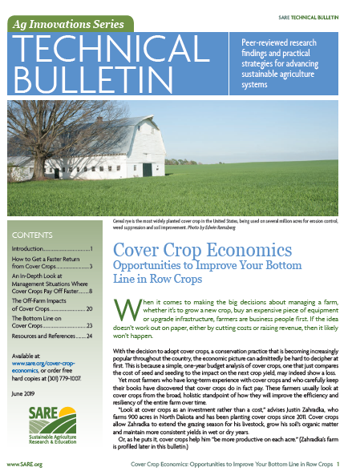
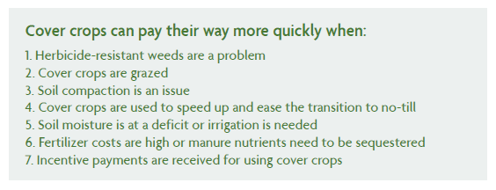
Understanding how cover crops can pay
SARE Technical Bulletin June 2019
https://www.sare.org/wp-content/uploads/Cover-Crop-Economics.pdf

Slide 16
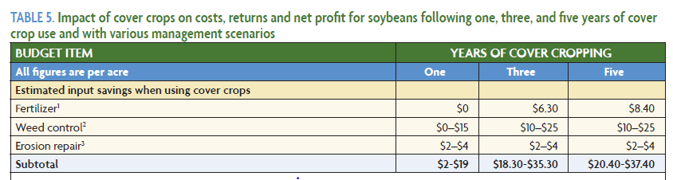
Understanding how cover crops can pay
Assumes no fertilizer savings in year one, then a savings of 15 lbs P per acre per in year 3 and 20 lbs per acre in year 5, $0.42 per lb
First year assumes either no herbicide savings or possible savings of $15 per acre by avoiding a fall herbicide pass (50:50 costs for chemical and application). The third and fifth years assume using a less expensive residual chemistry that costs $10 per acre, with the possibility of saving $15 per acre in fall
Based on the cost of machinery operations to repair gullies and clean ditches (costs will vary)
SARE Technical Bulletin June 2019
https://www.sare.org/wp-content/uploads/Cover-Crop-Economics.pdf

Slide 17
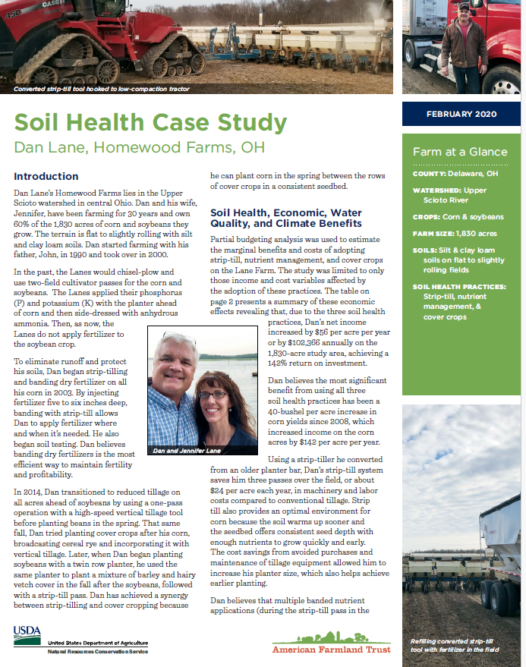
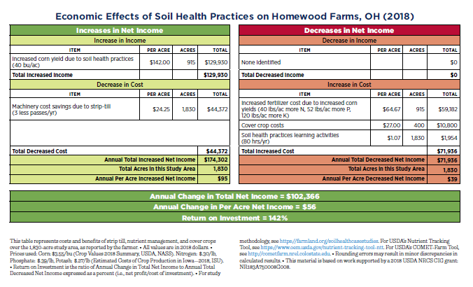
Understanding how cover crops can pay
https://farmland.org/soil-health-case-studies/
AFT published >20 case studies from 10 states from 2019-2022. Ohio corn-soy example here found…
-Increases from yield, less field passes
-Decreases for seeding/planting and fertilizer

Slide 18
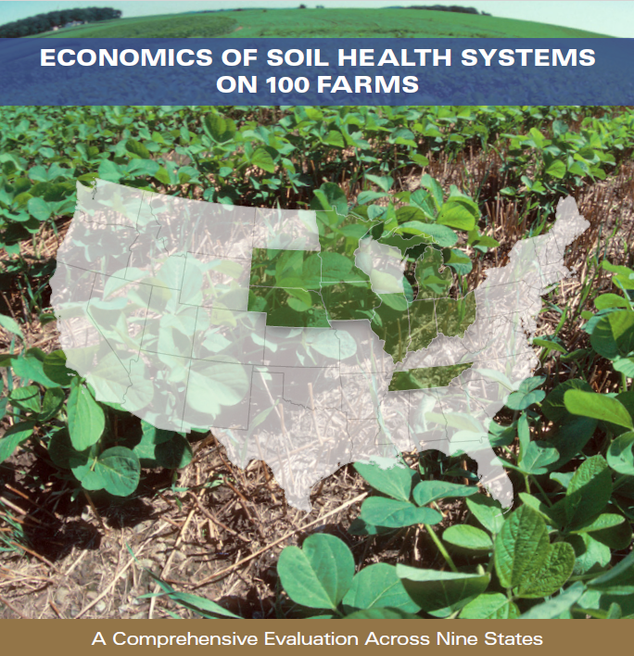
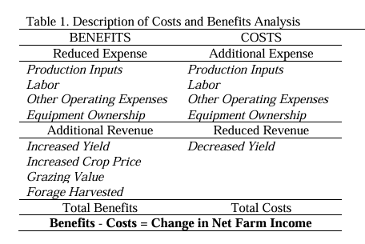
Understanding how cover crops can pay
The Soil Health Institute interviewed 100 farmers in nine Corn Belt states to estimate partial budgets of soil health management systems, publishing results and reports in 2020-2021
https://soilhealthinstitute.org/our-work/initiatives/economics-of-soil-health-systems/

Slide 19
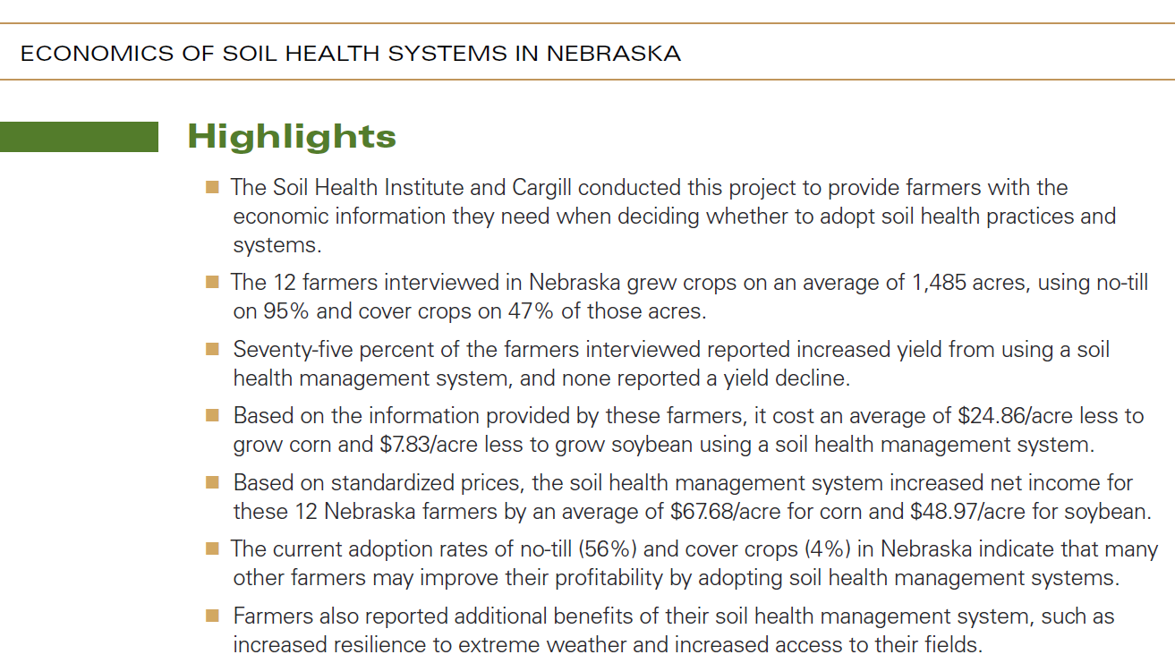
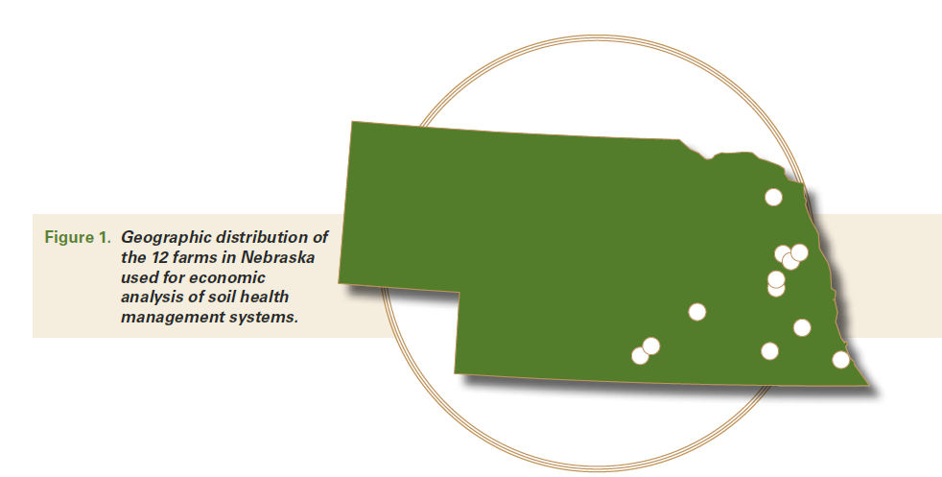
Cover crops were not the only change for farmers in these interviews (also no-till). **NT for 25 yrs, CC for 10 yrs
Estimated increase in net income of $68 per acre for corn and $49 for soybean

Slide 20
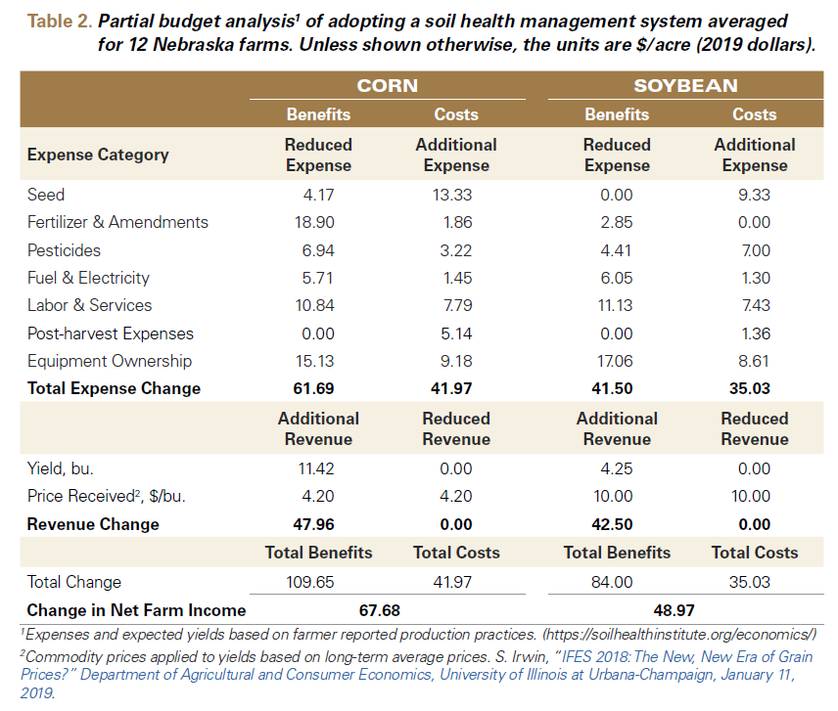
Categorized benefits and costs for both corn and soybean
Came from a mixture of categories including equipment, fertilizer, herbicides

Slide 21

Partial budgets can emphasize different elements and arrive at different conclusions
Plastina et al. worked with ~15 Iowa farmers to build partial budgets
“calculated annual net returns to cover crops were negative for most participants”
Compared to Soil Health Institute interviews, this effort had higher seed and termination costs, with lower benefits. They did count cost share.
SHI went beyond cover crops to include no-till or broader SH management systems
Plastina, A., Liu, F., Miguez, F. and Carlson, S., 2020. Cover crops use in Midwestern US agriculture: perceived benefits and net returns. Renewable Agriculture and Food Systems, 35(1), pp.38-48.

Slide 22
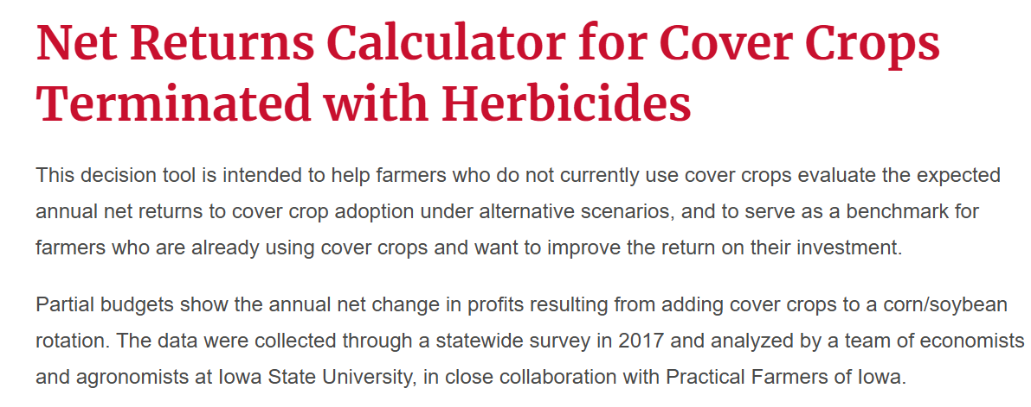
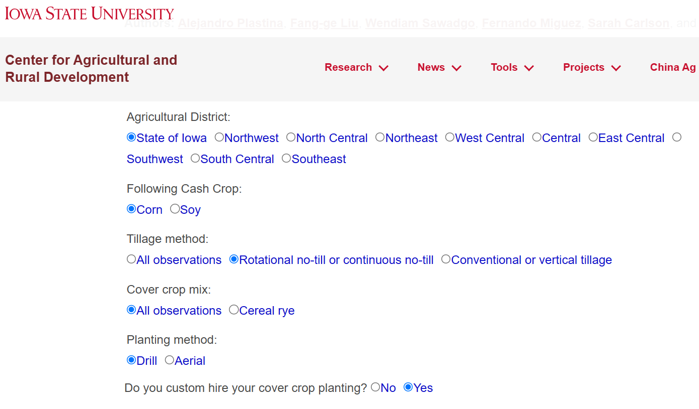
Tool based on Iowa interviews partial budgets
https://www.card.iastate.edu/conservation/economics-of-cover-crops/net-returns-calculator

Slide 23

Summary of research evidence
Reports vary significantly about cover crop costs and returns on investment. Not only can costs vary from year to year but scenarios and assumptions underlying what goes into the budget are not always consistent from report to report. Yet they can provide us reasonable estimates of costs (plus or minus) and revenues (plus or minus).
Estimating costs for cover crops are similar to how one might estimate partial budgets for cash crops. For cover crops, a partial budget might include costs for seed, planting, inputs like herbicides or fertilizers that might increase or decrease, labor and/or equipment (i.e. more or less field passes). Revenues could include higher or lower yields, grazing/forage, and cost share programs.
It makes a big difference how much you include in the partial budget and how we try to quantify benefits.
Many positive reports of return on investment are from those using cover crops after a few years.
Resources include: UNL crop budget platform and the ABC Calculator Tool, the numerous reports and case studies (Soil Health Institute, SARE, American Farmland Trust), and the Iowa State net returns calculator.
Soil N

Slide 24
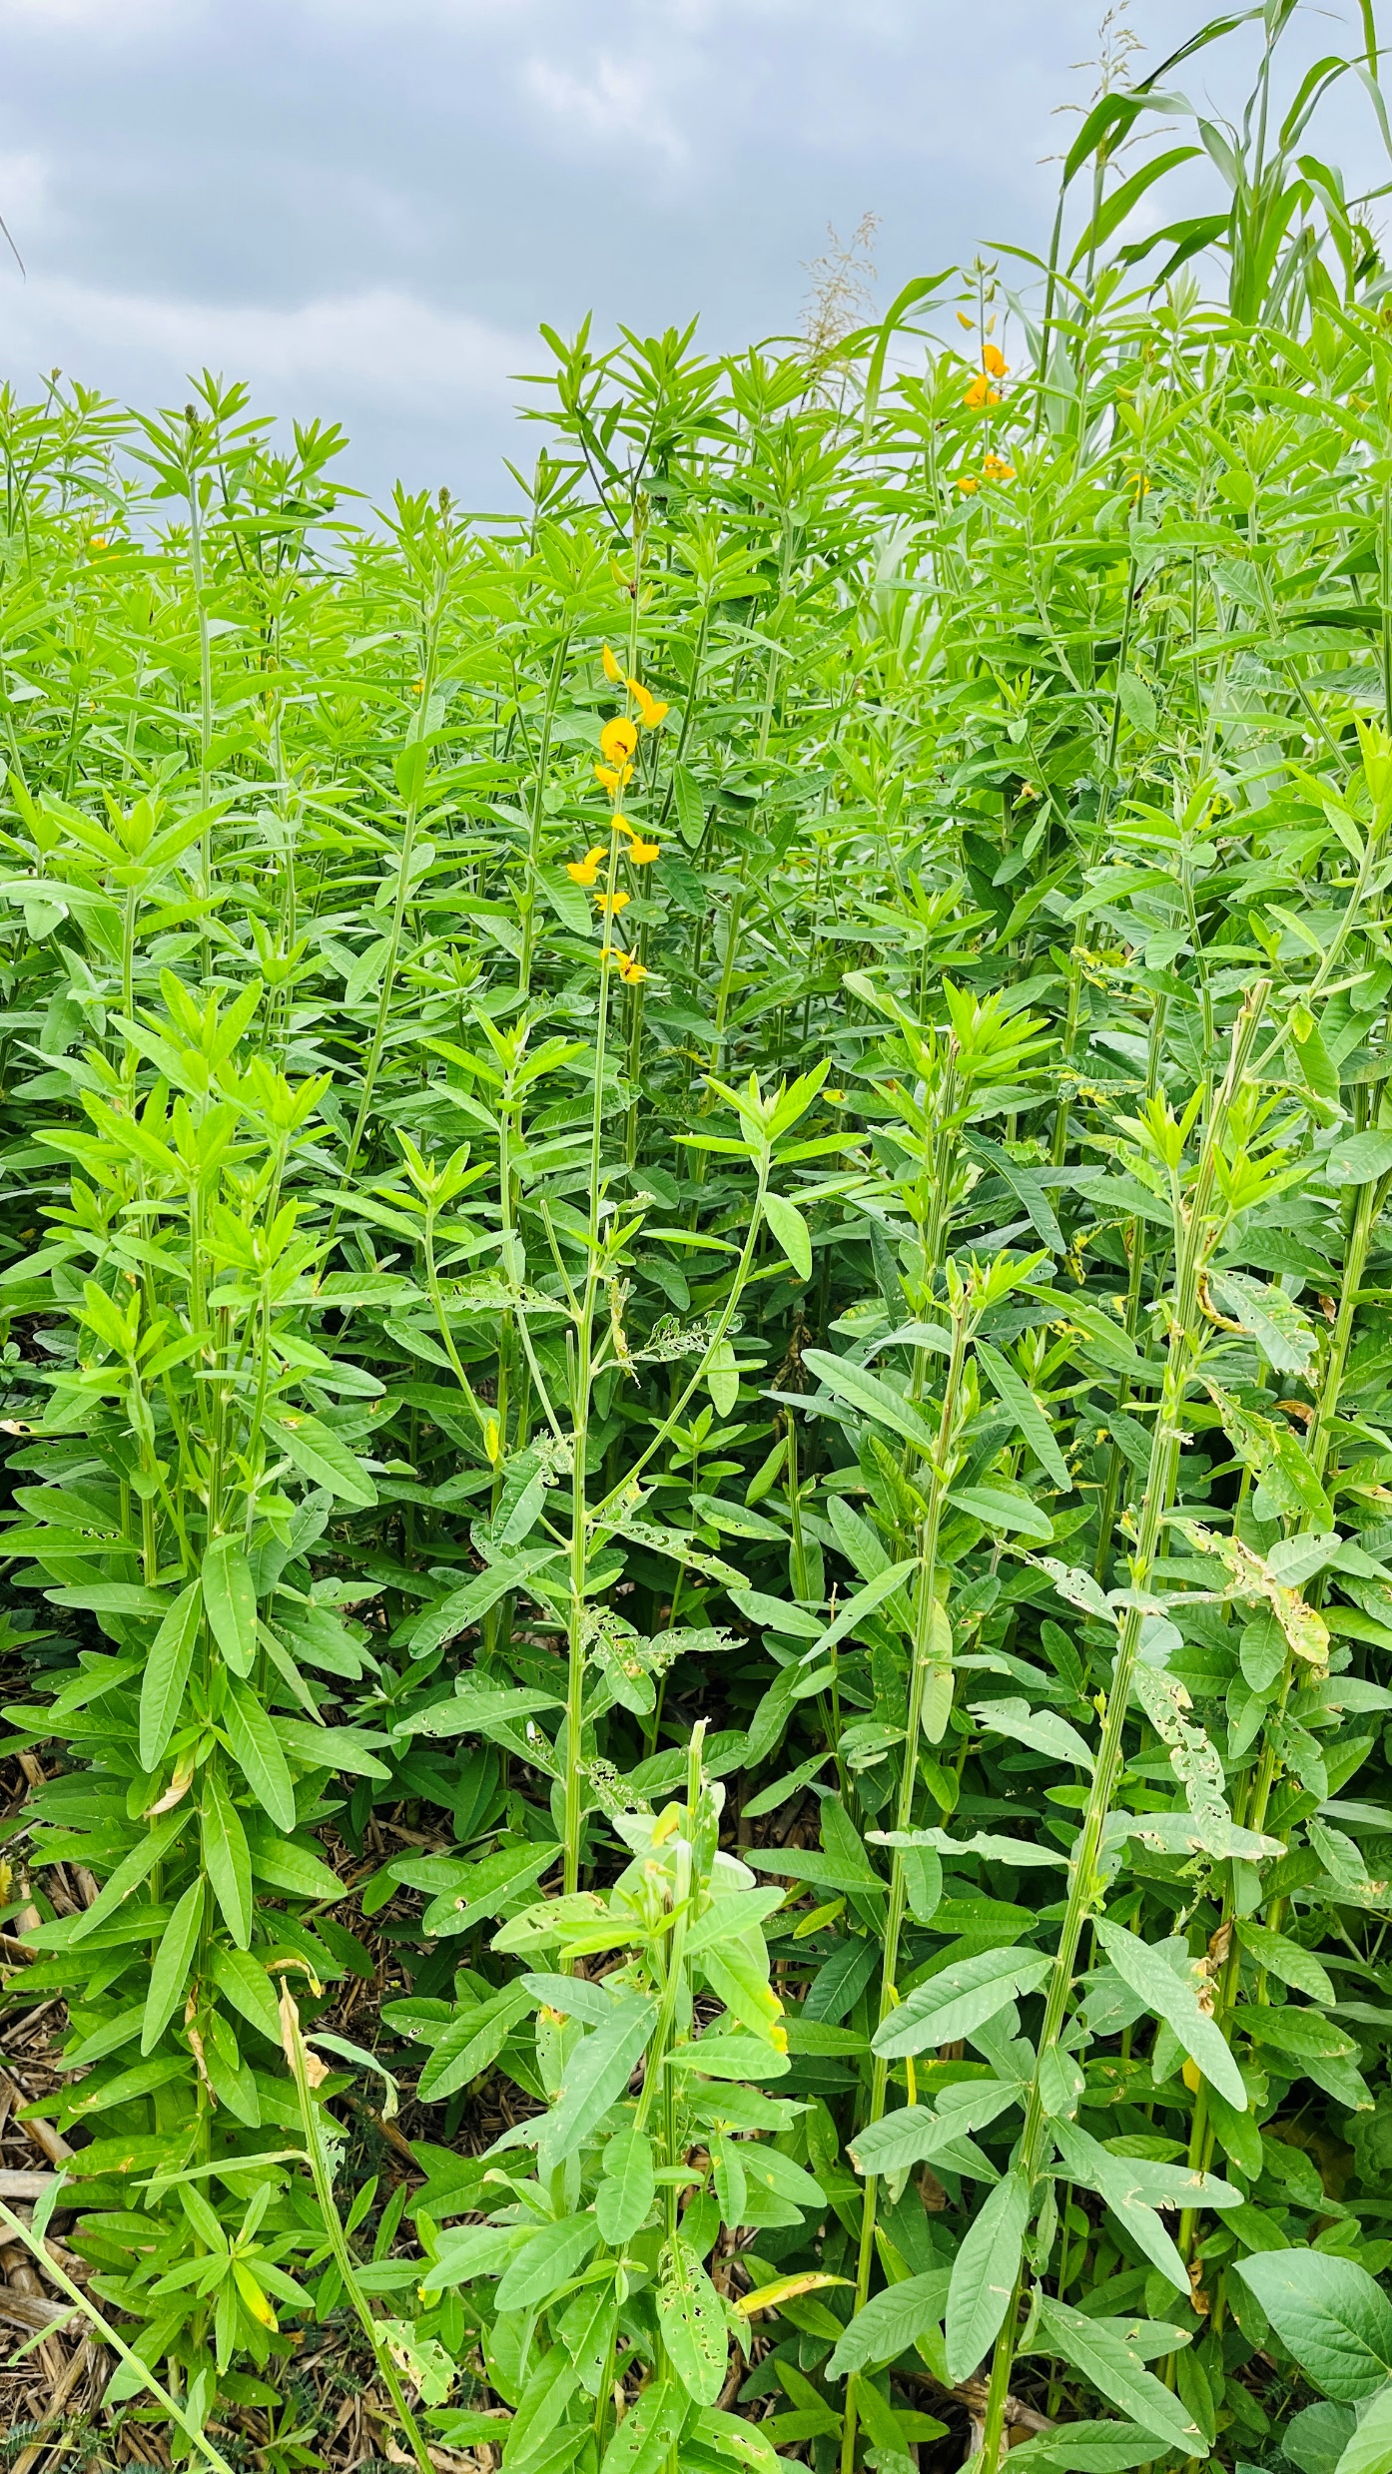





University of Nebraska-Lincoln
THANK YOU
Andrea Basche
(402) 472-6413
abasche2@unl.edu
279G Plant Sciences Hall, East Campus, Lincoln, NE 68583

