Slide 1
Research & Development and Product Development Update
Scott Staggenborg, VP, Research & Development

Slide 2
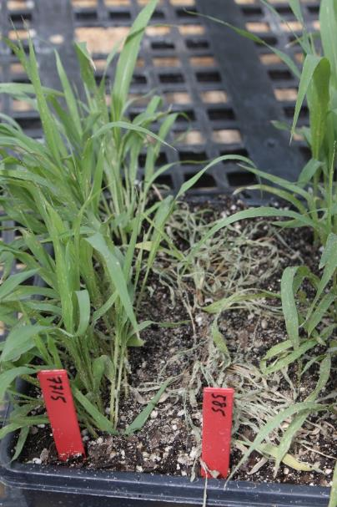
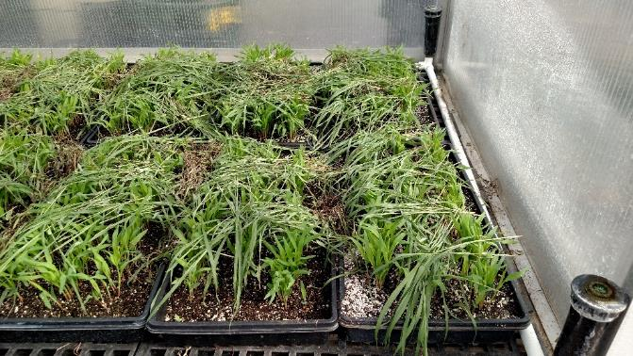
New SCA Tolerant Hybrids from Sorghum Partners
Most extensive Sugarcane Aphid (SCA) screening program in the industry.
Screened over 10,000 lines for SCA tolerance
identified over tolerant 40 lines.
Marker for SCA have been I.D. ed
More rapid development of tolerant hybrids.
Sorghum Partners will have eight experimental hybrids in strip trials in 2018.
Early and medium early with high SCA tolerance.

Slide 3
New Forage Hybrids from Sorghum Partners
Sorghum Partners will launch six experimental silage hybrids in 2018.
SPX39316, SPX37416, SPX37317, SPX37617
112 day brachytic dwarf BMR
SPX31017
85 day SCA tolerant, BMR (BMR NK300)
SPX35216
92 day SCA tolerant, BMR (HiKane II BMR)
Chromatin Forage
Improvement Targets
High yields (under stress)
High digestibility (BMR)
Early maturity (<105 day)
Lower harvest moisture
More digestible grain
Larger grain size
Heights below 10’
Standability
Sorghum Partners will launch two experimental hay type hybrids in 2018.
SPX56116
Brachytic dwarf sorghum x sudan, BMR
SPX55816
Dry stalk Sudan x Sudan, BMR

Slide 4
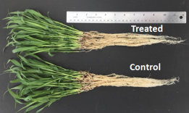
New Seed Treatment for Sorghum
Locations | No. of locations tested | Positive response (%) | Yield Increase
TX, KS and NE | 38 (2013-2017) | 61 | 8% (responsive sites)
Control
Treated
Mode of Action appears to be early season root growth. Best results in dryland environments

Slide 5
Technology and Trait Update
Herbicide Tolerant Sorghum
Non GMO approach to developing tolerance
Started with elite germplasm, so few if any agronomic problems.
Selective over the top herbicide with tolerance to 4x normal use.
Crossing into elite lines now and expect experimental hybrids for field testing in 2019.
Initial commercial launch in 2020 or 2021
Salt Tolerance
Have identified grain and forage hybrids that exhibit salt tolerance
Continue to screen for salt tolerance in the field and greenhouse.
Screened 700+ parent lines and found over 40 that were salt tolerant.

Slide 6
Questions about Sorghum
What do you as sorghum growers want or need from a sorghum development company?

Slide 7
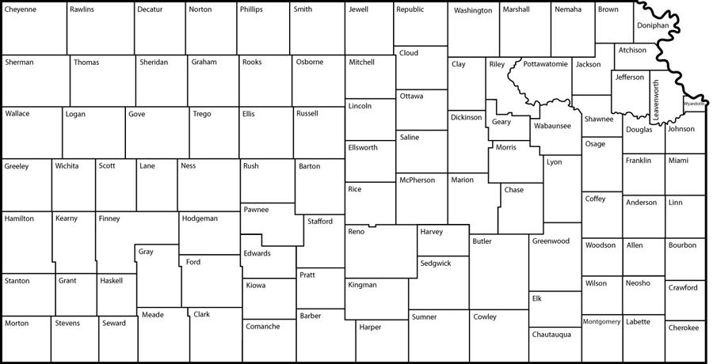
Returns ($/acre)
Sorghum = $-5.45
Corn = $-11.99
Sorghum = $103.76
Corn = $26.14
Sorghum = $107.79
Corn = $-3.12
Sorghum = $-21.54
Corn = $-5.75
Sorghum = $118.53
Corn = $36.59
Sorghum = $46.42†
Corn = $38.87
Source: AgManager.info, 2018 Cost-Return Budgets for Dryland Crops
† Published price for sorghum was $3.13/bu; price was changed to reflect the rest of NE and SC KS prices of $3.63

Slide 8
Sorghum & Corn Economics (SW NE)
Input Costs ($/ac) | Grain Sorghum | Corn
Seed | 12.00 | 64.90
Herbicides | 67.44 | 16.55
Insect/Fungicides | 0.00 | 0.00
Fertilizer | 52.68 | 88.64
Ins./Consult/Dry/ Misc. | 16.58 | 24.00
Machinery | 83.26 | 89.25
Non Machinery Labor | 20.00 | 20.00
Interest | 5.36 | 6.72
Cash Rent | 86.07 | 86.07
Total | 343.39 | 396.13
Simplified example using recent data
Per Acre Returns | Grain Sorghum | Corn
Yield (bu/acre) | 125 | 125
Price per bu ($) | 2.95 | 3.06
Total Revenue ($) | 368.75 | 382.5
Total Costs ($) | 343.39 | 396.13
Returns over Costs ($/acre) | 25.36 | -13.63
Copyright © 2015 Sorghum Partners – All Rights Reserved

Slide 9
Hybrid Maturity –What are you giving up?
UNL, Grant NE
Hybrid (days) | Yield
SP 31A15 (57) | 71.6
SP 34A19 (60) | 73.4
SP 68M57 (68) | 84.2
SP 73B12 (72) | 47.3
Are you giving up yield because of hybrid maturity?
Many would recommend a 65 day hybrid for Belleville, KS. But 70 to 72 (MF) hybrids routinely won the OVT trials there.
Dry years result in maturity “creep”. Earlier maturing hybrids tend to yield better in these years. What about in the better and average years?
If you have not tried a longer season hybrid in a while, I would suggest you do.

Slide 10
High Yields in Northern High Plains
Correct hybrid (see previous slide)
Correct planting date (early extends season)
Correct nutrient plan (not a free lunch)
Correct weed control program (Pre-Post)
Correct seeding rate (higher is better)
Half stands = replant = reduced yields

Slide 11
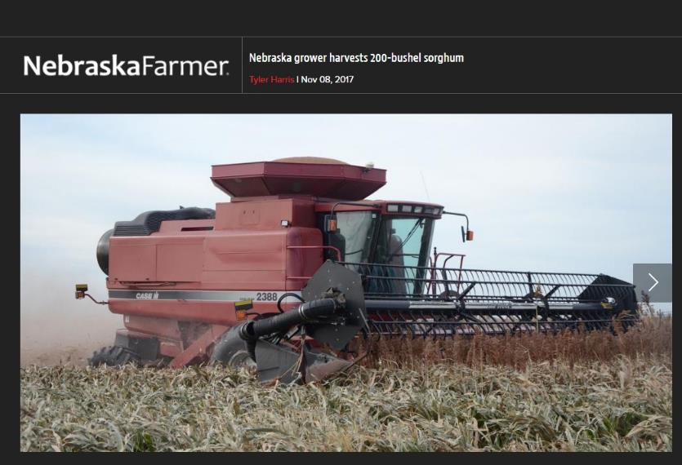
Maximizing Yields
Tom Hartman near Grand Island made over 201.3 bu/acre.
SP 68M57 (68 day to half bloom)
15 inch rows
Good weed control – post application of Huskie after planting into clean field of corn stalks (vertical till and glyphosate burn down)
150 lbs of N/acre at planting, 35 lb of N/acre at boot through pivot. (only 1.35 inch of irrigation water)

Slide 12
Grain Sorghum Seed Treatments
 | 2000 | 2001 | Avg
 | - - - - - -Yield (bu/a) - - - - - -
Gaucho | 115.5 | 99.5 | 107.5
Cruiser | 117.5 | 99.0 | 108.3
No Trt | 111.0 | 94.5 | 102.8
LSD | 2.4 | 3.3
Wilde, KSU
5 Locations and 2 Hybrids each Year

Slide 13
Row Spacing Results
Adapted from: Myers and Foale

