Slide 1
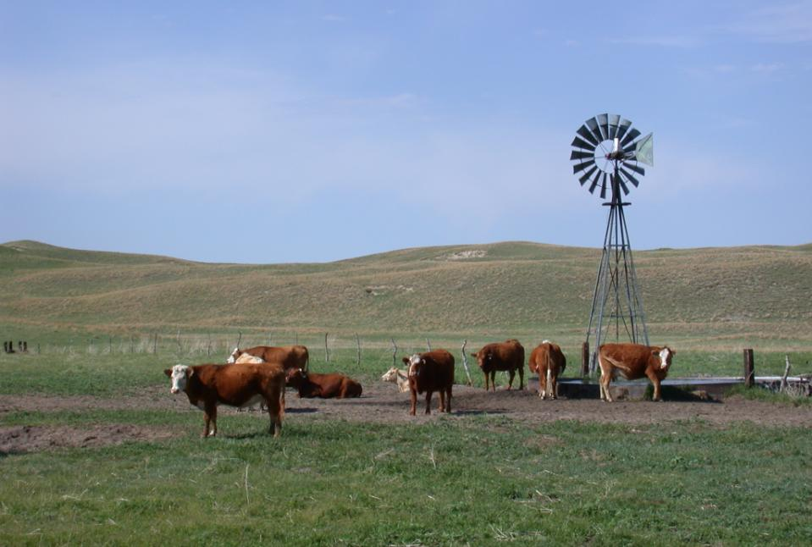

Range and Pasture Management - Soils
Jerry D. Volesky
Range / Forage Specialist
West Central Res. & Ext. Center
402 West State Farm Rd
North Platte, NE 69101
(308) 696-6710
jvolesky1@unl.edu
Ag. Ed. Soils Project - 2013

Slide 2
Range-Pasture-Haylands:
Key Soil Factors
Fertility, pH
Texture: water holding capacity, organic matter
Residual herbage, litter (hydrological)
Soil microbes, fungi, invertebrates (decomposers)
Compaction, water infiltration

Slide 3
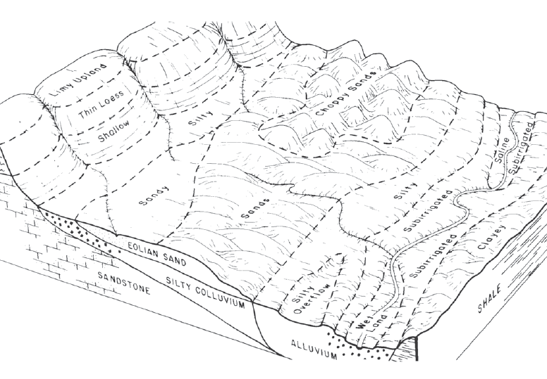
Nebraska range sites in relation to one another and topographical position

Slide 4
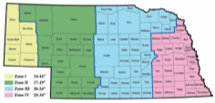
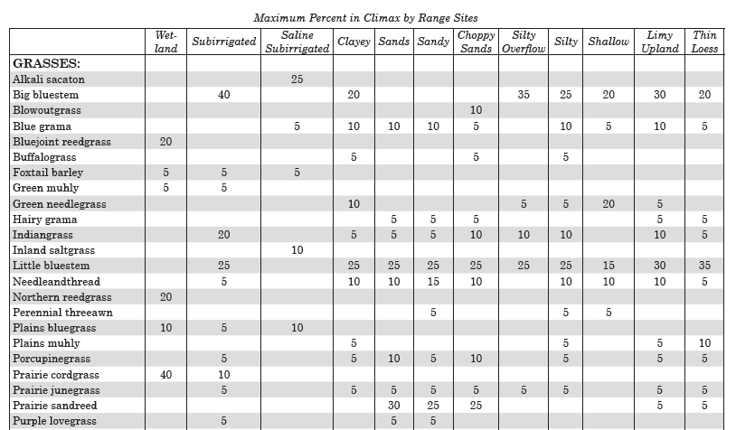
Range condition
Ecological rating based on current status relative to climax plant community.
% score = Poor – Fair – Good – Excellent

Slide 5
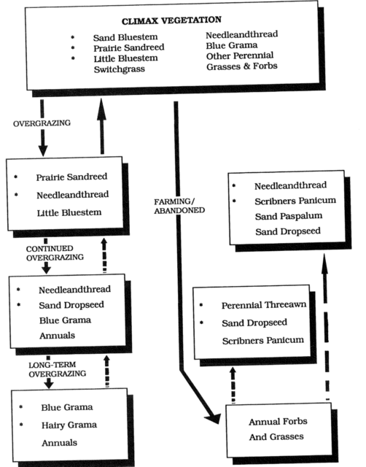
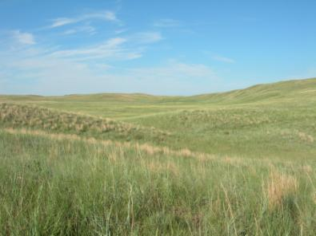
Plant communities associated with grazing or abandoned farming on a sands range site

Slide 6
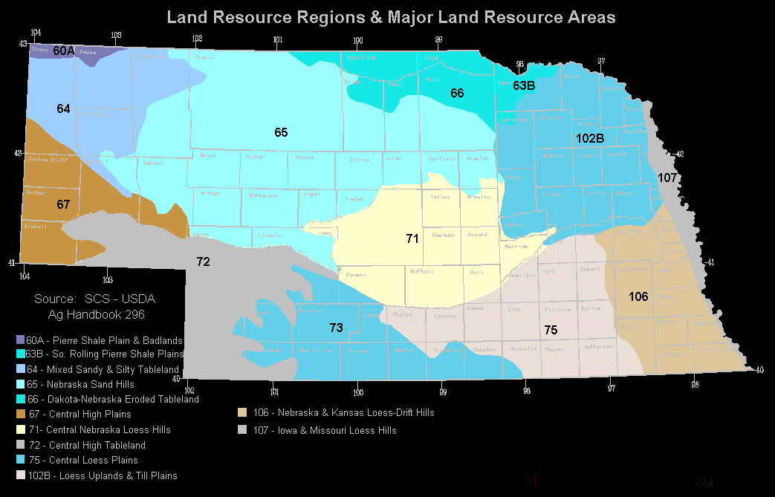
Ecological Site Description (ESD)
Standardized method for defining, delineating, and describing grasslands.
Distinctive kinds of land with specific physical characteristics.
Recognized and described based on its unique characteristics and ability to produce and support a characteristic plant community.
ESD contains more information – soil, physical, climate, and hydrologic features, plant communities and dynamics, production estimates, growth curves, animal communities, and interpretation for management.

Slide 7
Sands
Ecological
Site
Bluestem/prairie sandreed/switchgrass/ needlegrass
(1700 to 2200 lb/ac)
Disturbance
(animal, man, fire)
Eastern redcedar
Active blowout
HG
PG
Prairie sandreed/ needlegrass/dropseed/ragweed
(1200 to 1600 lb/ac)
PG
HG
Encroachment
Annual/ perennial pioneer
Nebraska Sandhills
(17-22” precipitation)
HG
PG
Long-term
PG
Grama/sedge/ dropseed/ragweed
(400 to 800 lb/ac)
(PG = proper grazing)
(HG = heavy grazing)

Slide 8
Range-Pasture-Haylands:
Key Soil Factors
Fertility, pH
Texture: water holding capacity, organic matter
Residual herbage, litter (hydrological)
Soil microbes, fungi, invertebrates (decomposers)
Compaction, water infiltration

Slide 9
Nitrogen recommendations (lb/acre)
 | Cool-season |  | Warm-season
Nebraska Location | Pasture | Hayland | Pasture | Hayland
Southeast, east | 80 - 120 | 100 - 150 | 60 - 90 | 75 - 100
East-central | 50 - 80 | 60 - 90 | 40 – 75 | 50 - 80
West-central | 40 - 60 | 50 - 75 | 25 - 50 | 40 - 60
Panhandle | 20 - 40 | 30 - 60 | 20 - 40 | 30 - 50
Sandhills subirrigated meadow¹ | 50 - 70 | 60 - 80 | - - | - -
¹ Phosphorus (20 – 30 lb/ac) and sulfur (20 – 30 lb/ac) are often included.

Slide 10
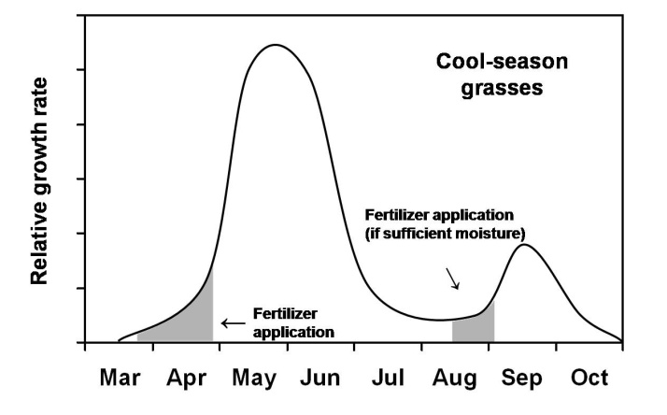

Slide 11
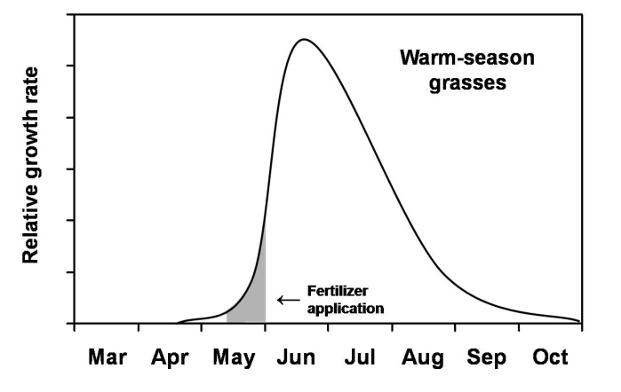

Slide 12
Effect of nitrogen fertilization on irrigated smooth bromegrass and orchardgrass yield.¹
¹ Three-year average (1970-72) from 4 harvests each year, Holt County.

Slide 13
Available water for different soil textures
 | Available water (in./ft.)
Soil Texture | Range | Typical
Coarse sand and gravel | 0.3 – 0.6 | 0.5
Sand | 0.5 – 0.8 | 0.6
Fine sand | 0.7 – 1.1 | 1.0
Loamy sand | 0.8 – 1.2 | 1.1
Loamy fine sand | 0.9 – 1.3 | 1.2
Sandy loam | 0.9 – 1.5 | 1.4

Slide 14
Available water for different soil textures
 | Available water (in./ft.)
Soil Texture | Range | Typical
Fine sandy loam | 1.1 – 1.9 | 1.6
Loam | 1.2 – 2.3 | 1.8
Silt loam | 1.4 – 2.6 | 2.0
Silty clay loam | 1.5 – 2.5 | 2.2
Clay loam | 1.4 – 2.4 | 2.0
Clay | 1.6 – 2.2 | 1.8

Slide 15
Organic matter and water holding capacity
100 lb dry soil at 1.5 to 2.0 % organic matter can hold 35 - 45 lbs (4 to 5 gal.) water.
100 lb dry soil at 4 to 5% organic level can hold 165 to 195 lbs (20 to 24 gal.) water.

Slide 16
I
II

Slide 17
I
II

Slide 18
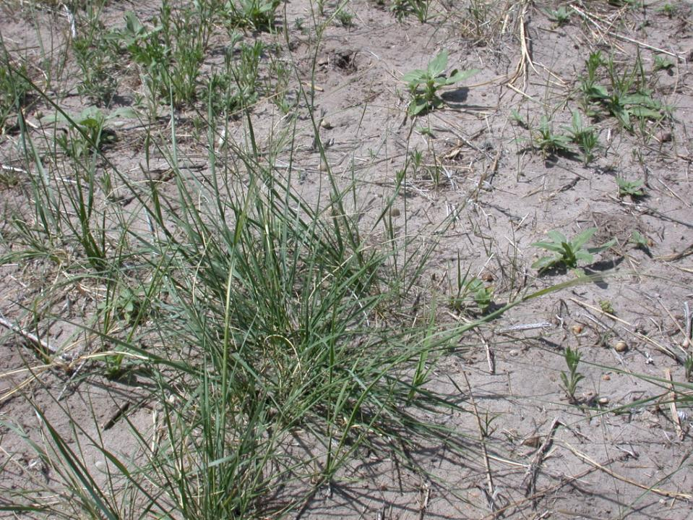
Low residue/litter

Slide 19
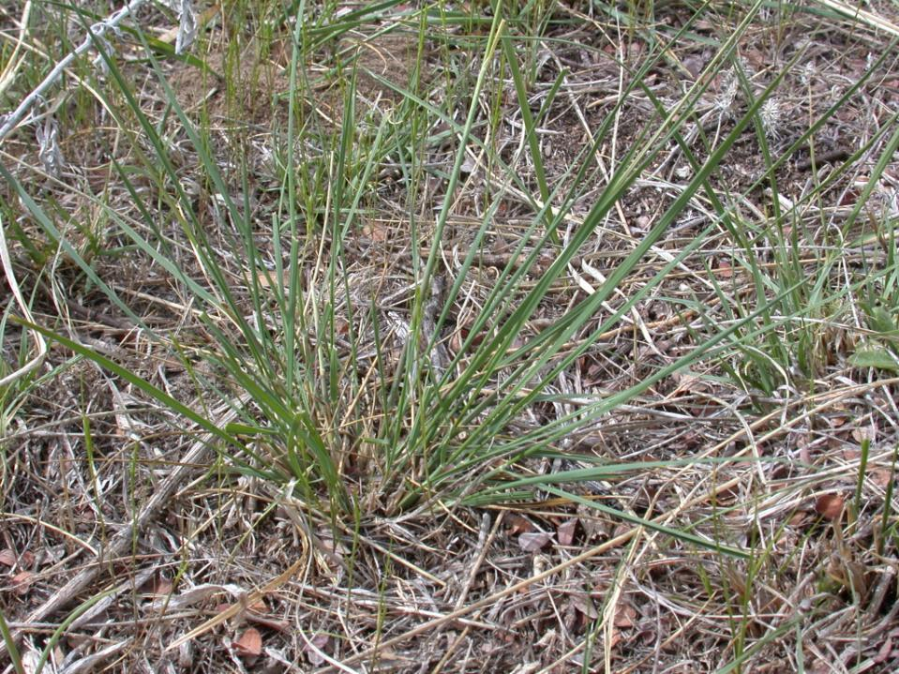
Excellent residue/litter

Slide 20
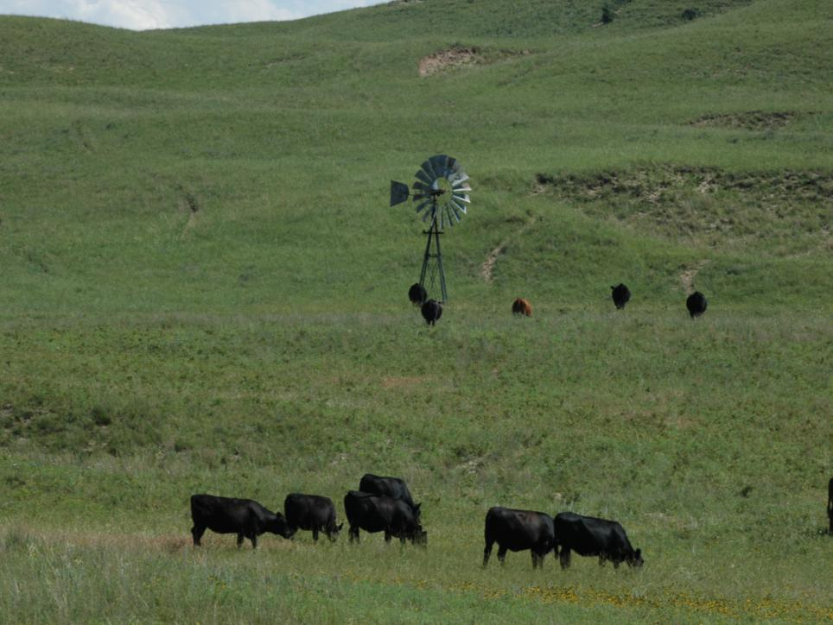
Elements of Good Grazing Management
Stocking rate
Timing of grazing (season of use)
Distribution
Kind/class of livestock

Slide 21
Stocking rate can be expressed by which of the following?
Quiz:
AUM/acre
Cows/section/month
Acres/pair/5 months
All the above
None of the above
Answer Now

Slide 22
Expressing stocking rate
Acres/ Acres/5
AUM/acre AUD/acre year/AU months/AU
0.3 9 40 16.7
0.5 15 24 10.0
0.8 24 15 6.3
1.0 30 12 5.0
2.0 60 6 2.5
3.0 90 4 1.7

Slide 23
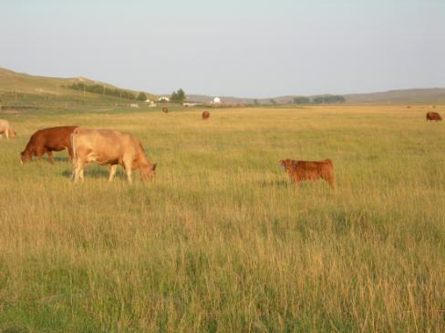
Grazing System:
A specialization of grazing management which defines the periods of grazing and non-grazing.
  A tool to achieve enterprise goals within a set of environmental, economic, resource, and management factors.
  Regardless of grazing system, stocking rate is still the primary management factor.

Slide 24
All systems with multi-pasture rotations do provide management control of:
  Timing of grazing
  Length of grazing period
  Length of rest / non-use period
  Stocking density – grazing pressure

Slide 25
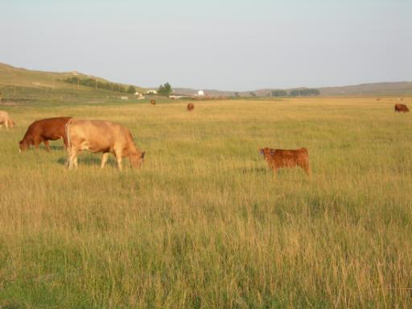
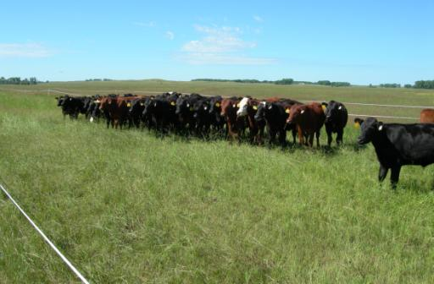
Grazing Systems
With multiple pastures,
they allow us to:
  Manipulate grazing distribution
  Control timing of grazing (season of use)
  Control length of grazing and rest
  Alter stocking density

Slide 26
Grazing Systems: History
Pre- 1900: Continuous grazing
Early 1900’s: 2 to 5 pastures - - deferment or rest period important
1950’s: Voison (France) - Pasture rotations
1960-1970’s: Savory (South Africa) – Short duration grazing (SDG) (Holistic approach)
1980’s: Gerrish – Management intensive grazing (MIG)
2000’s: Ultra-high stock density grazing, mob grazing, regenerative grazing

Slide 27
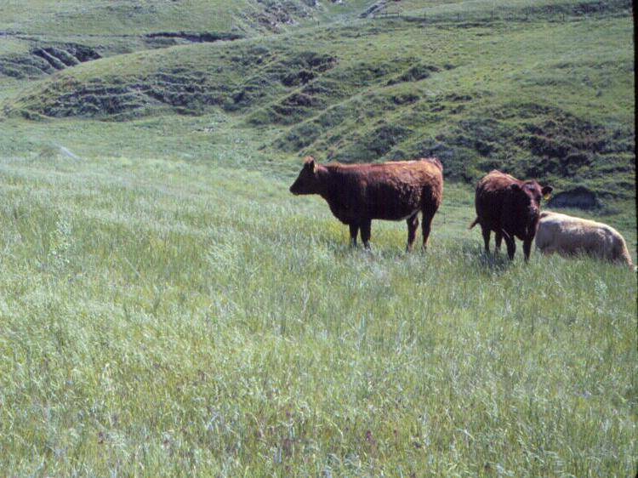
Timing of Grazing
Jan Feb Mar Apr May Jun Jul Aug Sep Oct Nov Dec

Slide 28
Growth of important Sandhills forage grasses

Slide 29
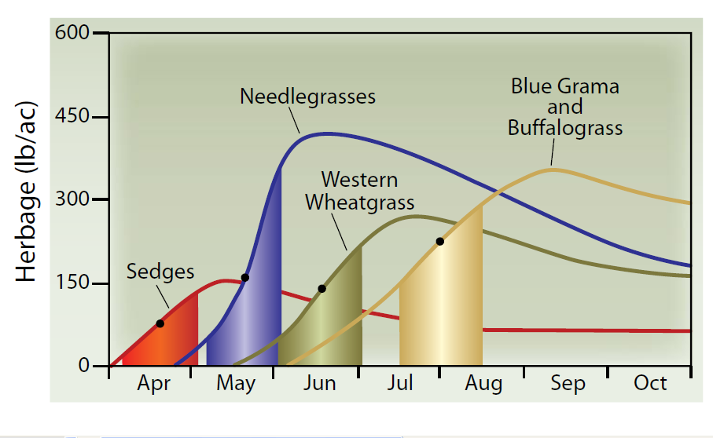
Growth of important western Nebraska forage grasses

Slide 30
Prairie Sandreed
100%
83%
62%
65%
From: Reece et al.

Slide 31
Prairie Sandreed: Root mass compared to ungrazed control
From: Reece et al.

Slide 32
Overgrazing
The level and date of grazing beyond which preferred (key) plant species cannot recover before pastures are grazed in a subsequent year.

Slide 33
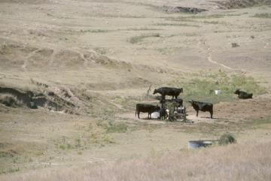
How to Best Overgraze?
Heavily graze preferred (key) grass species during rapid growth windows in consecutive years.
Combine grazing stress with drought stress.

Slide 34
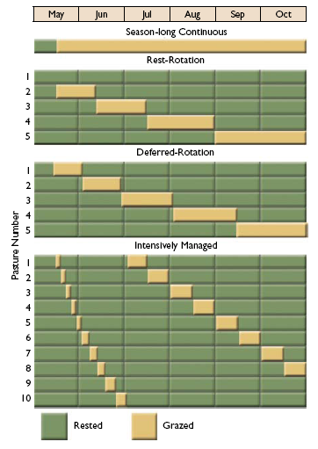
General Classification of Grazing Systems

Slide 35

Season-long Continuous
Easiest to manage – only decide how many head for how long.
May have less than desirable grazing distribution
Risk of range damage in preferred areas.
Cattle performance is very good with proper stocking rate.

Slide 36

Rest-Rotation
One pasture rested 1 (or more) full year.
Increase in vigor for rested pasture.
Proportionally higher stocking rate on other pastures.

Slide 37

Deferred-Rotation
Each pasture grazed 1 time per year.
Increase in vigor for late-spring and early summer deferred pastures.
Well suited for range grasses that benefit from seasonal rotation in grazing.

Slide 38
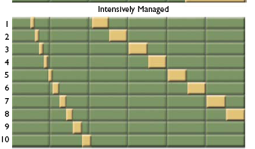
Intensively Managed
(Short Duration)
Each pasture grazed 1 or more times/year.
Inputs for fence and water developments.
Plans can include significant flexibility (use dates, stocking and grazing of specific pastures, etc.).

Slide 39
Effect of Grazing System on Livestock Performance, Botanical Composition, and Standing Crop in the Nebraska Sandhills

Slide 40
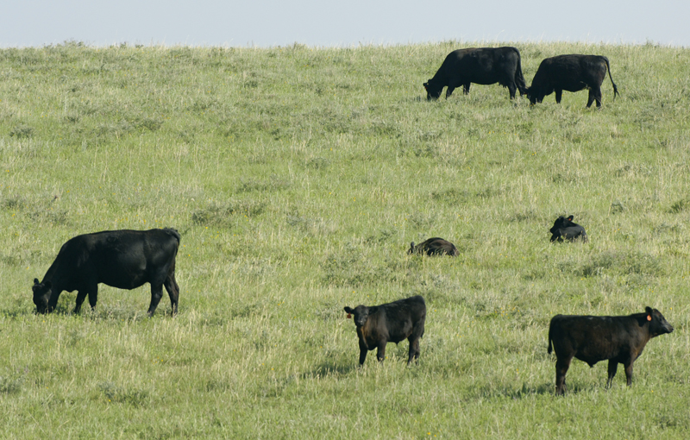
Grazing Systems
Grazing Season: May 15 – Oct 15
Stocking rate: 0.75 AUM/acre, pairs
Years: 1999-2008
Deferred rotation
  4 pastures
  1 occupation/year
Short duration grazing
  8 pastures
  3 occupations/year

Slide 41

Grazing Treatments
Pasture | May |  | June |  | July |  | August | September | October
1
2
3
4
DR
Pasture | May |  |  |  |  |  |  |  |  | June |  |  |  |  | July |  |  |  |  | August |  |  |  | September |  |  |  | October
1
2
3
4
5
6
7
8
SDG
Notes:
41

Slide 42
Daily gain of spayed heifers in 4-pasture deferred-rotation (DR) and 8-pasture short duration grazing (SDG) systems.
  No difference between grazing
  systems or years. (avg. 1.85 lb/d)

Slide 43
Total Herbage Standing Crop in mid-August
* Significant difference between grazing systems (P < 0.1)
Notes:
Discuss differences in mid-August production. Relate to June production where years with significant differences are different for August. Graph with rainfall during the summer months.

Slide 44
Conclusion - Grazing Systems
Short duration grazing:
  Did not have greater daily weight gains of heifers than the DR grazing system
  Did not increase the composition of high seral stage grass species as well as a DR grazing system
  Did not produce greater amounts of standing crop than the DR grazing system
Notes:
I want to show that the need for the research
Past research in the Sandhills has shown the need to study the effects of when grazing occurs during the growing season.
These two studies looked at how timing of grazing impacted individual warm-season grass species and stated the reasons why timing of grazing is important
Mullahey- Warm-Season grasses are the most important functional group in terms of production.
Reece-Time of grazing to achieve specific vegetation management objectives
While there have been several studies in the Sandhills that evaluated specific warm-season species we were interested in looking at the effects on all plant functional groups within a practical production scale scenario.

Slide 45
Conclusion - Grazing Systems
SDG systems will not produce superior benefits to livestock and rangelands that are in good to excellent condition when compared to a DR system at recommended stocking rates in the Sandhills
The multiple grazing periods of SDG do not provide the reported benefits on upland Sandhills range.
Well suited for pasture with good water availability and longer growing seasons
Notes:
I want to show that the need for the research
Past research in the Sandhills has shown the need to study the effects of when grazing occurs during the growing season.
These two studies looked at how timing of grazing impacted individual warm-season grass species and stated the reasons why timing of grazing is important
Mullahey- Warm-Season grasses are the most important functional group in terms of production.
Reece-Time of grazing to achieve specific vegetation management objectives
While there have been several studies in the Sandhills that evaluated specific warm-season species we were interested in looking at the effects on all plant functional groups within a practical production scale scenario.

Slide 46
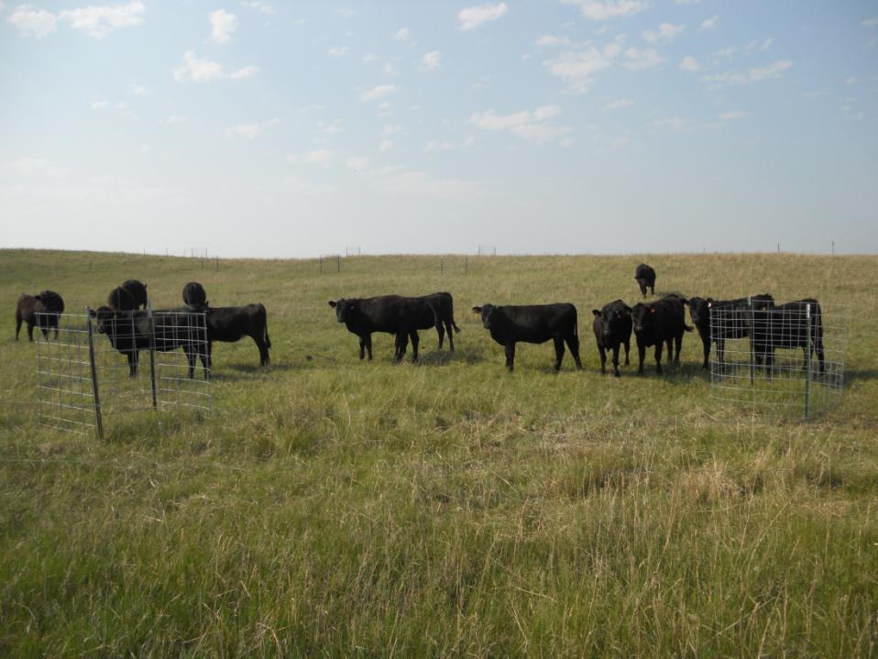
Rotational Grazing on Sandhills Uplands

Slide 47
Short-term Responses to Grazing Systems
Improvement in evenness of use of forage resource (grazing distribution)
Increased harvest efficiency (% of available forage consumed by the grazing animal)
Increased carrying capacity or stocking rate
Notes:
I want to show that the need for the research
Past research in the Sandhills has shown the need to study the effects of when grazing occurs during the growing season.
These two studies looked at how timing of grazing impacted individual warm-season grass species and stated the reasons why timing of grazing is important
Mullahey- Warm-Season grasses are the most important functional group in terms of production.
Reece-Time of grazing to achieve specific vegetation management objectives
While there have been several studies in the Sandhills that evaluated specific warm-season species we were interested in looking at the effects on all plant functional groups within a practical production scale scenario.

Slide 48
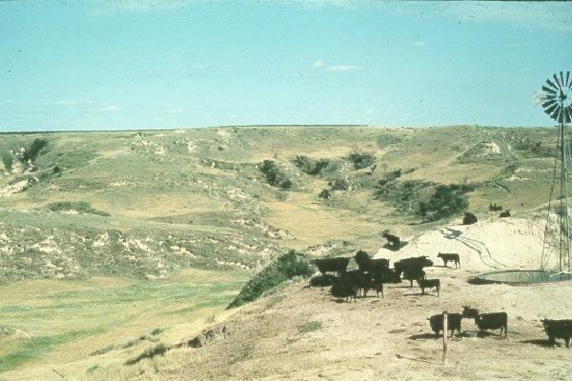
Methods of Improving Grazing Distribution
Placement of Livestock Water
- Fencing along Ecological Site Boundaries

Slide 49
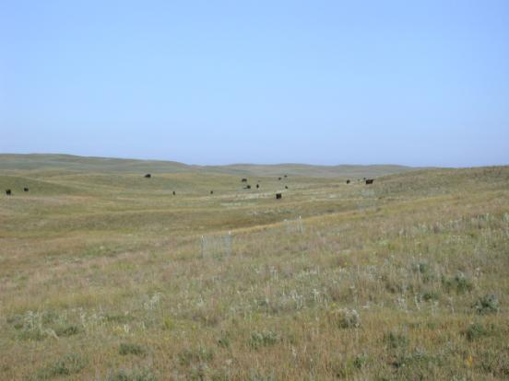
Low Stocking Density
High Stocking Density
(Mob grazing)
Notes:
I want to show that the need for the research
Past research in the Sandhills has shown the need to study the effects of when grazing occurs during the growing season.
These two studies looked at how timing of grazing impacted individual warm-season grass species and stated the reasons why timing of grazing is important
Mullahey- Warm-Season grasses are the most important functional group in terms of production.
Reece-Time of grazing to achieve specific vegetation management objectives
While there have been several studies in the Sandhills that evaluated specific warm-season species we were interested in looking at the effects on all plant functional groups within a practical production scale scenario.

Slide 50
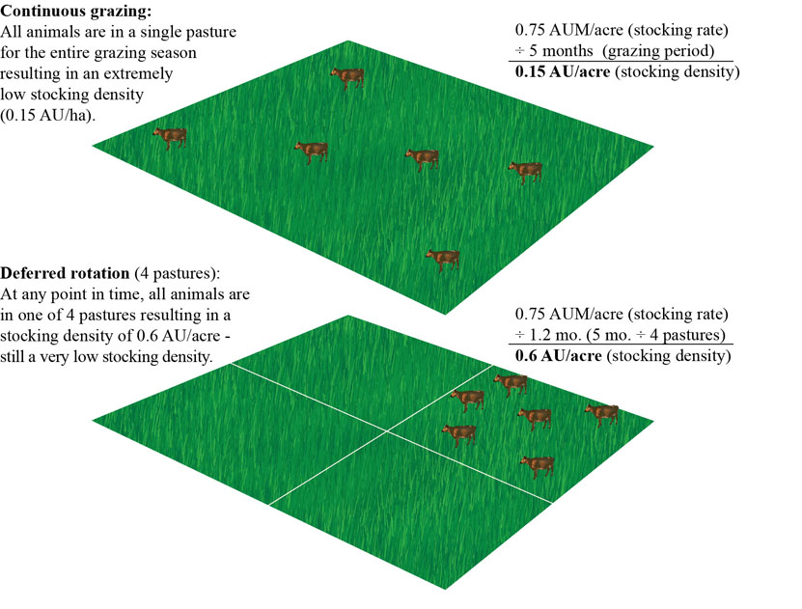
(0.15 AU/ac)
Stocking Density

Slide 51
Upland Range Grazing Systems Study
Treatments | Stocking rate (AUM/acre) | Stocking density (AU/acre) | Grazing days/ season
Continuous grazing –moderate | 0.75 | 0.15 | 150
Continuous grazing –heavy | 1.13 | 0.23 | 150
4-pasture DR – moderate | 0.75 | 0.60 | 37
4-pasture DR – heavy | 1.13 | 0.90 | 37
50-pasture rotation – moderate | 0.75 | 7.50 | 3
50-pasture rotation – heavy | 1.13 | 11.25 | 3
Control (non-grazed) | - - | - - | - -
DR = deferred-rotation
Heavy stocking rate is 1.5X moderate stocking rate

Slide 52
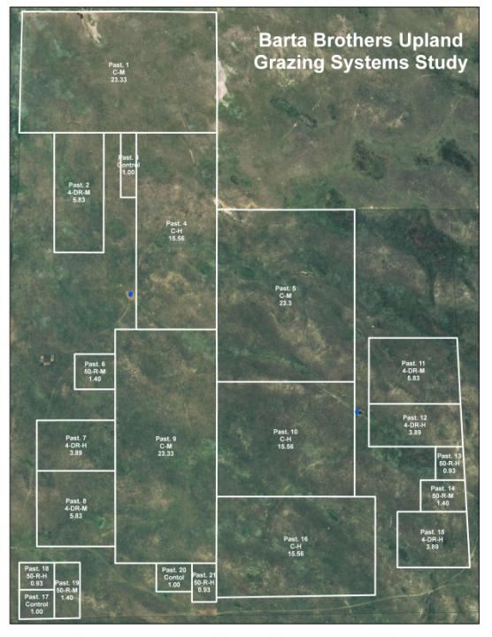
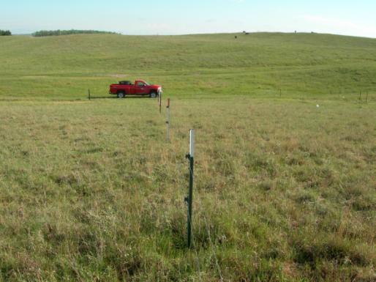

Slide 53
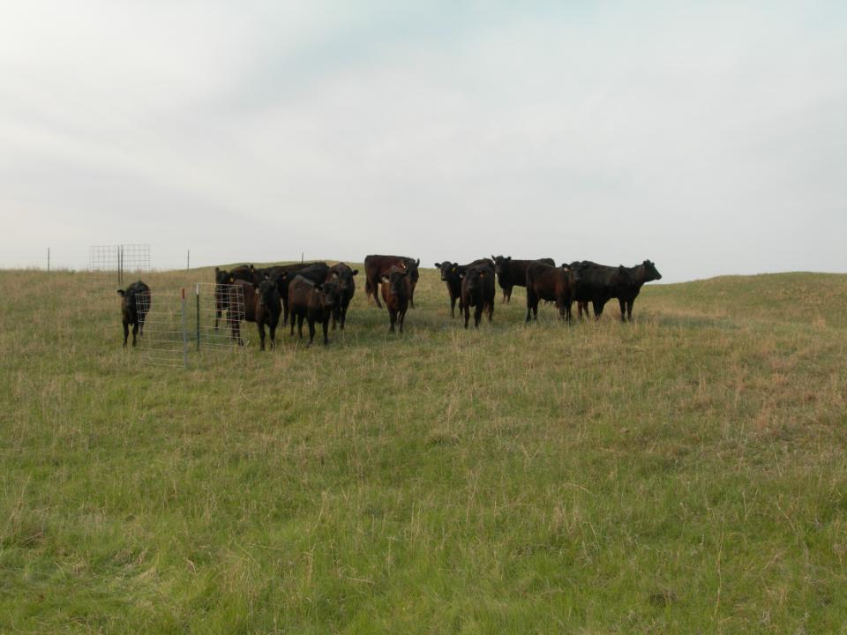
Objectives - Measurements
Plant community composition
Net primary production – above and below ground
Soil respiration and soil carbon properties
Grazing distribution

Slide 54
Residual Vegetation Height
Grazing System x Topographic Position

Slide 55
Meadow Grazing Systems Study
Treatments | Stocking rate (AUM/acre) | Stocking density (AU/acre) | Grazing days/ season
4-pasture rotation (twice-over in 90 days) | 3.3 | 0.60 | 22
4-pasture rotation (once in 60 days) | 3.3 | 0.90 | 15
Mob grazing (120 paddocks) | 3.3 | 200 | 0.5
Control (non-grazed) | - - | - - | - -
Haying | - - | - - | - -
- - - - - - - - - - - - - - - - - - - - - - - - 0.6 AU/acre = 600 lb/acre 0.9 AU/acre = 900 lb/acre 200 AU/acre = 200,000 lb/acre

Slide 56
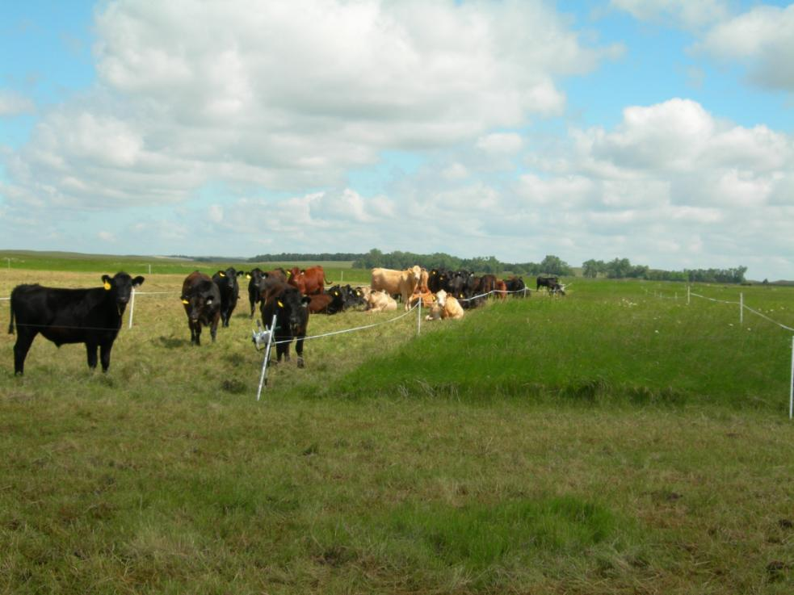
Mob Grazing – Subirrigated Meadow
200,000 lb beef/acre
(200 AU/acre)
(285 yearlings/acre)

Slide 57
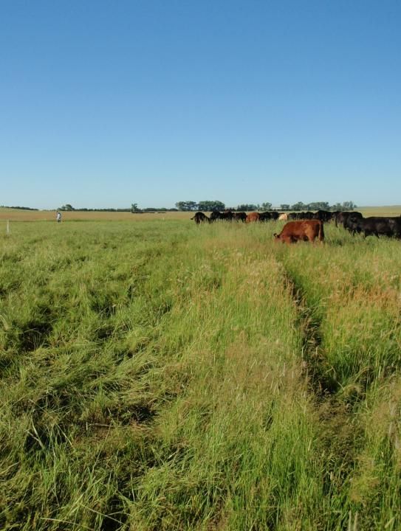
Animal performance
Species composition
Herbage production
Forage utilization
Harvest efficiency
Soil microbial biomass
Soil carbon & nutrient status
Litter decomposition
Root growth

Slide 58
  % Trampled
  = Trampled biomass amount x 100
  Pre-graze live amount
c
a
Notes:
Trampling in mob is where we wanted it to be…prac want that amount trampling

Slide 59
Harvest Efficiency
  = Pre-graze live - (Post graze live + Trampled biomass) x 100
  Pre-graze live

Slide 60
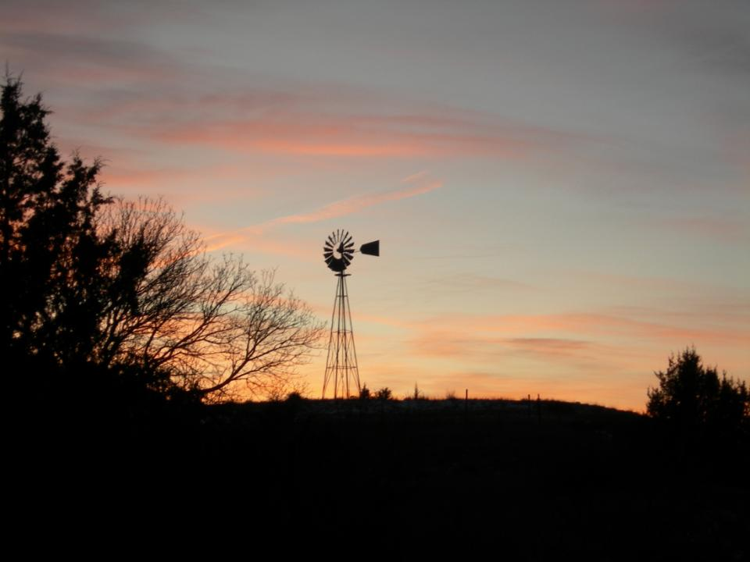
Thank You

