Slide 1
2013 Foliar Fungicide Product Comparison on Corn South Central Agriculture Laboratory Clay Center, NE
Tamra Jackson-Ziems
Extension Plant Pathologist
University of Nebraska - Lincoln

Slide 2
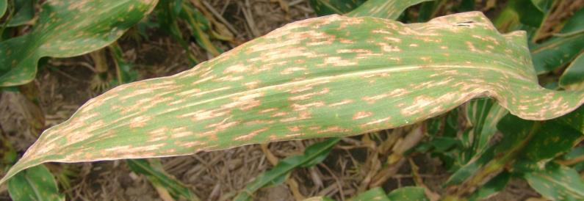
2013 Diseases
Although at very low severity, gray leaf spot was the predominant foliar disease during the growing season at this location. Gray leaf spot severity level was < 1% in the non-treated control.

Slide 3
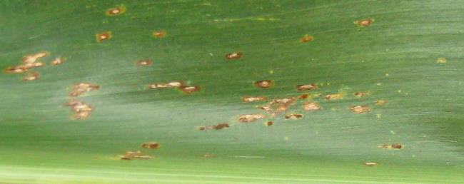
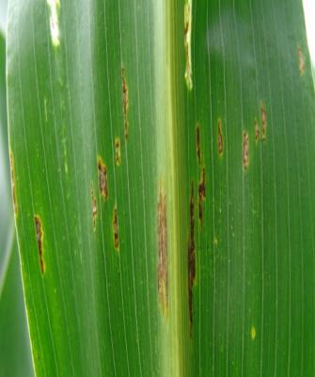
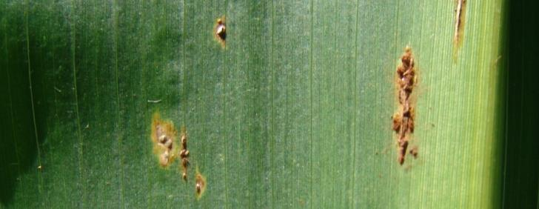
Common rust was the foliar disease first observed in this trial & was initially seen in late July. Disease severity was very low at this location and did not exceed trace amounts (≤ 0.1%) for any treatment.
2013 Diseases

Slide 4
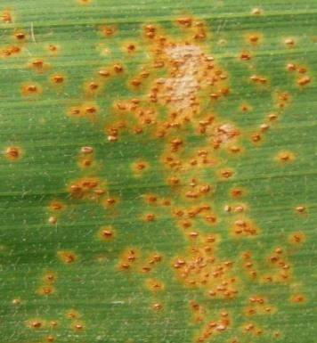
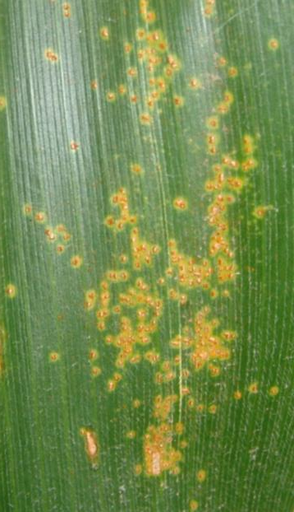
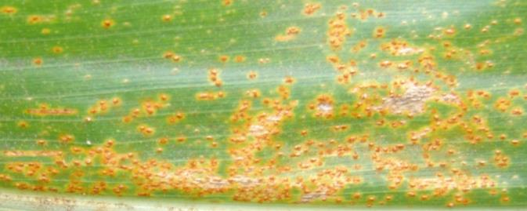
Southern rust was present and was first identified in this trial on September 4th. This disease was observed in trace amounts (≤0.2%) in the non-treated control.
2013 Diseases

Slide 5
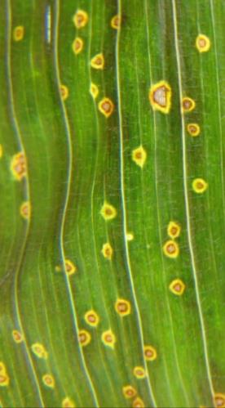
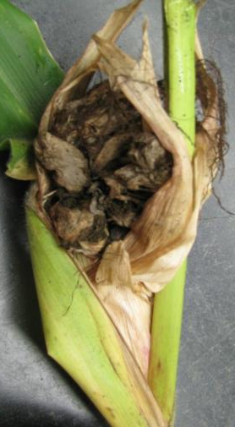
Eyespot, common smut, and Physoderma brown spot were observed sparsely in this trial, thus not justifying ratings for these diseases at this location in 2013.
2013 Diseases

Slide 6
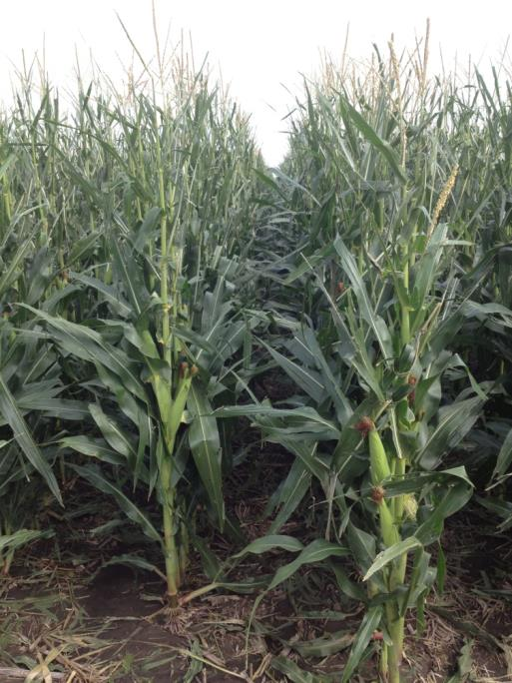
On August 1st, a storm event with strong wind and hail occurred when the corn was at the end of the R1 growth stage which caused an estimated 30% defoliation. Foliar fungicide treatments were applied on July 26th, six days prior to the event.
2013 Hail Damage

Slide 7
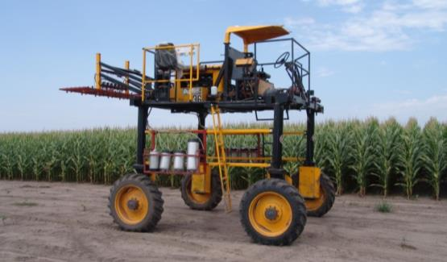
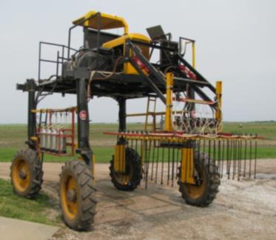
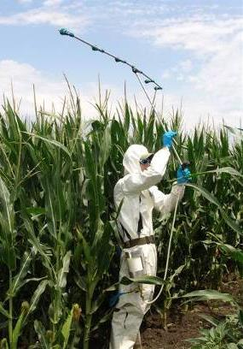
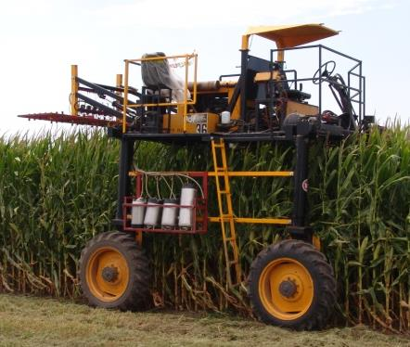
2013 Foliar Fungicide Trials
Last year’s crop was corn
Planting date: 5/15/13
Target plant population of 31,763 plants/A
Corn hybrid: NK N68B (GLS rating 7/9, ”fair”, not rated for CR, & SR rating 2/9, “excellent”)
Eight foliar fungicide treatments and a non-treated control replicated six times
NIS added at 0.25% v/v
High clearance sprayer used at 20 gpa at 40 psi
Alley width & row spacing = 30 inches
Overhead sprinkler irrigated
2005-2006
South Central Agriculture Laboratory
Clay Center, NE

Slide 8
2013 Fungicide Product Comparison Trial in NE Gray leaf spot disease severity (%)
Treatment & application rate
Rating Date & Growth Stage
Foliar fungicide application was made July 26th at silking (R1).
NIS added to each fungicide treatment at 0.25% v/v.
Notes:
8

Slide 9
2013 Fungicide Product Comparison Trial in NE Area Under the Disease Progress Curve (AUDPC) for gray leaf spot
a
ab
b
b
b
b
b
b
b
Quilt Xcel 10.5 fl oz/A
Stratego YLD 4 fl oz/A
Aproach 5.6 fl oz/A + Alto 5.6 fl oz/A
Fortix 6 fl oz/A
Evito 2 fl oz/A
Non-treated control
Headline AMP 10 fl oz/A
Priaxor 4 fl oz/A
Aproach 6 fl oz/A
Treatment & application rate
* Foliar fungicide applications made at silking (R1). NIS added at 0.25% v/v.
* Treatments with different letters are statistically different. Coefficient of variation is 42.8%.
Notes:
9

Slide 10
2013 Fungicide Product Comparison Trial in NE Common rust disease severity (%)
Treatment & application rate
Rating Date & Growth Stage
Foliar fungicide application was made July 26th at silking (R1).
NIS added to each fungicide treatment at 0.25% v/v.
Notes:
10

Slide 11
2013 Fungicide Product Comparison Trial in NE Area Under the Disease Progress Curve (AUDPC) for common rust
Quilt Xcel 10.5 fl oz/A
Stratego YLD 4 fl oz/A
Aproach 5.6 fl oz/A + Alto 5.6 fl oz/A
Fortix 6 fl oz/A
Evito 2 fl oz/A
Non-treated control
Headline AMP 10 fl oz/A
Priaxor 4 fl oz/A
Aproach 6 fl oz/A
Treatment & application rate
* Foliar fungicide applications made at silking (R1). NIS added at 0.25% v/v.
* No statistical differences among treatments. Coefficient of variation is 0%.
Notes:
11

Slide 12
2013 Fungicide Product Comparison Trial in NE Southern rust disease severity (%)
Treatment & application rate
Rating Date & Growth Stage
Foliar fungicide application was made July 26th at silking (R1).
NIS added to each fungicide treatment at 0.25% v/v.
Notes:
12

Slide 13
2013 Fungicide Product Comparison Trial in NE Area Under the Disease Progress Curve (AUDPC) for southern rust
a
b
b
b
b
b
b
b
b
Quilt Xcel 10.5 fl oz/A
Stratego YLD 4 fl oz/A
Aproach 5.6 fl oz/A + Alto 5.6 fl oz/A
Fortix 6 fl oz/A
Evito 2 fl oz/A
Non-treated control
Headline AMP 10 fl oz/A
Priaxor 4 fl oz/A
Aproach 6 fl oz/A
Treatment & application rate
* Foliar fungicide applications made at silking (R1). NIS added at 0.25% v/v.
* Treatments with different letters are statistically different. Coefficient of variation is 27.6%.
Notes:
13

Slide 14
2013 Fungicide Product Comparison Trial in NE Stay green % assessed on September 30th, 2013 Kernel dent stage (R6)
Quilt Xcel 10.5 fl oz/A
Stratego YLD 4 fl oz/A
Aproach 5.6 fl oz/A + Alto 5.6 fl oz/A
Fortix 6 fl oz/A
Evito 2 fl oz/A
Non-treated control
Headline AMP 10 fl oz/A
Priaxor 4 fl oz/A
Aproach 6 fl oz/A
Treatment & application rate
* Foliar fungicide applications made at silking (R1). NIS added at 0.25% v/v.
* No statistical differences among treatments. Coefficient of variation is 12.9%.
Notes:
14

Slide 15
2013 Fungicide Product Comparison Trial in NE Push lodging % assessed on October 16th, 2013 Physiological maturity stage (R6)
Quilt Xcel 10.5 fl oz/A
Stratego YLD 4 fl oz/A
Aproach 5.6 fl oz/A + Alto 5.6 fl oz/A
Fortix 6 fl oz/A
Evito 2 fl oz/A
Non-treated control
Headline AMP 10 fl oz/A
Priaxor 4 fl oz/A
Aproach 6 fl oz/A
Treatment & application rate
* Foliar fungicide applications made at silking (R1). NIS added at 0.25% v/v.
* No statistical differences among treatments. Coefficient of variation is 159.7%.
Notes:
15

Slide 16
2013 Fungicide Product Comparison Trial in NE 500 count kernel weight (g)
Quilt Xcel 10.5 fl oz/A
Stratego YLD 4 fl oz/A
Aproach 5.6 fl oz/A + Alto 5.6 fl oz/A
Fortix 6 fl oz/A
Evito 2 fl oz/A
Non-treated control
Headline AMP 10 fl oz/A
Priaxor 4 fl oz/A
Aproach 6 fl oz/A
Treatment & application rate
* Foliar fungicide applications made at silking (R1). NIS added at 0.25% v/v.
* No statistical differences among treatments. Coefficient of variation is 2.4%.
Notes:
16

Slide 17
2013 Fungicide Product Comparison Trial in NE Yield (bu/A) on October 23rd, 2013
cd
ab
a
ab
abc
a
ab
bcd
d
Quilt Xcel 10.5 fl oz/A
Stratego YLD 4 fl oz/A
Aproach 5.6 fl oz/A + Alto 5.6 fl oz/A
Fortix 6 fl oz/A
Evito 2 fl oz/A
Non-treated control
Headline AMP 10 fl oz/A
Priaxor 4 fl oz/A
Aproach 6 fl oz/A
Treatment & application rate
* Foliar fungicide applications made at silking (R1). NIS added at 0.25% v/v.
* Treatments with different letters are statistically different. Coefficient of variation is 2.5%.
Notes:
17

Slide 18
2013 Fungicide Product Comparison Trial in NE Grain moisture % at harvest on October 23rd, 2013
Quilt Xcel 10.5 fl oz/A
Stratego YLD 4 fl oz/A
Aproach 5.6 fl oz/A + Alto 5.6 fl oz/A
Fortix 6 fl oz/A
Evito 2 fl oz/A
Non-treated control
Headline AMP 10 fl oz/A
Priaxor 4 fl oz/A
Aproach 6 fl oz/A
Treatment & application rate
* Foliar fungicide applications made at silking (R1). NIS added at 0.25% v/v.
* No statistical differences among treatments. Coefficient of variation is 2.0%.
Notes:
18

Slide 19
Acknowledgments
Casey Schleicher, Technologist
UNL South Central Ag Lab (SCAL) Staff
UNL Student Workers
Notes:
19

Slide 20
Department of Plant Pathology
University of Nebraska-Lincoln
Institute of Agriculture and Natural Resources
Notes:
20

