Slide 1
2013 Foliar Fungicide Product & Timing Comparison on Corn South Central Agriculture Laboratory Clay Center, NE
Tamra Jackson-Ziems
Extension Plant Pathologist
University of Nebraska - Lincoln

Slide 2
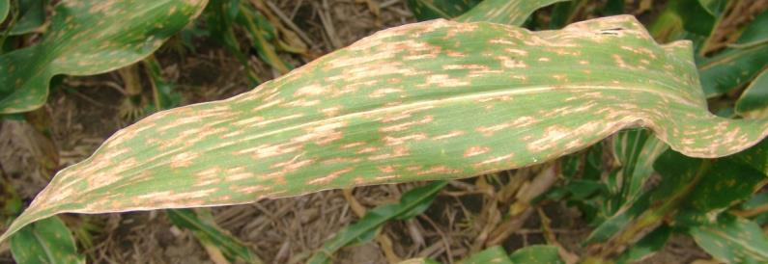
2013 Diseases
Although at very low severity, gray leaf spot was the predominant foliar disease during the growing season at this location. Gray leaf spot severity level was < 1% for all treatments.

Slide 3
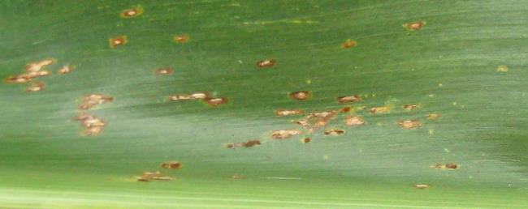
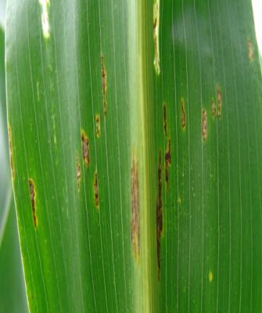
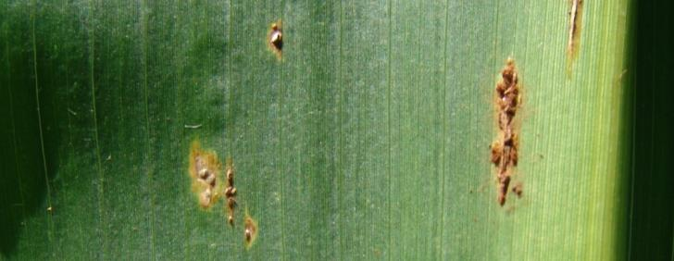
Common rust was the foliar disease first observed in this trial & was initially seen in mid-July. Disease severity was very low at this location and did not exceed trace amounts (≤ 0.1%) for any treatment.
2013 Diseases

Slide 4
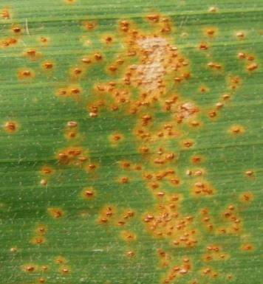
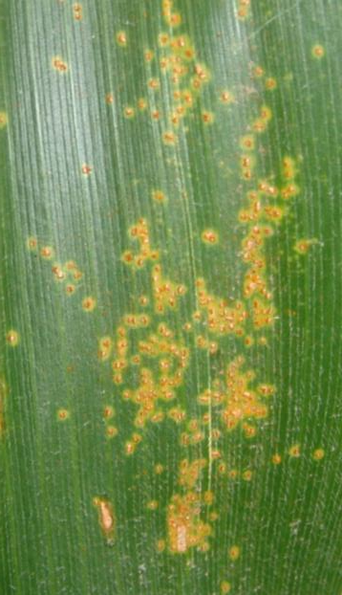
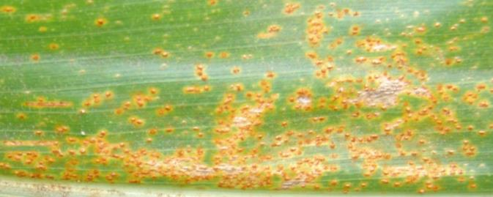
Southern rust was present and was first identified in this trial on September 4th. This disease was observed in trace amounts (0.1%) for all treatments.
2013 Diseases

Slide 5
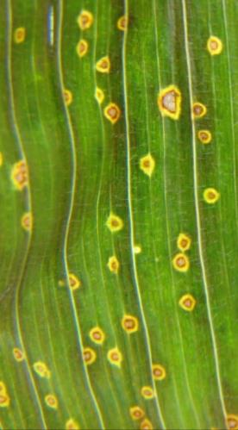
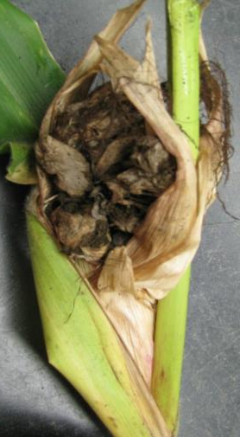
Eyespot, common smut, and Physoderma brown spot were observed sparsely in this trial, thus not justifying ratings for these diseases at this location in 2013.
2013 Diseases

Slide 6
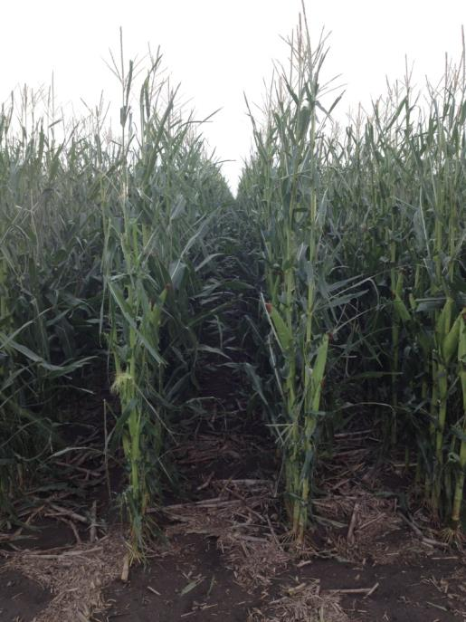
On August 1st, a storm event with strong wind and hail occurred when the corn was at the end of the R1 growth stage which caused an estimated 35% defoliation. Foliar fungicide treatments were applied prior to the event on June 13th, June 26th, July 11th, and July 26th.
2013 Hail Damage

Slide 7
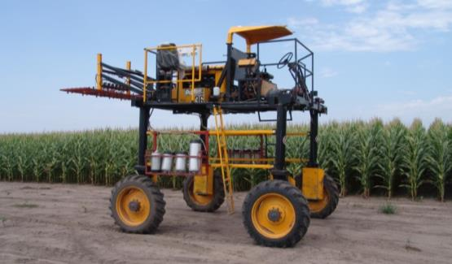
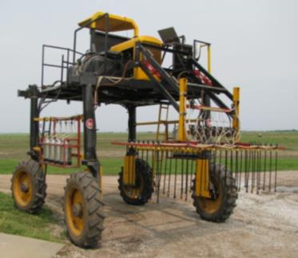
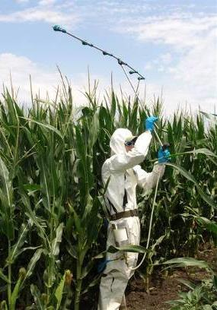
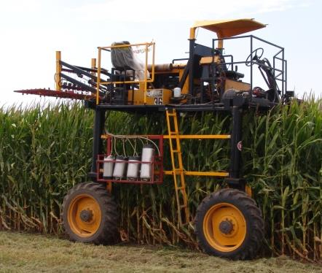
2013 Foliar Fungicide Trials
Last year’s crop was corn
Planting date: 5/15/13
Target plant population of 31,763 plants/A
Corn hybrid: NK N68B (GLS rating 7/9, ”fair”, not rated for CR, & SR rating 2/9, “excellent”)
Nine foliar fungicide treatments and a non-treated control replicated six times
NIS added at 0.25% v/v
High clearance sprayer used at 20 gpa at 40 psi
Alley width & row spacing = 30 inches
Overhead sprinkler irrigated
2005-2006
South Central Agriculture Laboratory
Clay Center, NE

Slide 8
2013 Fungicide Product & Timing Comparison Trial in NE Gray leaf spot disease severity (%)
Treatment & application rate
Rating Date & Growth Stage
Foliar fungicide applications were made June 13 (V4), June 26 (V7), July 11 (V11), and July 25th (R1).
NIS added to each fungicide treatment at 0.25% v/v.
Notes:
8

Slide 9
2013 Fungicide Product & Timing Comparison Trial in NE Area Under the Disease Progress Curve (AUDPC) for gray leaf spot
V4
V11
R1
V7
UTC
a
bc
ab
bc
c
c
bc
c
c
bc
Non-treated control
Stratego YLD V4, 2 fl oz/A
Stratego YLD V4, 4 fl oz/A
Stratego YLD V7, 2 fl oz/A
Stratego YLD V7, 4 fl oz/A
Stratego YLD V11, 4 fl oz/A
Stratego YLD R1, 4 fl oz/A
Headline AMP R1, 10 fl oz/A
Aproach R1, 6 fl oz/A
Priaxor R1, 4 fl oz/A
Treatment & application rate
Foliar fungicide applications were made June 13 (V4), June 26 (V7), July 11 (V11), and July 25th (R1).
NIS added to each fungicide treatment at 0.25% v/v. Treatments with different letters are
statistically different. Coefficient of variation is 15.9%.
Notes:
9

Slide 10
2013 Fungicide Product & Timing Comparison Trial in NE Common rust disease severity (%)
Treatment & application rate
Rating Date & Growth Stage
Foliar fungicide applications were made June 13 (V4), June 26 (V7), July 11 (V11), and July 25th (R1).
NIS added to each fungicide treatment at 0.25% v/v.
Notes:
10

Slide 11
2013 Fungicide Product & Timing Comparison Trial in NE Area Under the Disease Progress Curve (AUDPC) for common rust
V4
V11
R1
V7
UTC
Non-treated control
Stratego YLD V4, 2 fl oz/A
Stratego YLD V4, 4 fl oz/A
Stratego YLD V7, 2 fl oz/A
Stratego YLD V7, 4 fl oz/A
Stratego YLD V11, 4 fl oz/A
Stratego YLD R1, 4 fl oz/A
Headline AMP R1, 10 fl oz/A
Aproach R1, 6 fl oz/A
Priaxor R1, 4 fl oz/A
Treatment & application rate
Foliar fungicide applications were made June 13 (V4), June 26 (V7), July 11 (V11), and July 25th (R1).
NIS added to each fungicide treatment at 0.25% v/v. No statistical differences among treatments.
Coefficient of variation is 0%.
Notes:
11

Slide 12
2013 Fungicide Product & Timing Comparison Trial in NE Southern rust disease severity (%)
Treatment & application rate
Rating Date & Growth Stage
Foliar fungicide applications were made June 13 (V4), June 26 (V7), July 11 (V11), and July 25th (R1).
NIS added to each fungicide treatment at 0.25% v/v.
Notes:
12

Slide 13
2013 Fungicide Product & Timing Comparison Trial in NE Area Under the Disease Progress Curve (AUDPC) for southern rust
V4
V11
R1
V7
UTC
Non-treated control
Stratego YLD V4, 2 fl oz/A
Stratego YLD V4, 4 fl oz/A
Stratego YLD V7, 2 fl oz/A
Stratego YLD V7, 4 fl oz/A
Stratego YLD V11, 4 fl oz/A
Stratego YLD R1, 4 fl oz/A
Headline AMP R1, 10 fl oz/A
Aproach R1, 6 fl oz/A
Priaxor R1, 4 fl oz/A
Treatment & application rate
Foliar fungicide applications were made June 13 (V4), June 26 (V7), July 11 (V11), and July 25th (R1).
NIS added to each fungicide treatment at 0.25% v/v. No statistical differences among treatments.
Coefficient of variation is 16.3%.
Notes:
13

Slide 14
2013 Fungicide Product & Timing Comparison Trial in NE Stay green % assessed on September 30th, 2013 Kernel dent stage (R6)
V4
V11
R1
V7
UTC
ab
ab
a
ab
ab
ab
ab
b
ab
ab
Non-treated control
Stratego YLD V4, 2 fl oz/A
Stratego YLD V4, 4 fl oz/A
Stratego YLD V7, 2 fl oz/A
Stratego YLD V7, 4 fl oz/A
Stratego YLD V11, 4 fl oz/A
Stratego YLD R1, 4 fl oz/A
Headline AMP R1, 10 fl oz/A
Aproach R1, 6 fl oz/A
Priaxor R1, 4 fl oz/A
Treatment & application rate
Foliar fungicide applications were made June 13 (V4), June 26 (V7), July 11 (V11), and July 25th (R1).
NIS added to each fungicide treatment at 0.25% v/v. Treatments with different letters are
statistically different. Coefficient of variation is 12.1%.
Notes:
14

Slide 15
2013 Fungicide Product & Timing Comparison Trial in NE Push lodging % assessed on October 16th, 2013 Physiological maturity stage (R6)
V4
V11
R1
V7
UTC
a
ab
ab
ab
b
ab
b
b
b
b
Non-treated control
Stratego YLD V4, 2 fl oz/A
Stratego YLD V4, 4 fl oz/A
Stratego YLD V7, 2 fl oz/A
Stratego YLD V7, 4 fl oz/A
Stratego YLD V11, 4 fl oz/A
Stratego YLD R1, 4 fl oz/A
Headline AMP R1, 10 fl oz/A
Aproach R1, 6 fl oz/A
Priaxor R1, 4 fl oz/A
Treatment & application rate
Foliar fungicide applications were made June 13 (V4), June 26 (V7), July 11 (V11), and July 25th (R1).
NIS added to each fungicide treatment at 0.25% v/v. Treatments with different letters are
statistically different. Coefficient of variation is 119.4%.
Notes:
15

Slide 16
2013 Fungicide Product & Timing Comparison Trial in NE 500 count kernel weight (g)
V4
V11
R1
V7
UTC
Non-treated control
Stratego YLD V4, 2 fl oz/A
Stratego YLD V4, 4 fl oz/A
Stratego YLD V7, 2 fl oz/A
Stratego YLD V7, 4 fl oz/A
Stratego YLD V11, 4 fl oz/A
Stratego YLD R1, 4 fl oz/A
Headline AMP R1, 10 fl oz/A
Aproach R1, 6 fl oz/A
Priaxor R1, 4 fl oz/A
Treatment & application rate
Foliar fungicide applications were made June 13 (V4), June 26 (V7), July 11 (V11), and July 25th (R1).
NIS added to each fungicide treatment at 0.25% v/v. No statistical differences among treatments.
Coefficient of variation is 2.2%.
Notes:
16

Slide 17
2013 Fungicide Product & Timing Comparison Trial in NE Yield (bu/A) on October 22nd, 2013
V4
V11
R1
V7
UTC
a
a
a
ab
b
ab
ab
ab
ab
ab
Non-treated control
Stratego YLD V4, 2 fl oz/A
Stratego YLD V4, 4 fl oz/A
Stratego YLD V7, 2 fl oz/A
Stratego YLD V7, 4 fl oz/A
Stratego YLD V11, 4 fl oz/A
Stratego YLD R1, 4 fl oz/A
Headline AMP R1, 10 fl oz/A
Aproach R1, 6 fl oz/A
Priaxor R1, 4 fl oz/A
Treatment & application rate
Foliar fungicide applications were made June 13 (V4), June 26 (V7), July 11 (V11), and July 25th (R1).
NIS added to each fungicide treatment at 0.25% v/v. Treatments with different letters are
statistically different. Coefficient of variation is 3.7%.
Notes:
17

Slide 18
2013 Fungicide Product & Timing Comparison Trial in NE Grain moisture % at harvest on October 22nd, 2013
V4
V11
R1
V7
UTC
Non-treated control
Stratego YLD V4, 2 fl oz/A
Stratego YLD V4, 4 fl oz/A
Stratego YLD V7, 2 fl oz/A
Stratego YLD V7, 4 fl oz/A
Stratego YLD V11, 4 fl oz/A
Stratego YLD R1, 4 fl oz/A
Headline AMP R1, 10 fl oz/A
Aproach R1, 6 fl oz/A
Priaxor R1, 4 fl oz/A
Treatment & application rate
Foliar fungicide applications were made June 13 (V4), June 26 (V7), July 11 (V11), and July 25th (R1).
NIS added to each fungicide treatment at 0.25% v/v. No statistical differences among treatments.
Coefficient of variation is 3.3%.
Notes:
18

Slide 19
Acknowledgments
Casey Schleicher, Technologist
UNL South Central Ag Lab (SCAL) Staff
UNL Student Workers
Notes:
19

Slide 20
Department of Plant Pathology
University of Nebraska-Lincoln
Institute of Agriculture and Natural Resources
Notes:
20

